Slide 1
What is estimation and inference?
Dr. Tirthajyoti Sarkar
August 31st, 2019

Slide 2
Estimation
In statistics, estimation refers to the process by which one makes inferences about a population, based on information obtained from a sample.
Point estimate: A point estimate of a population parameter is a single value of a statistic. For example, the sample mean x is a point estimate of the population mean μ.
Interval estimate: An interval estimate is defined by two numbers, between which a population parameter is said to lie. For example, a < x < b is an interval estimate of the population mean μ.
Example: “What is the average age of all on-road private cars in the United States?”. We cannot count all cars’ age. So, we pick random sample from every state, or a large number of counties all over the nation and calculate the mean. Even then, we may not be sure and only can give an interval: 7 < average_age < 12

Slide 3
Confidence interval
Statisticians use a confidence interval to express the precision and uncertainty associated with a particular sampling method. A confidence interval consists of three parts.
A confidence level.
A statistic (quantity calculated in a sample to estimate a value in a population)
A margin of error.
The confidence level describes the uncertainty of a sampling method. The statistic and the margin of error define an interval estimate that describes the precision of the method. The interval estimate of a confidence interval is defined by the sample statistic + margin of error.

Slide 4
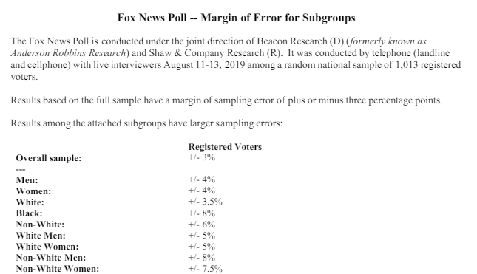
Margin of error
If the pollster used a method that contains the parameter 95% of the time it is used, he or she would arrive at the following 95% confidence interval: 0.46 < X < 0.60. The pollster would then conclude that somewhere between 46% and 60% of the population has the statistic X. The media usually reports this type of result by saying that 53% has the particular statistic with a margin of error of 7%.

Slide 5
Food for thought on the confidence interval
Suppose, you are sampling some data from a population of students to estimate their probability of success in a standardized test (e.g. SAT).
QUESTION 1: If you are allowed to sample only 10 students, would your estimation interval be narrow or wide than if you would have been allowed a sample of 100 students?
QUESTION 2: If you are asked to construct a 99% confidence interval vs. a 90% confidence interval for the estimated mean, which one would be wider (on the same sample dataset)?
We will simulate these scenarios in the coding exercise and see the answers!

Slide 6
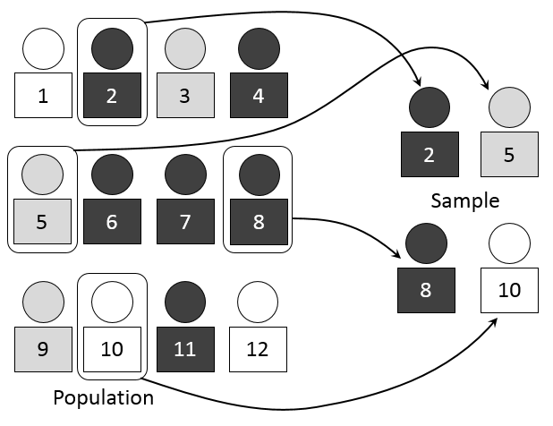

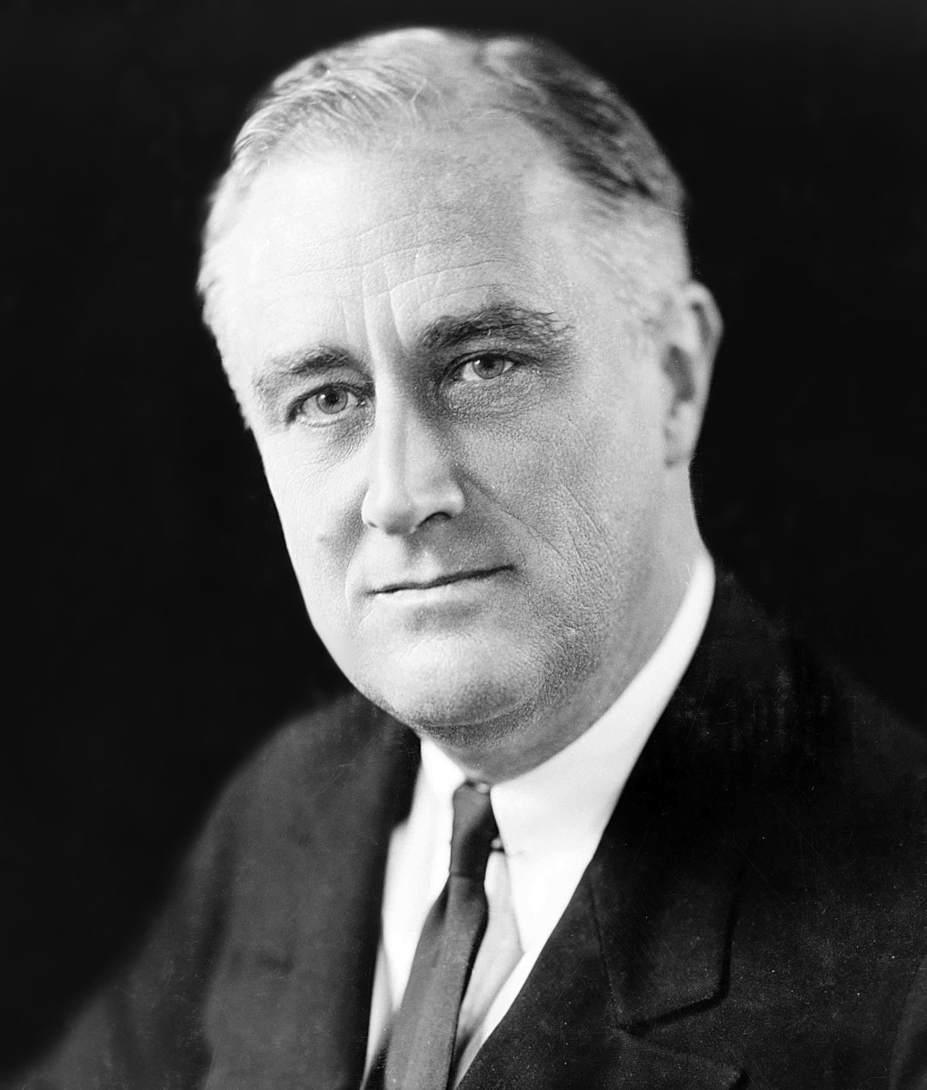
Sampling
Simple random sampling
Systematic (order-based) sampling
Stratified sampling
Probability-proportional-to-size sampling
Cluster sampling
Sampling with/without replacement
Common sense sampling :-)
https://www.math.upenn.edu/~deturck/m170/wk4/lecture/case1.html

Slide 7
Degrees of freedom
Some estimates are based on more information than others.
For example, an estimate of the variance based on a sample size of 100 is based on more information than an estimate of the variance based on a sample size of 5.
The degrees of freedom (df) of an estimate is the number of independent pieces of information on which the estimate is based.
In general, the degrees of freedom for an estimate is equal to the number of data points minus the number of parameters estimated en route to the estimate in question.
Suppose, to estimate variance of the age of the cars, we take 5 cars. Is the degrees of freedom 5? NO. Because to compute variance we need mean. But we do not have population mean. We first estimate/replace it by sample mean. So, df = 5 -1 = 4.

Slide 8
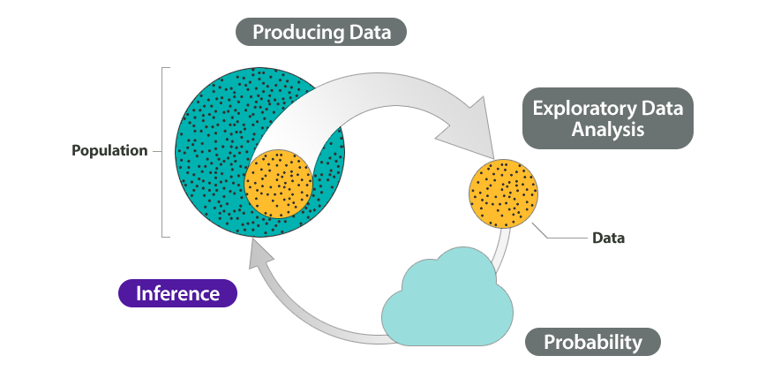
Inferential statistics
The branch of statistics concerned with drawing conclusions about a population from a sample.
This is generally done through random sampling, followed by inferences made about central tendency, or any of a number of other aspects of a distribution.
So, the process of inference encompasses the estimation method completely. However, the end goal of inference is not only just compute/estimate population statistics but to understand deeply the ‘nature’ of the population i.e. what probability distribution (or what combination) the data came from.

