Slide 1
Disease Tracker
COP290
Ratanlal (2012CS10265),
Pankaj Saini (2015CS50289)

Slide 2
Cause
As many as 21% of 12,608 participants of a 2014 pan India study were found to have hypertension but only 4.76% of those knew of their condition.
Barely 48% of participants of a 2014 study in Coimbatore were aware of cardiovascular risk factors.
In Kerala, 86% respondents of a 2011 study had heard of oral cancer but only 62% could pin-point the correct cause.
Can we rise the awareness of Disease through android game?

Slide 3
Gamify the cause
An android game app design , which is freely available for users.
Task for users to identify the Disease for given no of symptoms .
For the symptoms given in the image user have to identify the Disease for those symptoms.
Some rewards will be given to the player for every correct identification of disease on the basis of symptoms. That makes players interested in this game.

Slide 4
Game Model
This is a single player android game.
It has multiple levels.
In first level player has to select a Disease on the basis of given four symptoms, for each correct Disease player will get 10 points reward.
In second level player select the Disease on the basis of symptom given in the image and for each correct selection player get 10 points as reward.
After identified right disease the player will reach in the second level. In the second level, the payer has to select some cures regarding that disease. If those will be correct, the player will gain more points.

Slide 5
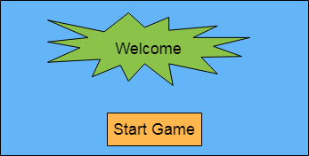
Welcome screen
The first screen of the game will be the welcome screen of the game.

Slide 6
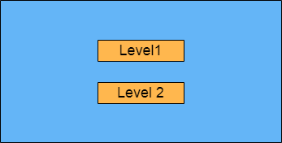
Game Level
In this screen player can the choose the level of the game that he/she want to play.

Slide 7
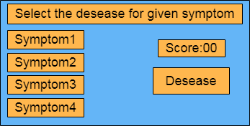
Game Level 1
In this level of the game player has to select the disease for the given symptoms.

Slide 8
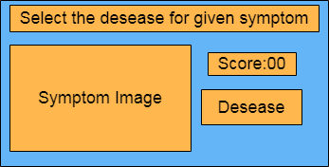
Game Level 2
In this level player has to identify the disease on the basis of given symptoms on the image.

Slide 9
Git Repository
https://github.com/ratanlal/DiseaseTracker.git

Slide 10
References
https://archive.indiaspend.com/cover-story/how-ignorance-cuts-indias-healthy-life-by-half-91181

