Slide 1



AI Text-to-SQL Application
Professional demo for database accessibility
Ratan Raj | AP23110010515
Ashwin Alle | AP23110010535
Vishnu Balmuri | AP23110010583
Venkata Vamsi Duddukuri | AP23110010580
Ratan Raj | AP23110010515

Slide 2

Introduction
Modern systems rely on structured relational databases
SQL is powerful but requires technical expertise
Non-technical users struggle with data access
Text-to-SQL bridges gap using natural language

Slide 3
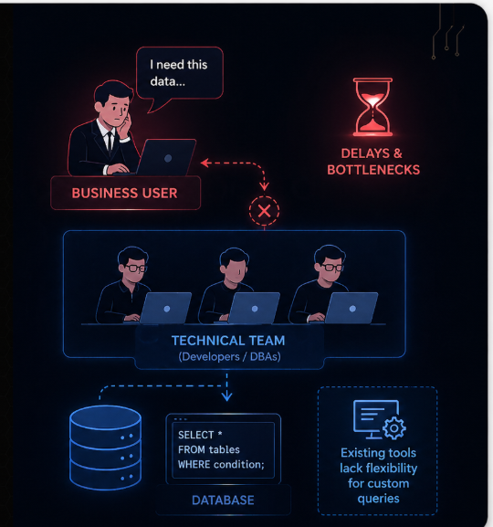
Problem Statement
SQL knowledge limited to developers and DBAs
Business users depend on technical teams
Delays in decision making due to bottlenecks
Existing tools lack flexibility for custom queries

Slide 4

Objectives
Convert natural language into accurate SQL queries
Enable self-service data access for users
Reduce dependency on developers
Provide fast and reliable query results

Slide 5
System Overview
User enters query in plain English
System analyzes intent and schema
LLM generates optimized SQL
Results displayed with explanation

Slide 6
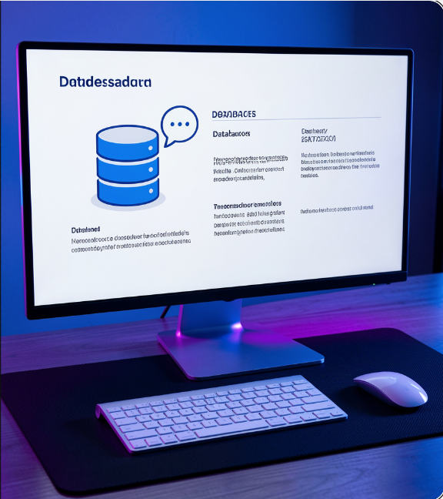
Architecture
Frontend: Streamlit chat interface
LangChain for orchestration
LLMs: Gemini, Groq, Llama
Database: MySQL / SQLite

Slide 7

Technologies Used
Python for backend logic
Streamlit for UI
LangChain for LLM integration
Gemini, Groq, Llama models

Slide 8
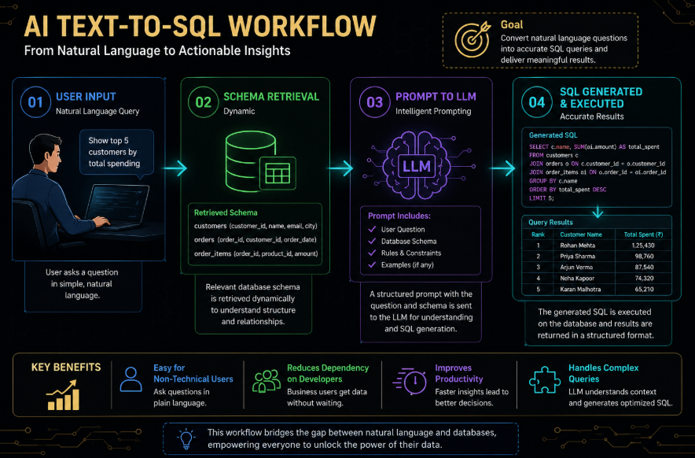
Working Process
User enters query in natural language
System retrieves schema and understands relationships
Prompt sent to LLM for SQL generation
SQL query generated and executed
Results displayed with explanation

Slide 9

Key Features
Natural language to SQL conversion
Multi-model support
Context-aware chat interface
Error handling and correction

Slide 10
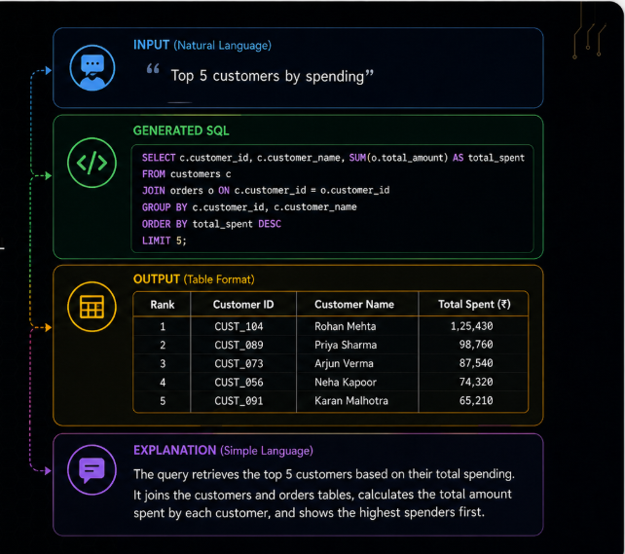
Example Output
Input: Top 5 customers by spending
Generated SQL with joins and aggregation
Output displayed in table format
Explanation in simple language

Slide 11
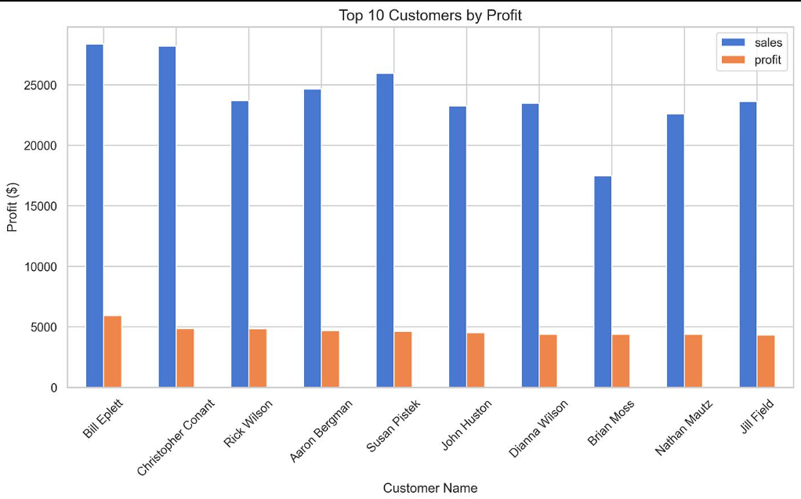
Results & Performance
90%+ accuracy for simple queries
Efficient handling of joins and aggregation
Fast response using Groq models
Reliable performance on real datasets

Slide 12
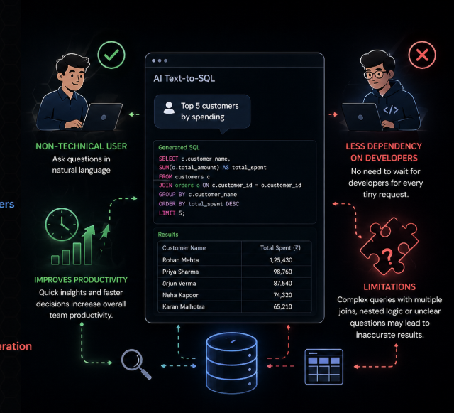
Advantages & Limitations
Easy for non-technical users
Reduces dependency on developers
Improves productivity
Limitations in complex query generation

Slide 13
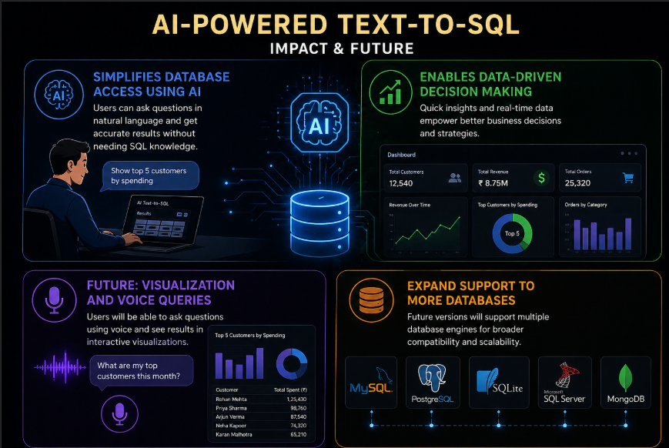
Conclusion & Future Scope
Simplifies database access using AI
Enables data-driven decision making
Future: visualization and voice queries
Expand support to more databases

