Slide 1


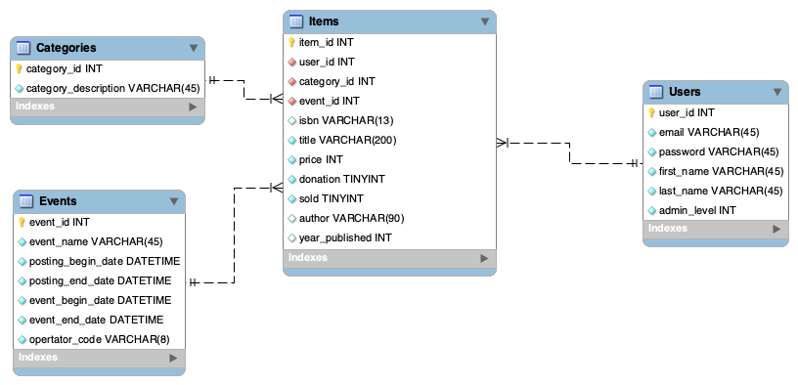
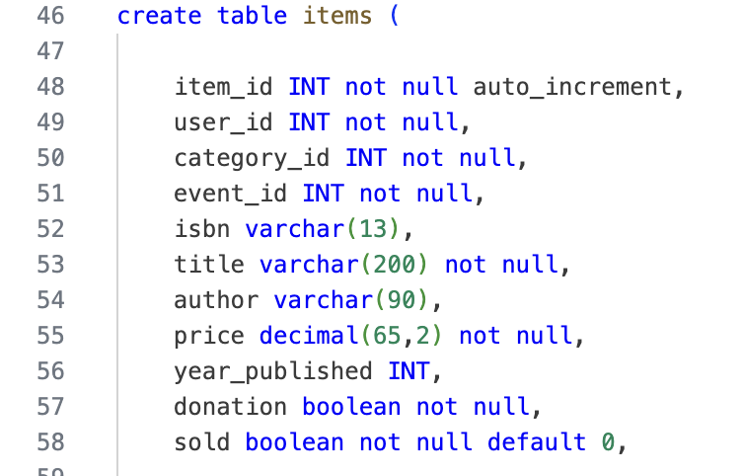
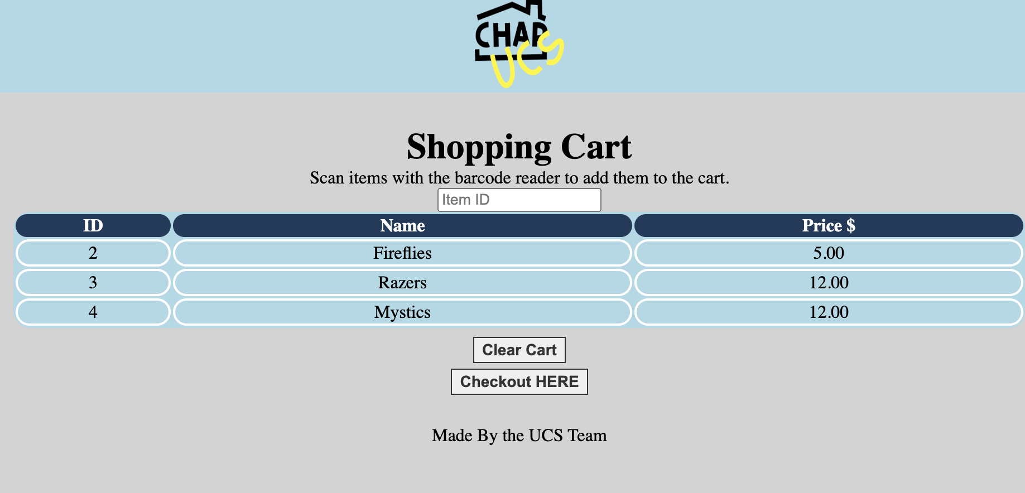
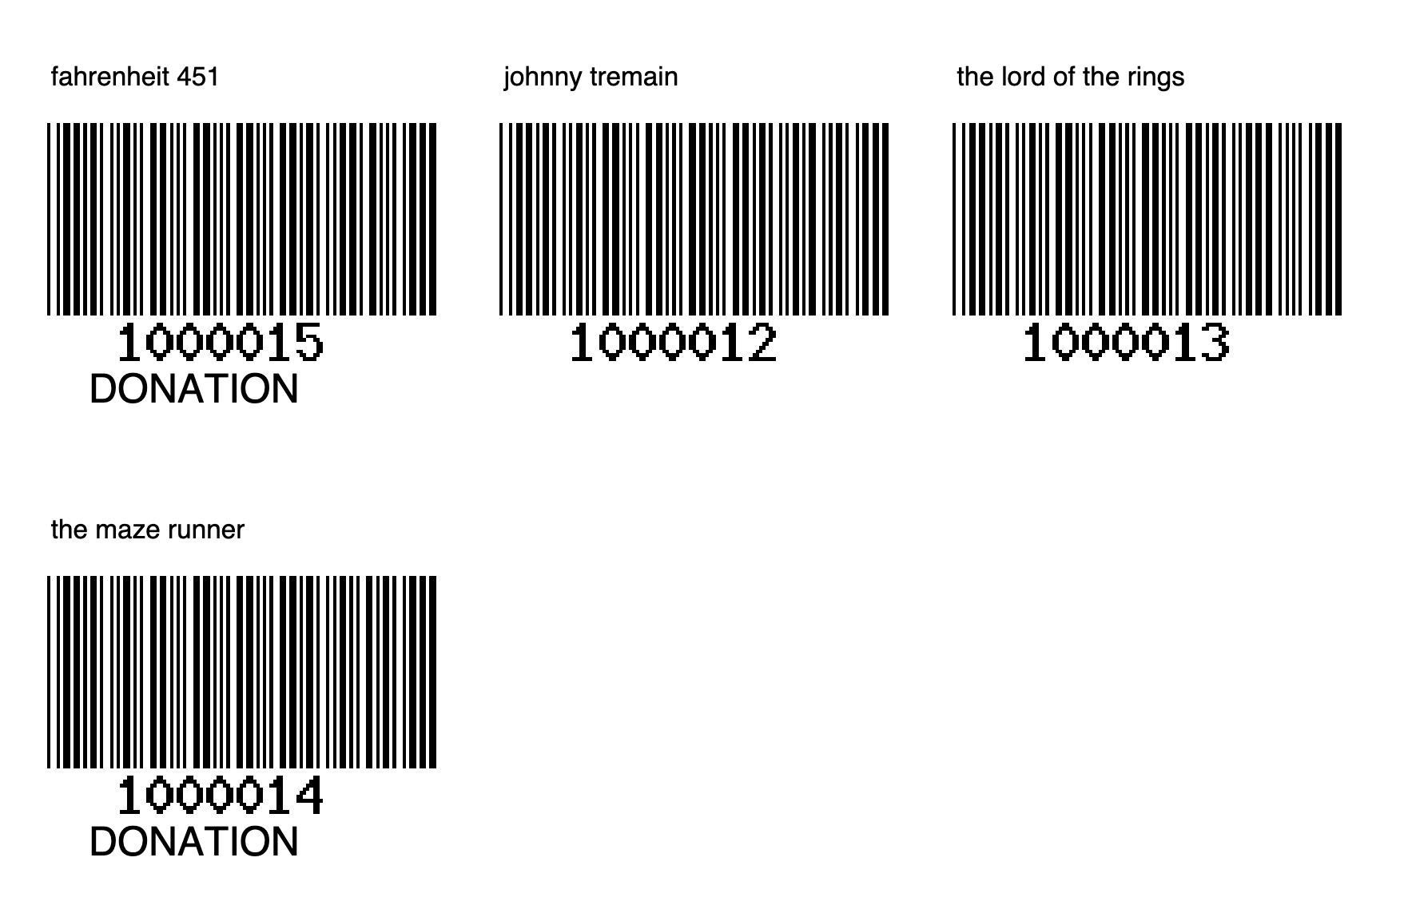
Used Curriculum Sale Website
Asher Wayde | John McGovern | Martin Ratchford
Professor Nancy Reddig | Dr. Sara Atwood
PURPOSE
To make a system to identify items and link them to users and events. These items are then sold at a used curriculum sale.
DATA MODEL
DESIGN SPECIFICATIONS & SYSTEM REQUIREMENTS
Register and login users
Add, view and delete items
Create barcodes to identify items at the sale
Sell the items and calculate the cost of the items sold
Administrators to create categories and events
PROCESS
Users can register and create an account. This enables them to add items to an event. A barcode sheet is generated which will easily allow the identified items to be sold. Administrators are able to oversee the entire process and make changes as necessary.
IMPACT
This project will cut down costs on education materials for home schoolers.
LESSONS LEARNED
Our group learned a lot about software engineering over the course of this project. In particular, we learned significantly more about PHP and web development.
We learned about how to test our systems as well. In the beginning, our testing process was basically just randomly playing with different parts of the website. By the end, however, we had fluid and functional test cases.
REFERENCES & ACKNOWLEDGEMENTS
Thank you to Professor Nancy Reddig for providing a barcode scanner and hosting the database.
Thank you to David Tufts for making the barcode generator and Oliver Plathey for the FPDF library.
UCS Website | Fall 2024
EDUCATE FOR SERVICE. ENGINEER FOR SOCIETY.
Notes:
Introduction. Include the student name, company name, internship location, internship position, and internship dates. Also note the course rubric and number, course title, and instructor(s). In addition, describe how you secured the internship.
Abstract. The abstract should provide a concise summary of what was done and learned in the internship and the course.
Learning Objectives. List 2 to 5 learning objectives that you had planned to achieve by completing the internship.
Description of Key Responsibilities. Summarize the major responsibilities, activities, and project(s) completed during the internship.
Application of VWU courses to the internship. Explain how your coursework helped with the internship. Link relevant courses, theories, and concepts to their applications within the internship.
Lessons Learned. Explain what you learned about the industry, the company, the career process, and yourself through the internship experience.
Acknowledgements. Recognize the people who helped you, including the internship site supervisor, the course instructor, and mentors. Include full titles in the acknowledgements. In addition, acknowledge funding sources.
Visuals. Incorporate visual aids to illustrate key points. Be sure to label all visuals. Include: names, dates, locations, and photographers. Do not include photographs of children unless you have secured approval from your site supervisor to use the children’s images.

