Slide 1


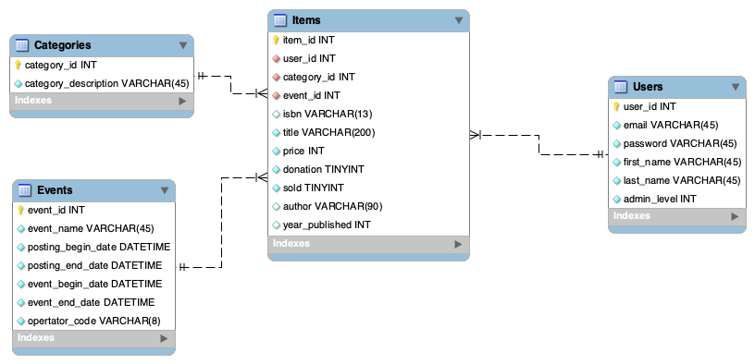
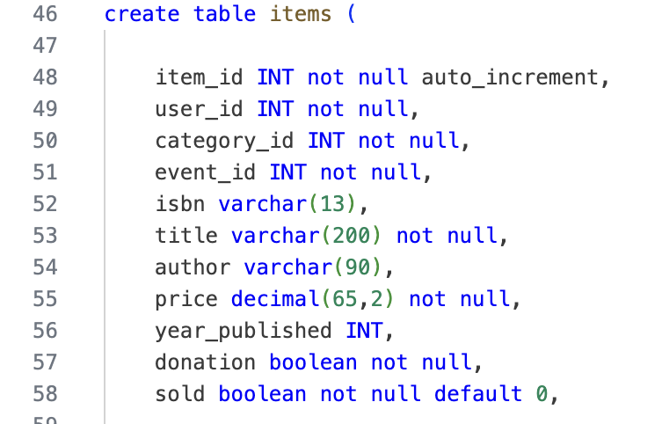
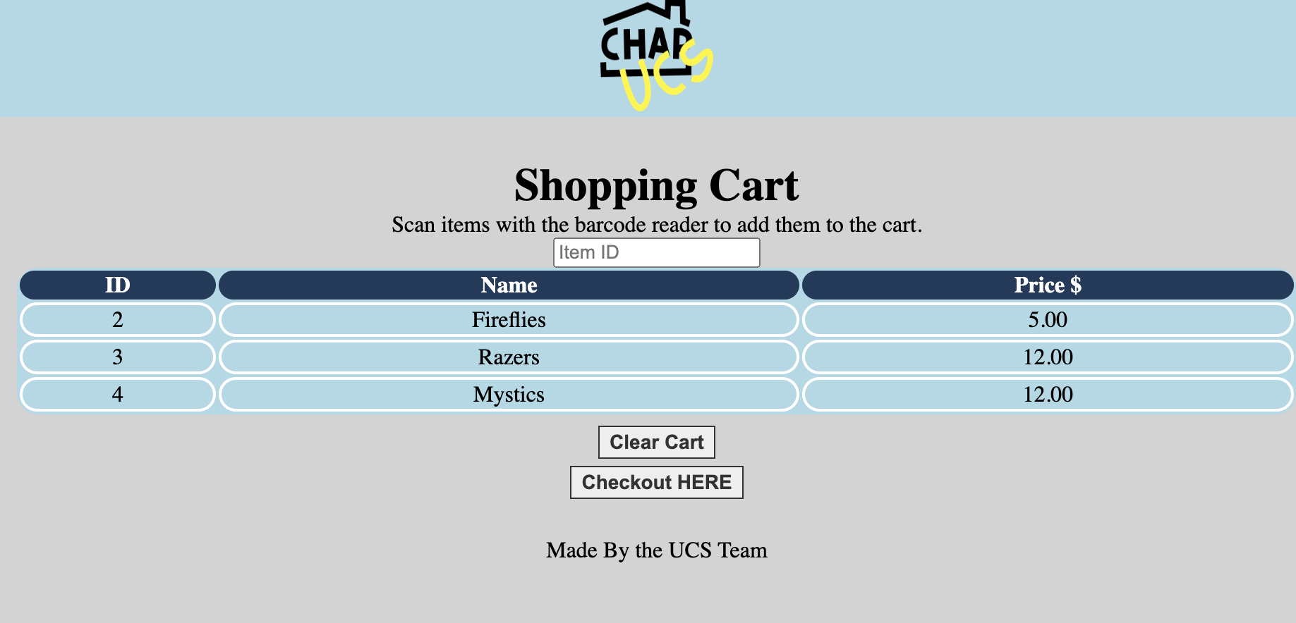
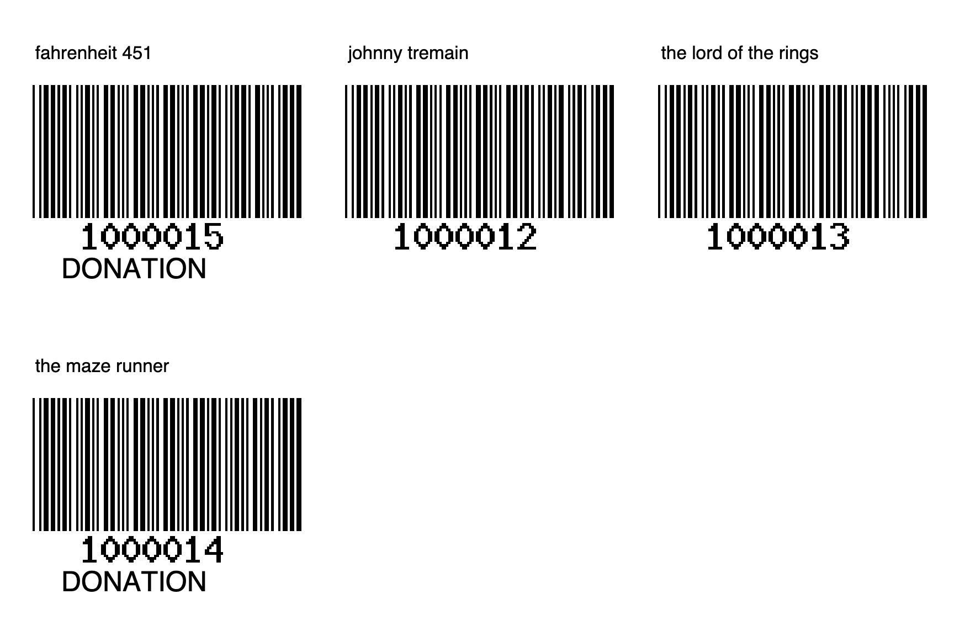
Used Curriculum Sale Website
Asher Wayde | John McGovern | Martin Ratchford
Professor Nancy Reddig, Dr. Sara Atwood
PURPOSE
To make a system to identify items and link them to users and events for selling them at a used curriculum sale.
DATA MODEL
DESIGN SPECIFICATIONS & SYSTEM REQUIREMENTS
Register and login users
Add, view and delete items
Create barcodes to identify items at the sale
Sell the items and calculate the cost of the items sold
Administrators to create categories and events
PROCESS
The user can register and create an account. This allows them to add items to the event. A barcode sheet will be generated which will easily enable the identified items to be sold. The administrators are able to oversee the entire process and make changes as necessary.
IMPACT
This project will cut down costs on education materials for home schoolers.
TESTING PROCESS OR LESSONS LEARNED
Explain what you learned about the software engineering life cycle through this hands-on project developed in Git using Agile practices including a project board with weekly stand-up meetings.
Or use your traceability matrix and discuss your use cases and test coverage.
REFERENCES & ACKNOWLEDGEMENTS
Recognize and thank the people who helped you, including your client and team members, anyone who helped you with resources, the course instructor, and other mentors. Include full titles. Also, this is a place to use a bibliography acknowledging open-source frameworks and references that
were helpful for training on a particular language or feature.
UCS Project | Fall 2024
EDUCATE FOR SERVICE. ENGINEER FOR SOCIETY.
Notes:
Introduction. Include the student name, company name, internship location, internship position, and internship dates. Also note the course rubric and number, course title, and instructor(s). In addition, describe how you secured the internship.
Abstract. The abstract should provide a concise summary of what was done and learned in the internship and the course.
Learning Objectives. List 2 to 5 learning objectives that you had planned to achieve by completing the internship.
Description of Key Responsibilities. Summarize the major responsibilities, activities, and project(s) completed during the internship.
Application of VWU courses to the internship. Explain how your coursework helped with the internship. Link relevant courses, theories, and concepts to their applications within the internship.
Lessons Learned. Explain what you learned about the industry, the company, the career process, and yourself through the internship experience.
Acknowledgements. Recognize the people who helped you, including the internship site supervisor, the course instructor, and mentors. Include full titles in the acknowledgements. In addition, acknowledge funding sources.
Visuals. Incorporate visual aids to illustrate key points. Be sure to label all visuals. Include: names, dates, locations, and photographers. Do not include photographs of children unless you have secured approval from your site supervisor to use the children’s images.

