Slide 1
Taxi Information Management System
GROUP 1

Slide 2
Members
1
7
BA10-004
Tran Ngoc Bach
BI11-291
Nguyen Le Dinh Vu
2
3
4
5
6
BA10-010
Ngo The Dung
BA10-024
Kieu Khanh Huyen
BA10-055
Nguyen Van Tai
BA10-066
Nguyen Duc Anh Tuan
BI11-136
Nguyen Hoang Tien Lam

Slide 3
Content
01
02
03
04
Introduction
Implement
Demo
Conclusion

Slide 4
01
Introduction
???
Now, let’s think about the question:
What is Taxi Information Management System ?
Why we should use this system ?

Slide 5
What is Taxi Information Management System ?
Information
Statistics
Drivers
Cars which are used to transport
Incomes, profits, …
Total booking

Slide 6
Advantages of Taxi Information Management System
Management | Easy to manage information of drivers, cars, …
Calculation | Calculate income, profit, … automatically
Expense | Save time, money

Slide 7





Preparation
Language
Python
IDE
Visual Studio Code
Libraries
Tkinter
Numpy
Pandas
…

Slide 8
02
Implement
2.1 Database :
ERD
2.2 Interface:
Sign in / Sign up
Dashboard
Main features
Other small features

Slide 9
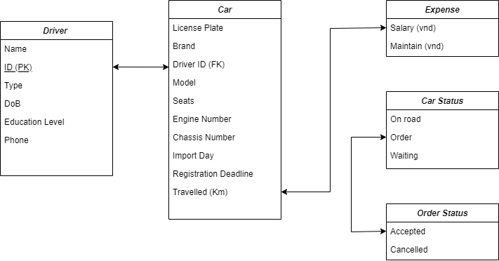
2.1
Database
ER Diagram

Slide 10
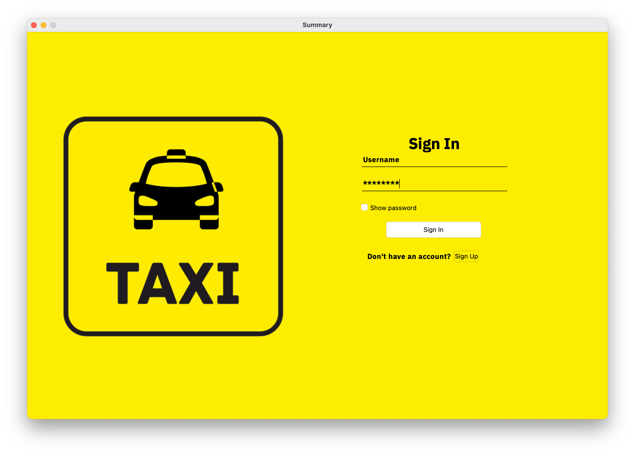
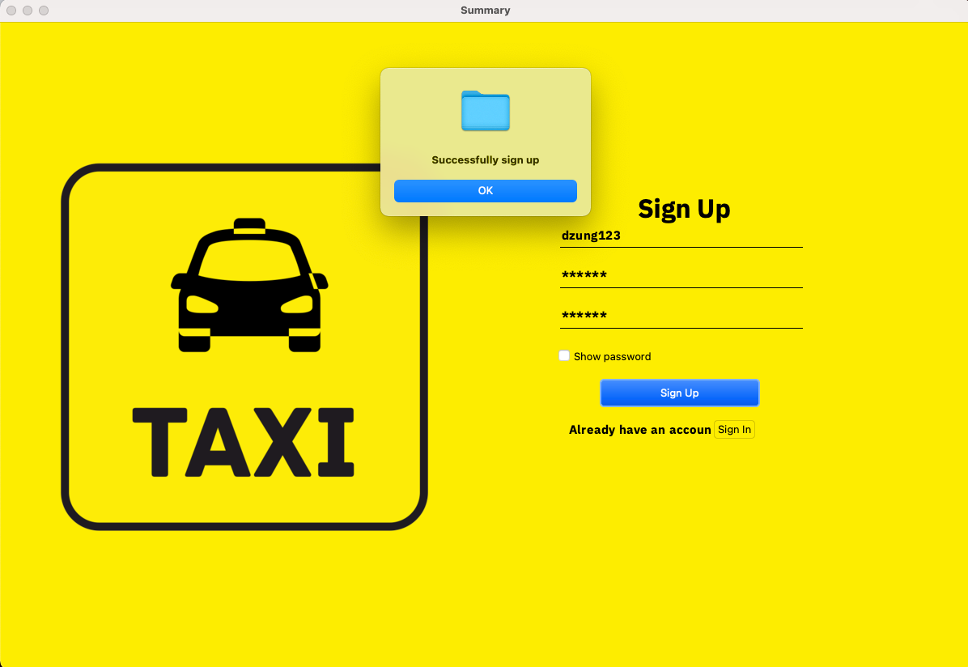
2.2
Interface
Sign up and sign in
Entries:
Name
Password
After sign in , you’ll get to dashboard window

Slide 11
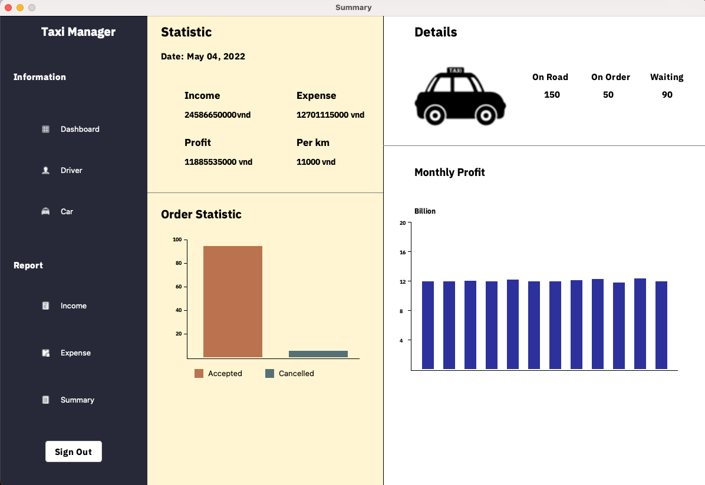
2.2
Interface
Dashboard:
The total income, profit and expense of the all company
Quantity and status of cars. For ex: 150 cars on road, 50 on order, ….
Graph about the profit and order statistic

Slide 12
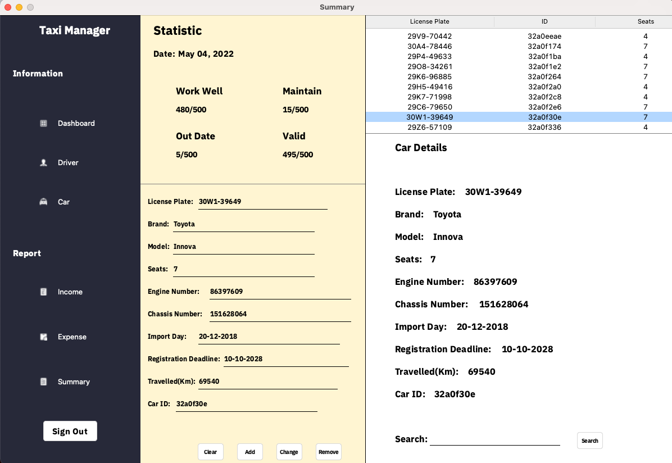
2.2
Interface
Mutate the information
Main features
Add new driver, car
Change the information, search
Remove
Exit
Information of car
Remove

Slide 13
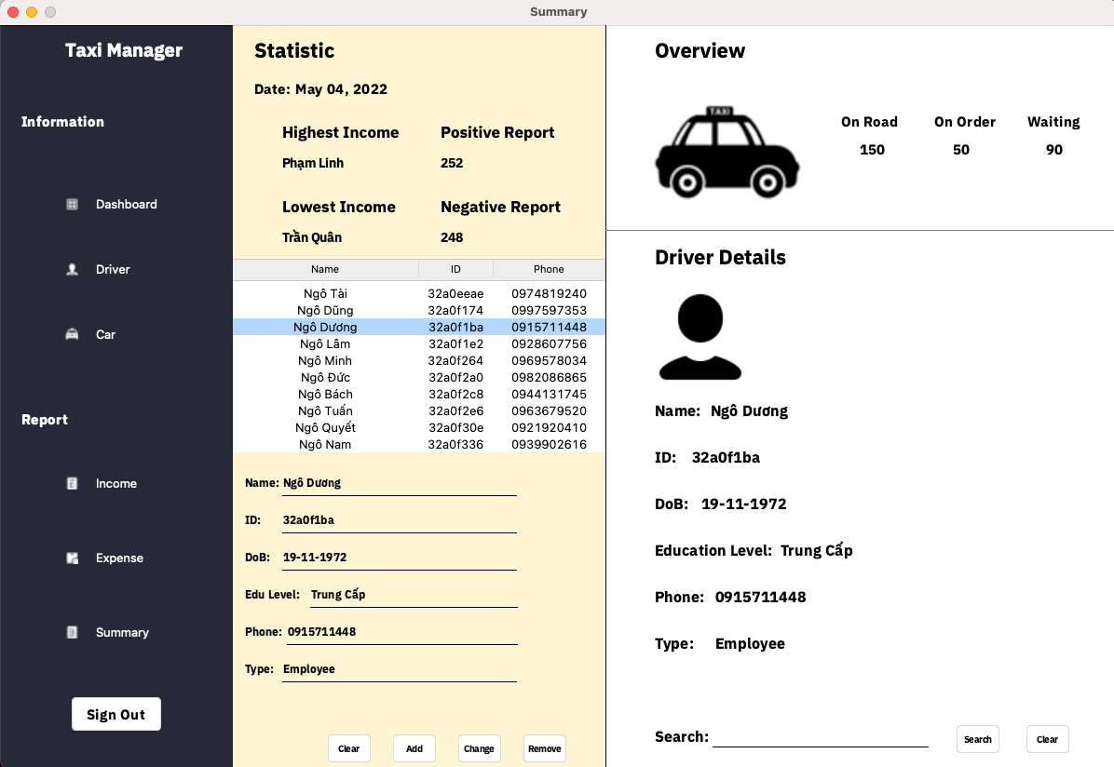
Driver information
Search field

Slide 14
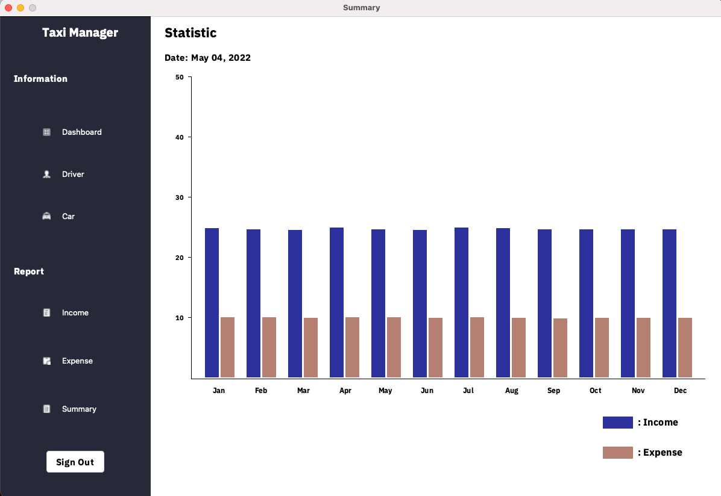
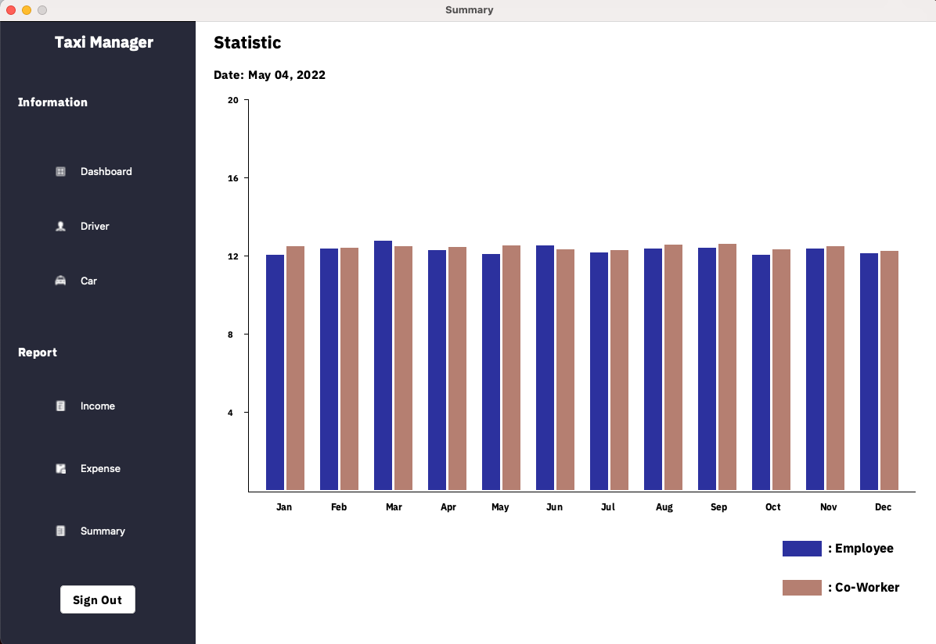
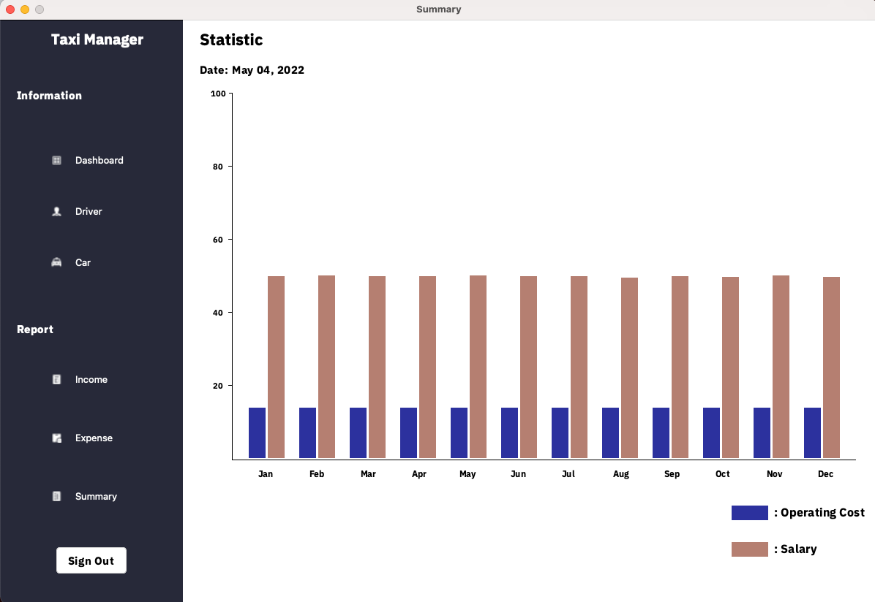
2.2
Interface
Beside main features,
We also use graph to represent the best view about the statistic

Slide 15

03
Demo
Now it’s time for demo.
Github: https://github.com/rateme5stars/TaxiMana

Slide 16
Conclusion
-In conclusion, this project has provided the specific details and information about Taxi Information Management System by using Python language
-However, it is not completely complete and will be researched and upgraded in the future

Slide 17
THANK FOR WATCHING !
Do you have any question ?

