Slide 1
Food Takeout or Delivered

Slide 2
Introduction of Project Topics and Team Members

Slide 3
Project Topics-----objective
Users can order food online.
Users can find out the restaurants which offer delivery service to their home easily.
Users can get the information about restaurants.
Restaurants can attract more customers.
Restaurants may reduce time in handling delivery orders from areas that delivery service is not offered.

Slide 4
Project Status

Slide 5
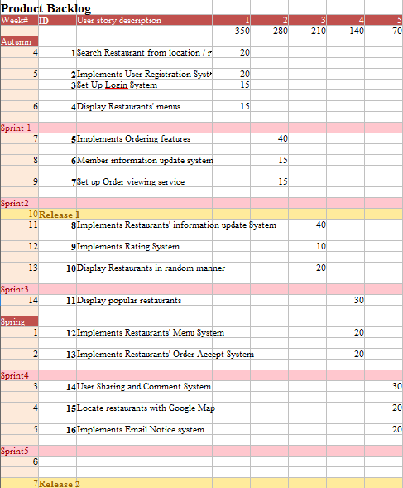

Slide 6
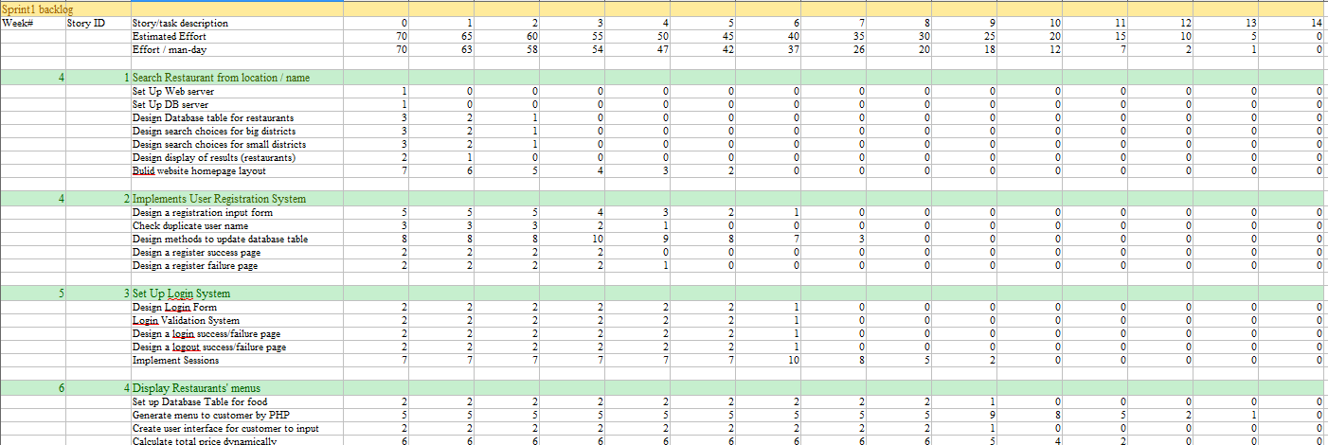

Slide 7
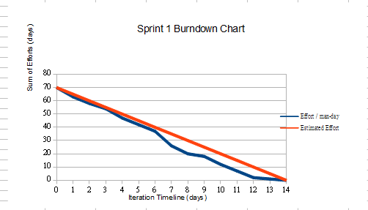

Slide 8
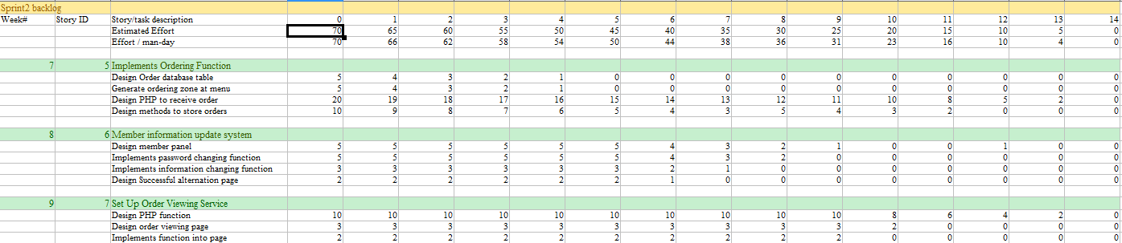

Slide 9
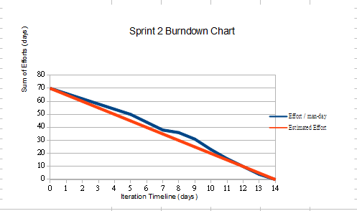

Slide 10
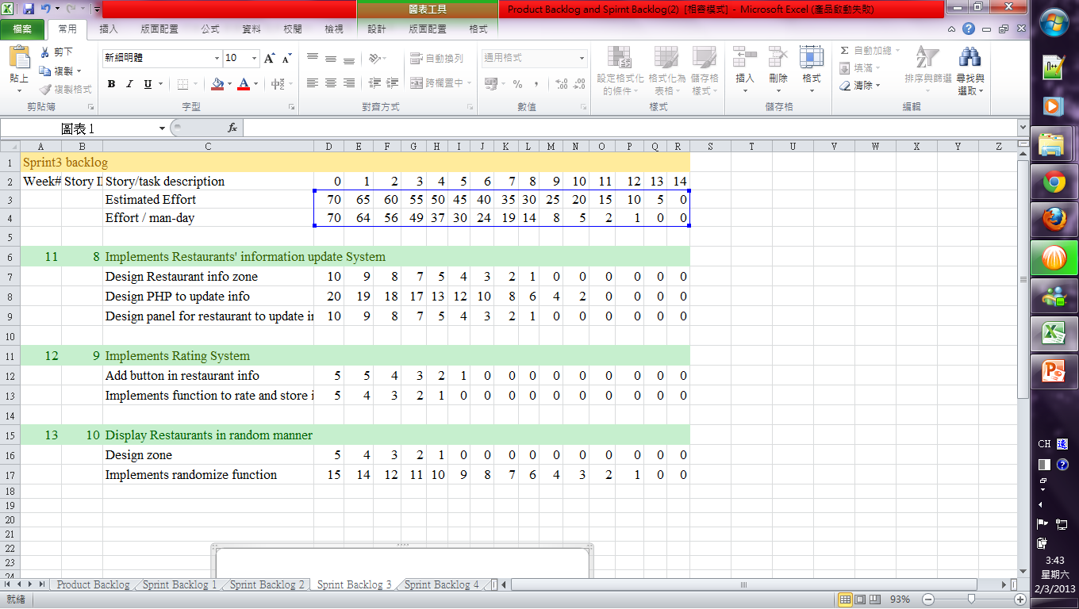

Slide 11
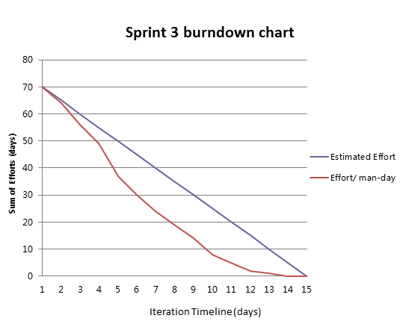
11/19/12

Slide 12
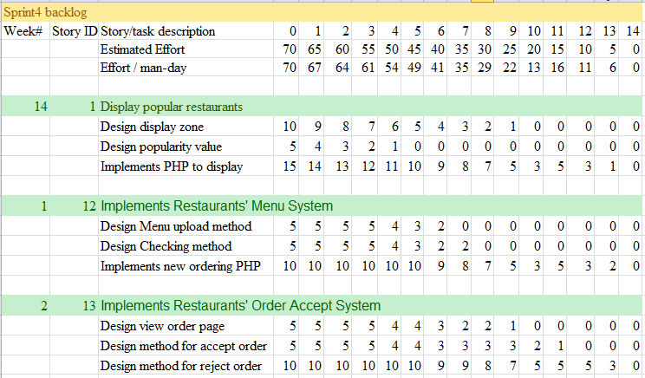

Slide 13
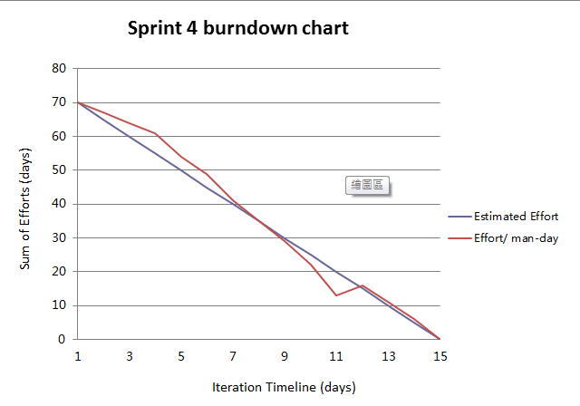

Slide 14
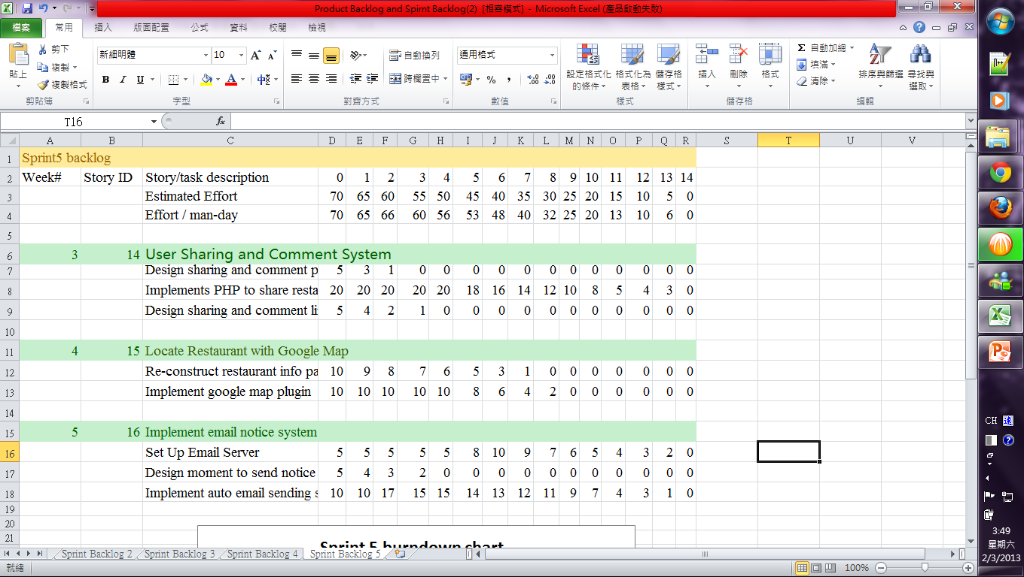

Slide 15
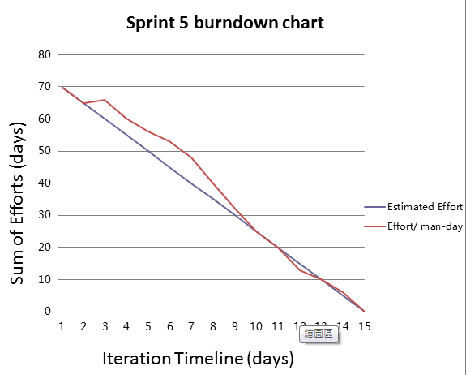

Slide 16
System Architecture
PRESENTATION TIER
Interface (CSS, HTML)
HTML, PHP
BUSINESS TIER
PHP
PHP
DATA TIER
Database table

Slide 17
Technology or Tool that we have used

Slide 18
Users and admin
Programs (php)
Website
(HTML, interface: CSS 3)
Web server (apache)
Customers
SQL
Data Base
restaurants

Slide 19
Features implemented in last software release
Search function
Registration
Login/logout
Online order
View Menu
View order
Change passwords
11/19/12

Slide 20
Features implemented in this software release
Restaurants' information update System
User Sharing and Comment System
Implement Google map
Display Restaurants in random manner
Restaurants' Order Accept System
Display popular restaurants
Update menu
Email Notice system
Live demo

Slide 21
Conclusion
By setting up the system, users can easily order food at home.
Restaurants can attract more potential customers.
As automatic system, mistakes can reduce at most at possible.
11/19/12

Slide 22
References
Social Button: http://sharethis.com/#sthash.bqed4Sbh.dpbs
Google Map: https://maps.google.com.hk/
Facebook: http://www.facebook.com
W3Schools: http://www.w3schools.com/
Login System: http://tinyurl.com/3t2trwy

