Slide 1
$35
Front end is made with
React, TypeScript, TailwindCSS, Shadcn UI Framework
Demo user
https://osmerge-development.vercel.app/dashboard/
Email: demo@osmerge.com password: 123123123

Slide 2
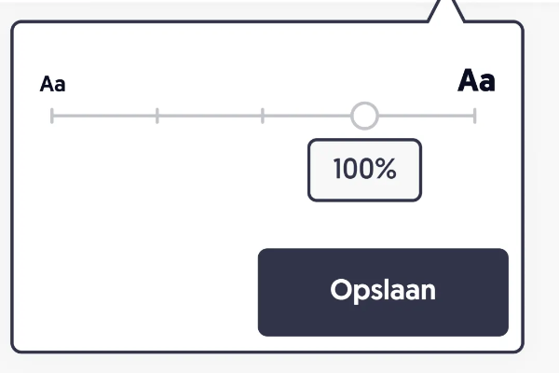



Support Documentation Workspace setting Prompt library
Username V
＃ Channel ABC
Chats Setting
This light grey texts are the models that are not slected in checkbox
osMerge / Channel ABC
Workspace
Workspace ABC
Order of models
CHATGPT | Gemini | CLAUDE | CHATGPT O1 Version | CLAUDE.AB1 | CLAUDE.A
Show 3
v
BACK NEXT
aa
Chat to multipe
aa
Category
CHATGPT
GEMINI
CLAUDE
Text generation
CHATGPT
GEMINI
CLAUDE
Search
Username A
2024.11.11
CHATGPT O1 Version
CLAUDE.AB1
Text to Image
Description descriotion全国の皆さまお待たせしました！「もっとTokyo」対象プランが、全国の皆さま向けに新たに登場！Description descriotion全国の皆さまお待たせしました！「もっとTokyo」対象プランが、全国の皆さま向けに新たに登場！
Username A
CLAUDE.A2
Text to Video
Description descriotion全国の皆さまお待たせしました！「もっとTokyo」対象プランが、全国の皆さま向けに新たに登場！Description descriotion全国の皆さまお待たせしました！「もっとTokyo」対象プランが、全国の皆さま向けに新たに登場！
SAVE
View more
Shared Channel
+
Please insert the text here
Username A
Channel ABC
. . .
Hello
Channel ABC
ChatGPT
Channel ABC
Titleblabla
Username A
Channel ABC
Description descriotion全国の皆さまお待たせしました！「もっとTokyo」対象プランが、全国の皆さま向けに新たに登場！Description descriotion全国の皆さまお待たせしました！「もっとTokyo」対象プランが、全国の皆さま向けに新たに登場！
Please redo the request again.
ChatGPT
Error: failed to generate.
Private
+
ChatGPT
#
How to open
…
#
CHat1
#
UI Designer
<WavyPulses/>
https://medium.com/@Aayush-Kumar/beyond-the-spinner-modern-loading-animations-for-your-react-applications-8f0b61276ea1
#
How to get the
#
Temporary
Please insert the text here
Please insert the text here
Please insert the text here

Slide 3
The colour should be grey, and not light blue, same goes for boarderline
#D9D9D9

Slide 4

Dropdown on channel to change the channel name or delete, Archive
Click Change the name, and the user able to remove, archive.
Archive will be hidden under View More button.

Slide 5
Chat space
Use as much space as possible (as same as the design)
Change the colour with boarderline.
Change the title size, space, numbering as per API returns.
**Title* etc..

Slide 6
When new channel is created
It should go to new channel

Slide 7
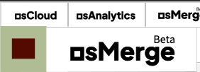
Scroll on the side menu is separate
This would stay the same position when the side menu is scrolled

Slide 8
Chatspace
As the new chat appears from API, it should go down.
The individual reply section should go up to certain position.
And goes down. (not side way)
And when the mouse is within the test space, when Enter is pressed, it should send

Slide 9
Support Documentation Workspace setting Prompt library
Username V
＃ Channel ABC
Chats Setting
osMerge / Channel ABC
Workspace
Workspace ABC
Order of tools
CHATGPT | Gemini | CLAUDE | CHATGPT O1 Version | CLAUDE.AB1 | CLAUDE.A
Show 3
v
BACK NEXT
aa
Chat to multipe
aa
Category
CHATGPT
GEMINI
CLAUDE
Text generation
CHATGPT
GEMINI
CLAUDE
Search
Username A
2024.11.11
CHATGPT O1 Version
CLAUDE.AB1
Text to Image
Description descriotion全国の皆さまお待たせしました！「もっとTokyo」対象プランが、全国の皆さま向けに新たに登場！Description descriotion全国の皆さまお待たせしました！「もっとTokyo」対象プランが、全国の皆さま向けに新たに登場！
Username A
CLAUDE.A2
Text to Video
Description descriotion全国の皆さまお待たせしました！「もっとTokyo」対象プランが、全国の皆さま向けに新たに登場！Description descriotion全国の皆さまお待たせしました！「もっとTokyo」対象プランが、全国の皆さま向けに新たに登場！
View more
Shared Channel
+
Please insert the text here
Channel ABC
. . .
Same goes for this, when it reaches the end, it would be scorllable
Channel ABC
ChatGPT
Channel ABC
Titleblabla
Username A
Channel ABC
Description descriotion全国の皆さまお待たせしました！「もっとTokyo」対象プランが、全国の皆さま向けに新たに登場！Description descriotion全国の皆さまお待たせしました！「もっとTokyo」対象プランが、全国の皆さま向けに新たに登場！
Please redo the request again.
Private
+
ChatGPT
#
How to open
…
#
CHat1
#
UI Designer
#
How to get the
#
Temporary
Blabla bla bla blabla bla bla bla lablab bla bla bala bka Blabla bla bla blabla bla bla bla lablab bla bla bala Blabla bla bla blabla bla bla bla lablab bla bla bala
Blabla bla bla blabla bla bla bla lablab bla bla bala
Blabla bla bla blabla bla bla bla lablab bla bla bala
Blabla bla bla blabla bla bla bla lablab bla bla bala
Blabla bla bla blabla bla bla bla lablab bla bla bala
Like up to here
Then more text will go down
Scrollable within this space
Please insert the text here
Please insert the text here

Slide 10
Add social logo
Add social logo on the auth

Slide 11
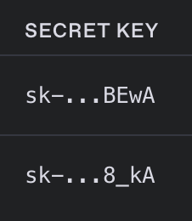
API secret key
Always hide except the first 3 and last 4 characters, no need to show again, only able to edit the name or remove

Slide 12
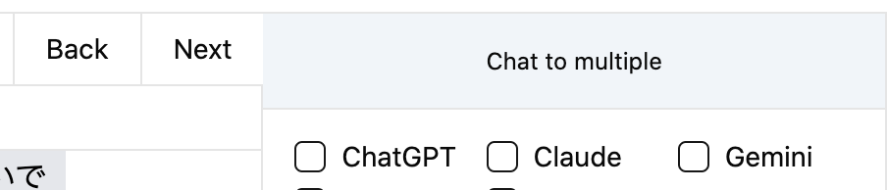
Make the Chat to multiple height the same as Next Back

Slide 13
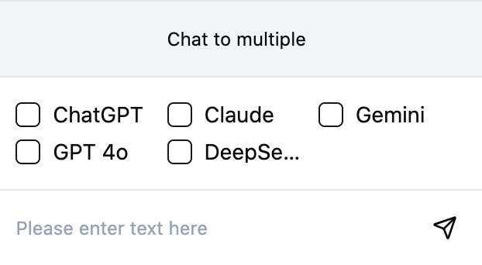
Should show full name, not deeps…
And should go to next line if the name is long.

Slide 14
Error message
Show that there was error
, error from the model

Slide 15
Other missing
Drag and drop of orders of models with chatspace moves accordingly
NextBack buttons
Missing the Show 3 buttons (should have options to show all added Models
Change text size bar (this should change the text size of texts within the chatspace
File icon to upload instead of the SEND button
Designs in detail are still somewhat different

Slide 16
Prompt list

Slide 17
Support Documentation Workspace Setting Prompt library
Username V
＃ Channel ABC
Chats Setting
osMerge / Channel ABC / Setting / Tools
Workspace
Workspace ABC
Tools
Members
Configuration
Category
ChatGPT
Chatbot
Description descriotion全国の皆さまお待たせしました！「もっとTokyo」対象プランが、全国の皆さま向けに新たに登場！Description descriotion全国の皆さまお待たせしました！「もっとTokyo」対象プランが、全国の皆さま向けに新たに登場！
ON
Search
Generative
View more
ChatGPT
Shared Channel
+
Description descriotion全国の皆さまお待たせしました！「もっとTokyo」対象プランが、全国の皆さま向けに新たに登場！Description descriotion全国の皆さまお待たせしました！「もっとTokyo」対象プランが、全国の皆さま向けに新たに登場！
ON
Channel ABC
. . .
Channel ABC
Channel ABC
Channel ABC
Private
+
#
How to open
I will share the full list later
#
CHat1
#
UI Designer
#
How to get the
#
Temporary

Slide 18
Support Documentation Workspace Setting Prompt library
Username V
＃ Channel ABC
Chats Setting
osMerge ＞ Channel ABC ＞ Setting ＞ Members
Workspace
Workspace ABC
Tools
Members
Configuration
Category
ID
Name
Role
Email address
ADD +
Chatbot
12
nameA
Admin
tanaka@gmail.com
REMOVE
Search
Generative
17
NameB
User
Takahashi@gmail.com
REMOVE
View more
Shared Channel
+
45
NameB
User
Ichihara@gmail.com
REMOVE
Channel ABC
. . .
Channel ABC
254
NameB
Admin
Suzuki@gmail.com
REMOVE
Channel ABC
Channel ABC
254
NameB
User
Suzuki@gmail.com
REMOVE
Private
+
#
How to open
#
CHat1
#
UI Designer
#
How to get the
#
Temporary

Slide 19
User to channel
When you are adding the users to the channel, it should be search Username/email of users who are already in workspace.
As you type the characters, it should show dropdown of user names
We should have option to add everyone

Slide 20
Configuration
Configuration page is not done

Slide 21
Support Documentation Workspace Setting Prompt library
Username V
＃ Channel ABC
Chats Setting
osMerge ＞ Channel ABC ＞ Setting ＞ Configuration
Workspace
Tools
Members
Configuration
Workspace ABC
Custom instructions
EDIT
Category
What would you like Models to know about you to provide the better response? (1500 words)
Chatbot
Search
Description descriotion全国の皆さまお待たせしました！「もっとTokyo」対象プランが、全国の皆さま向けに新たに登場！Description descriotion全国の皆さまお待たせしました！「もっとTokyo」対象プランが、全国の皆さま向けに新たに登場！
Generative
View more
How would you like Models to respond. (1500 words)
Shared Channel
+
Channel ABC
. . .
Description descriotion全国の皆さまお待たせしました！「もっとTokyo」対象プランが、全国の皆さま向けに新たに登場！Description descriotion全国の皆さまお待たせしました！「もっとTokyo」対象プランが、全国の皆さま向けに新たに登場！
Channel ABC
Channel ABC
Channel ABC
Private
+
#
How to open
#
CHat1
#
UI Designer
#
How to get the
#
Temporary

Slide 22
Workspace setting

Slide 23
Support Documentation Workspace Setting Prompt library
Username V
＃ Workspace setting
Members APIs Billing & Plans
osMerge ＞ Workspace setting ＞ Setting ＞ Configuration
Workspace
Workspace ABC
ID
Name
Role
Email address
ADD +
Category
12
nameA
Admin
tanaka@gmail.com
REMOVE
Chatbot
Search
17
NameB
User
Takahashi@gmail.com
REMOVE
Generative
View more
45
NameB
User
Ichihara@gmail.com
REMOVE
Shared Channel
+
Admin
Suzuki@gmail.com
REMOVE
Channel ABC
. . .
254
NameB
Channel ABC
Channel ABC
254
NameB
User
Suzuki@gmail.com
REMOVE
Channel ABC
Private
+
#
How to open
#
CHat1
#
UI Designer
#
How to get the
https://supabase.com/docs/reference/javascript/auth-admin-inviteuserbyemail
#
Temporary

Slide 24
Support Documentation Workspace Setting Prompt library
Username V
＃ Workspace setting
Members APIs Billing & Plans
osMerge ＞ Workspace setting ＞ Setting ＞ APIs
Workspace
Provider
API Keys
ADD +
Workspace ABC
Name
Category
ChatGPT o1
OpenAI
abc＊＊＊＊＊＊＊＊＊xXyz
EDIT
REMOVE
Chatbot
Search
GPT-4o for testing
OpenAI
abc＊＊＊＊＊＊＊＊＊xXyz
EDIT
REMOVE
Generative
View more
GPT-4o mini
OpenAI
abc＊＊＊＊＊＊＊＊＊xXyz
EDIT
REMOVE
Shared Channel
+
Gemini 2.0
Google
abc＊＊＊＊＊＊＊＊＊xXyz
EDIT
REMOVE
Channel ABC
. . .
Channel ABC
Channel ABC
Gemini 1.5 Flash
Google
abc＊＊＊＊＊＊＊＊＊xXyz
EDIT
REMOVE
Channel ABC
Check here to find available APIs and how to connect
Private
+
#
How to open
#
CHat1
#
UI Designer
#
How to get the
#
Temporary

Slide 25
Support Documentation Workspace Setting Prompt library
Username V
＃ Workspace setting
Members APIs Billing & Plans
osMerge ＞ Workspace setting ＞ Setting ＞ Billing & Plans / MyPage
Workspace
MyPage
Usaage
Workspace ABC
Category
Chatbot
Search
Generative
View more
Shared Channel
Channel ABC
. . .
Channel ABC
Channel ABC
https://docs.stripe.com/saas
Channel ABC
Private
#
How to open
#
CHat1
#
UI Designer
#
How to get the
#
Temporary

Slide 26
Support Documentation Workspace Setting Prompt library
Username V
＃ Workspace setting
Members APIs Billing & Plans
osMerge ＞ Workspace setting ＞ Setting ＞ Billing & Plans / MyPage
Workspace
MyPage
Usaage
UPGRADE
Workspace ABC
Category
Usage (Storage & Bandwidth)
05. GB / 1GB
Chatbot
Users
3 users / 3 users
Search
Generative
View more
Shared Channel
+
Channel ABC
. . .
Backend instruction
Channel ABC
Channel ABC
Track the storage and bandwidth
If it reaches the max, then it will pause any actions
For users, when reach the max user number,
New user cannot be created
Channel ABC
Private
+
#
How to open
#
CHat1
#
UI Designer
#
How to get the
#
Temporary

Slide 27
Tracking of usage
Bakcend
Usage is total of Storage (Database and File storage) and Bandwidth usage.

Slide 28
Prompt library
Same access control as channel rooms

Slide 29



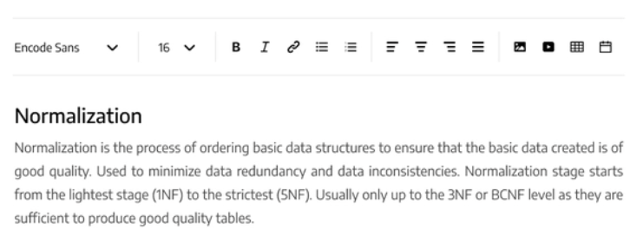
Support Documentation Workspace Setting Prompt library
Username V
＃ Prompt library
osMerge ＞ Prompt Library / Chatbot / Marketing / News article writing
Workspace
Workspace ABC
Prompt name
Rating
Like
Last modified
Created by
ADD +
Saved
+
News article writing.
90%
12
2024.11.12
John Brown
News article writing.should be bla bla bla bla bla bla be bla bla bla bla bla bla be bla bla bla bla bla bla
…
Saved prompts
News article writing.
90%
0
2024.11.12
John Brown
Category
General
News article writing.
90%
0
2024.11.12
John Brown
Created by
UsernameABC
Modified by
UsernameABC
Search
Created on:
2024.11.12 20 : 39 PM
Last modified
2024.09.12 20 : 39 PM
Generative
Category
Chatbot
Channel
Marketing
Shared Channel
+
Rating
90%
Likes
12
Marketing
. . .
Document
Content plans
Campaign email
Private
+
#
Note 1
#
Note2
#
Note 3
#
Note 4
#
Note 5
Use some opensource available for this
Like https://editorjs.io/

Slide 30
User page

Slide 31
Support Documentation Workspace Setting Prompt library
Username V
＃ Workspace setting
Members APIs Billing & Plans
Account / Security
Workspace
Profile
Workspace ABC
Setting
Profile
Profile
Security
Edit
General profile info
Username @Kevinheart
Name Kevin Heart
Email address kevin@example.com
Backup email KevinSuzuki@gmail.com
Phone number 090-1234-0987
Language
English
Edit profile image
PNG, JPEG (< 3MG)
Profile icons
https://www.dicebear.com/why-dicebear/
UPLOAD
Or Create your avatar

Slide 32



Support Documentation Workspace Setting Prompt library
Username V
＃ Workspace setting
Members APIs Billing & Plans
Account / Security
Workspace
Security
Workspace ABC
Setting
Password
Profile
Set your password to protect your account.
・・・・・・・・・・・・・・・・
EDIT
Security
Two step verification
We recommend requiring a verification code in addition to your password.
EDIT
ON
OFF
Two step verification
Connected
We recommend requiring a verification code in addition to your password.
Login now
Google
Microsoft
Facebook
Apple
Github
Twitter (x.com)
Kakao
Linkedin
https://supabase.com/docs/guides/auth

Slide 33
Is supabase social auth, email invitation done?

Slide 34
Workspace x Stripe path
Same as when user sign up
For initial registration, it will be name and email and password,
Then
Workspace name,
And select the pricing plan

Slide 35


Support Documentation
EN v
Login
Email address
Type your email address
LOGIN
Change the url end per each language
/jp or /en
Or Login Using
Login with Google
Login with Microsoft
Login with Facebook
Login with Github
Login with X
Login with Apple
Login with Kakao

Slide 36

Support Documentation
EN v
Login
Password
Type your Password
Forgot your password
LOGIN
Change the url end per each language
/jp or /en

Slide 37
Register page

Slide 38

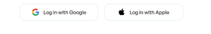
Support Documentation
EN v
Register
Let’s get started
Name
Type your name
Email Address
Type your email address
NEXT
Or Sign Up Using
Sign up with Google
Sign up with Microsoft
Sign up with Facebook
Sign up with Github
Something like this
Sign up with X
Sign up with Apple
Sign up with Kakao

Slide 39
Support Documentation
EN v
Register
Let’s get started
If the user chooses the register with email
Password
Type your Password
BACK
NEXT

Slide 40

Support Documentation
EN v
Register
Let’s get started
Workspace name
Type your Workspace name
BACK
NEXT
By signing up, you agree to our Terms of Service and Privacy policy,

