Slide 1
Boston housing dataset
By
Amrita Rath

Slide 2
Boston Housing Data
We have taken the Boston Housing dataset which contains information about different houses in Boston.
This data was originally a part of UCI Machine Learning .
There are 506 samples and 13 feature variables in this dataset.
The objective is to predict the value of the houses by data-driven recommendations and also how they can increase the value of the house using the given features.

Slide 3
List of Variables
CRIM - per capita crime rate by town.
ZN - proportion of residential land zoned for lots over 25,000 sq.ft.
INDUS - proportion of non-retail business acres per town.
CHAS - Charles River dummy variable (= 1 if tract bounds river; 0 otherwise).
NOX - nitric oxides concentration (parts per 10 million)
RM - average number of rooms per dwelling.
AGE - proportion of owner-occupied units built prior to 1940.
DIS - weighted distances to five Boston employment centers.
RAD - index of accessibility to radial highways.
TAX - full-value property-tax rate per USD 10,000
PTRATIO - pupil-teacher ratio by town.
B - 1000(B - 0.63)^2, where B is the proportion of blacks by town.
LSTAT - percentage of lower status of the population.
MEDV - median value of owner-occupied homes in USD 1000’s.

Slide 4
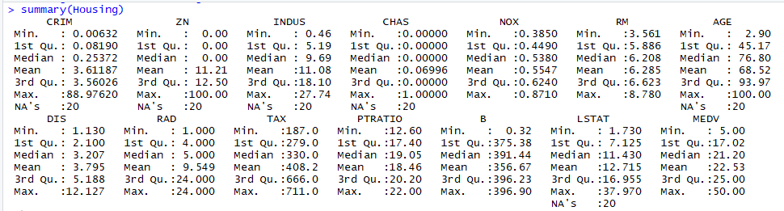
DATA
Housing <- read.csv("HousingData.csv")
summary(Housing)
The summary of the data set is basically showing a bird’s eye view of the data.

Slide 5
DATA CLEANING
We have to clean the data. I have used missmap() from Amelia package.
Checking for any NA’s in the data frame.

Slide 6
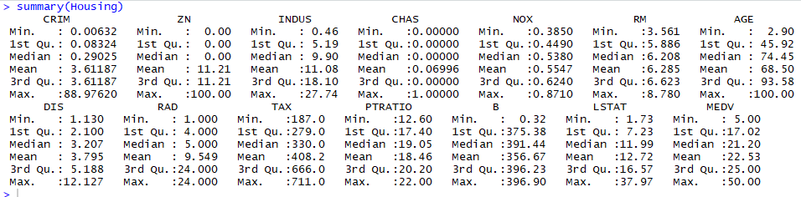
Data Cleaning
Replacing the NA values for variables with their Mean Values
Housing$CRIM[is.na(Housing$CRIM)] = 3.61187
Housing$ZN[is.na(Housing$ZN)]= 11.21
Housing$INDUS[is.na(Housing$INDUS)] = 11.08
Housing$CHAS[is.na(Housing$CHAS)] = 0.06996
Housing$AGE[is.na(Housing$AGE)] = 68
Housing$LSTAT[is.na(Housing$LSTAT)] = 12.715

Slide 7
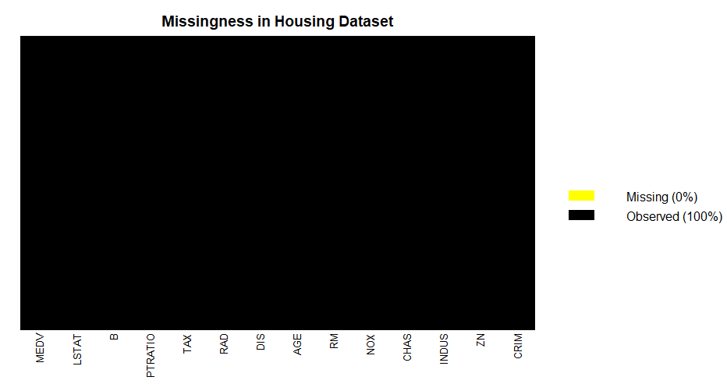
Missing Map
missmap(Housing,col=c('yellow','black'),y.at=1,y.labels='',legend=TRUE,main = "Missingness in Housing Dataset")
Missing map draws a map of the missingness in a dataset using the image function with color codes.

Slide 8
Exploratory Data Analysis (Visualizations)
Correlation plots are a great way of exploring data and seeing if there are any interaction terms, which measures a linear dependence between the variables.
MEDV decreases with increase in CRIM (medium), INDUS (High), NOX(low), AGE(low), RAD(low), TAX(low), PTRATIO(high), LSTAT (High) and increases with increase in ZN(low), RM(High).

Slide 9
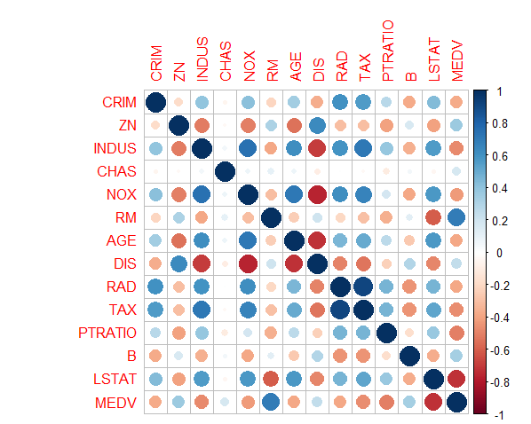
Correlation Matrix of the data set

Slide 10
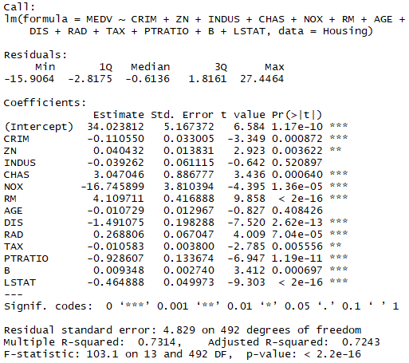
Building our Model
Model.1=lm(MEDV~CRIM+ZN+INDUS+CHAS+NOX+RM+AGE+DIS+RAD+TAX+PTRATIO+B+LSTAT,data = Housing)
summary(Model.1)
vif(lm(MEDV~CRIM+ZN+INDUS+CHAS+NOX+RM+AGE+DIS+RAD+TAX+PTRATIO+B+LSTAT,data = Housing))

Slide 11
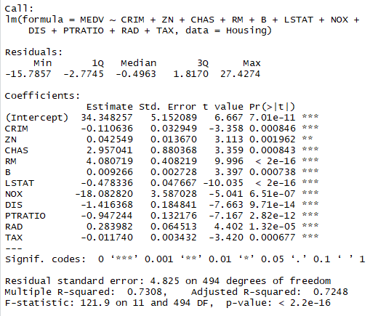
#have removed INDUS , AGE parameters by considering the p-values
Model.2=lm(MEDV~CRIM+ZN+CHAS+RM+B+LSTAT+NOX+DIS+PTRATIO+RAD+TAX,data = Housing)
summary(Model.2)
vif(lm(MEDV~CRIM+ZN+CHAS+RM+B+LSTAT+NOX+DIS+PTRATIO+RAD+TAX,data = Housing))

Slide 12
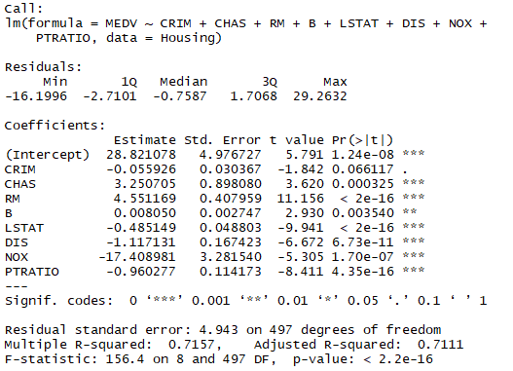
#have further removed ZN, RAD & TAX
Model.3=(lm(MEDV~CRIM+CHAS+RM+B+LSTAT+DIS+NOX+PTRATIO,data = Housing))
summary(Model.3)
vif(lm(MEDV~CRIM+CHAS+RM+B+LSTAT+DIS+NOX+PTRATIO,data = Housing))

Slide 13
A p-value of 5% or less is a good cut-off point. The p-values are very close to zero.
The ‘signif. Codes’ associated to each estimate. Three stars (or asterisks) represent a highly significant p-value. Consequently, a small p-value for the intercept and the slope indicates that we can reject the null hypothesis which allows us to conclude that there is a relationship between Medv and other remaining variables in Model.3.
The R-squared (R2) statistic provides a measure of how well the model is fitting the actual data.
In our case Model.3 gives the better result.
The variance inflation factor (VIF) quantifies the extent of correlation between one predictor and the other predictors in a model.
VIF has been used for diagnosing collinearity/multicollinearity. Higher values signify that it is difficult to impossible to assess accurately the contribution of predictors to a model.

Slide 14

Model.1
Model.2
Model.3
VIF values more than 4 is considered as moderate to high, below 4 are considered better for the model as the predictor is not highly correlated to the other variables.

Slide 15
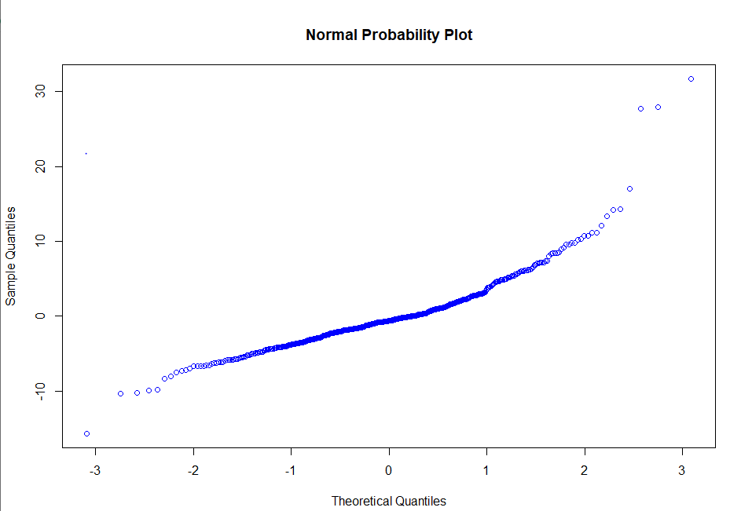
Residuals Analysis

Slide 16
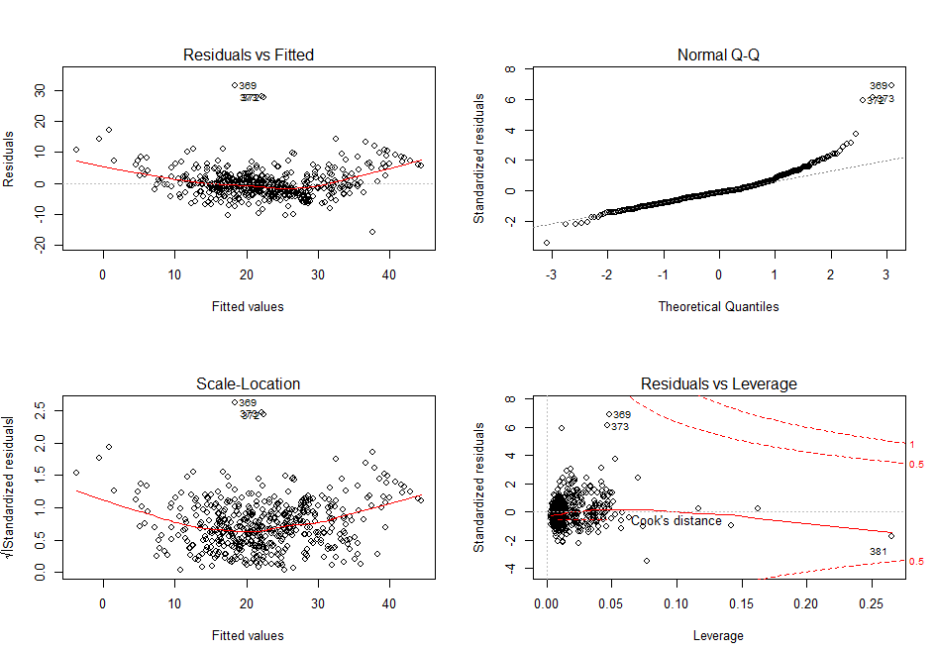
Chart Analysis
plot(Model.3)

Slide 17
Residuals Vs Fitted Plot: if the Red line is a strong curve, may be other model can be appropriate. We are checking whether there is equal variance along the regression line (i.e. homoscedasticity).
Normal Q Q Plot : we are checking whether the residuals are normally distributed or not.
Scale Location Plot: This plot is used to check if the variance is constant or not. Plot shows plot if residuals are spread equally along the ranges of predictors.
Residuals Vs Leverage Plot : This plot is used to check if there are any overly influential points.
CRIM, CHAS, RM, B, LSTAT, DIS, NOX, PTRATIO these are the variables that will influence the value of the house prices in Boston data set.

