Slide 1
Inflectional vs Derivational Morphology in NLP
Characteristics, applications and challenges
walk → walked
Inflectional: new form, same word
happy → unhappiness
Derivational: new word, new meaning
V.V.D.Nagasai Ratan Reddy
192324172 AI&DS
Notes:
Introduce the topic: two ways words are built and changed. Teal stands for inflection and orange for derivation throughout the deck. Walk to walked is the same word in another form; happy to unhappiness is a brand new word.

Slide 2
What is morphology?
un
break
able
prefix
root / stem
suffix
un + break + able = unbreakable
Free morpheme
Bound morpheme
Can stand alone as a word: break, happy, teach.
Must attach to another: un-, -able, -ed, -ness.
Notes:
Morphology is the study of word structure. A morpheme is the smallest unit that carries meaning. Take unbreakable: un- (prefix), break (root), -able (suffix). Free morphemes can stand alone; bound morphemes like un- and -able cannot. NLP systems need to split and interpret these parts.

Slide 3
Inflectional morphology
Adds grammar: tense, number, case, degree
Same word class and core meaning
Regular and highly productive
Always the outermost layer of a word
Suffix | Role | Example
-s | plural | cat → cats
-s | 3rd person | walk → walks
-ed | past tense | walk → walked
-ing | progressive | walk → walking
-er / -est | comparison | big → bigger
Notes:
Inflection adds grammatical information and keeps the word the same lexeme. English has only eight inflectional suffixes, which is why it is called morphologically poor. Read through the table: plural -s, possessive -'s, third person -s, past -ed, progressive -ing, past participle -en, comparative -er, superlative -est.

Slide 4
Derivational morphology
Creates a new word (new lexeme)
Often changes the word class
Meaning can shift or drift
Selective: many gaps and exceptions
verb → noun
teach → teacher
adj → noun
happy → happiness
noun → adj
care → careful
adj → verb
active → activate
Notes:
Derivation builds new words. It often changes the part of speech, shown by the four cards: verb to noun, adjective to noun, noun to adjective, adjective to verb. It is less productive and less regular than inflection, so some combinations are simply not words.

Slide 5
Side-by-side comparison
Aspect | Inflectional | Derivational
Purpose | Marks tense, number, case | Builds new words
Word class | Unchanged: walk → walked | Often changes: teach → teacher
Meaning | Core meaning unchanged | New or shifted meaning
Productivity | Regular, applies broadly | Selective, many exceptions
Affix order | Outer layer (teach-er-s) | Inner layer (teach-er)
Examples | -s, -ed, -ing, -est | -ness, -able, un-, re-
Rule of thumb: inflection changes the form, derivation changes the word.
Notes:
This is the core of the topic. Go row by row. The rule of thumb at the bottom is the one line to remember: inflection changes the form, derivation changes the word.

Slide 6
How they combine
teach
+
-er
+
-s
= teachers
nation
+
-al
+
-ize
+
-ation
+
-s
= nationalizations
Root
Derivational
Inflectional
Notes:
Words can stack several affixes. Derivation comes first and inflection comes last. In teachers, -er is derivational and -s is inflectional. In nationalizations, -al, -ize and -ation are derivational layers and the final -s is inflection. This ordering is something a morphological analyzer can exploit.

Slide 7
Applications in NLP
I
Inflectional
D
Derivational
Lemmatization and stemming for search and indexing
Agreement checks in POS tagging and parsing
Correct word forms in machine translation
Text normalization before tokenization
Vocabulary and query expansion
Sentiment cues from affixes (un-, -less)
Guessing the meaning of unseen words
Subword models such as BPE and WordPiece
Notes:
Inflectional analysis mostly serves normalization: reducing many surface forms to one lemma so search engines and models treat them alike. Derivational analysis serves meaning: relating words in a family, expanding queries, and handling words never seen in training.

Slide 8
Challenges
Inflectional
Derivational
Irregular forms
Ambiguous affixes
went, mice and better break rule-based stemmers
-er in teacher vs bigger; un- in undo vs unhappy
Derivational
Both
Unpredictable meaning
Data sparsity
department is not depart + ment; meaning drifts
Rich morphology (Tamil, Turkish) explodes the vocabulary
Notes:
Inflection is regular but irregular forms need lexicons. Derivation is harder because affixes are ambiguous and meaning is often not the sum of the parts. Sparsity affects both, especially in agglutinative languages like Tamil and Turkish.

Slide 9
Techniques used in NLP
1
Rule-based stemmers
Porter, Snowball: chop suffixes by rules. Fast, but crude.
2
Dictionary lemmatizers
WordNet, spaCy: return the real base form using POS.
3
Finite-state analyzers
Full analysis of rich morphology, e.g. Turkish, Tamil.
4
Subword tokenizers
BPE, WordPiece: learn word pieces from data.
Notes:
Four families of tools. Stemmers like Porter are fast but crude. Lemmatizers use a dictionary and part of speech, so they are more accurate. Finite-state analyzers give full morphological analysis, important for languages like Tamil and Turkish. Subword tokenizers such as BPE and WordPiece learn pieces from data and are what modern language models use.

Slide 10
Key takeaways
1
Inflection changes the form; derivation creates a new word.
2
Inflection is regular and rule-friendly; derivation needs semantics.
3
Modern NLP combines morphological analyzers with subword models to handle both.
Notes:
Close by linking back: grammar versus vocabulary. Rules and finite-state analyzers handle regular inflection well, while subword tokenization is the common way to cope with productive derivation and rare words. Thank the audience and invite questions.

Slide 11
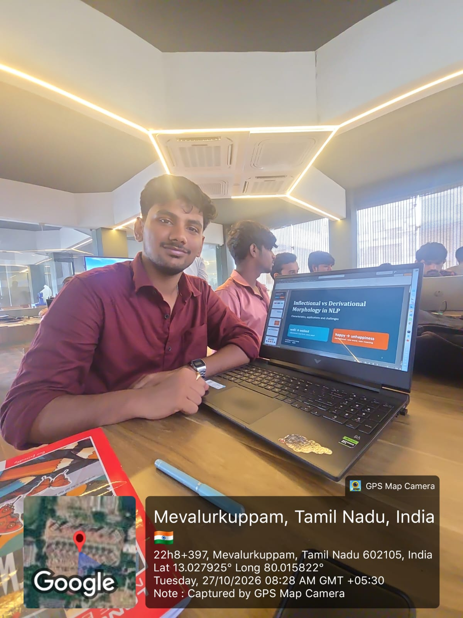
Presentation

Slide 12
THANK YOU!!

