Slide 1
Global BMI Trends
in Adults and Newborns
Course: DAB 422 | Professor: H. Virk | Term: 26W
Final Presentation — April 2026
NATALIA MEJIA ALVAREZ (0872835)
SHALINI SIRDHALA (0875854)
JIE ZHANG (0879447)
PUSHP CHANDRASINH RATHAVA (0867974)
Clustering · Anomaly Detection · Trend Forecasting · Evaluation

Slide 2
Agenda
01
Project Overview & Dataset
06
Prophet — Long-Horizon Forecast
02
Data Preparation & Feature Engineering
07
Hyperparameter Tuning
03
K-Means Clustering — Risk Groups
08
Evaluation Metrics & Model Comparison
04
Exploratory Trend Analysis
09
Key Findings & Conclusions
05
Isolation Forest — Anomaly Detection

Slide 3
Project Overview & Dataset
29,918
26
1990–2022
Total Records
Features
Year Range
Objectives
Segment countries into BMI risk groups using K-Means clustering
Detect anomalous BMI records using Isolation Forest
Forecast global mean BMI trends using Prophet time-series model
Tune and evaluate all models with rigorous metrics

Slide 4
Data Preparation & Feature Engineering
Type Conversion
CI_Range Feature
Cast BMI_Value, CI_Low, CI_High, Year to numeric; coerce errors
Derived CI_Range = CI_High − CI_Low to capture uncertainty width
Null Filtering
Final Dataset
Dropped rows missing Year, BMI_Value, CI_Range, CountryCode, Region
28,017 clean adult records across 6 WHO regions, 1990–2022

Slide 5
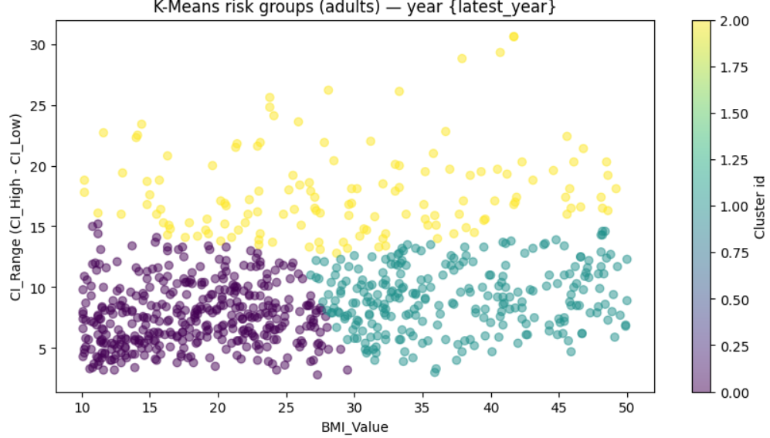
K-Means Clustering — Risk Groups (k = 3)
Methodology
Features: BMI_Value & CI_Range (StandardScaler)
k = 3 selected (confirmed by silhouette tuning)
Clusters ranked by mean BMI → Low / Medium / High Risk
Low Risk
397 countries · BMI ≈ 10–17
Medium Risk
139 countries · BMI ≈ 17–28
High Risk
264 countries · BMI ≈ 28–50

Slide 6
Exploratory Trend Analysis
Females: 26.3 · Both-sex: 24.5 · Males: 23.0 (mean BMI by sex)

Slide 7
Isolation Forest — Anomaly Detection
11,147
335
Africa
Adult records (NCD_BMI_25A)
Anomalies flagged (3.0%)
Most anomalies: 143
Anomaly Count by Region
Interpretation
Anomalies cluster at extreme BMI values (≈50) — ceiling effect in data reporting
Africa has the highest raw anomaly count due to data variability
South-East Asia has the highest anomaly ratio (4.6%)

Slide 8
Prophet — Long-Horizon BMI Forecast
Key Takeaways
Upward trend accelerating post-2015
Forecast projects mean BMI ≈ 28+ by 2031
Confidence interval widens — uncertainty grows with horizon
Non-linear shape motivates Prophet over simple regression

Slide 9
Hyperparameter Tuning
K-Means: Silhouette vs k
Isolation Forest Tuning Grid
Contamination | n_estimators | Anomaly Rate
0.01 | 100–300 | 1.00%
0.03 ✓ | 100–300 | 3.01% (≈target)
0.05 | 100–300 | 5.01%
Trend Model: Linear Regression (time split)
MAE: 1.39 · RMSE: 1.42 · R²: −20.4
→ Linear model fails the non-linear trend; validates Prophet choice
→ Best k = 3 (max silhouette = 0.422)

Slide 10
Evaluation Metrics — Model Comparison
K-Means (k = 3)
Silhouette Score | 0.422 | Good separation (range: −1 to 1)
Davies-Bouldin Score | 0.880 | Low = compact clusters (↓ better)
Calinski-Harabasz Score | 678.75 | High = dense clusters (↑ better)
Isolation Forest
Contamination | 0.03 | Matches target 3% rate
Anomaly Count / Rate | 335 / 3.01% | Precise alignment with target
Linear Regression Trend
MAE: 1.39 · RMSE: 1.42 · R²: −20.4 → Poor fit; non-linear trend requires advanced models

Slide 11
Regional Deep Dive
Americas
Highest mean BMI (31.8) — obesity epidemic well-documented
Africa
Most anomalies (143) driven by high data variability
SE Asia
Highest anomaly ratio (4.6%) — rapidly changing patterns
Europe
Stable mean BMI (26.8); lowest anomaly ratio

Slide 12
Challenges & Limitations
01
Welch t-test NaN result
02
Linear Regression Failure
Sex-based t-test returned NaN — Sex column uses coded values (SEX_MLE/FMLE), not 'male'/'female'. str.contains() matched nothing. Requires preprocessing fix.
R² = −20.4 on test set. BMI trend is non-linear (dip 1990–2000, surge 2010+). LR extrapolated linearly, missing the curve. Prophet is the correct model.
03
BMI Ceiling Effect
04
Newborn Data Not Used
Many anomalous records show BMI = 50.0, likely a data cap. This inflates anomaly counts in countries like IRL and MUS rather than reflecting true obesity.
Project title references newborns, but analysis focuses on adult indicator (NCD_BMI_18A / NCD_BMI_25A). Newborn BMI indicators were present but not explored.

Slide 13
Future Work & Recommendations
Fix Sex-Based Analysis
Advanced Clustering
Re-map Sex codes to 'male'/'female' and re-run Welch t-test; add Cohen's d for effect size.
Try DBSCAN or GMM to capture non-spherical BMI distributions; validate with geographic data.
Expand to Newborns
Socioeconomic Features
Include newborn BMI indicators; compare trajectory between adult and newborn trends.
Join GDP, urbanization, food-access indicators to explain anomalies and regional divergence.
Country-Level Forecasting
Interactive Dashboard
Train Prophet per country instead of global mean for more actionable public-health insights.
Build a Streamlit / Dash app for interactive BMI exploration by region, sex, and year.

Slide 14
Key Findings
1
Global adult BMI has risen from ~25 (1990) to ~26.6 (2022) with acceleration after 2010.
2
K-Means (k=3) cleanly segments countries into Low/Medium/High risk; best silhouette = 0.422.
3
Americas has the highest mean BMI (31.8); Africa the lowest (20.0).
4
335 anomalies (3%) detected — concentrated in Africa and SE Asia; often tied to BMI ceiling values.
5
Prophet forecast projects mean global BMI exceeding 28 by 2031 if trends continue.
6
Linear regression is inadequate (R²=−20.4); non-linear models are essential for BMI forecasting.

Slide 15
Web Site

Slide 16
Thank You
Questions & Discussion
Course: DAB 422 · Professor: H. Virk · Term: 26W
Global BMI Trends in Adults and Newborns
29,918 records · K-Means k=3 · 335 anomalies · 10-year forecast

