Slide 1

3White1brown
Marius Sclearuc
Harsh Rathee
Otto Vintola
Miro Keimiöniemi

Slide 2
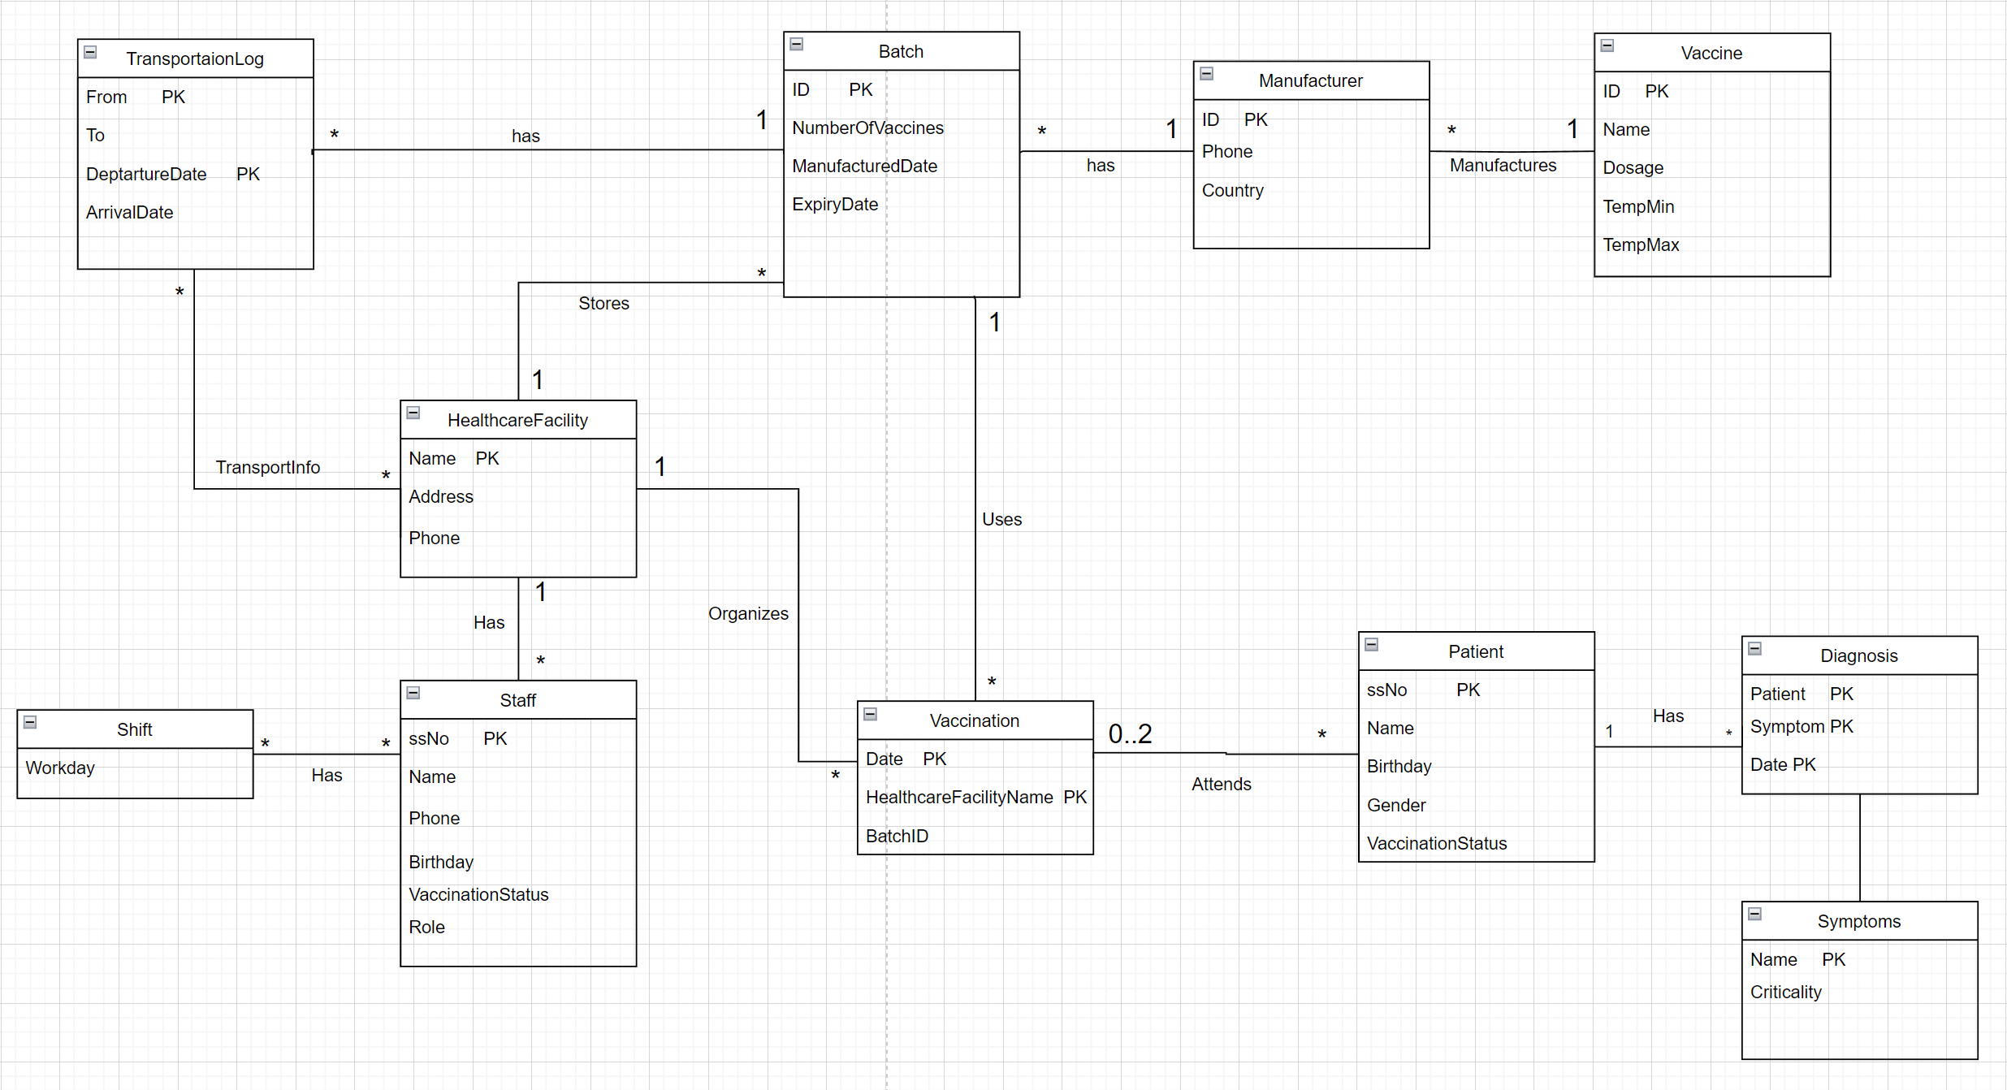

Slide 3
Relational schema
Vaccine(ID, Dosage, Temperature, ExpiryTime)
Manufacturer(ID, Phone, Country, VaccineID)
HealthcareFacility(Name, Address, Phone)
Batch(ID, NumberOfVaccines, ManufacturedDate, VaccineID, HealthcareFacilityName)
Staff(ssNo, Name, Phone, Birthday, VaccinationStatus, Role, HealthcareFacilityName)
Shift(Workday, ssNo)
TransportationLog(From, To, BatchID, DepartureDate, ArrivalDate)
Patient(ssNo, Name, Birthday, Gender, VaccinationStatus)
Attends(ssNo, date)
Vaccination(ID, Date, HealthcareFacilityName, BatchID)
Symptoms(name, Critical)
Diagnosis(Patient, Symptom, Date)

Slide 4
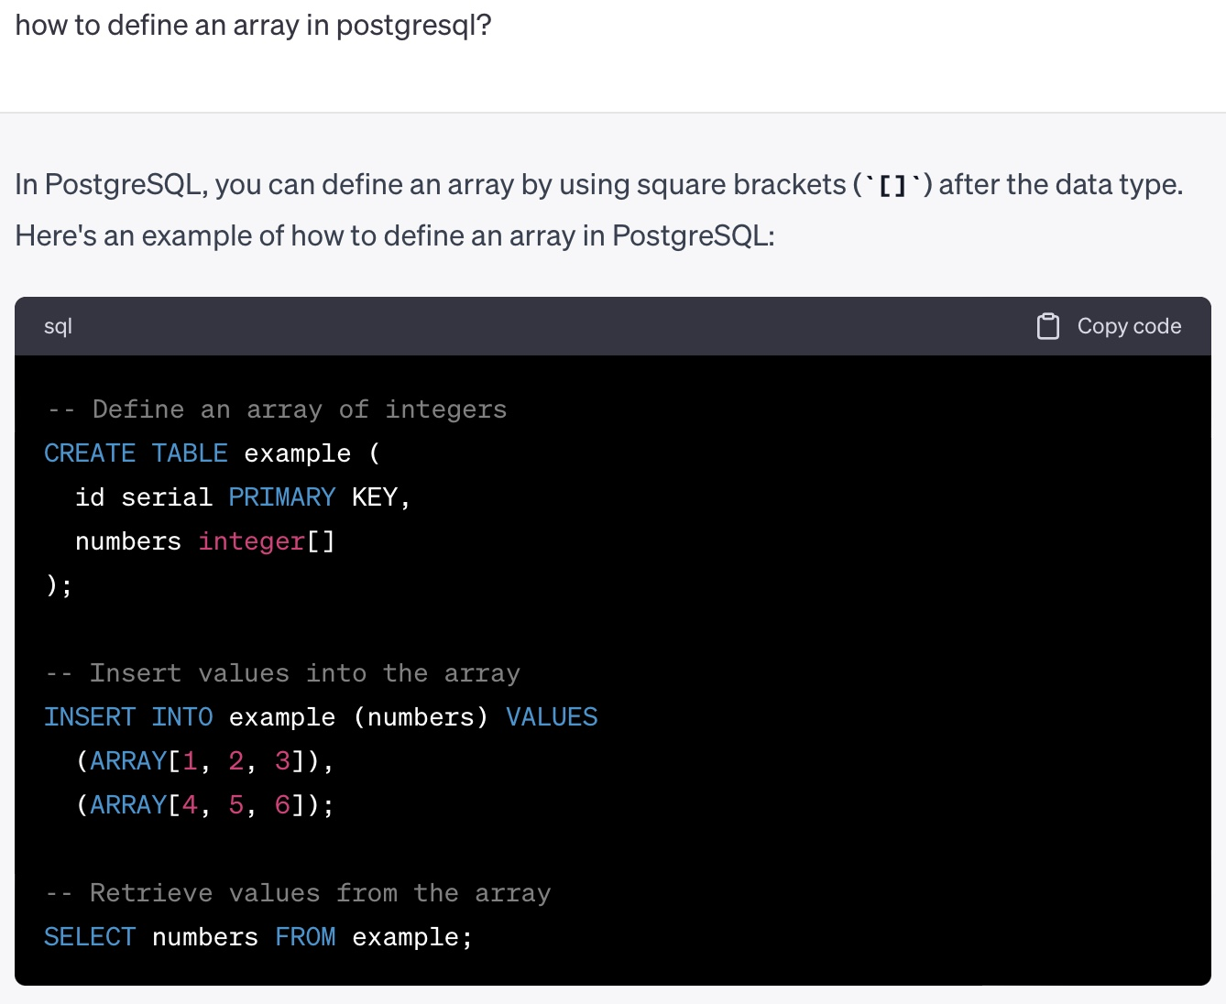
Difficult design choices
Arrays – we were lied to by ChatGPT
Turning our model into BCNF took a lot of thinking but few changes
Fitting our model to the data required formatting and finding the information

Slide 5
Improvements
Automated data cleaning – unlikely/difficult but possible
Storing VaccineID in Batch – makes queries simpler
Formatting tables uniformly – attributes resemble each other more
If we know the format of future data, we redesign the database to fit that

