Slide 1
Smart Campus: An Integrated Web-Based Platform for Automated Academic, Administrative, and Student Services Management in Higher Education Institutions
Conference focus
Unified platform replacing siloed attendance, safety, and office tools
PHP API layer with token-based access and role-scoped data retrieval
React frontend with role dashboards, Leaflet maps, and near-real-time polling
Attendance workflow includes QR + hotspot/network-prefix verification
SOS and live-location flows are wired for escalation and governance
Attendance Integrity
Campus Safety
Role-Based Ops
SmartCampus conference deck | generated from repository analysis

Slide 2
Why SmartCampus Exists
The platform addresses fragmented campus operations and weak cross-module accountability
Data silos
Separate tools for attendance, finance, safety, and records duplicate effort and fragment truth.
Operational delay
Manual reconciliation slows attendance closure, notifications, and incident handling.
Safety gaps
No single workflow for SOS, live location, and escalation across roles.
Inconsistent access
Responsibilities differ by role, but many systems do not enforce that boundary cleanly.
Core response
One frontend, one backend, one data model
Role-aware routing and backend authorization
Integrity controls where the workflow is security-sensitive
Result
Less duplication
Faster handoff between academic and admin teams
Clear audit trail for attendance and safety actions
SmartCampus conference deck | problem statement

Slide 3
System Architecture
React frontend, PHP service layer, and MySQL data persistence
Request lifecycle
1. User logs in and receives a bearer token
2. Frontend attaches Authorization header automatically
3. Backend validates token, role, and scope
4. Endpoint executes domain logic and returns JSON
5. Role-specific dashboard renders the result
React frontend
Role-based dashboards Vite + React Router Bootstrap, Leaflet, Chart.js
PHP API layer
Modular endpoints Auth, validation, CORS, security headers Bearer token checks
MySQL backend
Users, sessions, attendance, SOS, live locations Institutional module tables
Evidence
React/Vite frontend, PHP backend, MySQL schema, and bearer-token auth are documented across the repo.
SmartCampus conference deck | architecture

Slide 4
Modules and Roles
A single platform spans academic, operational, and service functions
Major modules
Academics: student/teacher management, timetables, marks, subject assignment
Attendance: session creation, marking, validation, rejection logs
Safety: SOS reporting, live location, escalation intelligence
Registrar: records, certificates, admissions workflows
Finance: fees, payments, budgets, cost centers
Exam, placement, hostel, library, dean, affairs, parent services
Role coverage
Admin and affairs: global oversight and incident visibility
Teacher, HOD, coordinator: scoped academic and attendance actions
Student and parent: self-service access and notifications
Accountant, registrar, exam controller: office workflows
Placement, hostel warden, librarian, dean: role-specific dashboards
The platform is designed around role boundaries, not just features.
SmartCampus conference deck | modules and roles

Slide 5
Attendance Integrity
A multi-layer verification pipeline blocks proxy attendance and records rejections
1
2
3
4
5
Teacher starts
Session context, class, period,
network prefix, QR token
Student joins
Available sessions are
filtered by class
membership
Token check
Bearer token, active session,
and student role are validated
Network gate
Gateway prefix
comparison
detects hotspot
mismatch
Write audit
Success inserts attendance;
failure writes rejection reason
Verification layers
QR token match
Network prefix check
Duplicate attendance prevention
Rejection log for suspicious attempts
Conference takeaway
Attendance is not just recorded; it is verified, scoped, and audited.
SmartCampus conference deck | attendance integrity

Slide 6
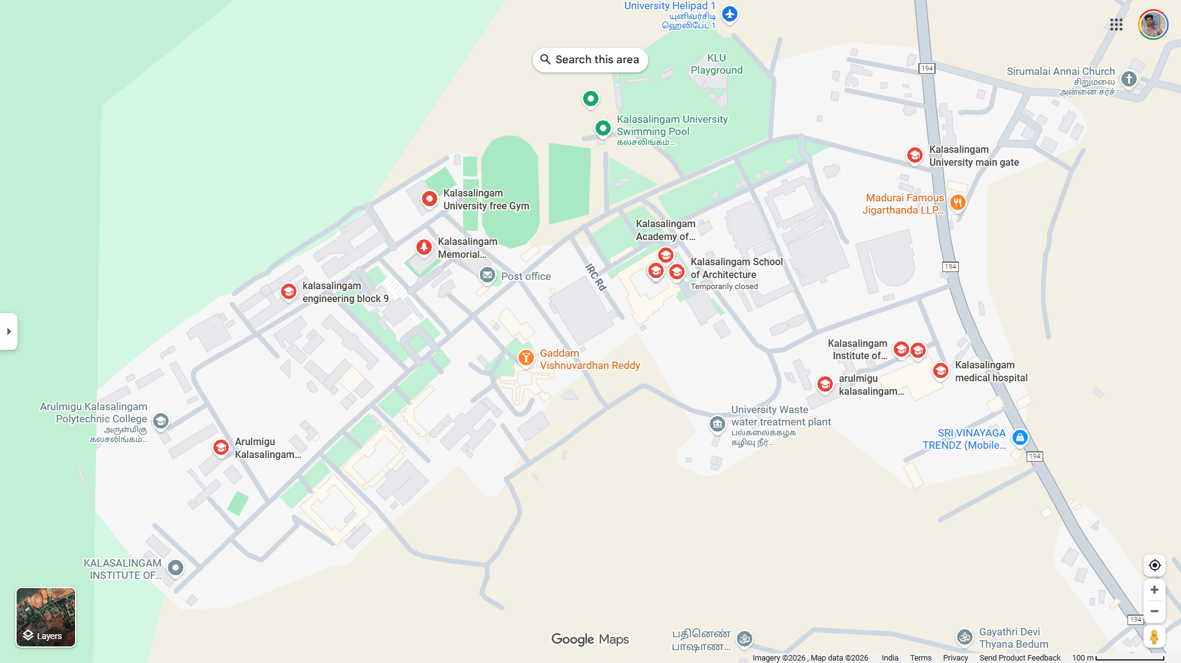
Safety, SOS, and Live Location
Emergency reporting is paired with real-time movement monitoring and scoped visibility
SOS workflow
Student submits an emergency message and optional photo
Backend resolves identity from the authenticated account
Role-scoped retrieval shows only what each authority should see
Safety intelligence adds context, severity, and escalation targeting
Incident history becomes searchable and auditable
Live location monitoring
Coordinates are updated in the backend and displayed on a Leaflet-based map.
Role filters keep admin, HOD, coordinator, and teacher views scoped appropriately.
SmartCampus conference deck | safety and location intelligence

Slide 7
Security and Production Hardening
The backend has a clear security posture, not just feature endpoints
Implemented controls
Prepared statements via DB helper
Input validation and sanitization
Bearer-token authentication
CORS, security headers, and rate limiting
bcrypt password hashing and generic errors
Web-server hardening and restricted file access
Production-readiness signals
Documentation covers environment setup, deployment, and security checks.
Netlify deployment is defined for the frontend with a separate PHP backend.
The repo includes a pre-production security checklist and operational guidance.
Notable follow-up areas
Broader prepared-statement adoption is still a consistency task across all endpoints.
Some frontend pages still have lint issues to clean up before stricter release gates.
Bundle size suggests further code-splitting opportunity.
SmartCampus conference deck | security posture

Slide 8
Deployment and Maturity
The system already has a credible path to production and demonstration
Deployment model
Frontend: Netlify static hosting from the Vite build
Backend: PHP app on shared hosting, VPS, or managed PHP runtime
Database: MySQL schema named smartcampus
Auth and API traffic: HTTPS + bearer tokens + environment variables
The repository includes deployment notes and integration guides
Why this is conference-ready
Clear narrative: one platform, multiple roles, one operational view
Demonstrable deep work: security, attendance integrity, and safety workflows
Practical deployment story: static frontend + modular PHP backend
Extensible architecture for future services and policy automation
The project combines implemented workflows, deployment notes, and security guidance into a coherent system story.
SmartCampus conference deck | deployment and maturity

Slide 9
Closing message
Suggested next steps
Trim a few frontend lint issues
Split large bundles for better performance
Standardize endpoint validation patterns
Add a short live demo or screenshot appendix
SmartCampus demonstrates how a university can unify academic, operational, and safety workflows into a single role-aware platform.
The strongest conference story is not just the breadth of modules, but the integrity model behind them: token-based access, scoped data visibility, layered attendance verification, and safety workflows that can be audited.
A unified campus platform is most valuable when it makes everyday operations visible, verifiable, and role-aware.
Thank you

