Slide 1
Bla bla

Slide 2
Model logic
Model the overall interaction for an agent as a superposition of all direct interactions between him and any other agent
Choose appropriate model functions to fulfill the two-agent problem
Gaussian as preference to go ahead
Polar coordination system with the agent centered -> Only consider the angle

Slide 3
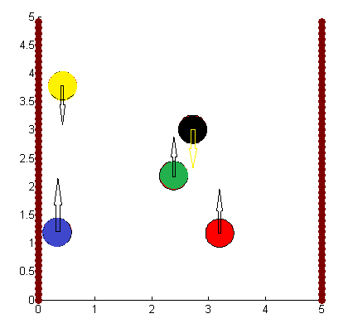
Model logic

Slide 4
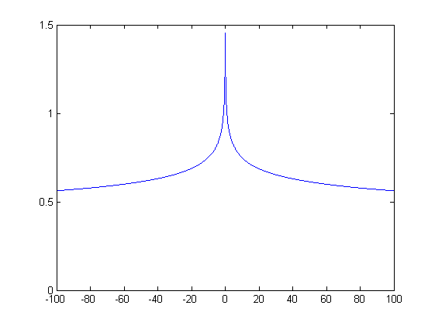
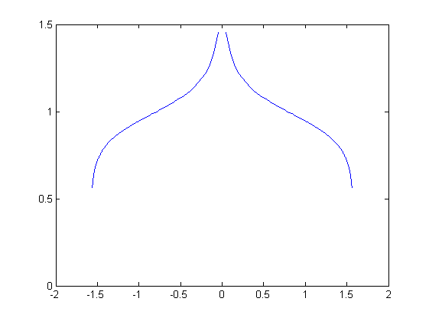

Model logic
Crossing agents: Absolute hyperbel functions
$y= \frac{1}{|x|n}$

Slide 5
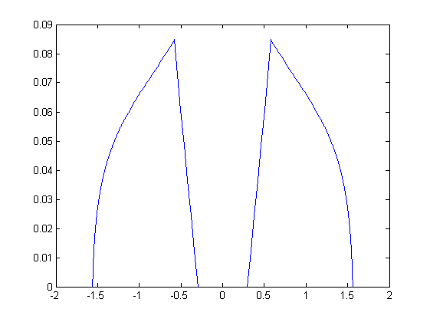
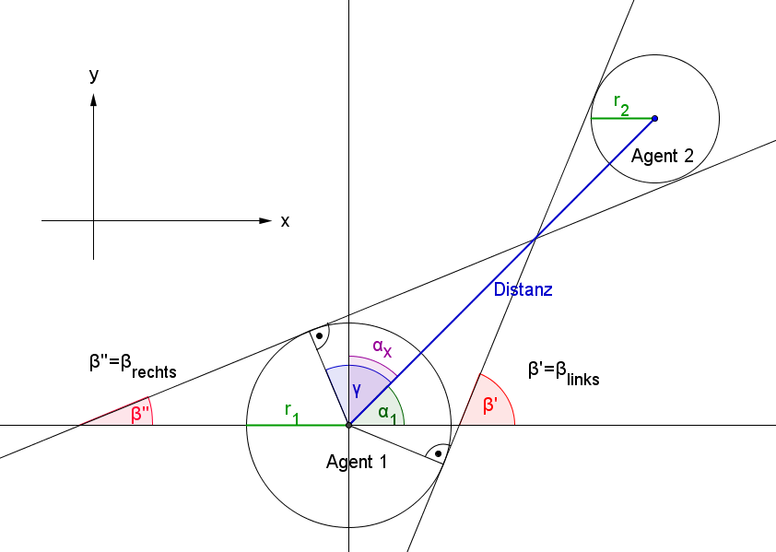
Model logic
Crossing agents: Absolute hyperbel functions

Slide 6
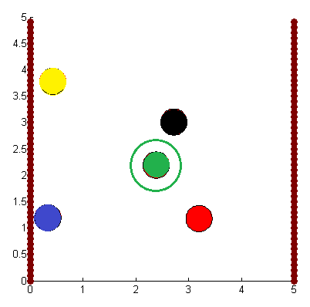
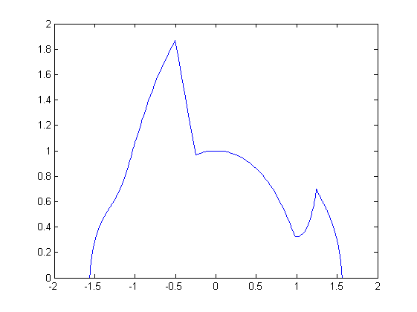
Model logic
Crossing agents: Absolute hyperbel functions

Slide 7
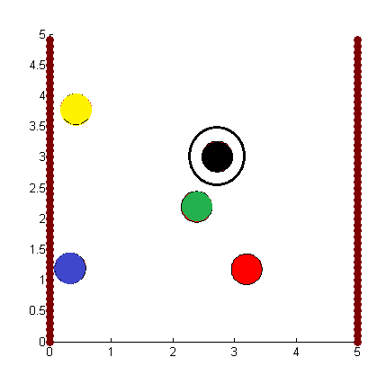
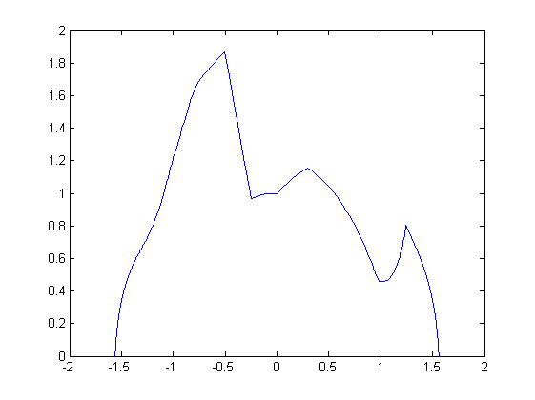
Model logic
Crossing agents: Absolute hyperbel functions

Slide 8
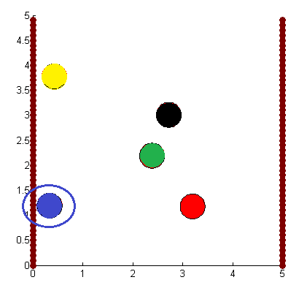
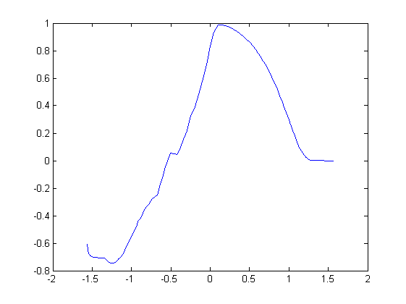
Model logic
Wall agents: Box-like function

Slide 9
Model logic
Following another agent: DISPERSIONFACTOR
> 0: Try to overtake, treated like crossing agent
< 0: Try to follow the other agent, gaussian

Slide 10
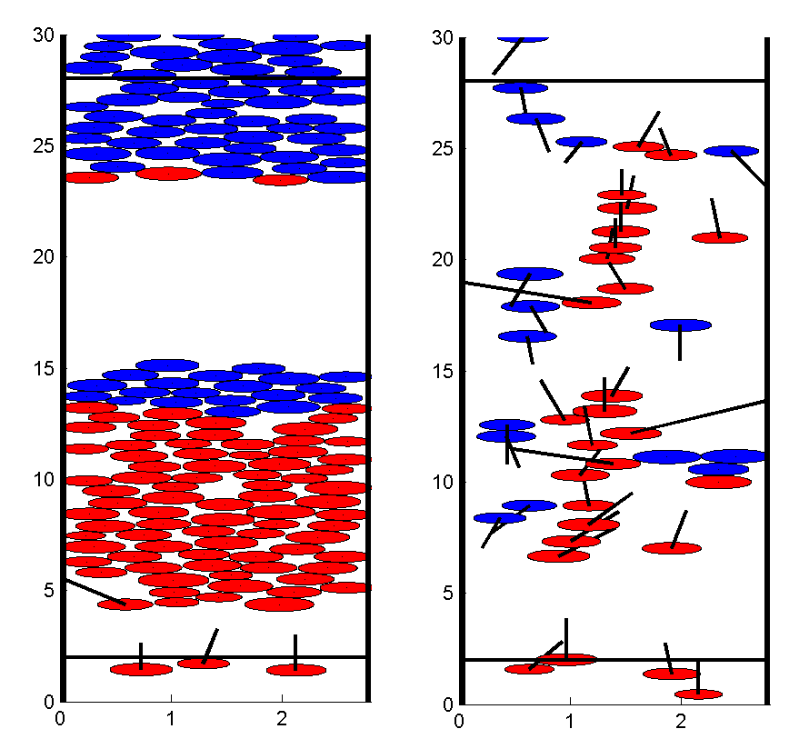
Limitations

Slide 11
Limitations
The agents can only move forward, no backward communication
Standoff breakup capabilities are very limited
A small clot will (in our model) jam the whole hallway
In reality, groups of people walk together

Slide 12
Limitations
Although obstacle courses can be set, it would be difficult to make spawn zones on the sides
Functions were chosen to meet certain criteria and not from explicit research
The whole set of global parameters is difficult to optimize

