Slide 1

Pedestrian dynamics in long, narrow hallways
Moser Manuel, Suter Yannick, Theiler Raffael https://github.com/ratheile/msssm Zurich, December 2012
Notes:
Mosi: Begrüssung

Slide 2

Contents
Introduction & basic idea
The logic in our model
Drawing of the field
Live simulation
Our tests
Limitations
Summary
Q&A
Notes:
Mosi: Inhalt ausschmücken, aber nicht allzu stark

Slide 3
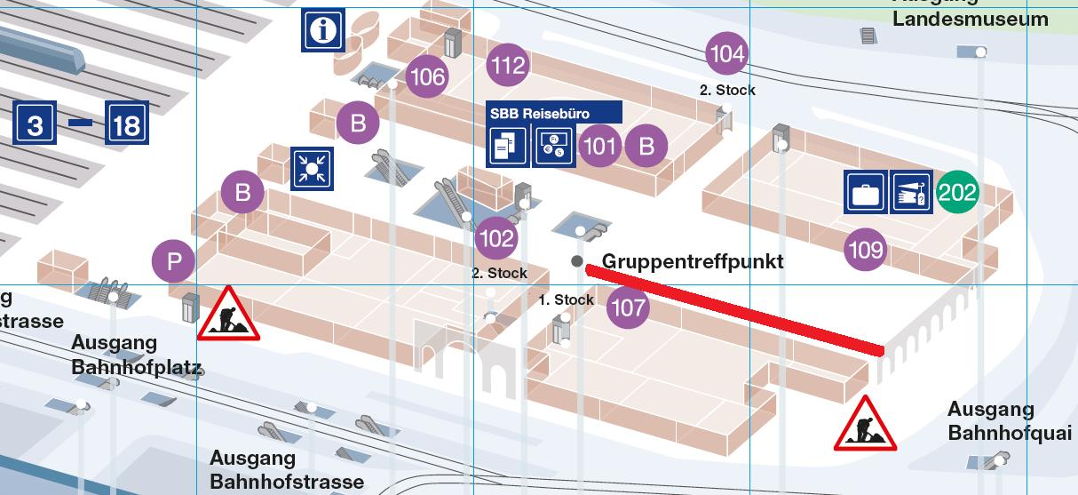
Introduction & basic idea
www.sbb.ch
Notes:
Mosi: Idee & Motivation, Grundidee – Überblick Situation „wovon rede ich“

Slide 4
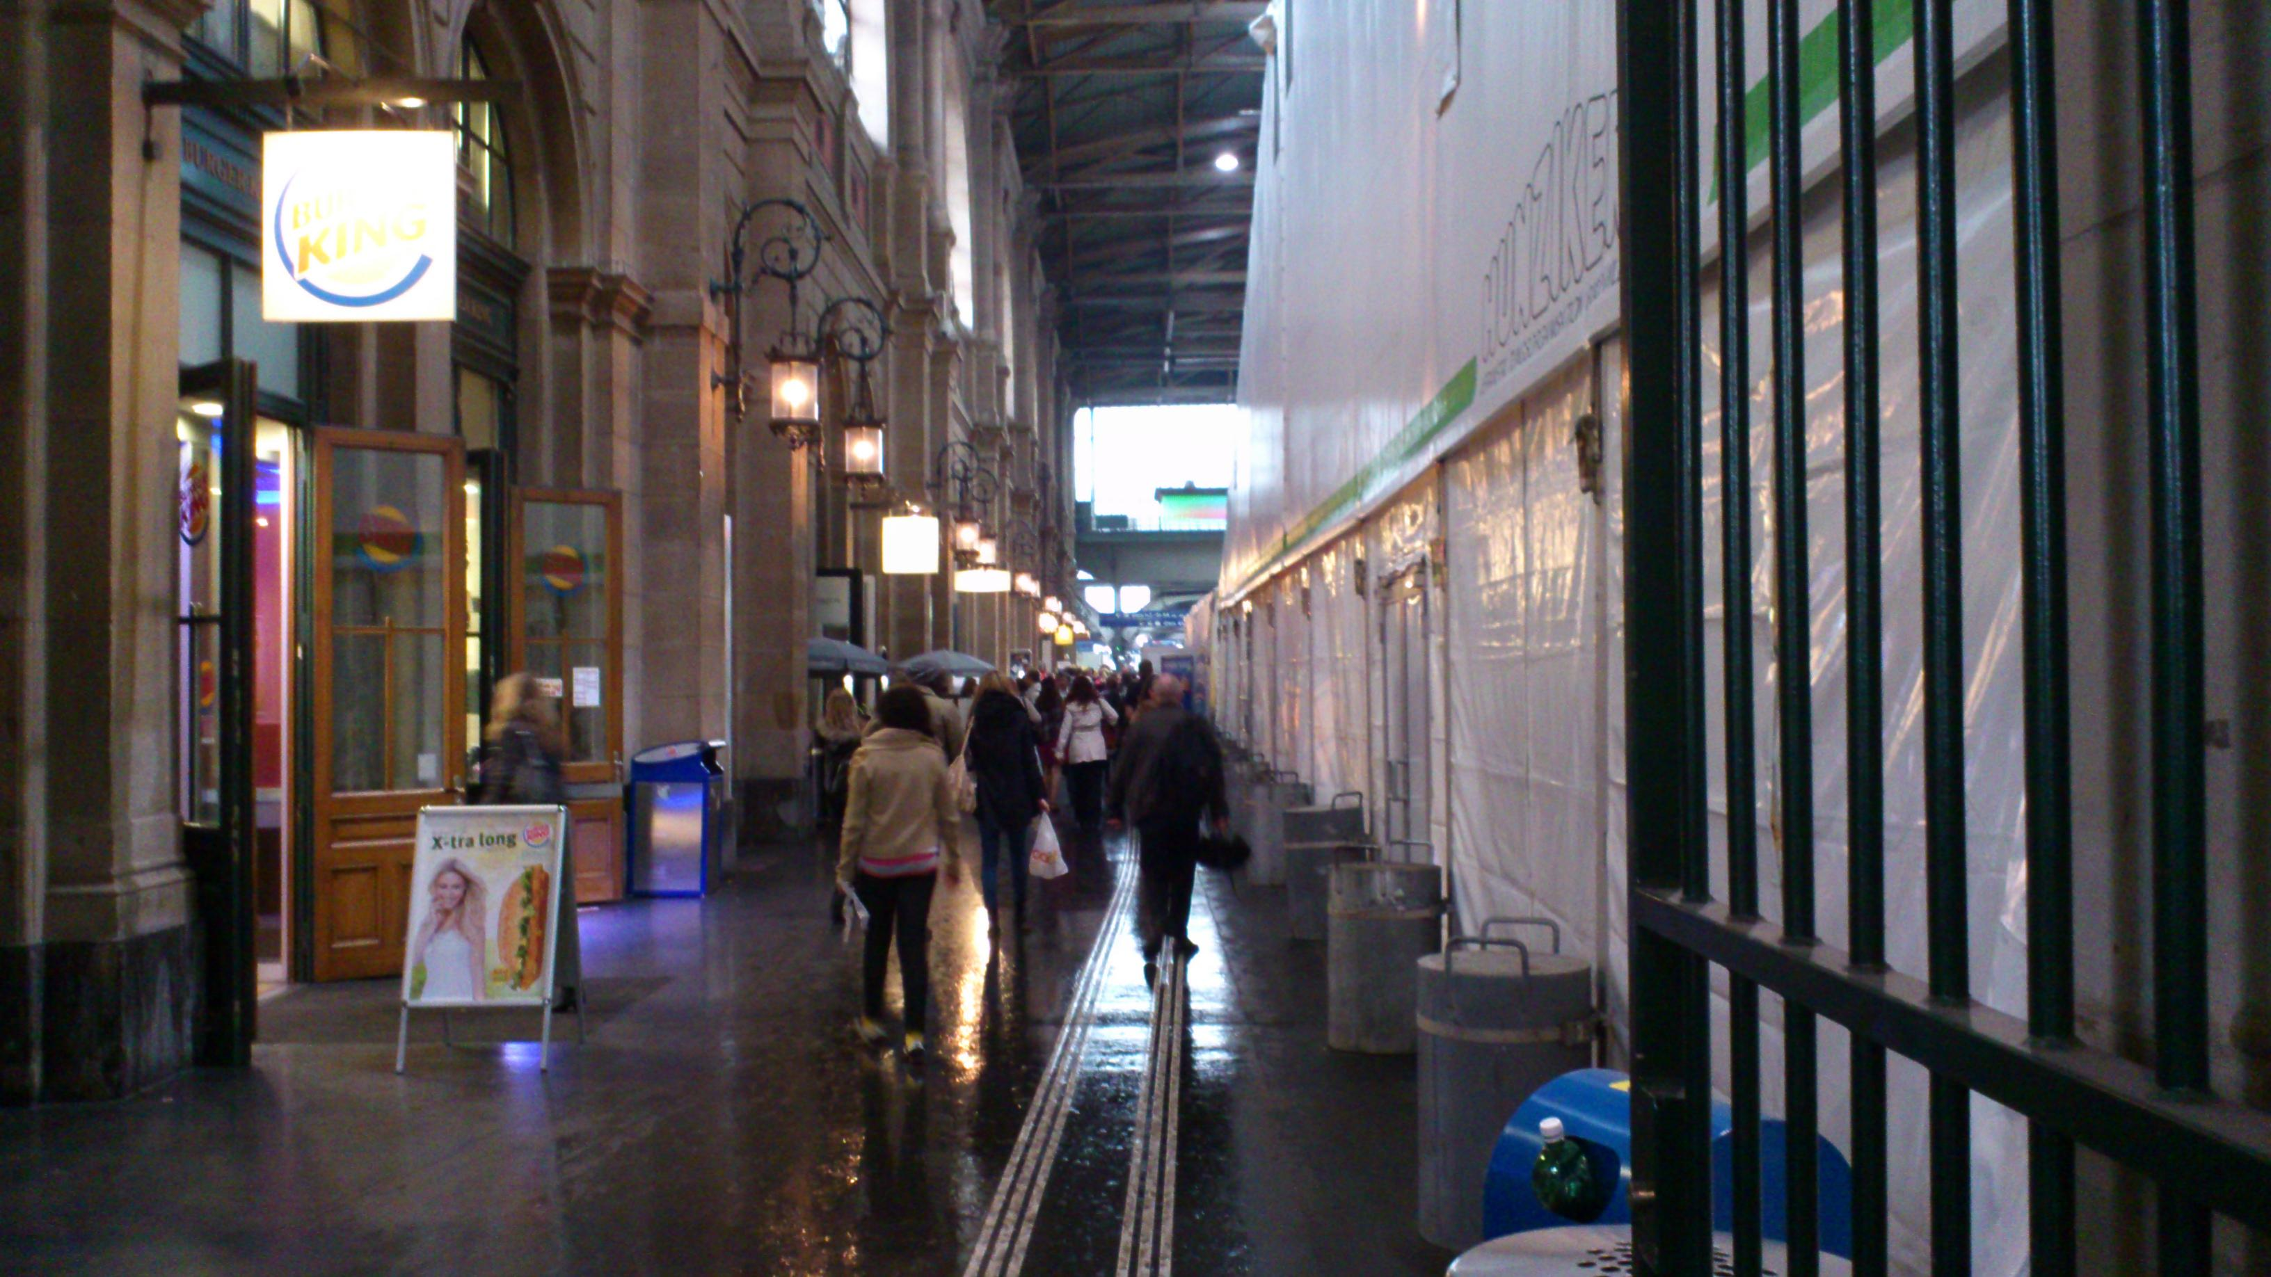
Introduction & basic idea
Notes:
Mosi: Idee & Motivation, Grundidee - hier: Auslöser der Idee

Slide 5
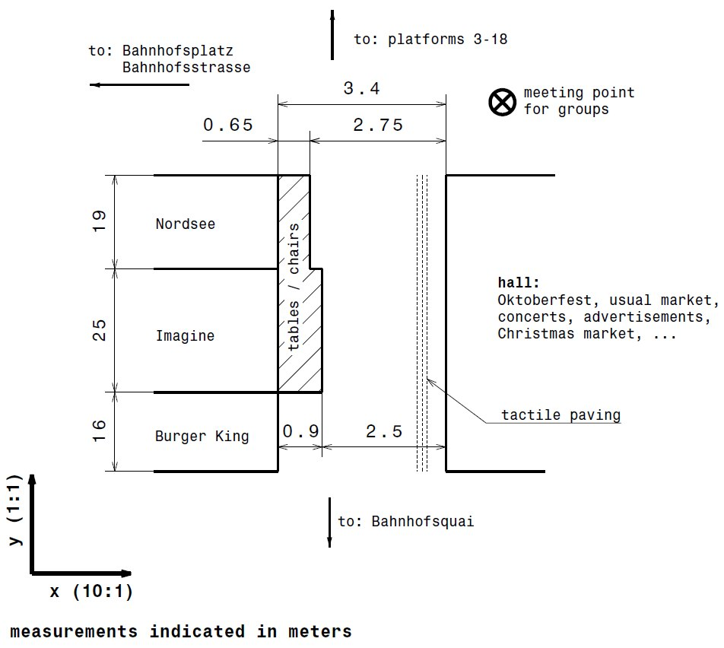
Introduction & basic idea
What is special?
Long & narrow hallway
What is the goal?
No path optimization
Notes:
Mosi: Idee & Motivation, Grundidee – Was ist speziell an unserem Modell, unseren Ideen?

Slide 6
The logic in our model
Model the overall interaction for an agent as a superposition of all direct interactions between him and any other agent
Choose appropriate model functions to fulfill the two-agent problem
Gaussian as preference to go ahead
Polar coordination system with the agent centered → Only consider the angle
Notes:
Yannick: Umsetzung der Logik, nicht allzu technisch, bildlich erklären
Polares System -> zunächst nur Bestimmung der Richtung

Slide 7
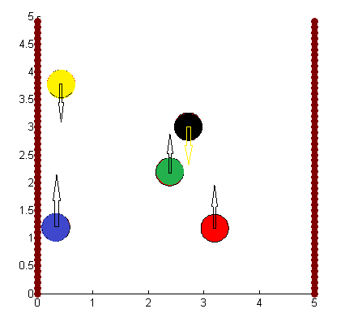
The logic in our model
Notes:
Beispielsituation aus der Entwicklungsstufe

Slide 8

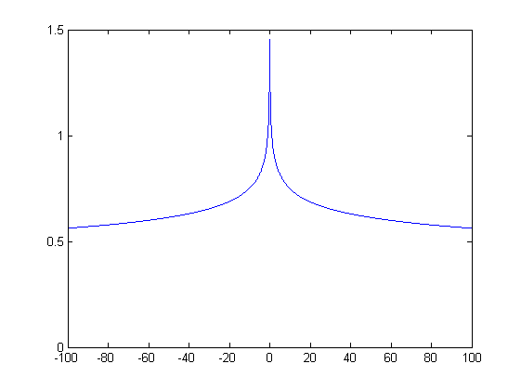
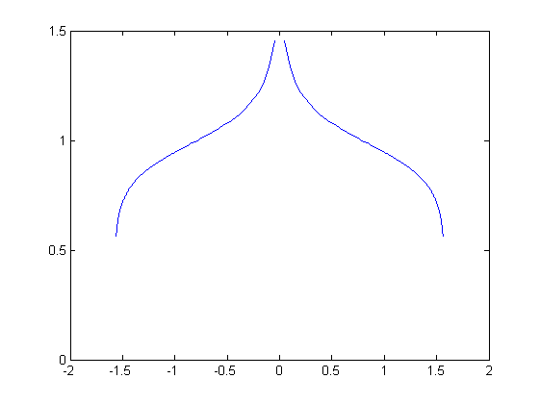
The logic in our model
Crossing agents: Absolute hyperbel functions
Notes:
Grundidee zentrierte Hyperbelfunktion in angular values

Slide 9
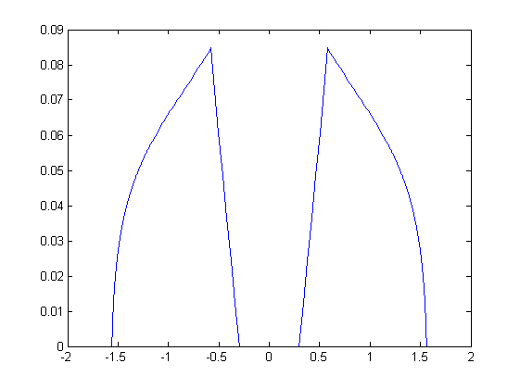
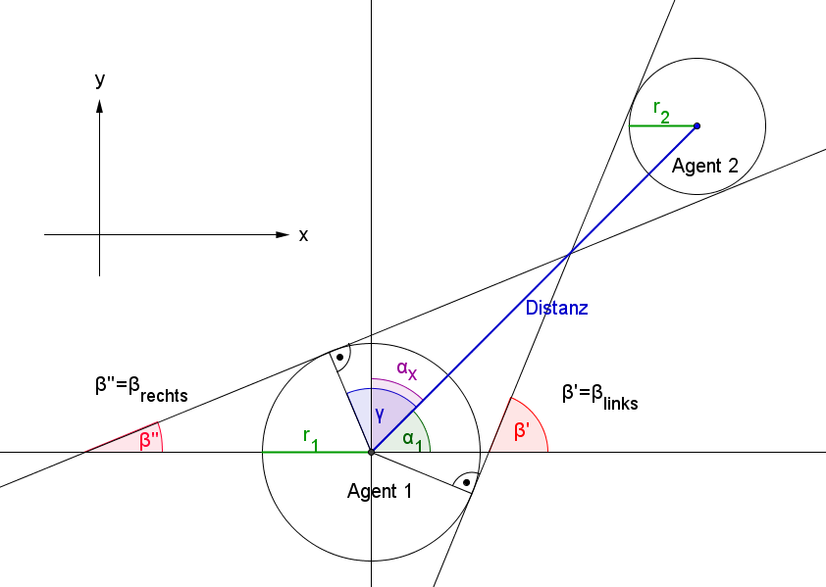
The logic in our model
Crossing agents: Absolute hyperbel functions
Notes:
Winkel, die einem Kollisionskurs entsprechen, werden auf 0 gesetzt. Zusätzlich ein Offset

Slide 10
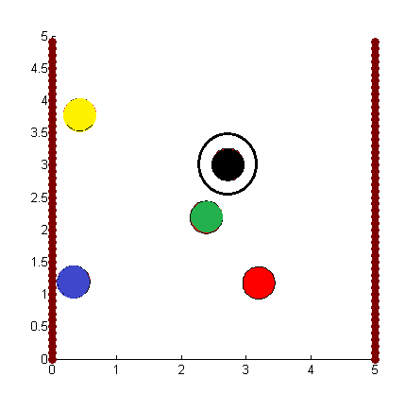
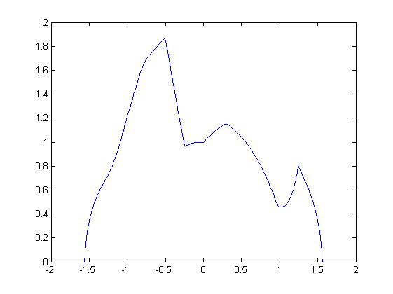
The logic in our model
Crossing agents: Absolute hyperbel functions
Notes:
2 verschiedene Einflüsse auf Gauss-Funktion sichtbar

Slide 11
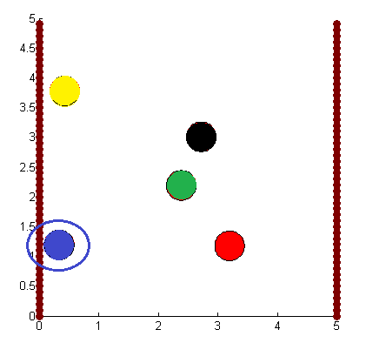
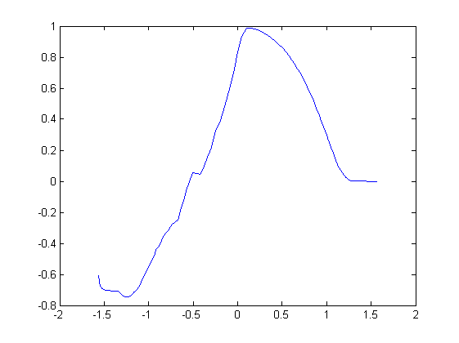
The logic in our model
Wall agents: Box-like function
Notes:
Boxfunktion, damit Agent nicht auf Wandagent läuft

Slide 12
The logic in our model
Following another agent: DISPERSIONFACTOR
→ If > 0: Try to overtake, treated like crossing agent
→ If < 0: Try to follow the other agent, Gaussian
Notes:
Tendency to overtake or to walk behind another agent

Slide 13
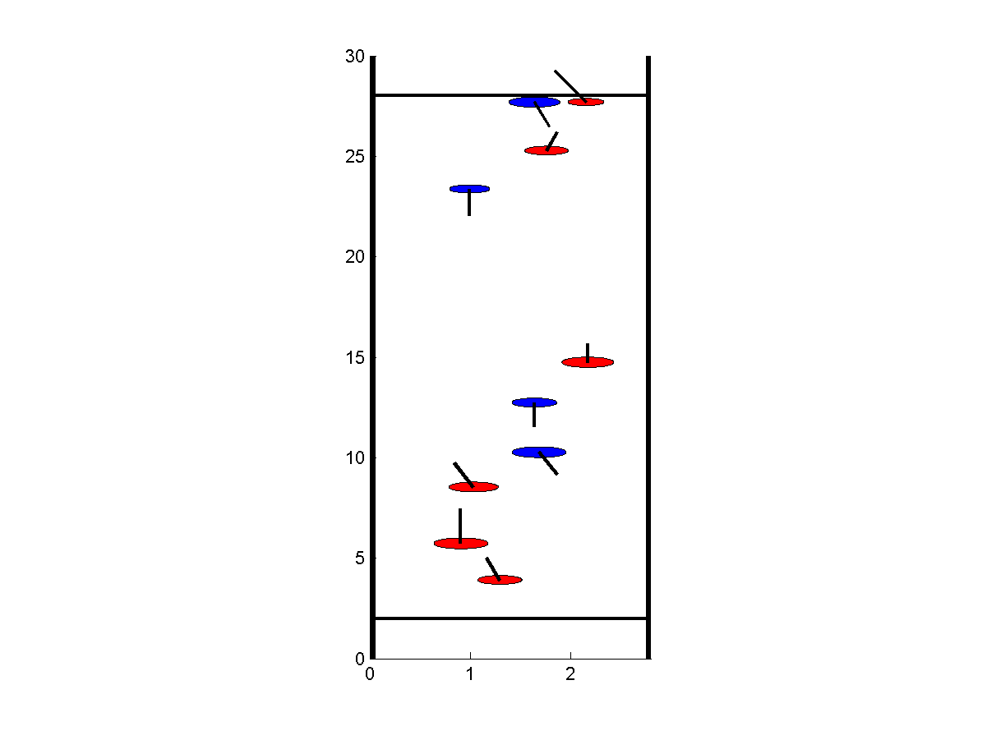

Realisation: Drawing of field & agents
Basic Matlab API
Circles, lines
Despawn lines
Wall agents
Direction indicators
xStretchFactor
Notes:
Ungestrecktes Bild erstellen

Slide 14
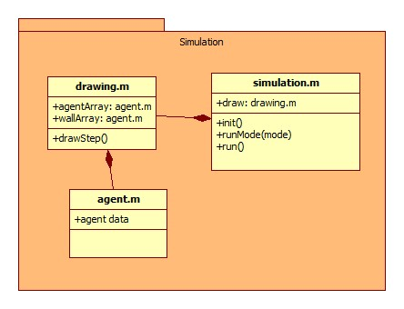
Realisation: Class diagram

Slide 15
Realisation: The main routine
Loop n times.
Steps of one loop:
Iterate trough all agents and calculate the new position
Add new agents to the simulation
Plot the new situation
Evaluate the data and save it if chosen to do so
Repeat…

Slide 16
Result: The Simulation
Seed: 51
One out of the DISPERSIONFACTOR series with 0.7 for DISPERSIONFACTOR
Notes:
Theiler: Simulation mal laufen lassen & kommentieren

Slide 17
Our tests
We did test series about:
Overtaking vs. lane formation
Different pedestrian flux densities
Radius of sight of an agent
Variation of the hallway‘s width
Measurements taken at the main station
Minority vs. majority of agents
Notes:
Mosi: Testreihen zeigen, eine genauer (Gangbreite), Rest nur kurz ansprechen

Slide 18
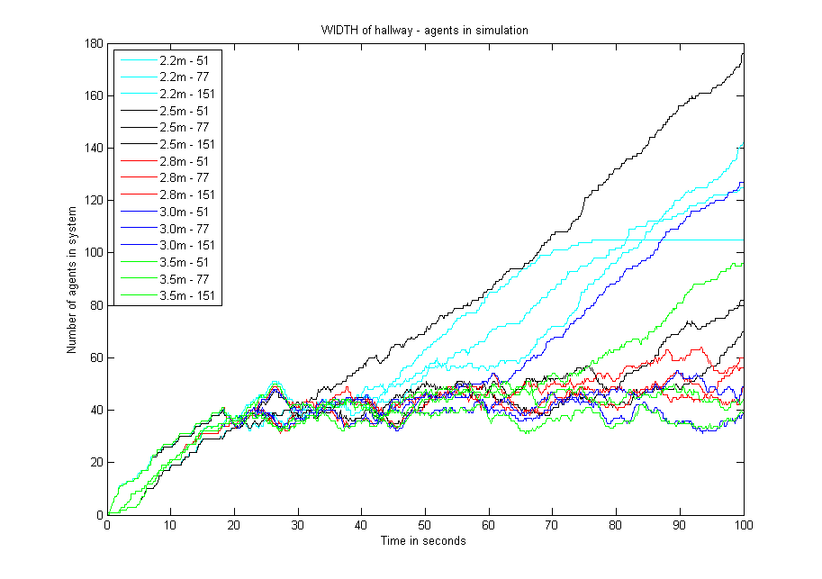
Our tests – width as variable

Slide 19
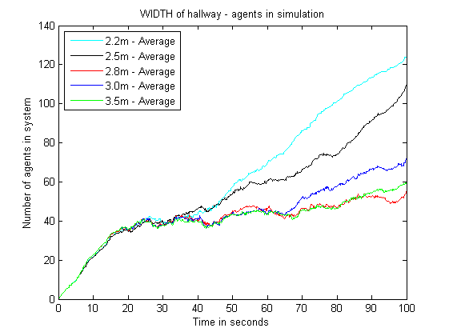
Our tests – width as variable

Slide 20
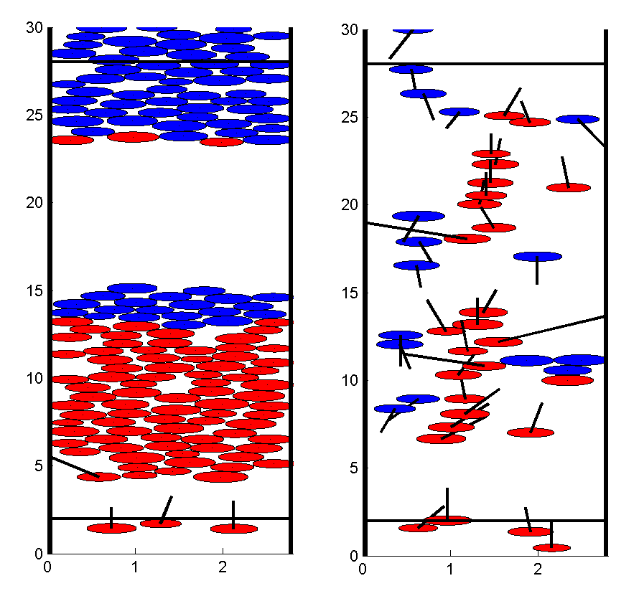
Limitations
Notes:
Yannick – Grenzen=Limitations des Modells aufzeigen (kurz, nur die wichtigsten)

Slide 21
Limitations
The agents can only move forwards, there is no backward communication
Standoff breakup capabilities are very limited
A small clot will (in our model) jam the whole hallway
In reality, groups of people walk together

Slide 22
Limitations
Although obstacle courses can be set, it would be difficult to make spawn zones on the sides
Functions were chosen to meet certain criteria and not from explicit research
The whole set of global parameters is difficult to optimize

Slide 23
Summary
Our model has limitations but…
…we think it runs properly what it’s supposed to do
…it can be expanded quite easily
If we had more time?
Expand vision field of the agents
Move backwards
Improved perfomance
Obstacles and other wall shapes
Groups of agents
Notes:
Theiler: Zusammenfassung: für unsere Situation gutes Modell, obwohls seine Grenzen (limitations) hat

Slide 24
Q&A – Questions?
Feel free to ask any question
Notes:
(alle)

