Slide 1
‘Popple Illusion’
How Gabor patches induce a global tilt
Notes:
In 1908, the British psychologist Sir James Fraser → a line made of small tilted elements appears to be tilted in the same direction of the elements.
This illusion was then modified and recreated using another kind of elements: Gabor patches
Fraser : local orientation of the elements influences the global orientation of the line,
the collinear Gabor patches, being vertical, did not show any local tilt. However, by inducing a phase-shift along the patches, a certain global tilt is created, causing the ‘Popple Illusions’.
They form a set of optical illusions where phase-shifted elements, even though perfectly straightly vertical, produce tilted-looking lines, or circles not looking quite circular.

Slide 2
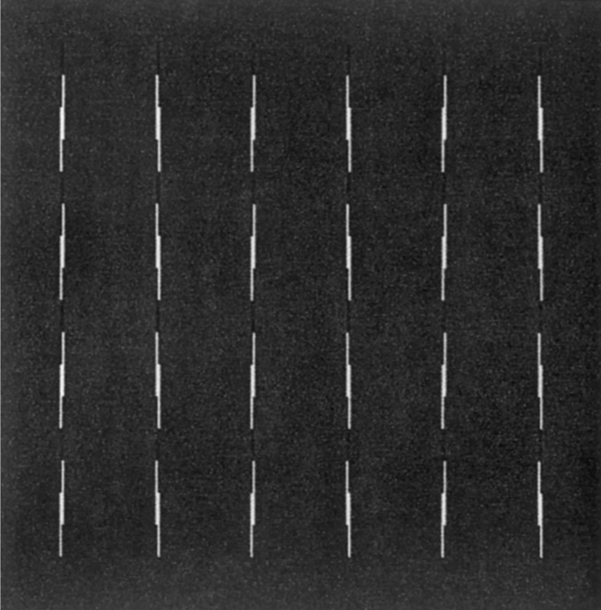
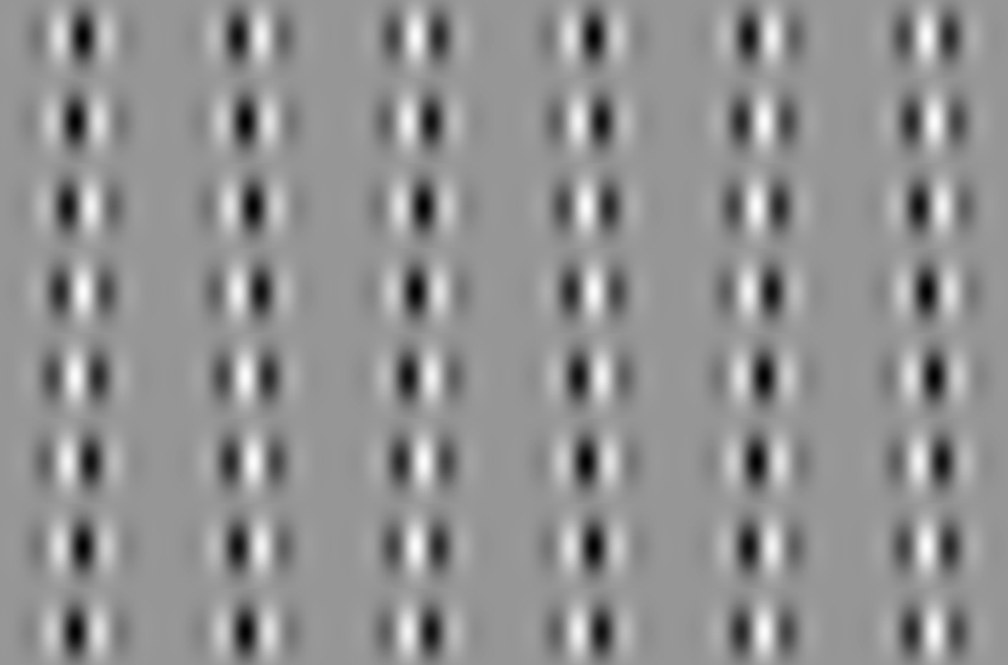
Fraser illusion & Popple Illusion
The Fraser illusion, after Morgan and Moulden (1986)
Popple illusion (lines made of Gabor patches appear tilted)
Notes:
The first paper (Popple, A.V., Sagi, Dove, Vision Research 40, 2000) relates an experiment about lines made of Gabor patches, shifted by a quarter of cycle, leading to the fact that these elements do produce an illusory tilt. In another paper (Popple, A.V, Levi, Dennis M., Vision Research 40, 2000) parameters are varied in order to assess the illusory tilt, measured in degrees.

Slide 3
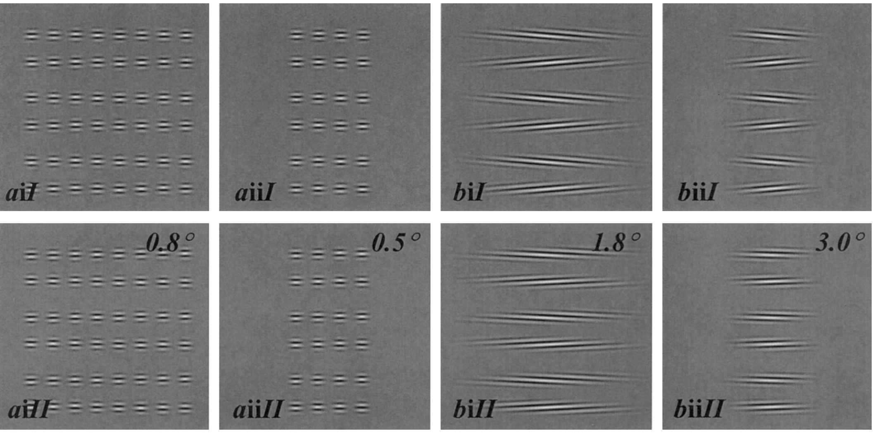
Phase illusion and Fraser illusion : Varying parameters
A new illusion demonstrates long-range processing, Ariella V. Popple *, Dennis M. Levi Vision Research 40 (2000)
Notes:
The chosen parameters are the number of patches in each row (length), as well as their separation
While the former gives rise to an increase in tilt illusion, the latter leads to the opposite.
A possible conclusion is that our visual system can ‘integrate information over large (>10°) strips of the central visual system’.

Slide 4
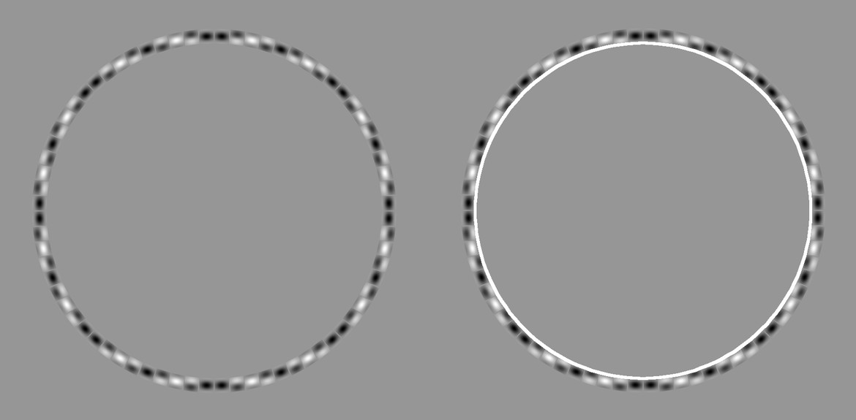

Slide 5
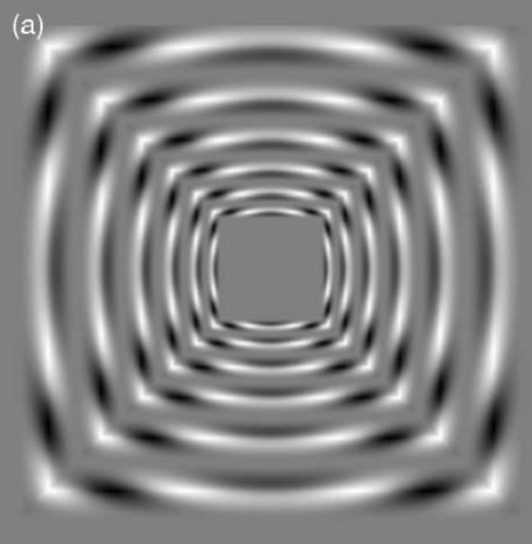
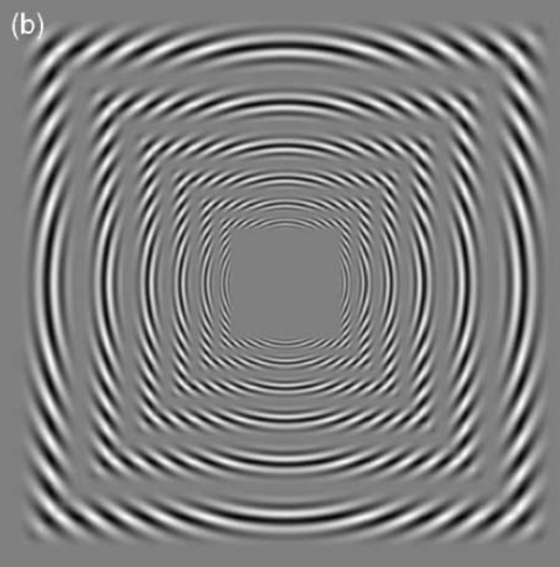
radial carrier grating (low vs high spatial frequency)
The importance of spatial scale in determining illusions of orientation, Jennifer Skillen a,*, David Whitaker a, Ariella V. Popple b, Paul V. McGraw a
Vision Research 42 (2002)
Notes:
A third paper relates a certain interaction between 1st-order processing (namely luminance-defined) and 2nd- (contrast-defined) in orientation processing.
The illusion perceived depends on the relative scale of the carrier (radial on the figure) and the envelope (squares).
When the carrier’s scale is relatively large → the global perception leads to the Fraser illusion,
When it is small, one can see the Zöllner illusion (edges of the squares bowing inwards).

