Slide 1
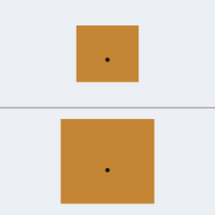
MODULE 1 · IMAGE-BASED VISION TRANSFORMER
Can a ViT read antenna performance from an image?
Vision Transformer-based visual analysis of hybrid-slotted DGS compact patch antennas for 5G and emerging 6G networks
Pre-registered hypotheses
▪ H1 ViT beats the majority baseline
▪ H2 ViT ≥ compact CNN (3 seeds)
▪ H3 Fine-tuning beats a frozen probe
▪ H4 Attention concentrates on patch and feed
▪ H5 Scores drop on unseen shapes (OOD)
Problem, gap and objective
▪ Slots and DGS reshape surface currents: small geometry changes shift resonance and matching
▪ Full-wave sweeps (HFSS) are slow; most ML antenna studies use tables only
▪ Gap: little evidence that standardised images + a ViT can screen performance and explain why
▪ Objective: build and test a reproducible, explainable image classifier for antenna performance
▪ Scope: no public HFSS DGS image set exists and HFSS was unavailable → proof of concept on open simulations
Real model input
Design P1307, class High. Top: true scale. Bottom: zoomed, so the feed dot is resolvable.
Proof of concept on public simulation data (openEMS, RadPat-50K) · Ansys HFSS not run · results not HFSS-validated
1 / 5
Notes:
Module 1 is the image branch of the two-module framework. The question: can a Vision Transformer look at a standardised picture of an antenna and predict how well it is matched, and can it show where it looked? HFSS was not available and no licensed HFSS image dataset of hybrid-slotted DGS antennas exists, so this is a proof of concept on public simulation data. The five hypotheses were committed to Git before any fine-tuned result existed. Reference: Dosovitskiy et al., ICLR 2021.

Slide 2
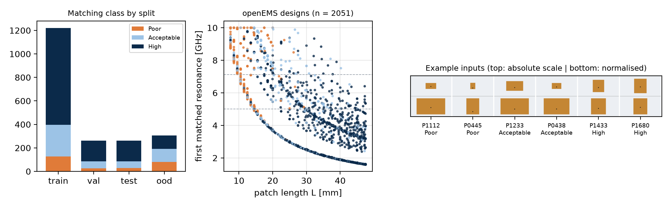
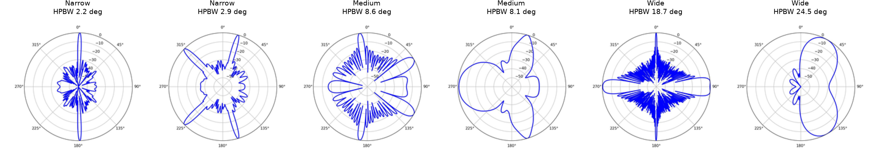
MODULE 1 · IMAGE-BASED VISION TRANSFORMER
Two verified public datasets, one standard image per design
2,051
3,000
70 / 15 / 15
307
openEMS patch designs
Hugging Face · MIT
RadPat-50K polar plots
Zenodo · CC BY 4.0
1,220 · 262 · 262 designs
design-level split, seed 42
OOD hold-out
widest patches, W/L > 1.95
Labels from simulated S11 (frozen before training)
▪ Matching: Poor > −10 dB · Acceptable −20 to −10 dB · High ≤ −20 dB*
▪ Band: first matched resonance < 5 | 5–7.125 | ≥ 7.125 GHz (3GPP)
▪ Beamwidth (RadPat): training-split HPBW terciles
▪ Leakage control: no text or legends, MD5 de-duplication, one image per design
▪ Augmentation (train only): mirror, ±3° rotation, 2% shift
*−20 dB is a project assumption that needs engineering confirmation
Proof of concept on public simulation data (openEMS, RadPat-50K) · Ansys HFSS not run · results not HFSS-validated
2 / 5
Notes:
Datasets were searched in the order the brief sets: Hugging Face, Kaggle, Mendeley, IEEE DataPort, GitHub, plus Zenodo. The openEMS patch sweep gives geometry and full S11 curves; each design is drawn as a two-panel image with fixed colours and no text. RadPat-50K adds a radiation-pattern modality. The tabular Mendeley data were assigned to Module 2. References: LaBash et al. 2025 (arXiv:2505.18188); Bhuma et al. 2025 (doi:10.5281/zenodo.17067881).

Slide 3
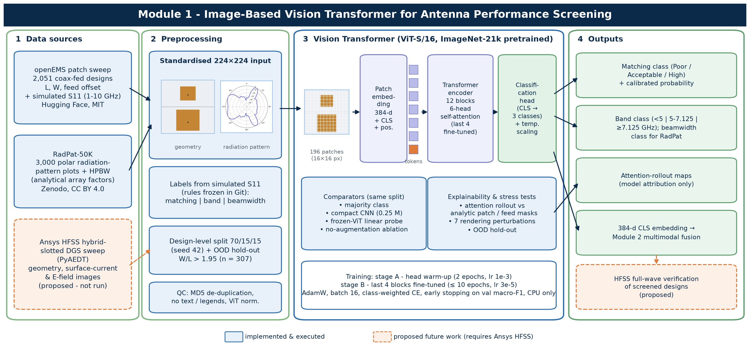
MODULE 1 · IMAGE-BASED VISION TRANSFORMER
ViT-S/16 pipeline with three baselines and explainability
Training recipe
▪ ImageNet-21k pretrained, 196 tokens + CLS
▪ Stage A: head only, 2 epochs
▪ Stage B: last 4 of 12 blocks, lr 3e-5
▪ AdamW, batch 16, early stop on val macro-F1
▪ Temperature-scaled probabilities
▪ CPU only (i7-10610U)
Outputs: matching / band / beamwidth class with calibrated confidence, attention-rollout maps, and a 384-d embedding per design that Module 2 uses for multimodal fusion. Dashed boxes need HFSS.
Proof of concept on public simulation data (openEMS, RadPat-50K) · Ansys HFSS not run · results not HFSS-validated
3 / 5
Notes:
Each 224 by 224 image is cut into 196 patches of 16 by 16 pixels. Self-attention lets the feed dot relate to the patch edges anywhere in the image. Three comparators run on the same split: majority class, a compact CNN with 0.25 million parameters, and a frozen-ViT linear probe. Explainability uses attention rollout (Abnar and Zuidema, 2020), scored against analytic patch and feed masks. Deviations for the CPU budget: 4 of 12 blocks unfrozen, patience 3.

Slide 4
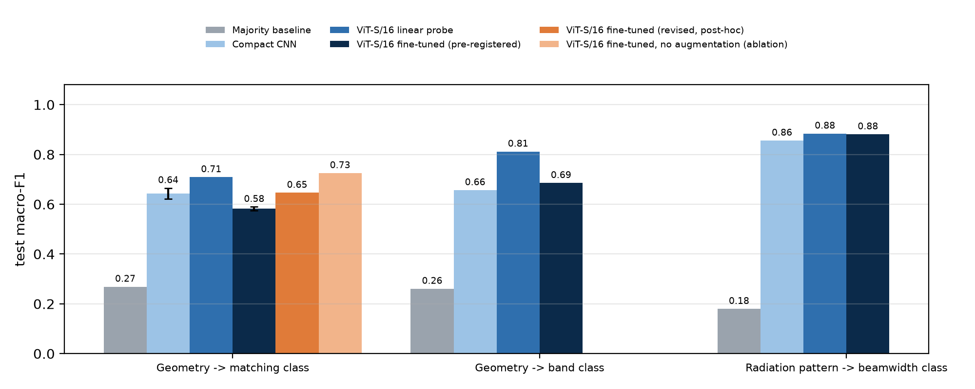
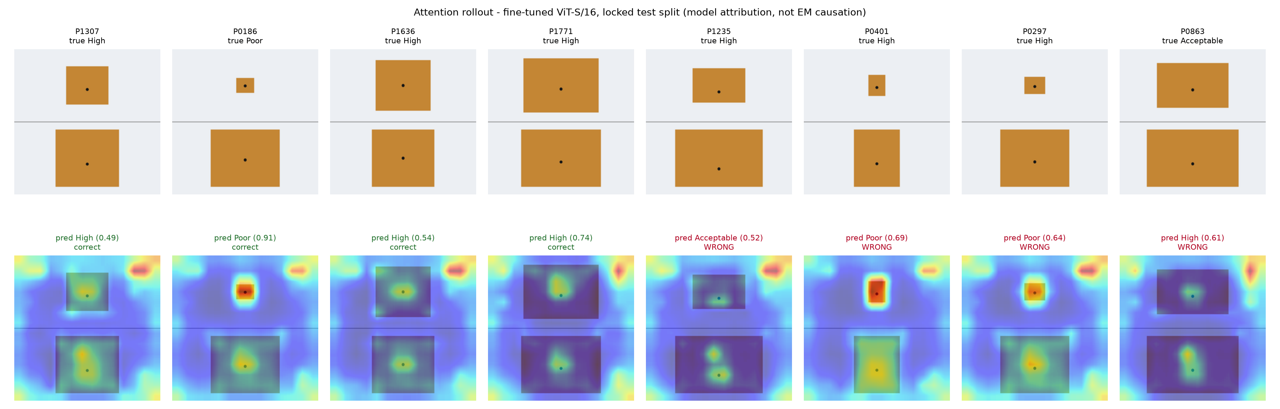
MODULE 1 · IMAGE-BASED VISION TRANSFORMER
All models beat chance; augmentation held the ViT back
Matching class, locked test (n = 262) | Macro-F1 | Bal. acc.
Majority baseline | 0.269 | 0.333
Compact CNN (3 seeds) | 0.643 ± 0.022 | 0.669
ViT-S/16 frozen linear probe | 0.709 | 0.729
ViT-S/16 fine-tuned (3 seeds) | 0.582 ± 0.008 | 0.649
ViT fine-tuned, no augmentation* | 0.725 | 0.737
▪ H1 supported; H2, H3 not: CNN beat the ViT (McNemar p = 0.0009)
▪ Why: ±3° / 2% shifts blur the 1–2 px feed offset; without them 0.58 → 0.73
▪ H4: feed gets ×1.41 its area share, patch ×1.03
▪ H5 not supported: OOD 0.68, confounded by class balance
▪ Other tasks (ViT): band 0.69 (probe 0.81), beamwidth 0.88
*exploratory, one seed · attention maps are model attribution, not EM causation
Proof of concept on public simulation data (openEMS, RadPat-50K) · Ansys HFSS not run · results not HFSS-validated
4 / 5
Notes:
All values come from saved metric files of executed runs. Hypothesis outcomes: H1 Supported: matching 0.582 vs 0.269; band 0.685 vs 0.260; H2 Not supported: 0.582 ± 0.008 vs 0.643 ± 0.022; McNemar p = 0.000912 (seed 42); H3 Not supported: 0.582 vs 0.709; McNemar p = 0.00877; H4 Supported: patch ×1.03, feed halo ×1.41 (patch effect negligible); H5 Not supported: OOD 0.679 ± 0.027 vs test 0.582 ± 0.008 (confounded by class balance). The training curves show underfitting. The ablation planned in the Module 1 report found the cause: the augmentation blurred the feed offset that sets matching. Robustness: blur and grey recolouring hurt most.

Slide 5
MODULE 1 · IMAGE-BASED VISION TRANSFORMER
A working, reproducible image module, ready for HFSS data
Contribution
Limitations
Next: HFSS validation
▪ End-to-end ViT pipeline executed on CPU
▪ Geometry images carry a learnable signal for matching and band class
▪ Attribution measured against known patch and feed regions
▪ Lesson: augmentations must preserve fine physical detail
▪ Plain rectangular patches; no slots or DGS
▪ Simulation only (openEMS, analytical patterns)
▪ −20 dB boundary assumed; CPU-limited tuning
▪ Attention ≠ causation; OOD test confounded
▪ ≥ 1,000 hybrid-slotted DGS designs via PyAEDT
▪ Geometry, current and E-field images at fixed scale
▪ Retrain unchanged; hold out a slot topology
▪ Verify screened designs in full-wave
Deliverables: code, configs, split manifests, 18 passing tests, data and model cards, Word/PDF/LaTeX report, this deck, poster
GitHub: https://github.com/rathiabeth-sudo/901---module-1
Proof of concept on public simulation data (openEMS, RadPat-50K) · Ansys HFSS not run · results not HFSS-validated
5 / 5
Notes:
Module 1 shows the pipeline works end to end, from rendering through training, testing and explaining. It does not show anything yet about hybrid-slotted DGS antennas; that needs the HFSS dataset described in the Module 1 report. The image embeddings feed Module 2's fusion experiment. References: Dosovitskiy et al. (2021); Abnar and Zuidema (2020); Guo et al. (2017); Darcet et al. (2024); 3GPP TS 38.101-1.

