Slide 1
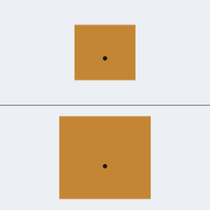
MODULE 1 · IMAGE MODULE
A Vision Transformer for antenna performance screening
Predicting impedance matching and band class from standardised geometry images: the first stage of a hybrid-slotted DGS patch antenna framework for 5G and 6G.
Real model input · design P1307 (High)
Proof of concept on public simulated data · October 2026
Notes:
This deck covers Module 1, the image module. The question: can a Vision Transformer look at a picture of an antenna and tell how well it will perform? Everything was run end to end on a CPU, using public simulated datasets, because Ansys HFSS was not available. The image on the right is an actual model input.

Slide 2
WHAT MODULE 1 ASKS
Can a ViT read antenna performance from a picture?
RQ1
Prediction
Can a standardised geometry image predict an antenna’s performance class?
RQ2
Architecture
Does a pretrained ViT beat a compact CNN under the same design-level split?
RQ3
Modality
Which image type carries most signal: geometry drawings or radiation-pattern plots?
RQ4
Explainability
Does the ViT’s attention fall on physically meaningful regions (patch, feed)?
RQ5
Robustness
How do predictions hold up on unseen shapes and altered images?
Module 1 · Vision Transformer for antenna screening
2 / 13
Notes:
Module 1 turns the broad goal into five research questions. RQ1 is the core: does the image carry enough information? RQ2 and RQ3 compare architectures and image types. RQ4 asks whether the model looks at the right places. RQ5 asks how fragile it is.

Slide 3
DATA
Two public image datasets stand in for HFSS
2,051 patch designs
3,000 polar plots
Rectangular patch antennas · openEMS
RadPat-50K radiation patterns
Source: Hugging Face (LaBash et al., 2025), MIT licence
Coax-fed patch, εr 3.68, h 1.61 mm
Tasks: matching class (main) and band class
Split: 1,220 train / 262 val / 262 test + 307 OOD
Source: Zenodo (Bhuma et al., 2025), CC BY 4.0
Linear-array patterns, sampled from the 10K polar set
Task: beamwidth class (Narrow / Medium / Wide)
Split: 2,100 train / 450 val / 450 test
Scope note No HFSS data was used. The patches have no slots or DGS, so results are a proof of method, not of the target antenna.
Module 1 · Vision Transformer for antenna screening
3 / 13
Notes:
Ansys HFSS was not available, and no public HFSS image dataset of hybrid-slotted DGS antennas exists. So Module 1 uses two public datasets. The main one is 2,051 rectangular patch antennas simulated with openEMS. The second is 3,000 radiation-pattern plots from RadPat-50K. All quality checks passed: no broken curves, duplicates or identical images.

Slide 4
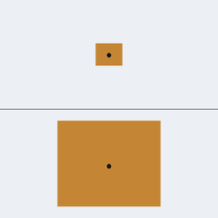
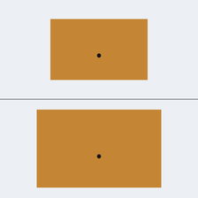
INPUT REPRESENTATION
Every design becomes one standard 224×224 image
1
Top panel · absolute scale
Fixed 1.962 px/mm. Patch size is visible, and size drives the resonant frequency.
2
Bottom panel · zoomed to fill
The same patch, enlarged. The feed position, which drives matching, can be resolved.
Poor
P0186
Acceptable
P0863
High
P1307
3
Anti-aliased rendering
Actual inputs from the test split. Same colours, feed dot and canvas for every design.
Drawn at 4× and downsampled, so a feed shift smaller than a pixel still changes the image.
Module 1 · Vision Transformer for antenna screening
4 / 13
Notes:
Each design is drawn the same way, with no text or axes. The top half is at a fixed scale, so the patch's physical size, which sets the resonant frequency, is visible. The bottom half zooms the patch to fill the panel, so the feed point, which sets matching, can be resolved. Images are drawn at four times the size and shrunk, so sub-pixel feed shifts survive.

Slide 5
LABELS AND SPLIT
Labels come from simulated S11, fixed before training
Matching class (main task)
Poor
S11 above −10 dB
Acceptable
−20 to −10 dB
High
S11 ≤ −20 dB
Lowest S11 over 1–10 GHz
Band class
Below 5 GHz
FR1, covers n77–n79
5 – 7.125 GHz
Upper FR1
7.125 GHz and above
FR3, 6G candidate
First matched resonance
Design-level split, stratified 70 / 15 / 15, seed 42
1,220
262
262
307
train
validation
test (locked)
OOD hold-out, W/L > 1.95
The −20 dB boundary is a project assumption and needs engineering confirmation.
Module 1 · Vision Transformer for antenna screening
5 / 13
Notes:
Labels were frozen in Git before any model was trained. The matching class uses the lowest S11 between 1 and 10 GHz. Minus 10 dB is the standard matched criterion; the minus 20 dB line is a project assumption that needs engineering sign-off. The band class uses the first matched resonance and maps onto 5G FR1 and the FR3 6G candidate band. The widest patches were kept out completely as an out-of-distribution test.

Slide 6
MODELS
Four models, same data, same split
Model | What it is | Trainable params
Majority baseline | Always predicts the most common class | 0
Compact CNN | Small convolutional net, trained from scratch | 0.25 M
ViT linear probe | Frozen pretrained ViT + one linear layer | 1,155
ViT fine-tuned | Head + last 4 of 12 blocks trained | 7.1 M
ViT-S/16 training recipe
Backbone ImageNet-21k pretrained, 16×16 px patches
Stage A 2 epochs, head only, lr 1e-3
Stage B ≤10 epochs, +4 blocks, lr 3e-5
Early stop validation macro-F1, patience 3
Augmentation ±3° rotation, 2% shift
Seeds 42, 43, 44 on the main task
The ViT splits each image into 196 patches of 16×16 px and uses self-attention to relate them. This lets it link the feed dot to the patch edges anywhere in the image.
Module 1 · Vision Transformer for antenna screening
6 / 13
Notes:
Four models were trained on identical splits, all on a 4-core CPU. The majority baseline sets the floor. The compact CNN is the classic alternative. The linear probe keeps the pretrained ViT frozen and trains only a tiny final layer. The fine-tuned ViT trains its head and its last four transformer blocks.

Slide 7
METHOD
Rules were committed before the results
1
Pre-registration
2
Metrics
3
Stress tests
Hypotheses H1–H6 committed before training
Selection on validation macro-F1 only
Test split evaluated once per final model
Macro-F1: the average over 3 classes, so the common class cannot dominate
Balanced accuracy, ROC-AUC, calibration (ECE)
McNemar’s test for paired model differences
Ablation: retrain without augmentation
Attention rollout vs patch and feed areas
OOD hold-out + 6 image perturbations
Amendment 1 · disclosed deviation
The pre-registered ViT underfitted (train accuracy ≈ 0.70, still rising). A revised setting was adopted only if its validation macro-F1 beat both 0.660 and the probe’s 0.702. It reached 0.694, so it was not adopted.
Module 1 · Vision Transformer for antenna screening
7 / 13
Notes:
Hypotheses, labels, thresholds, split and seed were committed to Git before the main results existed. Models were selected on validation scores, and each final model saw the test set once. When the pre-registered ViT underfitted, a revised setting was added under a rule fixed in advance. It did not pass the rule, so the original model stayed the official one.

Slide 8
RESULTS · MAIN TASK
Every model beats guessing; the pre-registered ViT trails
Other tasks (seed 42, macro-F1)
Task | CNN | Probe | ViT FT
Band class | 0.657 | 0.811 | 0.685
Beamwidth (RadPat) | 0.856 | 0.884 | 0.881
The frozen probe also scores highest on both secondary tasks.
Radiation-pattern plots give the highest scores (≈0.88), but they are a different dataset and task, so this is descriptive only.
* Exploratory, single seed, not part of the pre-registered tests.
Module 1 · Vision Transformer for antenna screening
8 / 13
Notes:
On 262 locked test designs, all models beat the majority baseline. The pre-registered fine-tuned ViT scored 0.582, below the CNN at 0.643 and the frozen linear probe at 0.709. The two lighter bars are exploratory: the ViT retrained without augmentation reached 0.725, and an MLP on the fine-tuned ViT's features reached 0.775.

Slide 9
HYPOTHESIS TESTS
One clear yes, one weak yes, three not supported
 | Hypothesis | Verdict | Evidence
H1 | Fine-tuned ViT beats the majority baseline | Supported | 0.582 vs 0.269 (matching); 0.685 vs 0.260 (band)
H2 | Fine-tuned ViT ≥ compact CNN (3 seeds) | Not supported | 0.582 vs 0.643; McNemar 5 vs 23, p = 0.0009
H3 | Fine-tuning beats the frozen linear probe | Not supported | 0.582 vs 0.709; McNemar p = 0.009
H4 | Attention enriched on patch and feed | Supported, weak | Feed 1.41×, patch 1.03× their area share
H5 | Scores drop on unseen wide patches (OOD) | Not supported | OOD 0.679 vs test 0.582; class mix differs
H6 (fusion with numeric features) belongs to the fusion stage: 0.737 fused vs 0.775 image-only, not supported.
Module 1 · Vision Transformer for antenna screening
9 / 13
Notes:
H1 holds. H2 fails: McNemar shows the CNN was right on 23 designs the ViT missed, versus 5 the other way. H3 fails: frozen features beat fine-tuning. H4 holds weakly: attention favours the feed, barely the patch. H5 fails, but the OOD set has a more even class mix, which confounds it.

Slide 10
WHY THE VIT UNDERPERFORMED
Augmentation blurred the detail that decides matching
Matching depends on a feed offset of only 1–2 pixels. ±3° rotation and 2% shift smear exactly that offset.
0.582
0.725
0.775
Pre-registered ViT
Same ViT, no augmentation
MLP on fine-tuned ViT features
with ±3° / 2% augmentation
level with the frozen probe
the features carry the signal
Test macro-F1 on the matching task. The last two results are exploratory (single seed).
Module 1 · Vision Transformer for antenna screening
10 / 13
Notes:
This is the key lesson of Module 1. Matching depends on where the feed sits, an offset of only one or two pixels. Rotating by 3 degrees or shifting by 2 percent smears exactly that detail. Removing augmentation lifted the same ViT from 0.582 to 0.725, level with the probe. An MLP on its features reached 0.775. The representation is good; the end-to-end classifier did not converge on a CPU budget.

Slide 11
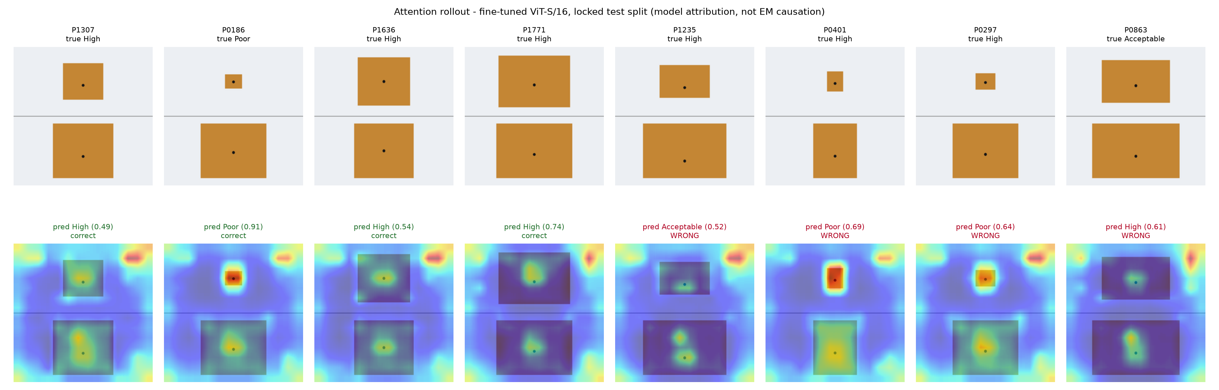
EXPLAINABILITY
Attention favours the feed point, and barely the patch
1.41×
feed attention vs its area share; above 1 for every test design
1.03×
patch attention vs its area share: almost no preference
51%
of attention falls on the top, absolute-scale panel
Module 1 · Vision Transformer for antenna screening
11 / 13
Notes:
Attention rollout shows which parts of the image the ViT relies on. The ratio compares the share of attention in a region with the share of the image that region covers. Above 1 means the model looks there more than chance. Feed: 1.41 times, and above 1 for every test design. Patch: only 1.03 times. Note the bright spots in the top-right background, an artefact the model attends to that has no physical meaning. Attention shows what the model used, not electromagnetic cause.

Slide 12
ROBUSTNESS
Blur and colour changes hurt most
Stable
Shift, rotation, contrast and JPEG: 0.575–0.615, against 0.581 clean.
Fragile
Blur 0.526 and grey colouring 0.521.
Both remove the feed detail or the colour cue the model relies on.
Module 1 · Vision Transformer for antenna screening
12 / 13
Notes:
Each test image was redrawn with one change. Shift, rotation, contrast and JPEG compression barely moved the score. Blur and swapping copper for grey hurt most, because they erase the fine feed detail and the colour cue that separates patch from background.

Slide 13
OUTLOOK
What Module 1 shows, and what it does not yet show
Limitations
Next steps
No HFSS: all results are openEMS or synthetic
Plain coax-fed patches; no slots or DGS
Clean drawings, not noisy solver exports
No surface-current or E-field images
CPU only; short patience; no hyperparameter search
Attention is attribution, not physics
≥1,000 hybrid-slotted DGS designs simulated in HFSS
Geometry, surface-current and E-field images at a fixed camera, colour map and scale
Engineering sign-off on the −20 dB label line
Hold out whole slot topologies and substrates
Retrain without augmentation, or with feed-safe augmentation
Bottom line Module 1 is a working, reproducible image pipeline, ready to be pointed at HFSS data.
Module 1 · Vision Transformer for antenna screening
13 / 13
Notes:
Module 1 proves the pipeline works end to end, from rendering through training, testing and explaining. It does not yet say anything about hybrid-slotted DGS antennas. The next step is real HFSS data: at least a thousand designs with standard geometry, surface-current and E-field images, labels signed off by an engineer, and whole slot topologies held out for testing. Retraining without augmentation is the first modelling change to try.

