Slide 1
MODULE 2 · NUMERICAL-TEXT SURROGATE, FUSION & OPTIMISATION
Can antenna parameters stand in for slow sweeps?
Numerical-text surrogate modelling, multimodal fusion and NSGA-II optimisation for compact patch antennas (5G / 6G)
Hypothesis and criteria
▪ H6 (pre-registered): image + numeric fusion beats image-only
▪ E1 surrogate beats the mean baseline on every target
▪ E2 slot geometry adds to frequency (Mendeley)
▪ E3 NSGA-II finds feasible n78 designs
Problem, gap and objective
▪ Every design iteration of a slotted / DGS patch needs a slow full-wave run (HFSS)
▪ A fast surrogate can screen thousands of candidates, if its errors are known
▪ Gap: surrogates rarely report out-of-range behaviour, or explain outputs in plain text
▪ Objective: predict resonance, S11, bandwidth, gain and efficiency; summarise them; fuse with ViT features; optimise for n78
▪ Scope: HFSS unavailable → proof of concept on open simulations
Real generated summary
“Predicted first matched resonance 3.57 GHz, inside 5G NR n78 … Simulated reference 3.54 GHz … requires full-wave verification.”
Proof of concept on public simulation data (openEMS, Mendeley) · Ansys HFSS not run · proposals not simulated
1 / 5
Notes:
Module 2 is the numerical-text branch of the framework. It replaces the slow simulator by a fast surrogate for screening, writes short engineering summaries that only restate computed numbers, tests whether numbers add to Module 1's image features, and uses the surrogate in an NSGA-II search for the 5G n78 band. H6 was pre-registered with the Module 1 hypotheses; E1 to E3 are evaluation criteria from the analysis plan.

Slide 2
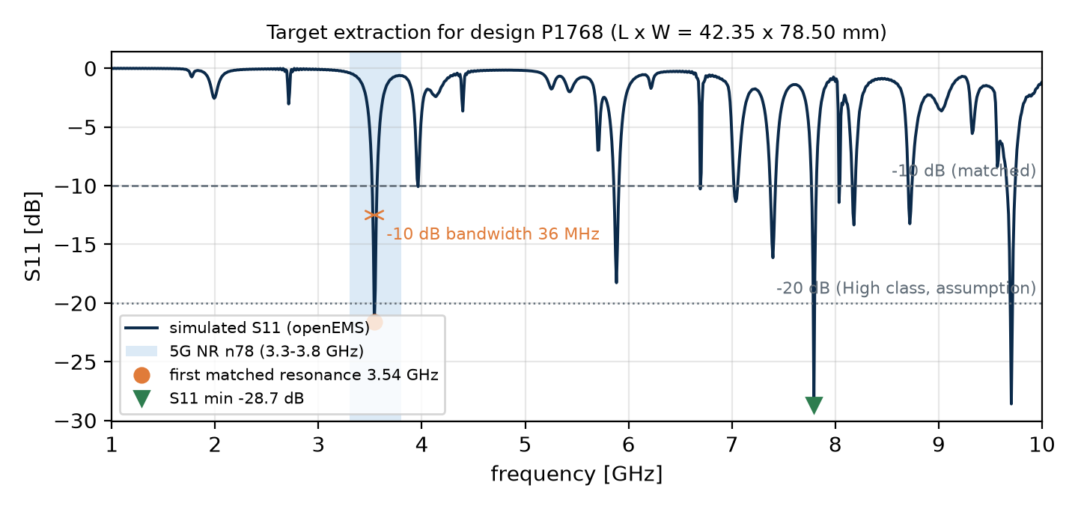
MODULE 2 · NUMERICAL-TEXT SURROGATE, FUSION & OPTIMISATION
Two simulation datasets, targets extracted from S11
2,051
103 × 16
245
70 / 15 / 15
openEMS patch designs
Hugging Face · MIT
dual-slot designs × frequencies
Mendeley v2 · CC BY 4.0
implausible solver rows
flagged by a fixed rule
1,220 · 262 · 262 + 307 OOD
split shared with Module 1
Preparation
▪ Targets: first matched resonance, S11 min, S11 at resonance, −10 dB bandwidth
▪ Mendeley: S11, gain, radiation efficiency at 16 frequencies
▪ Cleaning: efficiency > 1, gain > directivity, D > 20 dBi → excluded from gain / efficiency
▪ Leakage control: locked manifests; GroupKFold keeps a design's frequencies together
Proof of concept on public simulation data (openEMS, Mendeley) · Ansys HFSS not run · proposals not simulated
2 / 5
Notes:
The patch data give full S11 curves, which are reduced to four targets. The first matched resonance is used because the deepest dip is often a higher-order mode, as in this example. The Mendeley dataset adds slots, substrate and gain and efficiency outputs, but 245 rows are physically impossible and were flagged by a documented rule. References: LaBash et al. 2025 (arXiv:2505.18188); Mihad, Islam and Sojib 2024 (doi:10.17632/3gxr2vvd9n.2).

Slide 3
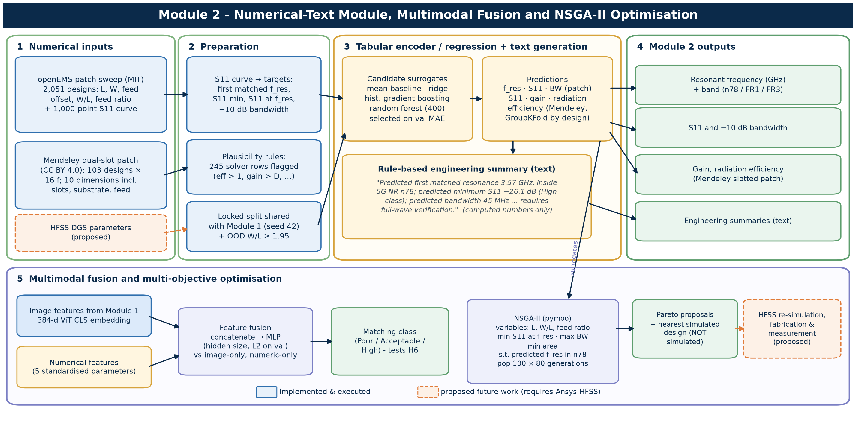
MODULE 2 · NUMERICAL-TEXT SURROGATE, FUSION & OPTIMISATION
Surrogate, text, fusion and NSGA-II in one pipeline
Key settings
▪ Random forest (400 trees) vs ridge vs gradient boosting
▪ Selected on validation MAE
▪ Template text: numbers only, never invented
▪ Fusion MLP: 384-d ViT + 5 numeric
▪ NSGA-II: 100 × 80 gen, 3 objectives
Input from Module 1: only the 384-d embedding per design (with SHA-256 provenance). Dashed boxes need HFSS.
Proof of concept on public simulation data (openEMS, Mendeley) · Ansys HFSS not run · proposals not simulated
3 / 5
Notes:
Four candidate regressors are compared per target and the best on validation MAE is kept. A deterministic template turns predictions into a paragraph, so it cannot invent numbers. Fusion concatenates the ViT embedding from Module 1 with five numeric features. NSGA-II (Deb et al. 2002, pymoo) minimises predicted S11 and area and maximises bandwidth with the predicted resonance constrained to n78.

Slide 4
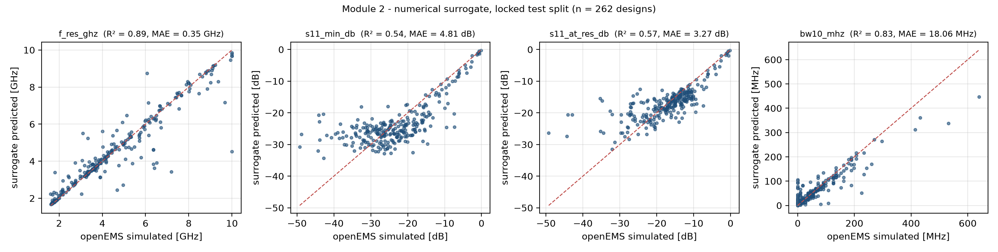
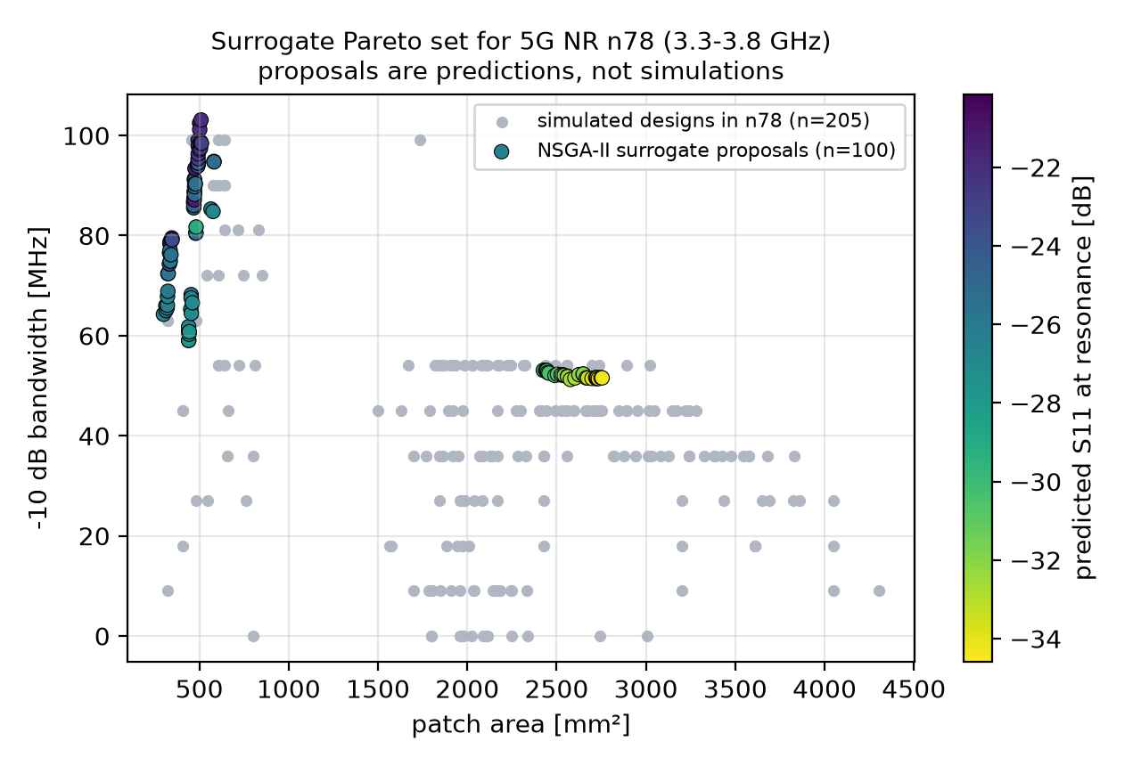
MODULE 2 · NUMERICAL-TEXT SURROGATE, FUSION & OPTIMISATION
Resonance is easy, matching depth is hard
Target (random forest) | Test R² | OOD R²
First matched resonance (GHz) | 0.89 | 0.44
Minimum S11 (dB) | 0.54 | 0.13
S11 at resonance (dB) | 0.57 | -1.54
−10 dB bandwidth (MHz) | 0.83 | -3.72
Mendeley S11 (grouped CV) | 0.86 | –
Mendeley Gain (grouped CV) | 0.99 | –
Mendeley Radiation efficiency (grouped CV) | 0.97 | –
▪ E1, E2 met: geometry halves the frequency-only error
▪ H6 not supported: fusion 0.737 < image-only 0.775 (numeric 0.716)
▪ E3 met: 100 n78 proposals, 299–2754 mm², not simulated
▪ Caveat: surrogates fail outside the training range (OOD)
Proof of concept on public simulation data (openEMS, Mendeley) · Ansys HFSS not run · proposals not simulated
4 / 5
Notes:
All values come from saved metric files. Outcomes: E1 Met: all four targets; weakest s11_min_db (4.81 vs 7.36); E2 Met: S11_dB 0.533 vs 1.089; Gain 0.513 vs 1.096; Rad_eff 0.026 vs 0.047; H6 Not supported: 0.737 vs 0.775 (numeric-only 0.716); E3 Met: 100 proposals, median distance to nearest simulated design 0.08 SD (surrogate only, not simulated). Resonance follows patch length smoothly; matching depth depends sharply on feed impedance, so it is predicted only moderately. On the wider OOD patches the surrogates break down, which is why NSGA-II is bounded to the training ranges. The image-only MLP (0.775) beats Module 1's own ViT head (0.581).

Slide 5
MODULE 2 · NUMERICAL-TEXT SURROGATE, FUSION & OPTIMISATION
A traceable surrogate pipeline, ready for HFSS data
Contribution
Limitations
Next: HFSS validation
▪ Executed surrogate, text, fusion and NSGA-II pipeline
▪ Every summary number traceable to a model or simulation
▪ OOD test exposes where surrogates cannot be trusted
▪ Embeddings show Module 1's features are strong
▪ No slots / DGS in the patch data; Mendeley is one-at-a-time
▪ Simulation only; no HFSS, no measurement
▪ Matching-depth R² only about 0.5
▪ Proposals unverified and close to existing designs
▪ Space-filling DGS sweep via PyAEDT
▪ Uncertainty-aware surrogate for NSGA-II
▪ Re-simulate proposals; active learning
▪ Fabricate and measure a shortlist
Deliverables: code, configs, 10 passing tests, data and model cards, Word/PDF/LaTeX report, this deck, poster
GitHub: https://github.com/rathiabeth/module2-numerical-surrogate-antenna-design
Proof of concept on public simulation data (openEMS, Mendeley) · Ansys HFSS not run · proposals not simulated
5 / 5
Notes:
Module 2 shows that parameter-based surrogates are fast and accurate for resonance and bandwidth, weaker for matching depth, and unreliable outside their training range. The optimised designs are hypotheses for full-wave verification. References: Breiman (2001) random forests; Deb et al. (2002) NSGA-II; Blank and Deb (2020) pymoo; 3GPP TS 38.101-1.

