Slide 1
MODULE 2 · EXTENDED
Fast, explainable antenna screening with AI
Module 2 - Numerical-Text Surrogate Modelling, Multimodal Fusion and NSGA-II Optimisation of Compact Patch Antennas for 5G and Emerging 6G Networks (extended presentation)
2,051
103 × 16
R² 0.89
100
simulated patch designs
slotted designs × frequencies
resonance prediction (test)
AI design proposals for 5G n78
Ms. Rathi Devadhas
Student ID 1737089 · Master of Applied Artificial Intelligence · 28 October 2026
https://github.com/rathiabeth-sudo/902---Module-2
Simulation evidence only (openEMS, Mendeley) · Ansys HFSS not run · AI proposals are not simulated
1 / 21
Notes:
This extended deck explains Module 2 from first principles: what antennas and slot / DGS antennas are, why AI helps, which inputs the models use, the stage-by-stage pipeline, every executed output, and what it means for engineers. All numbers come from the executed runs in the GitHub repository.

Slide 2
OVERVIEW · MODULE 2 · EXTENDED
Agenda
Note
The deck moves from physics to data to AI to engineering value.
Yellow bubbles like this one carry the presenter's explanation for each slide; the same text is in the speaker notes.
Every number shown later is read from the executed results, not typed by hand.
1
Antenna basics
2
Why AI for antenna design
antenna, slot antenna, hybrid-slotted DGS antenna
conventional loop vs AI-assisted screening
3
Pipeline stages
4
Inputs and features
acquisition → cleaning → vectorisation → training → text
what the AI sees, and why each parameter matters
5
Outputs
6
Value for engineers
surrogate accuracy, text summaries, fusion, NSGA-II designs
benefits, limits and the path to HFSS validation
Simulation evidence only (openEMS, Mendeley) · Ansys HFSS not run · AI proposals are not simulated
2 / 21
Notes:
The deck moves from physics to data to AI to engineering value. Yellow bubbles like this one carry the presenter's explanation for each slide; the same text is in the speaker notes. Every number shown later is read from the executed results, not typed by hand.

Slide 3
1 · ANTENNA BASICS · MODULE 2 · EXTENDED
What is an antenna, and how is it judged?
Definition
Note
Engineers judge an antenna by where it resonates, how well it is matched (S11), how wide its usable band is, and how much power it radiates (gain, efficiency).
These same quantities are what Module 2's AI learns to predict from the design dimensions.
−10 dB S11 is the standard matching criterion; the −20 dB 'High' class is a project assumption.
An antenna converts guided electrical signals into radiated electromagnetic waves (and back). A microstrip patch antenna is a flat copper patch on a dielectric substrate above a ground plane - cheap, thin and easy to print on a PCB.
Performance term | What it means | Used in this project as
Resonant frequency f_res | frequency where the antenna is matched and radiates best | regression target (GHz)
S11 / return loss | share of power reflected back; lower dB = better match | target (dB) + class label
−10 dB bandwidth | frequency range with S11 < −10 dB (VSWR ≈ 1.9) | regression target (MHz)
Gain | radiated power in the best direction vs an isotropic source | target (dBi), Mendeley
Radiation efficiency | radiated power / accepted power (0–1) | target, Mendeley
Band (5G / 6G) | n78 3.3–3.8 GHz; FR1 ≤ 7.125 GHz; FR3 above | label and NSGA-II constraint
Simulation evidence only (openEMS, Mendeley) · Ansys HFSS not run · AI proposals are not simulated
3 / 21
Notes:
Engineers judge an antenna by where it resonates, how well it is matched (S11), how wide its usable band is, and how much power it radiates (gain, efficiency). These same quantities are what Module 2's AI learns to predict from the design dimensions. −10 dB S11 is the standard matching criterion; the −20 dB 'High' class is a project assumption.

Slide 4
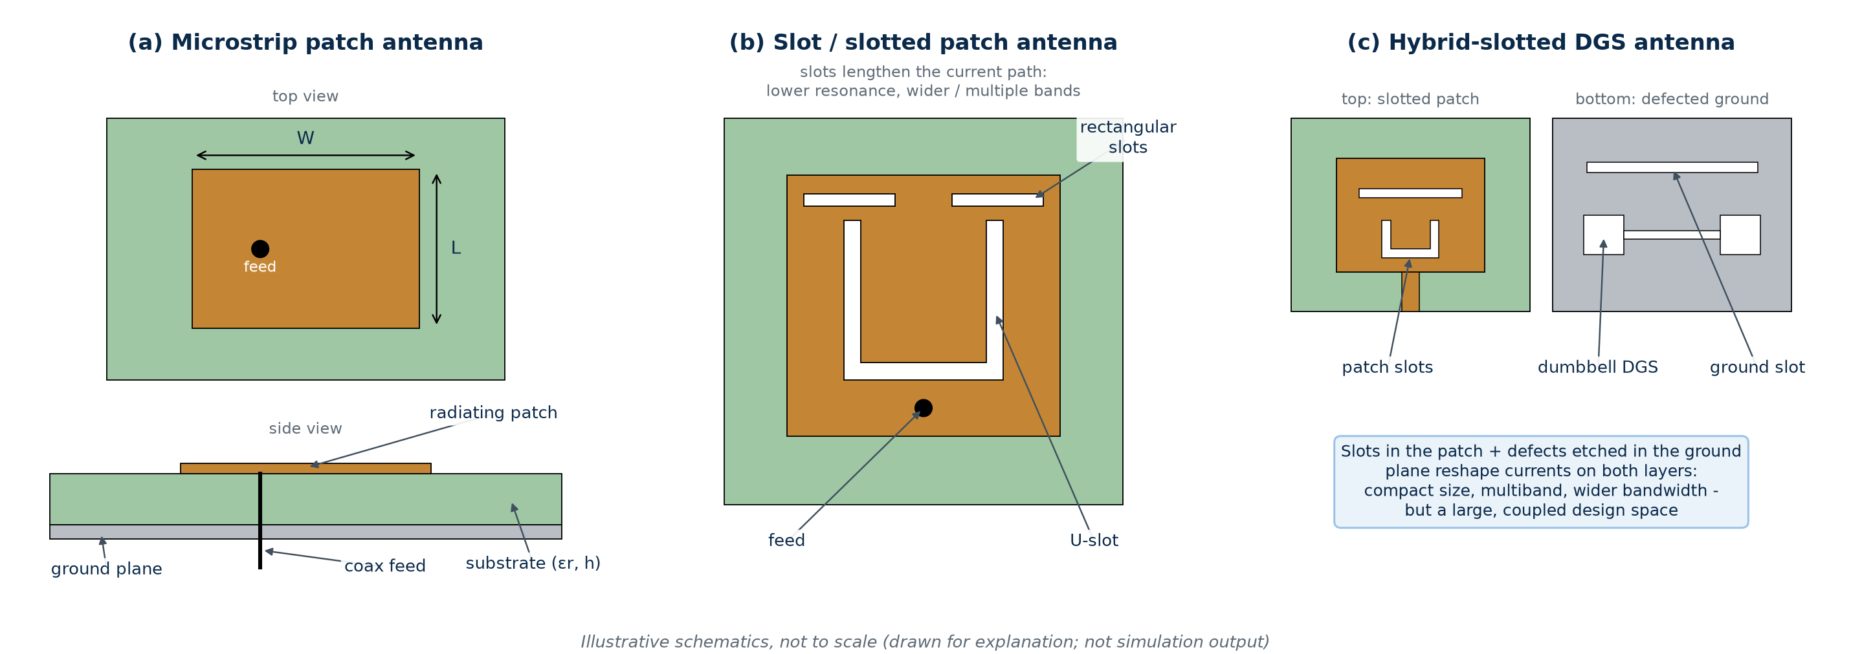
1 · ANTENNA BASICS · MODULE 2 · EXTENDED
Slot antennas and hybrid-slotted DGS antennas
Note
A plain patch has three main dimensions; a hybrid-slotted DGS antenna has dozens (slot lengths, widths, offsets, DGS shape).
Every extra dimension multiplies the number of full-wave simulations needed to explore the design.
That combinatorial growth is exactly where a fast AI surrogate earns its place.
The target topology here is hybrid-slotted DGS; the executed prototype uses public patch and dual-slot data.
Slot antenna
Defected ground (DGS)
Hybrid-slotted DGS
Slots cut in the patch (or a slot as the radiator) lengthen the current path: lower resonance for the same size, and extra or wider bands.
Shapes etched into the ground plane (dumbbell, slot) change the ground current: better matching, filtering, smaller size.
Both together - slotted patch plus DGS. Very compact and multiband, but dozens of coupled dimensions to tune.
Simulation evidence only (openEMS, Mendeley) · Ansys HFSS not run · AI proposals are not simulated
4 / 21
Notes:
A plain patch has three main dimensions; a hybrid-slotted DGS antenna has dozens (slot lengths, widths, offsets, DGS shape). Every extra dimension multiplies the number of full-wave simulations needed to explore the design. That combinatorial growth is exactly where a fast AI surrogate earns its place. The target topology here is hybrid-slotted DGS; the executed prototype uses public patch and dual-slot data.

Slide 5
2 · WHY AI · MODULE 2 · EXTENDED
Why AI helps: from slow loops to fast screening
Conventional design loop
Note
The AI does not replace the solver: it learns from solver results, then screens new candidates almost instantly.
Speeds on this slide were measured on the project laptop (src/timing.py).
Only the short-listed designs go back to full-wave simulation, so fewer expensive runs are needed.
The orange step is required: AI proposals are hypotheses until simulated and measured.
Pick sizes
Full-wave run
Read S11
Tweak
Repeat
Each candidate typically costs minutes to hours of solver time; sweeps grow exponentially with the number of dimensions.
AI-assisted loop (Module 2)
Simulate once
Train
Screen 1000s
NSGA-II
HFSS check
0.7 s
≈3 ms
0.8 s
to predict all 4 outputs for 262 test designs
per design in a batch (measured, laptop CPU)
to train one 400-tree random forest
Simulation evidence only (openEMS, Mendeley) · Ansys HFSS not run · AI proposals are not simulated
5 / 21
Notes:
The AI does not replace the solver: it learns from solver results, then screens new candidates almost instantly. Speeds on this slide were measured on the project laptop (src/timing.py). Only the short-listed designs go back to full-wave simulation, so fewer expensive runs are needed. The orange step is required: AI proposals are hypotheses until simulated and measured.

Slide 6
3 · PIPELINE · MODULE 2 · EXTENDED
The Module 2 pipeline: seven stages
1 Acquisition
2 Cleaning
3 Vectorisation
4 Training
Note
The work is a fixed sequence of stages, each a script in the repository, so anyone can rerun it end to end.
Stages 1-5 are classic supervised machine learning on tabular data.
Stage 6 is where text enters: the AI's numbers are turned into readable engineering sentences.
Stage 7 links to Module 1 (image features) and searches for new designs.
5 Evaluation
6 Text generation
7 Fusion & NSGA-II
Stage | Code | Main output
1-2 Acquisition, cleaning | src/download_data.py, src/preprocessing.py | clean tables, targets, locked split
3-5 Features, training, evaluation | src/numerical_model.py | surrogates, metrics, parity plots
6 Text generation | src/numerical_model.py, src/fusion_optimization.py | engineering summaries (.md)
7 Fusion & NSGA-II | src/fusion_optimization.py | fusion metrics, Pareto proposals
Simulation evidence only (openEMS, Mendeley) · Ansys HFSS not run · AI proposals are not simulated
6 / 21
Notes:
The work is a fixed sequence of stages, each a script in the repository, so anyone can rerun it end to end. Stages 1-5 are classic supervised machine learning on tabular data. Stage 6 is where text enters: the AI's numbers are turned into readable engineering sentences. Stage 7 links to Module 1 (image features) and searches for new designs.

Slide 7
3 · PIPELINE · MODULE 2 · EXTENDED
How the classic text-AI stages map onto this project
Text-AI stage | Used? | What Module 2 does
1 Data acquisition | Yes | Downloads two public simulation datasets with pinned versions and SHA-256 checks
2 Text cleaning & noise removal | Adapted | Cleans numeric data: names, types, a corrupt entry, solver artefacts, 245 impossible rows
3 Linguistic & semantic analysis | Output side | No text is read as input. Semantic rules map numbers to meaning (band, match class) when writing text
4 Vectorisation | Yes (numeric) | Design parameters → standardised feature vectors; images → 384-d ViT vectors (from Module 1)
5 Model building & training | Yes | Random forest, gradient boosting, ridge, MLP; NSGA-II search on the trained surrogates
Text generation | Yes | Data-to-text templates write one summary per design; no language model, no invented values
Note
Module 2 is a numerical-text module: its inputs are numbers and its text is an output.
So linguistic analysis of input text (tokenising, parsing, sentiment) is not used - there is no input text to analyse.
The 'semantic' step happens when writing: rules decide what a number means for an engineer (in n78? matched?).
Vectorisation is numeric: each design becomes a vector the models can learn from.
Simulation evidence only (openEMS, Mendeley) · Ansys HFSS not run · AI proposals are not simulated
7 / 21
Notes:
Module 2 is a numerical-text module: its inputs are numbers and its text is an output. So linguistic analysis of input text (tokenising, parsing, sentiment) is not used - there is no input text to analyse. The 'semantic' step happens when writing: rules decide what a number means for an engineer (in n78? matched?). Vectorisation is numeric: each design becomes a vector the models can learn from.

Slide 8
3 · PIPELINE · MODULE 2 · EXTENDED
Stage 1 - Data acquisition
openEMS patch sweep
Mendeley dual-slot patch
Note
No public HFSS dataset of hybrid-slotted DGS antennas exists, so two verified public simulation datasets stand in.
The patch sweep gives full S11 curves; the Mendeley set adds slots, gain and efficiency.
Raw files are re-downloaded by script with checksums, so the data trail is reproducible.
Module 2 uses the same locked split as Module 1, so test results refer to the same designs.
2,051 coax-fed rectangular patches (Hugging Face, MIT, rev 4be72a2). Inputs: L, W, feed offset. Output: a 1,000-point S11 curve from 1 to 10 GHz per design (full-wave FDTD).
103 slotted designs × 16 frequencies, 1–50 GHz (Mendeley Data v2, CC BY 4.0). Inputs: 10 dimensions incl. two slots. Outputs: S11, gain, directivity, efficiency, VSWR.
Module 1 image embeddings
Locked split (shared)
384-d ViT vector per patch design, exported by Module 1; SHA-256 hashes recorded in provenance.json.
1,220 train · 262 validation · 262 test · 307 out-of-distribution (W/L > 1.95), seed 42.
Simulation evidence only (openEMS, Mendeley) · Ansys HFSS not run · AI proposals are not simulated
8 / 21
Notes:
No public HFSS dataset of hybrid-slotted DGS antennas exists, so two verified public simulation datasets stand in. The patch sweep gives full S11 curves; the Mendeley set adds slots, gain and efficiency. Raw files are re-downloaded by script with checksums, so the data trail is reproducible. Module 2 uses the same locked split as Module 1, so test results refer to the same designs.

Slide 9
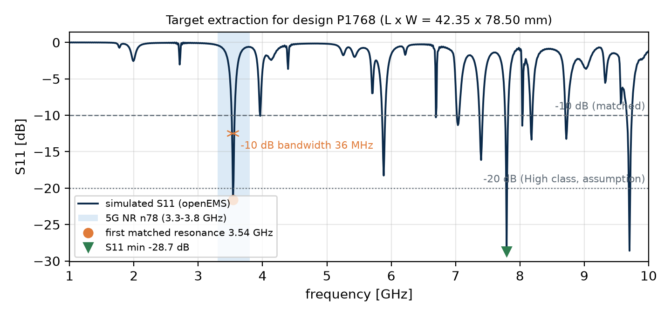
3 · PIPELINE · MODULE 2 · EXTENDED
Stage 2 - Cleaning and noise removal
▪ Column names and types: stripped, renamed, cast to numbers
▪ Corrupt entry: 1 truncated efficiency value set to missing
▪ Solver artefacts: 1,170 curves rise ≤ 0.2 dB above 0 dB - documented, kept
▪ Physically impossible rows: 245 of 1,648 (efficiency > 1, gain > directivity, D > 20 dBi) removed from gain / efficiency
▪ Duplicates / missing: 0 duplicate designs, 0 missing values
▪ Curve → targets: the noisy S11 curve is reduced to 4 robust numbers
Note
For numeric data, 'noise removal' means finding values that cannot be physical and handling them by a fixed, documented rule.
Rows are flagged rather than silently deleted, so the decision can be audited.
Reducing each 1,000-point curve to four engineering targets removes ripple and keeps what engineers care about.
The first matched resonance is used, not the deepest dip: the deepest dip (here near 7.8 GHz) is often a higher-order mode.
Simulation evidence only (openEMS, Mendeley) · Ansys HFSS not run · AI proposals are not simulated
9 / 21
Notes:
For numeric data, 'noise removal' means finding values that cannot be physical and handling them by a fixed, documented rule. Rows are flagged rather than silently deleted, so the decision can be audited. Reducing each 1,000-point curve to four engineering targets removes ripple and keeps what engineers care about.

Slide 10
4 · FEATURES · MODULE 2 · EXTENDED
Inputs: the features the AI learns from
Feature (input) | Unit | Why it matters physically
Patch length L | mm | sets the half-wavelength resonance → main driver of f_res
Patch width W | mm | changes radiation resistance, bandwidth and gain
Feed offset (from centre) | mm | sets input impedance → controls the S11 match
Aspect ratio W/L | - | captures shape effects; defines the OOD hold-out
Normalised feed position | 0–1 | feed offset relative to L/2: centre (0) to edge (1)
Slot 1 / slot 2 width & length | mm | slotted antenna: lengthen current paths, add bands
Substrate W, L, h; feed width | mm | dielectric volume and feed-line impedance
Frequency | GHz | Mendeley outputs are given at 16 frequencies
ViT image embedding (fusion only) | 384-d | learned picture of the geometry from Module 1
Note
These are the features in the machine-learning sense: the numbers the model receives.
Patch models use 5 inputs; the slotted (Mendeley) models use 10 dimensions plus frequency.
Engineered ratios (W/L, feed ratio) encode physics the trees would otherwise have to discover.
The image embedding is used only in the fusion experiment.
Simulation evidence only (openEMS, Mendeley) · Ansys HFSS not run · AI proposals are not simulated
10 / 21
Notes:
These are the features in the machine-learning sense: the numbers the model receives. Patch models use 5 inputs; the slotted (Mendeley) models use 10 dimensions plus frequency. Engineered ratios (W/L, feed ratio) encode physics the trees would otherwise have to discover. The image embedding is used only in the fusion experiment.

Slide 11
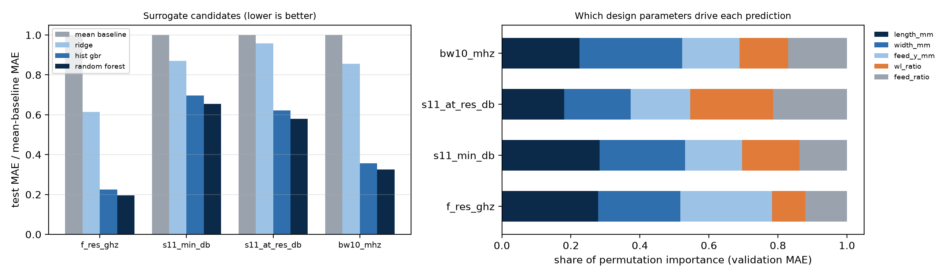
3 · PIPELINE · MODULE 2 · EXTENDED
Stage 3 - Feature engineering and vectorisation
Design record
Features
Scaled x ∈ R⁵
Model
Note
Vectorisation turns each design into a fixed-length list of numbers.
Linear models and the MLP need standardised inputs (mean 0, SD 1, fitted on training data only); trees do not.
For fusion, the 384 image numbers and 5 design numbers are joined into one 389-number vector.
Right chart: permutation importance - every input matters, length most for resonance.
Image (Module 1)
ViT-S/16
e ∈ R³⁸⁴
[e, x] ∈ R³⁸⁹
Simulation evidence only (openEMS, Mendeley) · Ansys HFSS not run · AI proposals are not simulated
11 / 21
Notes:
Vectorisation turns each design into a fixed-length list of numbers. Linear models and the MLP need standardised inputs (mean 0, SD 1, fitted on training data only); trees do not. For fusion, the 384 image numbers and 5 design numbers are joined into one 389-number vector. Right chart: permutation importance - every input matters, length most for resonance.

Slide 12
3 · PIPELINE · MODULE 2 · EXTENDED
Stage 4 - Model building and training
Random forest (selected)
Gradient boosting
Note
Several model families compete; the one with the lowest validation error wins - here the random forest for every target.
The test split is used once, after the choice, so the reported accuracy is not tuned to it.
GroupKFold keeps all 16 frequencies of a Mendeley design in the same fold, preventing leakage.
NSGA-II is not trained: it searches using the trained surrogates.
400 decision trees on bootstrap samples; prediction = average. Captures non-linear, interacting effects; robust on small data.
Trees added one at a time, each fixing the previous errors (500 rounds, lr 0.05).
Ridge regression
MLP (fusion)
Linear baseline with L2 penalty - shows how non-linear the physics is.
Small neural network on the 389-d fusion vector; size and L2 chosen on validation.
NSGA-II (search)
Training protocol
Evolutionary multi-objective optimiser; uses the trained forests as a fast simulator.
Fit on train only · choose the model on validation MAE · score the test split once · GroupKFold for Mendeley.
Simulation evidence only (openEMS, Mendeley) · Ansys HFSS not run · AI proposals are not simulated
12 / 21
Notes:
Several model families compete; the one with the lowest validation error wins - here the random forest for every target. The test split is used once, after the choice, so the reported accuracy is not tuned to it. GroupKFold keeps all 16 frequencies of a Mendeley design in the same fold, preventing leakage. NSGA-II is not trained: it searches using the trained surrogates.

Slide 13
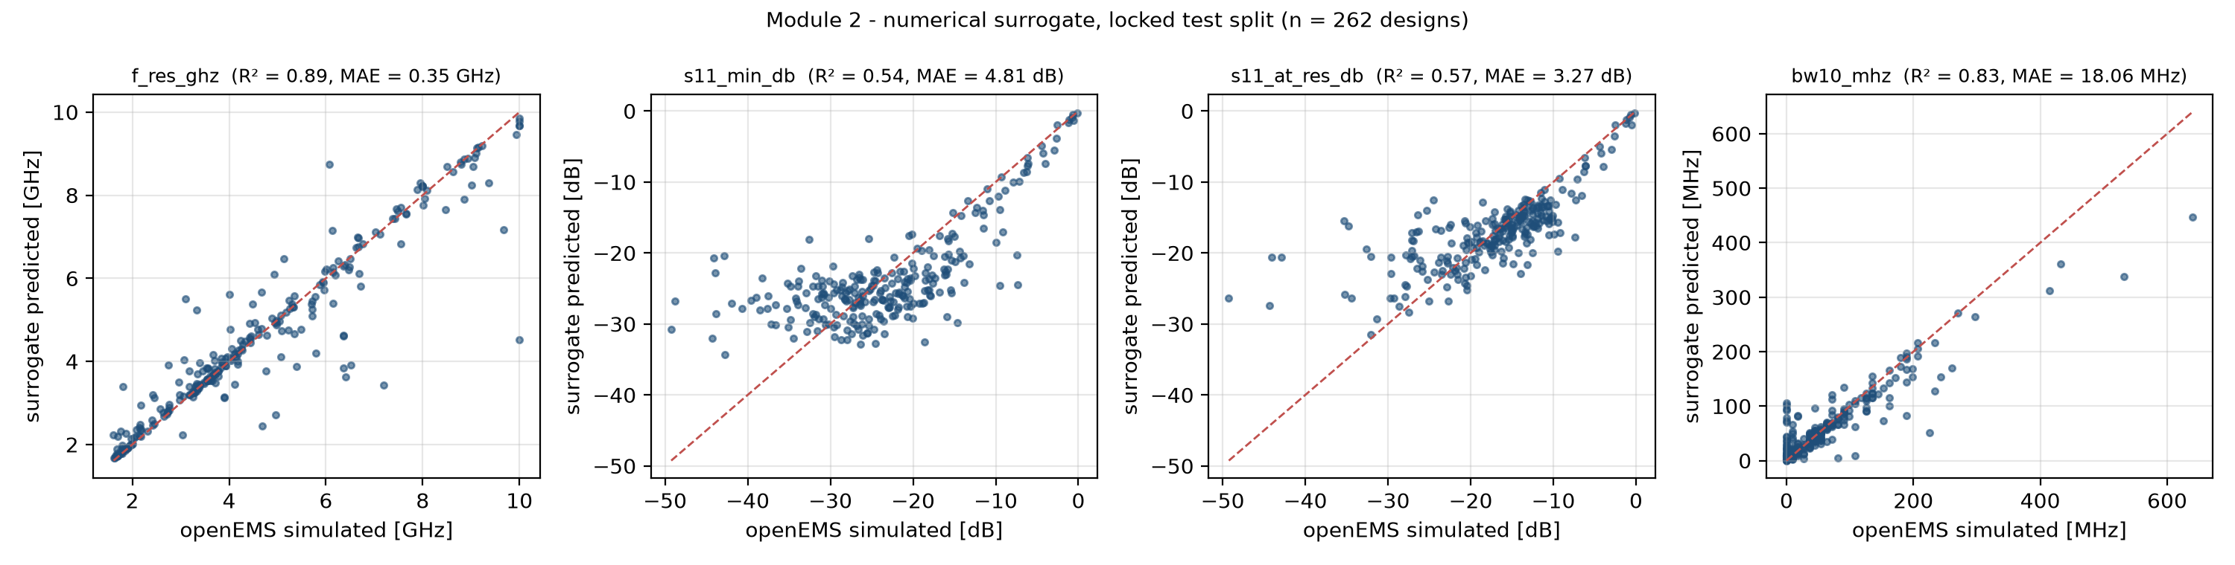
5 · OUTPUTS · MODULE 2 · EXTENDED
Output 1 - Patch surrogate accuracy
Target | Test R² | Test MAE | Mean-baseline MAE | OOD R²
First matched resonance (GHz) | 0.89 | 0.35 | 1.82 | 0.44
Minimum S11 (dB) | 0.54 | 4.81 | 7.36 | 0.13
S11 at resonance (dB) | 0.57 | 3.27 | 5.65 | -1.54
−10 dB bandwidth (MHz) | 0.83 | 18.06 | 55.36 | -3.72
Note
Resonance is predicted well (R² 0.89, error 0.35 GHz) and bandwidth well (R² 0.83).
Matching depth (S11) is harder (R² 0.54) because it changes sharply with feed impedance.
On wider, unseen patches (OOD) accuracy collapses - surrogates are only trustworthy inside their training range.
Dots close to the red line = accurate predictions.
Simulation evidence only (openEMS, Mendeley) · Ansys HFSS not run · AI proposals are not simulated
13 / 21
Notes:
Resonance is predicted well (R² 0.89, error 0.35 GHz) and bandwidth well (R² 0.83). Matching depth (S11) is harder (R² 0.54) because it changes sharply with feed impedance. On wider, unseen patches (OOD) accuracy collapses - surrogates are only trustworthy inside their training range. Dots close to the red line = accurate predictions.

Slide 14
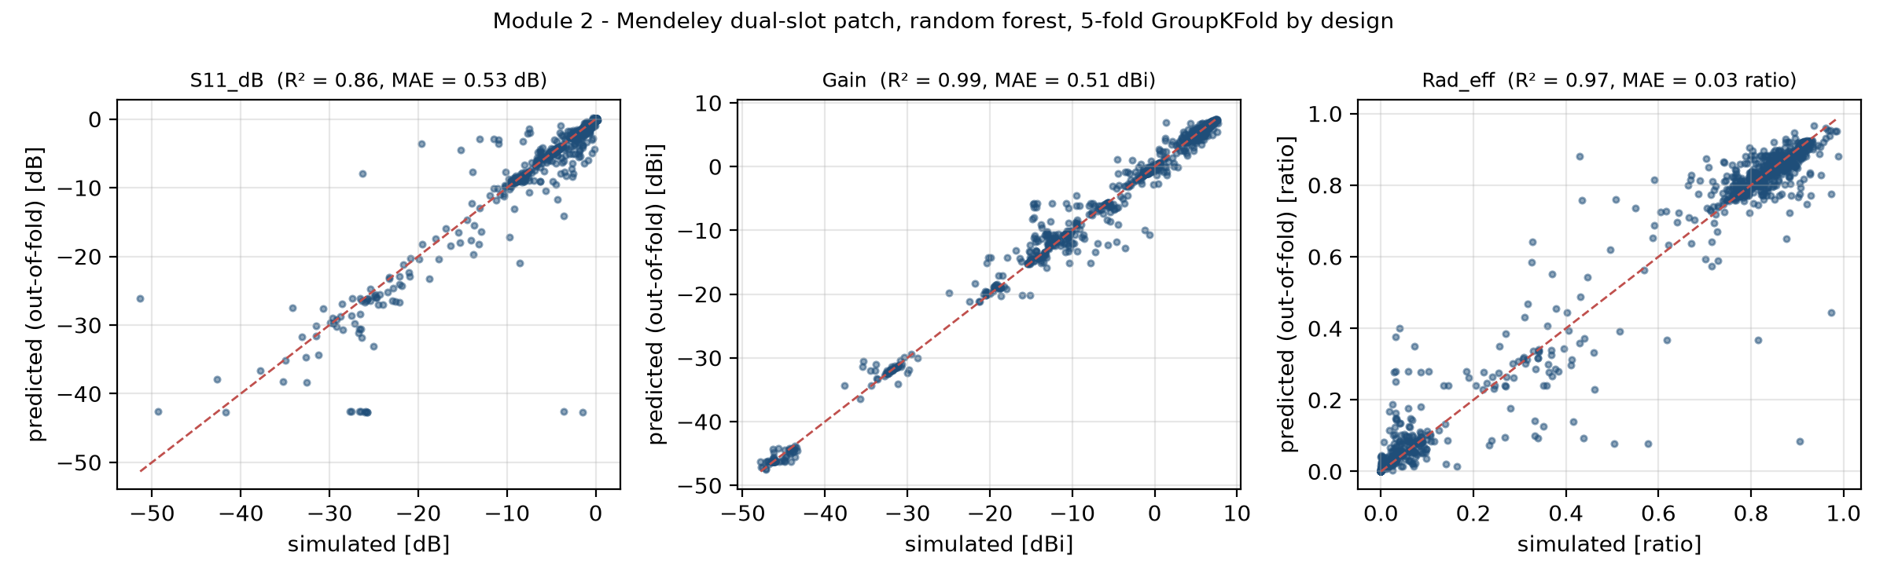
5 · OUTPUTS · MODULE 2 · EXTENDED
Output 2 - Slotted antenna: S11, gain and efficiency
Target (random forest) | R² | MAE | Frequency-only MAE
S11 (dB) | 0.86 | 0.533 | 1.089
Gain (dBi) | 0.99 | 0.513 | 1.096
Radiation efficiency (ratio) | 0.97 | 0.026 | 0.047
Note
On the slotted antenna the forests predict S11, gain and radiation efficiency from the 10 dimensions and frequency.
Adding the slot and substrate dimensions roughly halves the error of a frequency-only model - the geometry matters.
Scores are optimistic: the data vary one dimension at a time around one design (grouped 5-fold cross-validation).
Simulation evidence only (openEMS, Mendeley) · Ansys HFSS not run · AI proposals are not simulated
14 / 21
Notes:
On the slotted antenna the forests predict S11, gain and radiation efficiency from the 10 dimensions and frequency. Adding the slot and substrate dimensions roughly halves the error of a frequency-only model - the geometry matters. Scores are optimistic: the data vary one dimension at a time around one design (grouped 5-fold cross-validation).

Slide 15
5 · OUTPUTS · MODULE 2 · EXTENDED
Stage 6 - How text plays its role
Select
Interpret
Write
Caveat
Note
Engineers read sentences faster than tables, so each prediction is also written as a short summary.
This is data-to-text generation with rules and templates - deliberately not a large language model, which could invent values.
Each summary puts prediction and simulation side by side and ends by asking for full-wave verification.
Step | What happens
Content selection | pick predicted f_res, S11, bandwidth and the simulated reference for the same design
Semantic interpretation | rules give meaning: 3.3–3.8 GHz → 'inside 5G NR n78'; ≤ −20 dB → 'High class'
Template realisation | fixed sentence patterns, so wording is consistent and every number is copied, not invented
Generated example (unedited)
P1768 - patch L x W = 42.35 x 78.50 mm (W/L 1.85), feed offset -1.89 mm. Predicted first matched resonance 3.57 GHz, inside 5G NR n78 (3.3-3.8 GHz, FR1); predicted minimum S11 -26.1 dB, which meets the -20 dB project threshold (High class); predicted -10 dB bandwidth 45 MHz. Simulated reference (openEMS): 3.54 GHz, -28.7 dB, 36 MHz. Status: surrogate screening only - requires full-wave verification.
Simulation evidence only (openEMS, Mendeley) · Ansys HFSS not run · AI proposals are not simulated
15 / 21
Notes:
Engineers read sentences faster than tables, so each prediction is also written as a short summary. This is data-to-text generation with rules and templates - deliberately not a large language model, which could invent values. Each summary puts prediction and simulation side by side and ends by asking for full-wave verification.

Slide 16
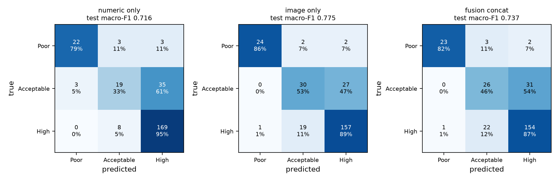
5 · OUTPUTS · MODULE 2 · EXTENDED
Output 3 - Multimodal fusion (numbers + images)
Input to the MLP | Features | Val macro-F1 | Test macro-F1 | OOD macro-F1
Numeric only | 5 | 0.742 | 0.716 | 0.581
Image embedding only | 384 | 0.787 | 0.775 | 0.608
Fusion (both) | 389 | 0.766 | 0.737 | 0.611
Note
Task: predict the matching class (Poor / Acceptable / High). Fusion scored 0.737, below the image embedding alone (0.775), so the pre-registered hypothesis H6 is not supported.
The image-only MLP beats Module 1's own ViT head (0.581): the ViT features are better than its classifier suggested.
Adding 5 numbers to 384 image numbers added redundancy rather than new information.
Simulation evidence only (openEMS, Mendeley) · Ansys HFSS not run · AI proposals are not simulated
16 / 21
Notes:
Task: predict the matching class (Poor / Acceptable / High). Fusion scored 0.737, below the image embedding alone (0.775), so the pre-registered hypothesis H6 is not supported. The image-only MLP beats Module 1's own ViT head (0.581): the ViT features are better than its classifier suggested. Adding 5 numbers to 384 image numbers added redundancy rather than new information.

Slide 17
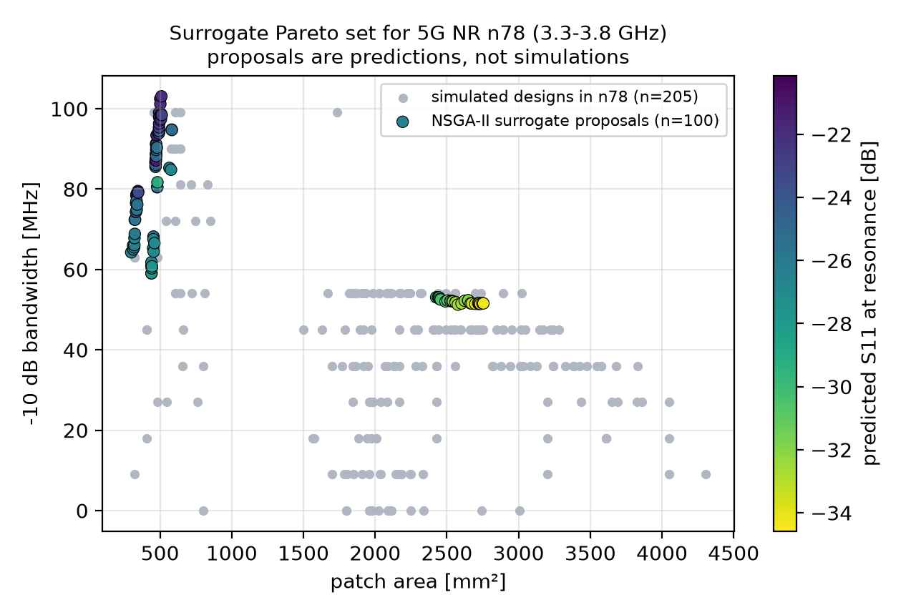
5 · OUTPUTS · MODULE 2 · EXTENDED
Output 4 - AI-proposed designs for 5G NR n78
Search set-up
Note
NSGA-II found 100 trade-off designs, from 299 to 2754 mm².
Each dot is a compromise: smaller area costs bandwidth or match depth.
All proposals sit close to simulated designs (median 0.08 SD) - interpolations, not miracles.
These are predictions only: NOT simulated. They are a shortlist for HFSS.
Variables: L, W/L, feed position. Goals: deepest match, widest band, smallest area. Constraint: predicted resonance in 3.3–3.8 GHz. 100 candidates × 80 generations.
Proposal | L × W (mm) | f_res (GHz) | S11 (dB) | BW (MHz)
N78-001 (smallest) | 19.3 × 15.5 | 3.79 | -26.6 | 64
N78-066 (widest band) | 22.1 × 23.1 | 3.72 | -22.0 | 103
N78-098 (deepest match) | 40.7 × 67.1 | 3.68 | -34.6 | 51
Simulation evidence only (openEMS, Mendeley) · Ansys HFSS not run · AI proposals are not simulated
17 / 21
Notes:
NSGA-II found 100 trade-off designs, from 299 to 2754 mm². Each dot is a compromise: smaller area costs bandwidth or match depth. All proposals sit close to simulated designs (median 0.08 SD) - interpolations, not miracles. These are predictions only: NOT simulated. They are a shortlist for HFSS.

Slide 18
6 · VALUE · MODULE 2 · EXTENDED
What this means for engineers
Aspect | Conventional (full-wave only) | With the AI surrogate (Module 2)
Time per candidate | minutes to hours of solver time (typical) | ≈3 ms in a batch (measured)
Design-space coverage | a few dozen hand-picked runs | thousands of candidates screened, Pareto trade-offs
Insight | engineer reads plots one by one | feature importance + plain-language summaries
Accuracy | physics-exact within the model | good for resonance / bandwidth, weaker for S11 depth
Trust boundary | valid everywhere it is meshed | only inside the training range (OOD drops sharply)
Role | final verification | screening and shortlisting before verification
Note
AI changes where the engineer spends time: less waiting for sweeps, more judging a ranked shortlist.
It complements, not replaces, HFSS - every promising design is still simulated and measured.
The out-of-distribution test shows engineers exactly when not to trust the surrogate.
Text summaries make results readable for non-specialists and reports.
Simulation evidence only (openEMS, Mendeley) · Ansys HFSS not run · AI proposals are not simulated
18 / 21
Notes:
AI changes where the engineer spends time: less waiting for sweeps, more judging a ranked shortlist. It complements, not replaces, HFSS - every promising design is still simulated and measured. The out-of-distribution test shows engineers exactly when not to trust the surrogate. Text summaries make results readable for non-specialists and reports.

Slide 19
6 · VALUE · MODULE 2 · EXTENDED
Outcomes and limitations
ID | Statement | Outcome
E1 | Surrogate beats the mean baseline on every patch target (test MAE) | Met
E2 | Geometry + frequency beats frequency-only (Mendeley, GroupKFold) | Met
H6 | Fusion (ViT embedding + numeric) > image-only (pre-registered) | Not supported
E3 | NSGA-II returns feasible n78 proposals inside the training ranges | Met
Note
E1-E3 are the planned evaluation criteria; H6 was pre-registered before any fusion result existed.
Three criteria met, one hypothesis not supported - reported as found, not adjusted.
The limitations define the next step: a proper HFSS hybrid-slotted DGS dataset.
▪ No HFSS: all evidence is openEMS or Mendeley simulation, no measurements
▪ Patch data have no slots / DGS; Mendeley varies one dimension at a time
▪ Surrogates do not extrapolate; S11 depth only moderately predicted
▪ Fusion: one embedding run, one seed; NSGA-II proposals unverified
Simulation evidence only (openEMS, Mendeley) · Ansys HFSS not run · AI proposals are not simulated
19 / 21
Notes:
E1-E3 are the planned evaluation criteria; H6 was pre-registered before any fusion result existed. Three criteria met, one hypothesis not supported - reported as found, not adjusted. The limitations define the next step: a proper HFSS hybrid-slotted DGS dataset.

Slide 20
MODULE 2 · EXTENDED
Conclusion and next steps
What was achieved
What it shows
Next steps
▪ Working 7-stage numerical-text pipeline
▪ Accurate resonance and bandwidth surrogates
▪ Readable, traceable engineering summaries
▪ 100 n78 design proposals
▪ AI screens designs in milliseconds
▪ Geometry features carry the physics
▪ ViT features help more than raw numbers
▪ Trust ends at the training range
▪ Space-filling HFSS DGS sweep (PyAEDT)
▪ Uncertainty-aware surrogate
▪ Re-simulate the Pareto shortlist
▪ Fabricate and measure the best
Module 2 code, data, tests and outputs: https://github.com/rathiabeth-sudo/902---Module-2
Module 1 (Vision Transformer): https://github.com/rathiabeth-sudo/901---module-1
Tests: 10 passed in 2.71s
Simulation evidence only (openEMS, Mendeley) · Ansys HFSS not run · AI proposals are not simulated
20 / 21
Notes:
Module 2 shows that parameter-based AI surrogates can screen antenna designs in milliseconds, explain themselves in plain text, and propose candidates for a 5G band - with clear limits. The next step is the HFSS hybrid-slotted DGS dataset.

Slide 21
SOURCES · MODULE 2 · EXTENDED
References
▪ LaBash et al. (2025) Rectangular patch antenna frequency-response dataset, arXiv:2505.18188 (MIT)
▪ Mihad, Islam & Sojib (2024) Antenna Parameters Dataset v2, Mendeley Data, doi:10.17632/3gxr2vvd9n.2 (CC BY 4.0)
▪ Balanis, C. A. (2016) Antenna Theory: Analysis and Design, 4th ed., Wiley
▪ 3GPP TS 38.101-1 - NR user equipment radio transmission and reception, Range 1
▪ Breiman, L. (2001) Random forests, Machine Learning 45(1)
▪ Ke, G. et al. (2017) LightGBM: a highly efficient gradient boosting decision tree, NeurIPS
▪ Pedregosa, F. et al. (2011) Scikit-learn: machine learning in Python, JMLR 12
▪ Deb, K. et al. (2002) NSGA-II, IEEE Trans. Evolutionary Computation 6(2)
▪ Blank, J. & Deb, K. (2020) pymoo: multi-objective optimization in Python, IEEE Access 8
▪ Dosovitskiy, A. et al. (2021) An image is worth 16x16 words (ViT), ICLR
▪ Reiter, E. & Dale, R. (2000) Building Natural Language Generation Systems, Cambridge University Press
Note
Datasets are cited with their licences, as their terms require.
Reiter & Dale describe the data-to-text pipeline (content selection, realisation) used for the summaries.
Full reference list and DOIs are in the Module 2 report.
Simulation evidence only (openEMS, Mendeley) · Ansys HFSS not run · AI proposals are not simulated
21 / 21
Notes:
Datasets are cited with their licences, as their terms require. Reiter & Dale describe the data-to-text pipeline (content selection, realisation) used for the summaries. Full reference list and DOIs are in the Module 2 report.

