Slide 1







Digital portfolio
Student Name: Rathika Sri
Register no:asbrubd2428k0055
Department: BSC (AI&DS)
College:Shree Venkateshwara Arts and Science (co-education) College-Othakuthirai
University:Bharathiar University
01

Slide 2



Rathika Sri
Portfolio
Project
Title
02

Slide 3




Agenda
5
Portfolio design and
layout
program statement
1
6
Features and Functionality
Project overview
2
End Users
3
7
Result and screenshot
Tools and Technologies
4
8
Conclusion and
GitHub Link
03

Slide 4


Students often struggle to present their skills and projects effectively. This digital portfolio for Rathika Sri showcases education, technical skills, projects, and contact information in a visually appealing and interactive format to connect with teachers, recruiters, and collaborators.
Problem statement
04

Slide 5
The Rathika Sri Portfolio is an interactive digital platform to showcase her education, technical skills, projects, and achievements. It features a blue-purple light theme, responsive design, and a dark/light mode toggle. Interactive elements like buttons, cards, and a contact form make it user-friendly and visually appealing, helping connect with teachers, recruiters, and collaborators.
Project Overview
05

Slide 6
The portfolio is designed for teachers, recruiters, peers, and professional connections to review Rathika Sri’s skills, projects, and achievements. It provides a platform for mentorship, job opportunities, collaboration, and networking.
End Users
06

Slide 7
1)Web Development: HTML,
CSS, JavaScript
Use: To build the portfolio structure (HTML), style it with colors, layout, and themes (CSS), and add interactivity like buttons, theme toggle, animations, and form handling (JavaScript).
Tools and Technologies
07

Slide 8
2)Image Hosting: ImgBB
Use: To host images online, such as profile pictures, project screenshots, and certificates. This allows the images to be linked directly in HTML using a URL, making the portfolio accessible anywhere without relying on local files.
Tools and Technologies
08

Slide 9


3)Programming Languages: C, C++, Java, Python
Use: These languages are used for Rathika Sri’s academic projects and technical work. They demonstrate problem-solving, coding skills, and application development abilities, which are showcased in the portfolio.
Tools and Technologies
09

Slide 10

4)CodePen
Use: CodePen is an online code editor and playground for front-end web development. It allows you to write and test HTML, CSS, and JavaScript in real-time, making it easier to build, preview, and share your portfolio online without installing software locally.
Tools and Technologies
10

Slide 11


Designing the portfolio involves creating a clean, organized, and visually appealing structure. Sections like About Me, Education, Skills, Projects, Goals, and Contact are arranged in cards, grids, and responsive layouts. The design uses colors, borders, hover effects, and theme toggles to make the portfolio interactive and user-friendly.
Portfolio Design and Layout
11

Slide 12



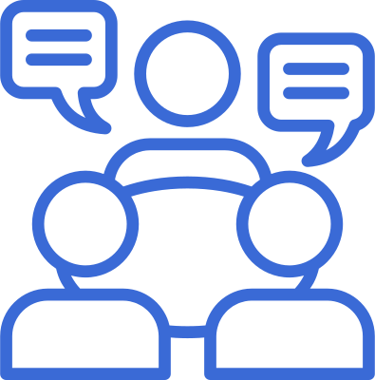


1. Light and Dark Theme Toggle:
Users can switch between light and dark modes for easy viewing.
Features and Functionality
2. Interactive Buttons
3. Responsive Design
Buttons have hover effects to make navigation simple and engaging.
Works well on desktops, tablets, and mobile devices.
12

Slide 13
4. Contact Form:
Visitors can send messages directly with simple validation.
Features and Functionality
5. Project Showcase:
6. Smooth Animations
Shows projects with descriptions and images.
Sections and cards appear smoothly when scrolling.
13

Slide 14

7. Visual Enhancements:
Features and Functionality
Blue-purple theme, borders, shadows, and card layouts make it attractive and readable.
14

Slide 15
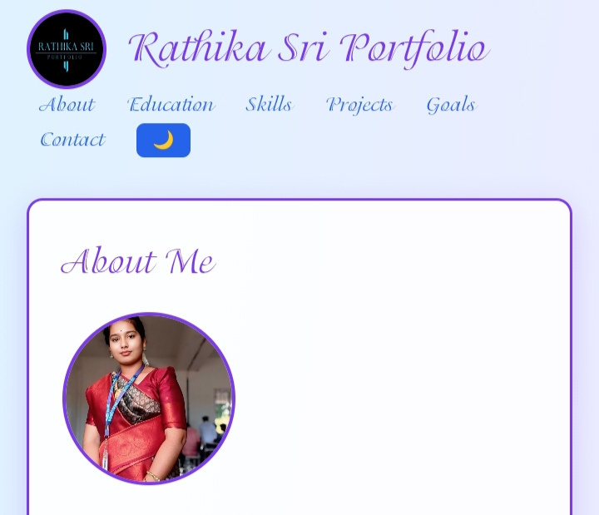
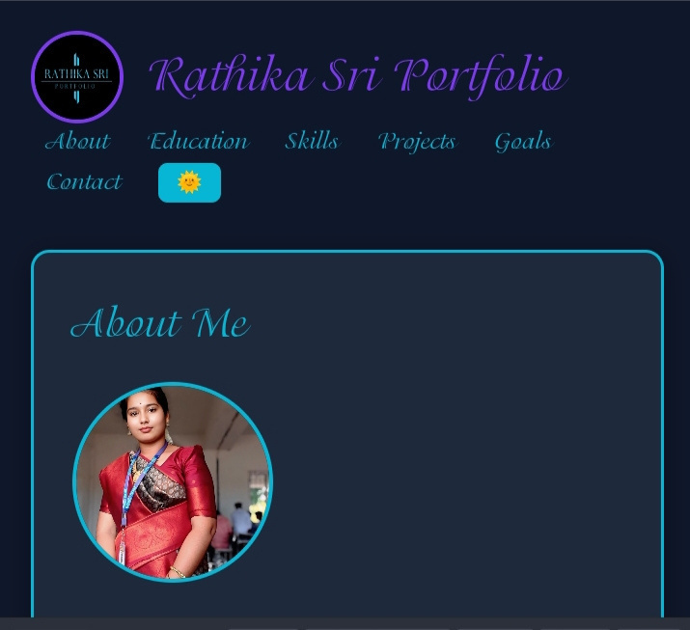
Result and screenshot
Light Theme – Front Side:
Dark Theme – Front Side:
15

Slide 16
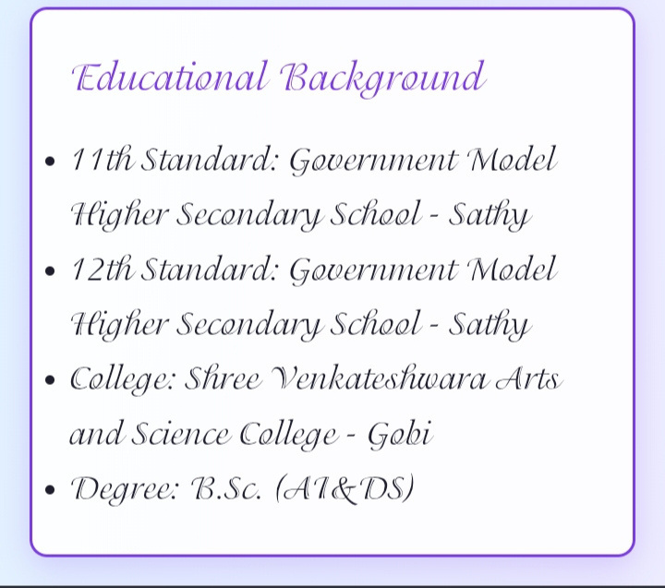
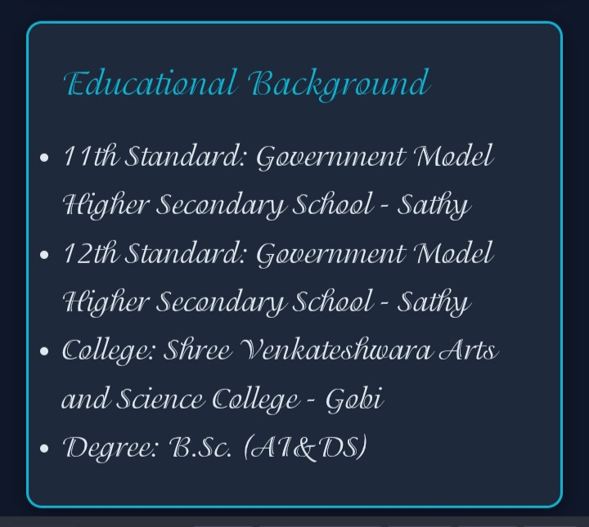
Light Theme – Education
Dark Theme Education:
17

Slide 17
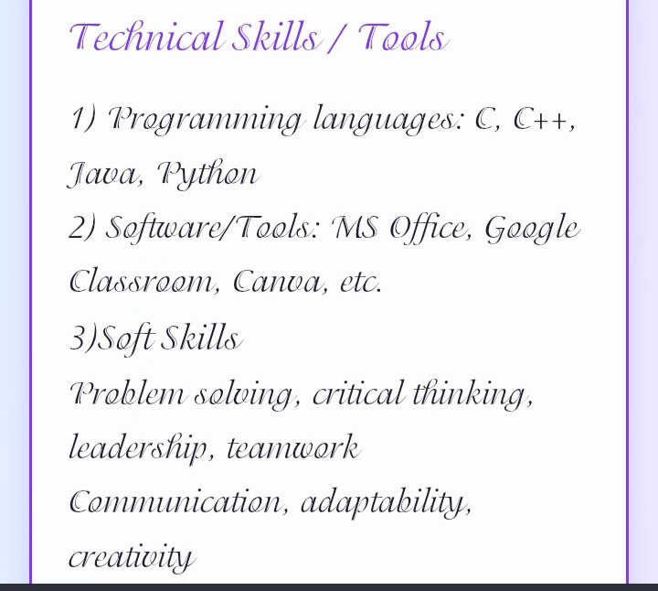
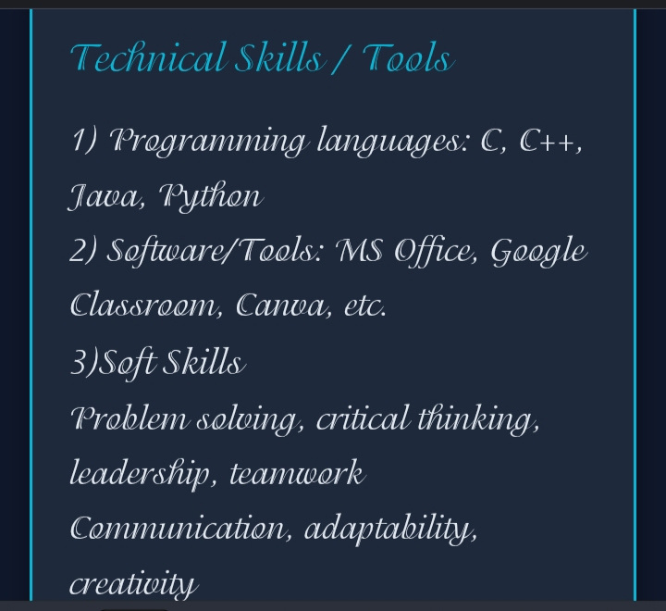
Light Theme – Technical and tools
Dark Theme – Technical and tools
18

Slide 18
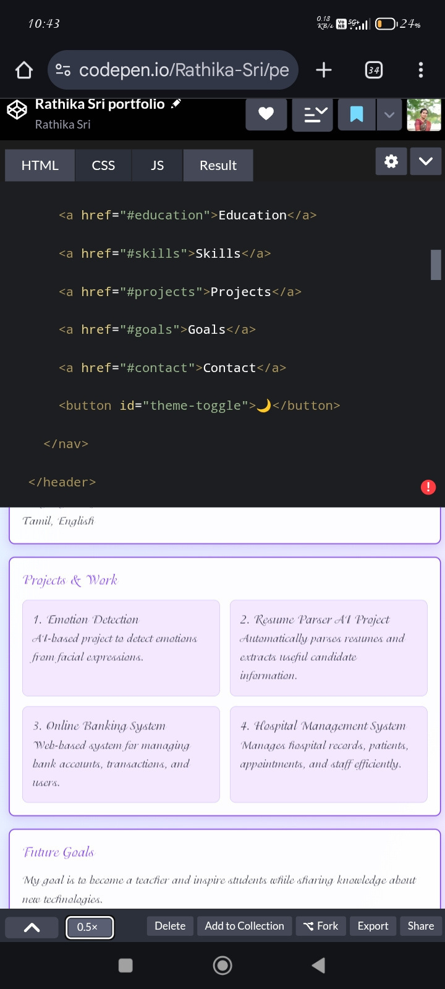
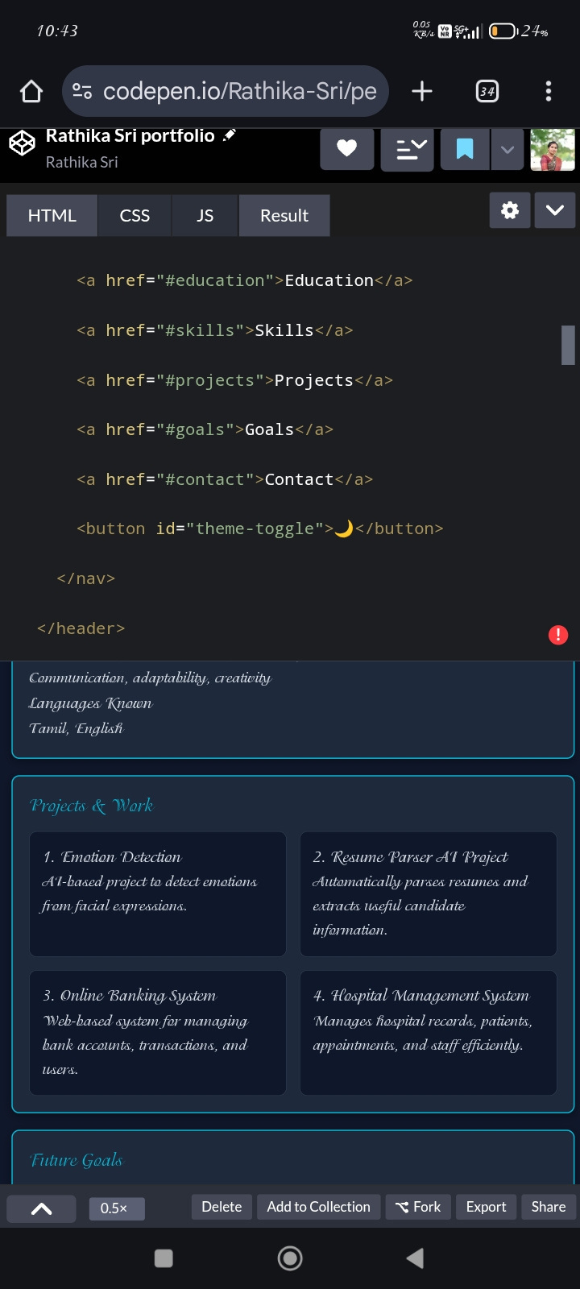
Light Theme – Project
DarkTheme – Project
19

Slide 19
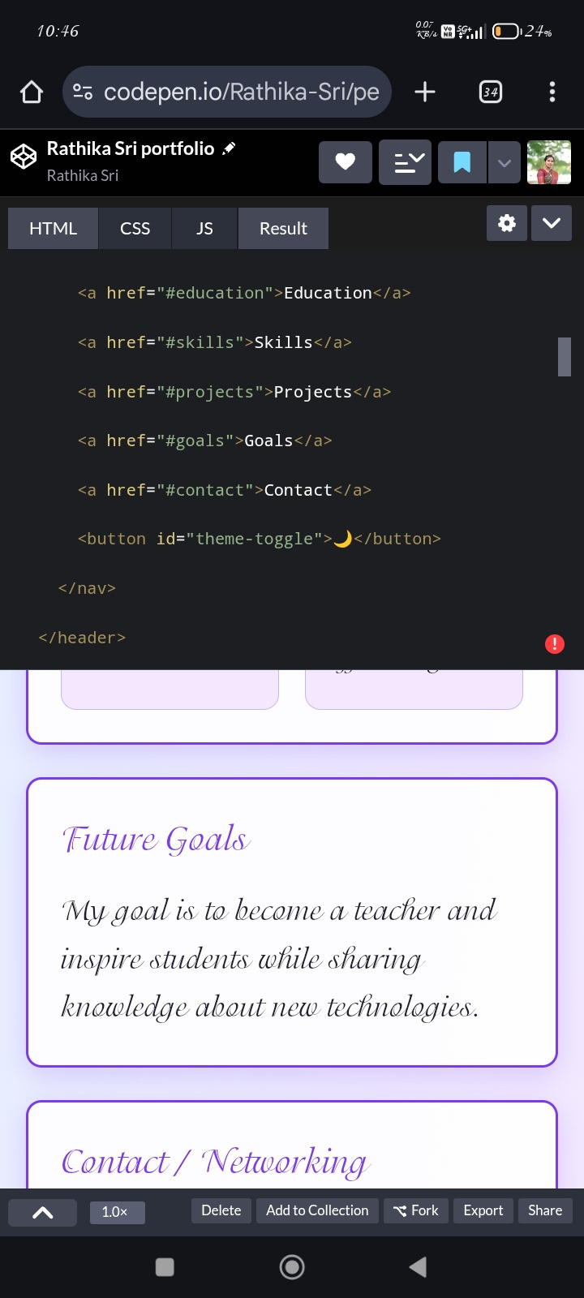
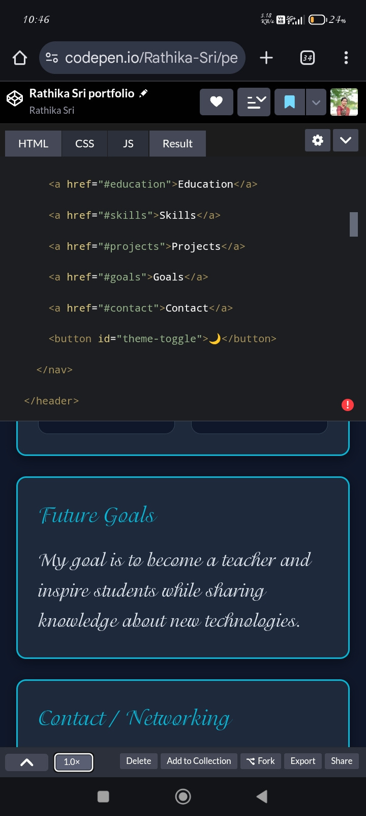
Light Theme –Goal
Dark Theme –Goal
20

Slide 20
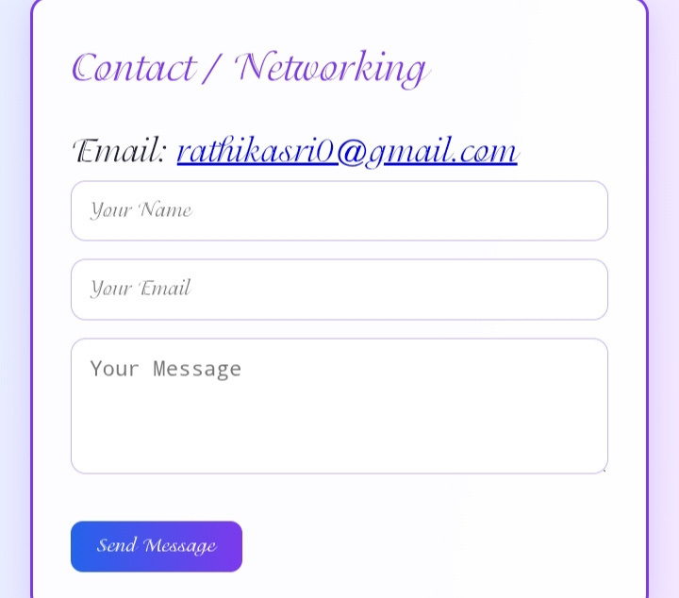
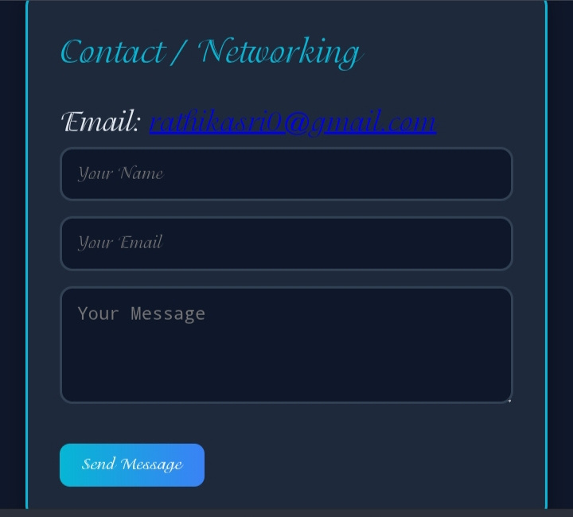
Light Theme – contact
DarkTheme – contact
21

Slide 21


The Rathika Sri Portfolio is a user-friendly and interactive platform that showcases education, skills, projects, and achievements. With light/dark themes, responsive design, and smooth animations, it provides a clean and professional look. The portfolio helps connect with teachers, recruiters, and peers while highlighting technical and personal abilities.
Conclusion
22

Slide 22


GitHub Link 🔗
https://github.com/rathikasri0-web
23

Slide 23

Home
Service
About Us
Contact
Thank
You
24

