Slide 1
A2A Protocol Demo
A Complete Implementation of the Agent-to-Agent Protocol
Built with Google ADK 1.25.1 | Vertex AI | Cloud Run
24 Features | 9 Agents | 4 Auth Schemes | 300 Tests
GCP Project: openshift-research-479702 | Region: us-central1

Slide 2
Agenda
01 What is A2A?
The protocol & why it matters
02 Google ADK
Agent Development Kit fundamentals
03 Architecture
System design & communication flow
04 Project Structure
Directory layout & shared infra
05 Agent Deep Dives
All 9 agents explained
06 Authentication
4 schemes from none to OAuth 2.0
07 Callbacks & Safety
Guardrails, logging, caching
08 Testing
300 tests, mocking strategies
09 Deployment
Local, Cloud Run, Agent Engine
10 Live Demo
End-to-end walkthrough

Slide 3
SECTION 01
Why A2A?
AI agents today are siloed. A LangChain agent can't talk to a CrewAI agent. An AutoGen agent can't discover a Vertex AI agent's capabilities. Every framework has its own proprietary communication format.

Slide 4
SECTION 01
A2A Protocol -- Core Concepts
Agent Card
/.well-known/agent.json
JSON document advertising name, skills, capabilities, auth requirements. Think: business card for AI agents.
JSON-RPC 2.0
POST /
All communication uses JSON-RPC 2.0. Methods: message/send, message/stream, tasks/get, tasks/cancel, tasks/list
Task Lifecycle
7 States
submitted -> working -> completed -> failed / canceled -> input-required
Message Parts
role + parts[]
TextPart: plain text FilePart: binary data or URI DataPart: structured JSON

Slide 5
SECTION 01
Protocol vs SDK vs Framework
Layer | What It Is | Example
A2A Protocol | The specification (like HTTP spec) | JSON-RPC methods, Agent Card schema
a2a-sdk | Reference implementation | Python package, gRPC stubs
Google ADK | Agent framework that implements A2A | LlmAgent, RemoteA2aAgent, to_a2a()
Key Insight
You can build an A2A-compliant agent WITHOUT ADK.
The a2a_client/client.py in this project proves it -- it uses only httpx (raw HTTP).
The a2a_client/grpc_client.py does the same over gRPC with Protobuf.

Slide 6
SECTION 02
Google Agent Development Kit (ADK)
Open-source framework for building AI agents | Version 1.25.1

Slide 7
SECTION 02
ADK Building Blocks
LlmAgent
LLM-backed agent with model, instruction, tools, sub_agents, callbacks, output_key
SequentialAgent
Runs sub-agents in order: A -> B -> C Deterministic pipeline orchestration
ParallelAgent
Runs sub-agents concurrently (fan-out) All execute simultaneously
LoopAgent
Repeats sub-agents until exit condition or max_iterations reached
RemoteA2aAgent
Proxy to a remote A2A server. Discovers capabilities via Agent Card at construction
to_a2a()
Converts any ADK agent into an A2A-compliant web app with JSON-RPC + agent card route

Slide 8
SECTION 03
Architecture Overview
Multi-agent ecosystem with specialist routing

Slide 9
SECTION 03
Request Flow -- Top to Bottom
"What is the weather in Paris?" | Layer 1 v CLIENT: a2a_client (HTTP / gRPC) -- Any HTTP client, no SDK needed | | JSON-RPC 2.0 over HTTP Layer 2 v ROUTER: orchestrator_agent -- LLM reads descriptions, picks agent 5x RemoteA2aAgent sub-agents httpx clients with auth headers | | A2A Protocol (Agent Card discovery + JSON-RPC) Layer 3 v AGENTS: weather research code data async :8001 :8002 :8003 :8004 :8005 No Auth JWT API Key OAuth Push+SSE | Layer 4 v SHARED: config.py | auth.py | callbacks.py Settings 4 schemes Logging + Guardrails + Cache

Slide 10
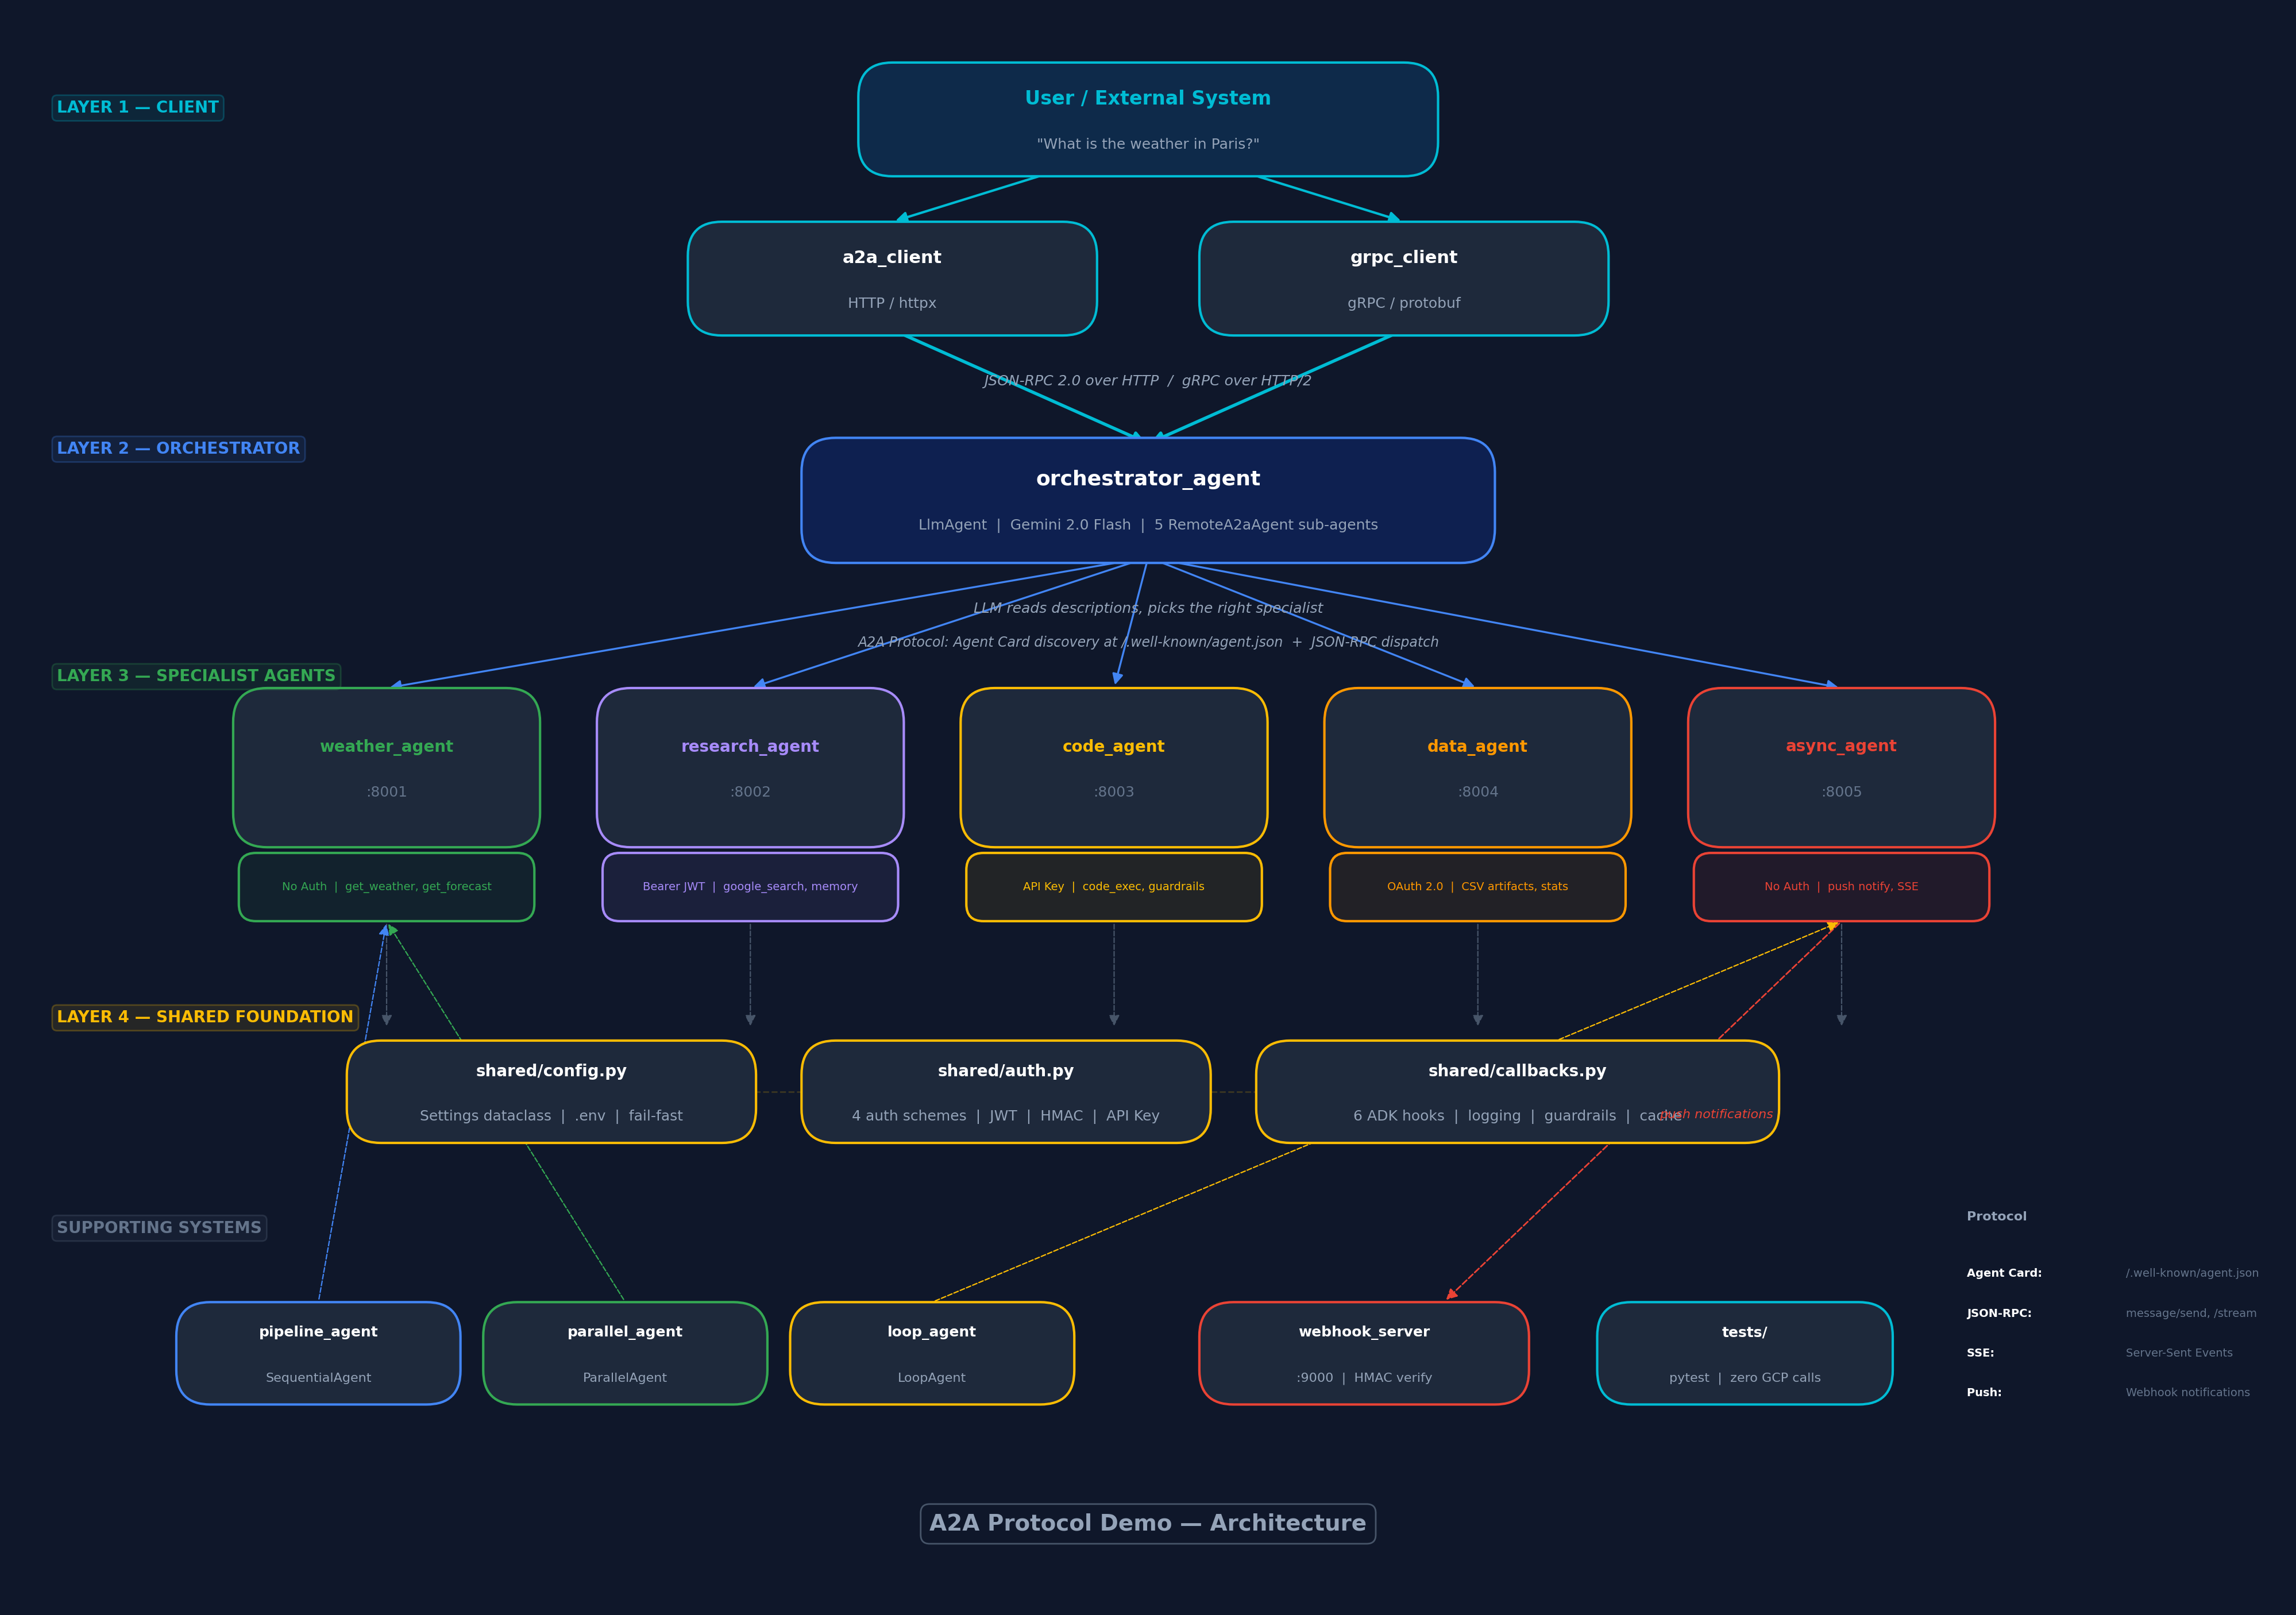
SECTION 03
Architecture Diagram

Slide 11
SECTION 03
Communication Patterns
Pattern | Example | A2A Method | Agent
Sync request/response | "Weather in Paris?" | message/send | weather_agent
SSE Streaming | "5-day forecast for Tokyo" | message/stream | weather, research
Async + Push | "Run 20-sec simulation" | message/send + webhook | async_agent
Polling | Loop agent checks status | tasks/get | loop_agent
Cancellation | Stop a running task | tasks/cancel | async_agent
Multi-turn | "Research AI" -> "Focus safety" | message/send + taskId | research_agent

Slide 12
SECTION 04
Project Structure
Directory layout, shared infrastructure, and configuration

Slide 13
SECTION 04
Directory Layout
A2A_Research_demo_1/ | |-- shared/ Config, auth, callbacks |-- weather_agent/ Simplest A2A agent |-- research_agent/ JWT + extended card |-- code_agent/ Code execution sandbox |-- data_agent/ CSV artifacts + OAuth |-- async_agent/ Custom FastAPI (no ADK) |-- orchestrator_agent/ Root router agent |-- pipeline_agent/ Sequential pipeline |-- parallel_agent/ Fan-out weather |-- loop_agent/ Polling loop
|-- a2a_client/ Standalone clients | |-- client.py HTTP (httpx only) | |-- grpc_client.py gRPC (protobuf) | |-- webhook_server/ Push notification sink |-- evals/ ADK evaluation datasets |-- protos/ gRPC .proto definitions |-- scripts/ start/stop/deploy |-- tests/ 300 pytest tests | |-- .env Runtime configuration |-- requirements.txt Pinned dependencies

Slide 14
SECTION 04
shared/config.py -- Centralized Configuration
@dataclass class Settings: GOOGLE_CLOUD_PROJECT: str = field( default_factory=lambda: os.environ.get("GOOGLE_CLOUD_PROJECT", "") ) GEMINI_MODEL: str = "gemini-2.0-flash" WEATHER_AGENT_URL: str = "http://localhost:8001" # ... 14 fields total def validate(self) -> None: """Check all required env vars are set.""" ... settings = Settings() # Singleton if "pytest" not in sys.modules: # Skip during test collection settings.validate()
Design Principles
Python dataclass -- typed, testable
Reads from .env via python-dotenv
Singleton pattern -- one instance
validate() checks required fields
Test guard prevents broken collection
Every agent imports:
from shared.config import settings

Slide 15
SECTION 05
Agent Deep Dives
Starting with the simplest: weather_agent

Slide 16
SECTION 05
weather_agent -- The Minimal A2A Agent Pattern
# Step 1: Define the Agent Card _AGENT_CARD = AgentCard( name="weather_agent", skills=[_weather_skill, _forecast_skill], capabilities=AgentCapabilities(streaming=True), ) # Step 2: Create the LLM Agent root_agent = LlmAgent( model=settings.GEMINI_MODEL, instruction="You are a weather assistant...", tools=[get_weather, get_forecast], ) # Step 3: Convert to A2A web application app = to_a2a(root_agent, port=8001, agent_card=_AGENT_CARD) # That's it! to_a2a() auto-creates: # GET /.well-known/agent.json --> Agent Card # POST / --> JSON-RPC dispatcher
3-Step Pattern
1. Agent Card
Advertise skills & capabilities
2. LLM Agent
Model + instruction + tools
3. to_a2a()
Instant A2A web server
Features: F1, F2, F3, F8, F12

Slide 17
SECTION 05
Function Tools -- How ADK Turns Python into Tool Calls
async def get_weather(city: str) -> dict: """ Return current weather conditions for a city. Args: city: City name, e.g. "London" Returns: Dict with temperature_c, conditions, etc. """ if not settings.OPENWEATHERMAP_API_KEY: return _mock_weather(city) # Fallback async with httpx.AsyncClient() as client: resp = await client.get(f"{OWM}/weather", params={"q": city, ...}) data = resp.json() return {"city": data["name"], "temperature_c": data["main"]["temp"], ...}
ADK Auto-Schema
Type hints -> JSON Schema
Docstring -> tool description
LLM sees function signature
Mock Data Fallback
No API key? Return mock data
Demo works out of the box
Async by Design
httpx.AsyncClient -- non-blocking
ADK handles async tools natively

Slide 18
SECTION 05
orchestrator_agent -- The Router
# Pre-configured httpx clients with auth headers _code_client = httpx.AsyncClient( headers={"X-API-Key": settings.CODE_AGENT_API_KEY}, timeout=httpx.Timeout(120.0), ) # RemoteA2aAgent with auth client code_agent = RemoteA2aAgent( name="code_agent", agent_card=f"{URL}/.well-known/agent.json", httpx_client=_code_client, # auth pre-set ) root_agent = LlmAgent( model=settings.GEMINI_MODEL, instruction="Route to the right specialist...", sub_agents=[weather, research, code, data, async], tools=[list_available_agents, get_agent_status], )
LLM-as-Router
LLM reads sub-agent descriptions
Decides which specialist to call
No if/else routing rules
Auth via httpx Clients
Each RemoteA2aAgent gets a
pre-configured httpx.AsyncClient
with auth headers + 120s timeout

Slide 19
SECTION 05
async_agent -- Custom A2A (No ADK)
Why Custom?
ADK's default handler doesn't support:
Background task execution (20-sec tasks)
Push notification delivery (webhooks)
Task cancellation (asyncio.Task.cancel())
SSE streaming with progress updates
Cursor-based task pagination
In-Memory Architecture
_task_store: dict[str, dict] -- task state
_webhook_store: dict[str, dict] -- configs
_running_tasks: dict[str, asyncio.Task]
_sse_queues: dict[str, list[Queue]]
Request Flow
1. Client POSTs message/send
2. Create task (status: submitted)
3. asyncio.create_task() for background
4. Store Task in _running_tasks
5. Return immediately to client
6. Background: 20-sec simulation
- 0%, 25%, 50%, 75% progress
- Push notifications to webhook
- SSE events to connected clients
7. Final: status -> completed + artifact

Slide 20
SECTION 05
Workflow Agents -- Sequential, Parallel, Loop
pipeline_agent
SequentialAgent
fetch_agent
Gather raw information
output_key='raw_data'
v
analyze_agent
Extract 3-5 key insights
output_key='analysis'
v
report_agent
Markdown report
output_key='final_report'
parallel_agent
ParallelAgent + SequentialAgent
Fan-Out (concurrent):
London -> RemoteA2aAgent
Tokyo -> RemoteA2aAgent
New York -> RemoteA2aAgent
Sydney -> RemoteA2aAgent
Paris -> RemoteA2aAgent
v
Fan-In (aggregate):
Summary table of all 5 cities
loop_agent
LoopAgent (max 10 iterations)
start_task_agent
Delegates to RemoteA2aAgent
Starts async task
v
poll_agent (loop)
Checks task status
WORKING -> continue
exit_check_agent
DONE/FAILED -> EXIT
WORKING -> CONTINUE

Slide 21
SECTION 06
Authentication Schemes
4 schemes from zero security to full OAuth 2.0

Slide 22
SECTION 06
Four Authentication Schemes
Scheme | Agent | Header | How It Works
No Auth | weather_agent | (none) | Fully open -- no credentials needed
API Key | code_agent | X-API-Key: <key> | Shared secret in header, middleware validates
Bearer JWT | research_agent | Authorization: Bearer <jwt> | HMAC-SHA256 signed token with expiry
OAuth 2.0 | data_agent | Authorization: Bearer <token> | GCP service account token verification
Cross-Cutting Rule
Discovery is ALWAYS public. Operations require auth.
if request.url.path == "/.well-known/agent.json": return await call_next(request)
Agents must be discoverable without pre-shared credentials -- this is essential for A2A.

Slide 23
SECTION 07
Callbacks, Guardrails & Safety
6 ADK callback hooks for logging, security, and caching

Slide 24
SECTION 07
The Callback Chain
Incoming message | v [before_model_callback] <-- Log agent + message count | v LLM Call (Gemini) | v [after_model_callback] <-- Log tokens, redact URLs | v LLM decides to call a tool | v [before_tool_callback] <-- GUARDRAIL: block os.system, eval | CACHE: return cached result v Tool Execution | v [after_tool_callback] <-- Log result, store in cache | v Response to client
Return Value Semantics
return None
Pass through (normal processing)
return {...}
Intercept (use this result instead)
Guardrail Example
Blocked patterns:
os.system, subprocess
eval(), exec(), open()
shutil.rmtree, __import__

Slide 25
SECTION 08
Testing Strategy
300 tests | ~4 seconds | Zero GCP calls

Slide 26
SECTION 08
Test Architecture
Category | Files | What They Test
Config | test_config.py | Settings defaults, validation, env overrides
Auth | test_shared_auth.py | API key, Bearer JWT, HMAC signatures
Callbacks | test_shared_callbacks.py | Logging, guardrails, caching
Weather | test_weather_agent.py + ext | Mock data, API parsing, aggregation
Async | test_async_agent.py + lifecycle | Task CRUD, pagination, cancel, HMAC
Webhook | test_webhook_server.py + ext | Event receipt, HMAC, timestamps
Client | test_a2a_client.py + ext | URL normalization, send, stream, get
Data | test_data_agent.py + ext | CSV parsing, statistics, reports
Orchestrator | test_orchestrator_*.py | Agent listing, status, URL redaction

Slide 27
SECTION 08
Key Testing Techniques
# 1. Auto-mock environment (conftest.py) @pytest.fixture(autouse=True) def mock_env_vars(monkeypatch): monkeypatch.setenv("GOOGLE_GENAI_USE_VERTEXAI", "0") monkeypatch.setenv("OPENWEATHERMAP_API_KEY", "") # mock # 2. FastAPI TestClient (sync wrapper for async) client = TestClient(app) resp = client.post("/", json=payload) assert resp.status_code == 200 # 3. AsyncMock for httpx.AsyncClient mock_client = AsyncMock() mock_client.get = AsyncMock(return_value=mock_resp) with patch("httpx.AsyncClient", return_value=mock_client): result = await tools_mod.get_weather("London") # 4. monkeypatch settings singleton monkeypatch.setattr(tools_mod.settings, "API_KEY", "fake")

Slide 28
SECTION 09
Deployment
Local dev | Google Cloud Run | Vertex AI Agent Engine

Slide 29
SECTION 09
Deployment Options
Local Dev
./scripts/start_all.sh
weather_agent :8001
research_agent :8002
code_agent :8003
data_agent :8004
async_agent :8005
webhook_server :9000
adk web --host 0.0.0.0 --port 8000 .
ADK Dev UI at :8000/dev-ui/
Cloud Run
Dockerised microservices
./scripts/deploy_cloud_run.sh
Builds with Cloud Build
Auto-scales to zero
HTTPS endpoints
IAM authentication
Each agent has its own
Dockerfile
Vertex AI Agent Engine
Managed agent hosting
Orchestrator deployed as
managed Vertex AI agent
Auto-routing to Cloud Run
Built-in monitoring
OpenTelemetry tracing
GCP Resources:
Cloud Run APIs
Cloud Build APIs
GCS staging bucket

Slide 30
COMPLETE MATRIX
All 24 A2A Features
# | Feature | Where
F1 | Agent Cards | All agents
F2 | Sync Request/Response | All agents
F3 | SSE Streaming | weather, research, async
F4 | Push Notifications | async -> webhook_server
F5 | Task Lifecycle | async_agent (7 states)
F6 | Multi-turn | research, loop agents
F7 | Extended Card | research_agent
F8 | Auth Schemes (4) | weather/code/research/data
F9 | A2A Routing | orchestrator_agent
F10 | Workflow Agents | pipeline/parallel/loop
F11 | Agent Types (5) | LLM/Seq/Para/Loop/Remote
F12 | Tool Types (3) | Functions/Search/CodeExec
# | Feature | Where
F13 | Session State | pipeline_agent
F14 | Memory | research_agent
F15 | Artifacts | data_agent (CSV)
F16 | Callbacks (6 hooks) | shared/callbacks.py
F17 | Safety Guardrails | code_agent
F18 | Evaluation | evals/ (5 datasets)
F19 | Agent Engine | orchestrator deploy
F20 | Cloud Run | All remote agents
F21 | gRPC Transport | a2a_client/grpc_client
F22 | Observability | OpenTelemetry config
F23 | ADK Dev UI | adk run/web/api_server
F24 | Interoperability | a2a_client (httpx only)

Slide 31
SECTION 10
Live Demo
Agent discovery | Routing | Async tasks | Auth | Tests

Slide 32
SECTION 10
Demo Commands
# 1. Start all agents (uvicorn, not adk api_server) ./scripts/start_all.sh # 2. Agent Discovery curl http://localhost:8001/.well-known/agent.json | python3 -m json.tool # 3. Sync message/send (note: messageId is required) curl -X POST http://localhost:8001/ \ -H "Content-Type: application/json" \ -d '{"jsonrpc":"2.0","id":"1","method":"message/send", "params":{"message":{"role":"user","messageId":"m1", "parts":[{"kind":"text","text":"Weather in Paris?"}]}}}' # 4. Orchestrator (ADK Web UI -- use "." for project root) adk web --host 0.0.0.0 --port 8000 . # 5. Standalone A2A client (no ADK, just httpx) python3 -m a2a_client.client # 6. Run Tests pytest tests/ -v

Slide 33
Key Takeaways
A2A is the HTTP of the agent world
Open protocol for agent-to-agent communication, framework-agnostic
Agent Cards enable discovery
Standardized capability advertisement at /.well-known/agent.json
ADK makes it simple
3 steps: Agent Card -> LlmAgent -> to_a2a() = production A2A server
Security is layered
Discovery always public, operations authenticated, 4 auth schemes
Test everything
300 tests, mock environment, zero GCP calls in CI
Production-ready patterns
Callbacks, guardrails, URL redaction, HMAC signatures, retry logic

Slide 34
Thank You
Resources
A2A Protocol Spec: a2a-protocol.org/latest/specification/
Google ADK Docs: google.github.io/adk-docs/
Project Docs: README.md | ENV_SETUP.md | DEMO.md | SPEAKER_NOTES.md

