Slide 1

POD-4
RETAIL-BANKING-SYSTEM

Slide 2
Mentor - Anish Kumar Das
Coach - Kanchan Nilkanthrao Bhise
Members
2151995 Siddhi Anant Pansare
2152057 Gokarna Shrestha
2152324 Jafar Sadique
2151980 Shivam Rathi
2151780 Harshit Shukla

Slide 3
INTRODUCTION
●The Retail Banking System provides Microservice Architecture based software solution.
●It provides high Availability operations for their client & bank employees without disruption.
●Different Microservices combines together to perform together as a unified application.

Slide 4
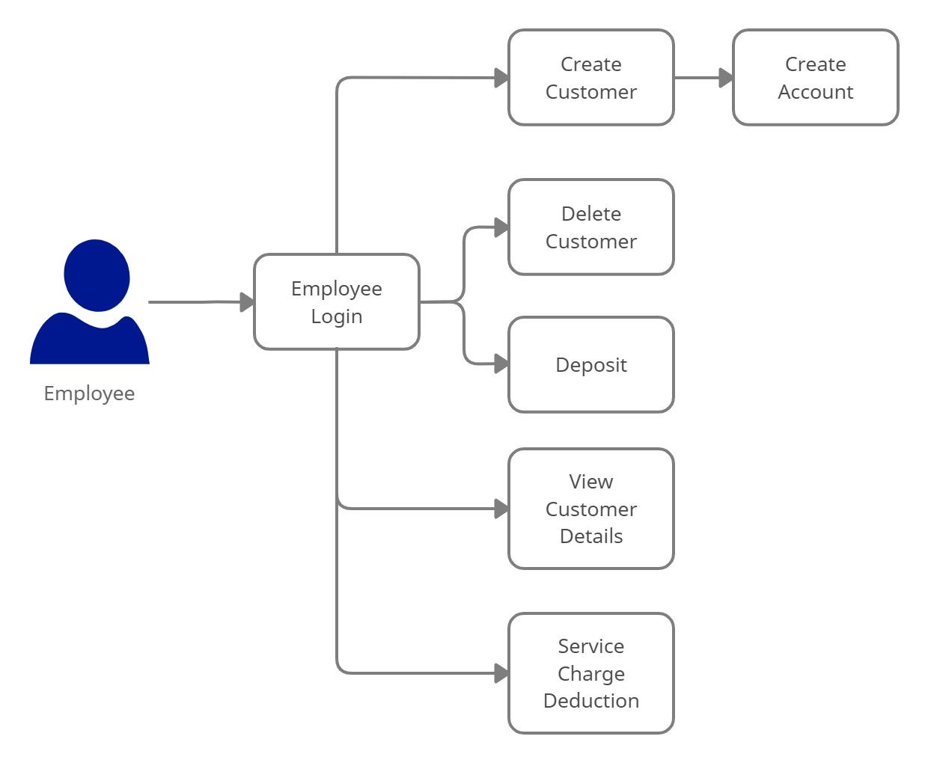
Architecture Diagram for Employee

Slide 5
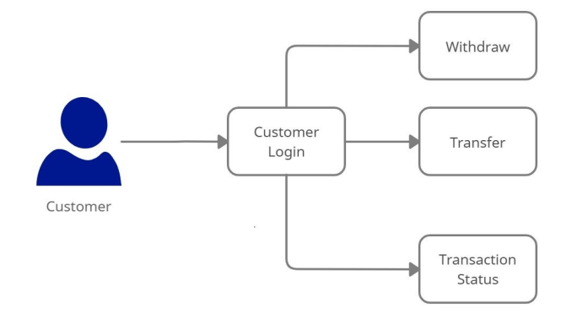
Architecture Diagram for Customer

Slide 6
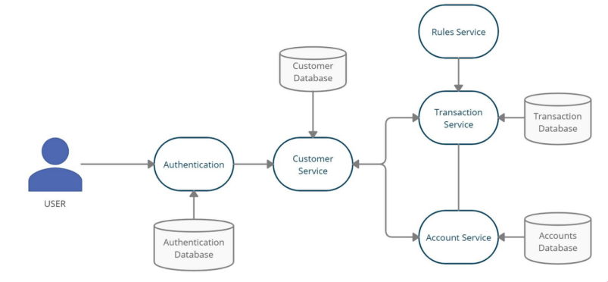
Work Flow

Slide 7
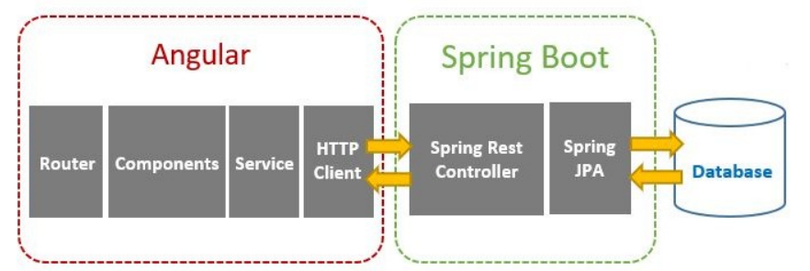
Client Server

Slide 8
Technologies
❖Front End : Angular 8
❖Backend : Java, Spring Boot, Restful-Services
❖Database : H2 - database
❖Tools : Spring Tool Suite, Swagger, Eclemma, Postman, AWS

Slide 9
Working
❖Authorization microservice
❖Customer microservice
❖Account microservice
❖Transaction microservice
❖Rules microservice

Slide 10
Authentication
❖Authentication Microservice will perform operations like:
●Login &
●Logout
❖Authentication will provide the JWT token after user’s validation.
❖Providing the authorisation based on user’s login

Slide 11
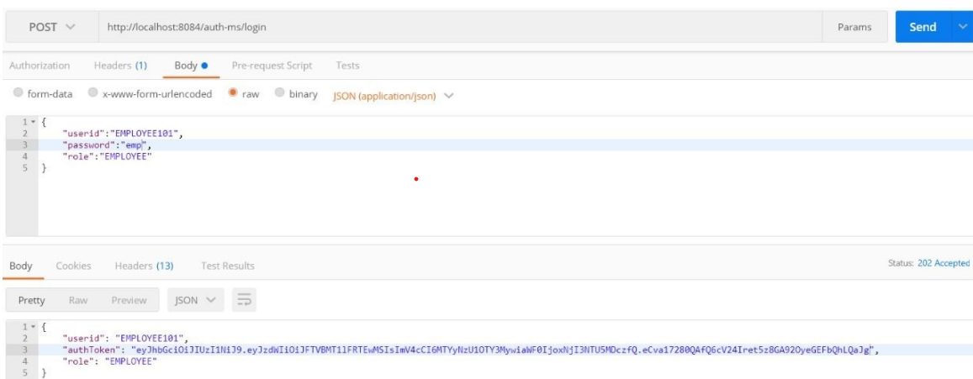
Authentication Microservice

Slide 12
Customer
❖Customer microservice will performs operations like :
●Creation and Updation of Customer Details
●Fetching Customer Details
●Deletion of Customer
❖It even interacts with authentication and account microservices for the purpose of sharing details.

Slide 13
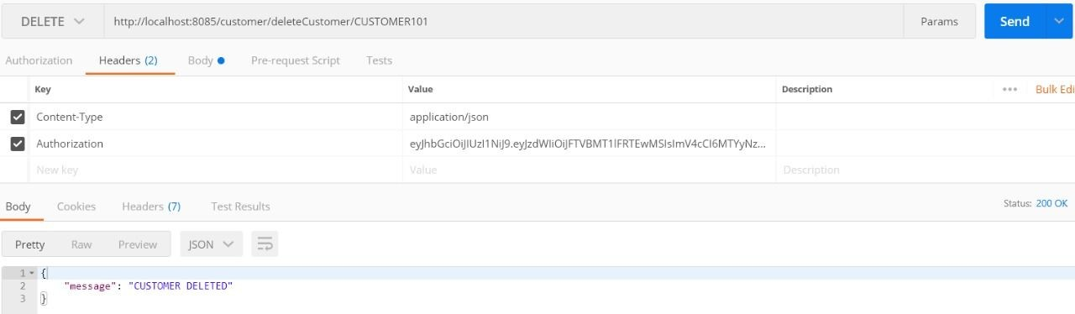
Customer Microservice

Slide 14
Account
❖Account Microservice will perform following operations:
●Customer Account Creation
●Fetching Account Details for Each Customer
●Deposit and Withdraw from customer’s account.
❖Interacts with transaction microservice for validating the account details and transferring the amount.

Slide 15
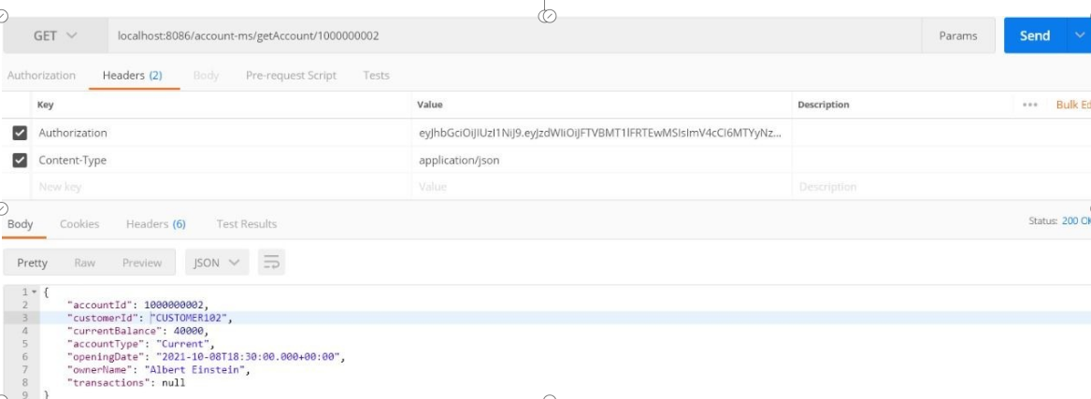
Account Microservice

Slide 16
Transaction
❖Transaction Microservices will perform operations like:
●Fetching transactions history for individual account.
●Validating the account details for individual customer.
●Checks minimum balance for the transfer and withdraw account.
❖Transactions microservice will interact with Account microservice to actually complete the transactions within the accounts.

Slide 17
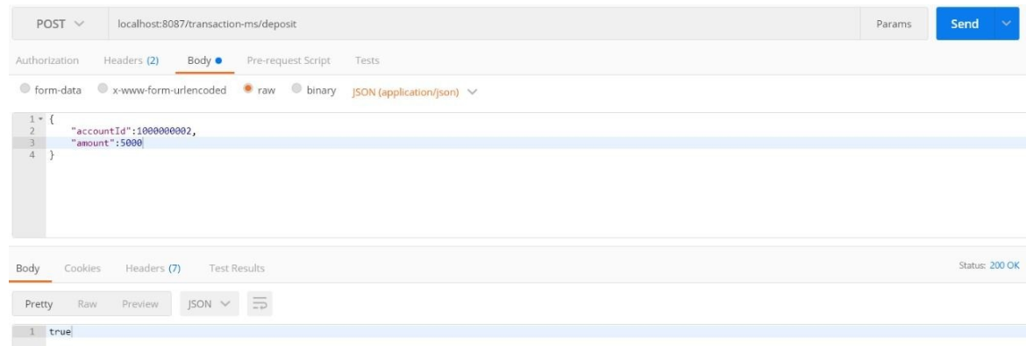
Transaction Microservice

Slide 18
Rules
❖Rules Microservice will be responsible for evaluating rules:
●Minimum Account Balance &
●Service Charge Deduction
❖Interacts with account and transaction microservice for checking rules while transferring and withdrawing from source account.

Slide 19
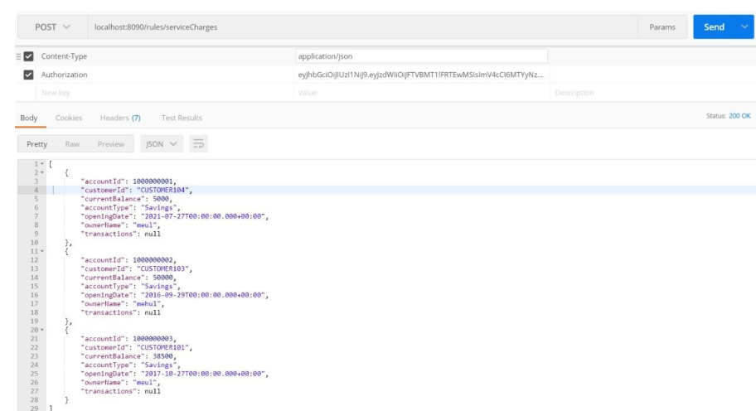
Rules Microservice

Slide 20
AWS Working URLs
Account:
http://retail-bank-account-ms-env.eba-acd8m6sf.us-east-1.elasticbeanstalk.com/
Customer:
http://retail-bank-customer-ms-env.eba-56j4use6.us-east-1.elasticbeanstalk.com/
Rules:
http://retail-bank-rules-ms-env.eba-8gbgkyt9.us-east-1.elasticbeanstalk.com/
Authentication:
http://retailbankauthms-env.eba-ajxjmqqz.us-east-1.elasticbeanstalk.com/
Transaction:
http://retail-bank-transaction-ms-env.eba-wyahx7n3.us-east-1.elasticbeanstalk.com/

Slide 21
THANK YOU

