Slide 1
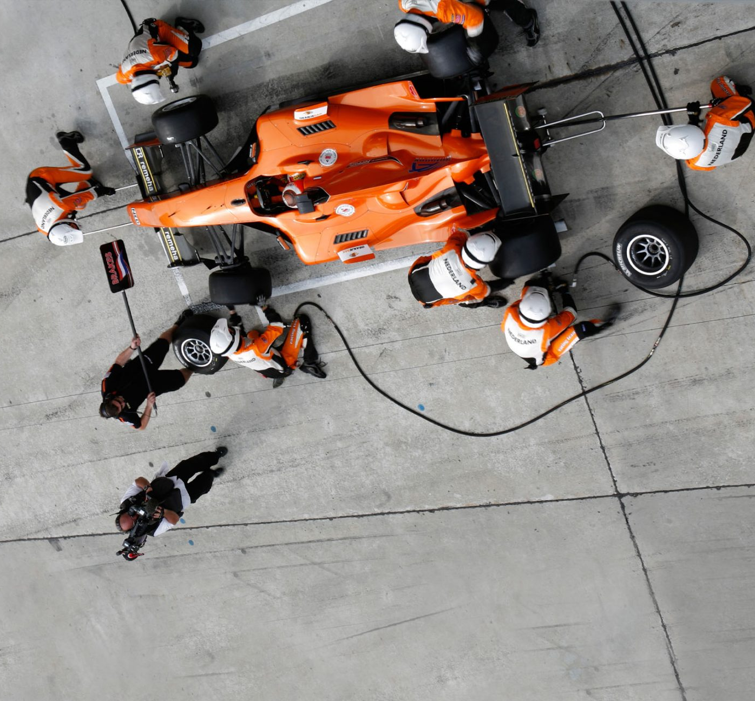
EZ Brand Guidelines 2.0

Slide 2



Entities

Slide 3



Brand Image
Brand Image
Faster than the Fastest
Consistently High-Quality
Round the Clock Availability

Slide 4


Brand Values
Brand Values
Innovating with AI
People First

Slide 5
Brand Identity
R: 60
G: 195
B: 242
R: 234
G: 123
B: 44
R:61
G:61
B: 61
R: 10
G: 53
B: 31
R: 241
G: 183
B: 21
R: 237
G: 162
B: 124
R: 14
G: 41
B: 73
R: 144
G: 25
B: 24
#3cc3f2
#ea7b2c
#3d3d3d
#0a351f
#F1b715
#eda27c
#112949
#901918
Primary
Secondary
Typography
Exo 2.0
Cambria

