Slide 1
Data Visualization
Exploratory Health and Fitness Data Analysis using Smart Watches
Apple Watches Vs FitBits
Akshya Ramesh
Rathnapriya Gopalakrishnan
Gokul Ragunandhan Narayanasamy

Slide 2
Introduction
Fitness trackers like smartwatches gives users important information that can help with the improvement of their health.
Users can monitor their step count, heart rate, and calories burnt to determine which aspects of his/her health need to be improved
Around 92% of people with smartwatches use it to improve their health by tracking their daily activity. [5]

Slide 3
AIM
To explore and analyze data collected from smart watches to investigate the association among fitness metrics and how they are influenced by various physical activities

Slide 4
About the Dataset
Data is collected from Harvard datasets where they conducted a study on participants wearing Apple watch Series 2 and Fitbit watch
The participants were 23 men and 26 women, who performed a series of physical activities like lying, sitting, running 3, 5, and 7 meters
Metrics such as heart rate, number of steps taken, distance covered, calories burned, are recorded and attributes such as age, gender, height and weight of the participants are noted down

Slide 5
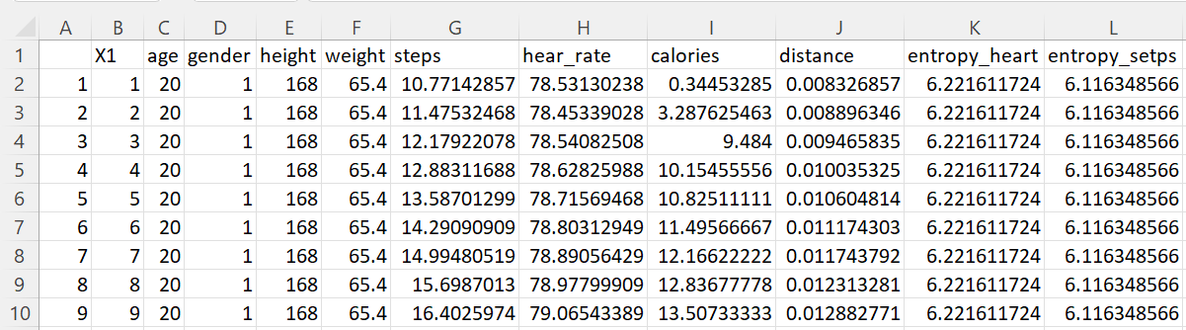
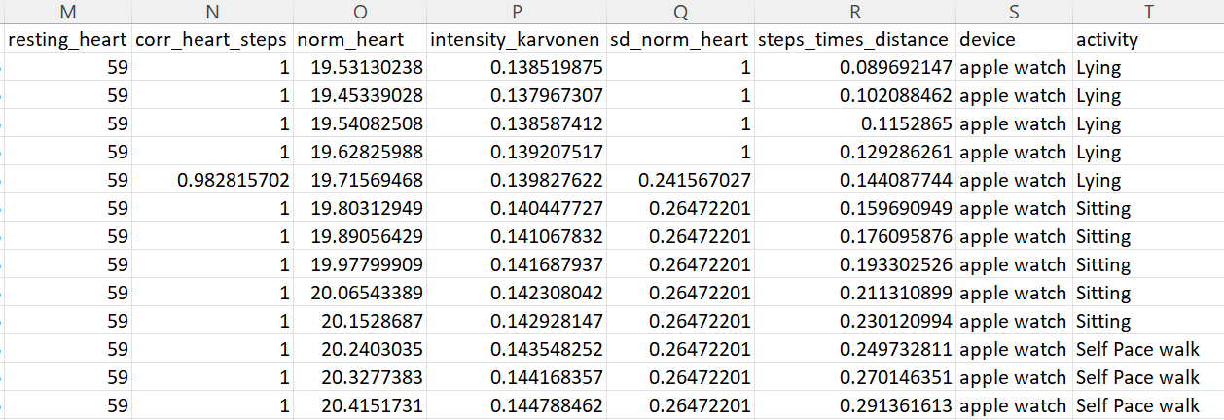

Slide 6
Data Visualizations

Slide 7
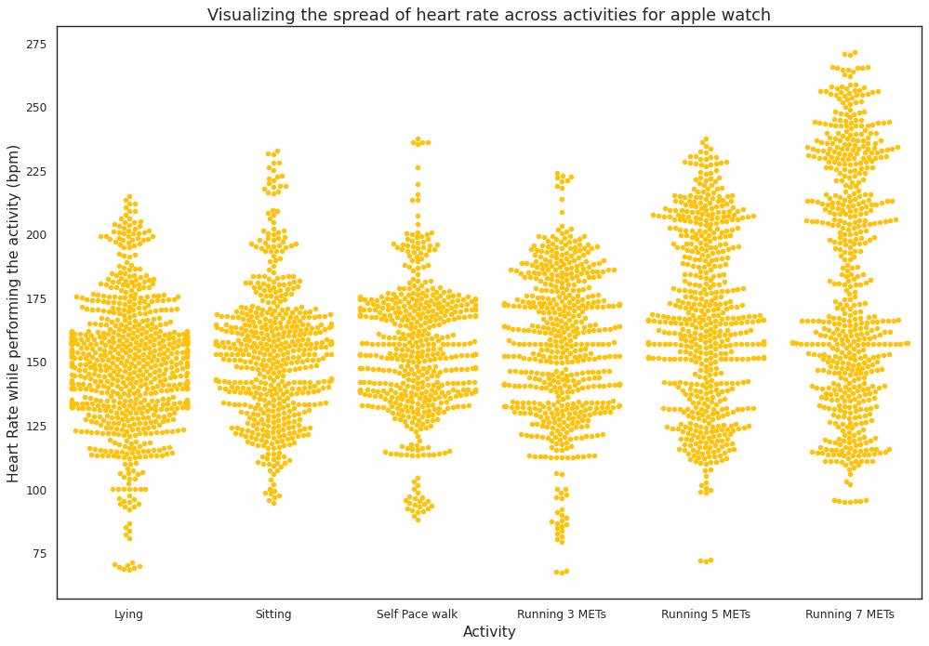
Visualizing the difference in the heart rate across six activities for apple watch
We can see that as the level of running increases from 3m to 7m, the range of heart rate shifts higher.
Heart Rate for lying activity lies in lower ranges from 75 to 225.
Sitting, Self Pace Walk an 3m running have similar distributions.
Notes:
Talk about the number of records increase for each activity. For eg: for lying most of the records lie between 130 to 160…
Not easy to infer mean and median in this visualisation. May be useful to reprsertn that too

Slide 8
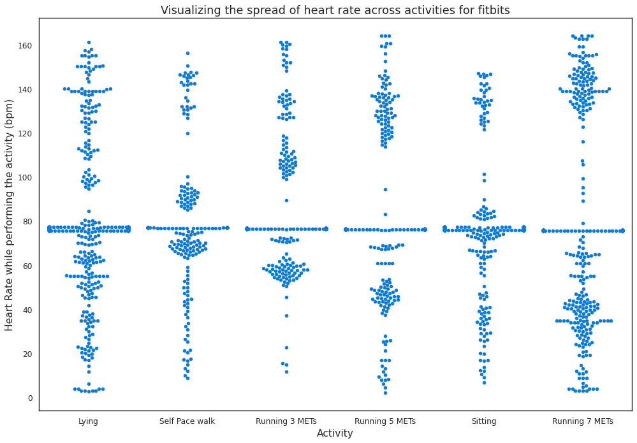
Visualizing the difference in the heart rate across six activities for fitbit watch
Unlike the apple watch data, we have a lot of gaps in the fitbit heart rate data.
All of activities have similar distributions which seems unlikely.
Let us use a violin plot to visualize this better in the coming slides.
Notes:
2nd point - give example - lying and 7 meter have almost same distribution.
Most people have the same heart rate which seams to be a little odd.

Slide 9
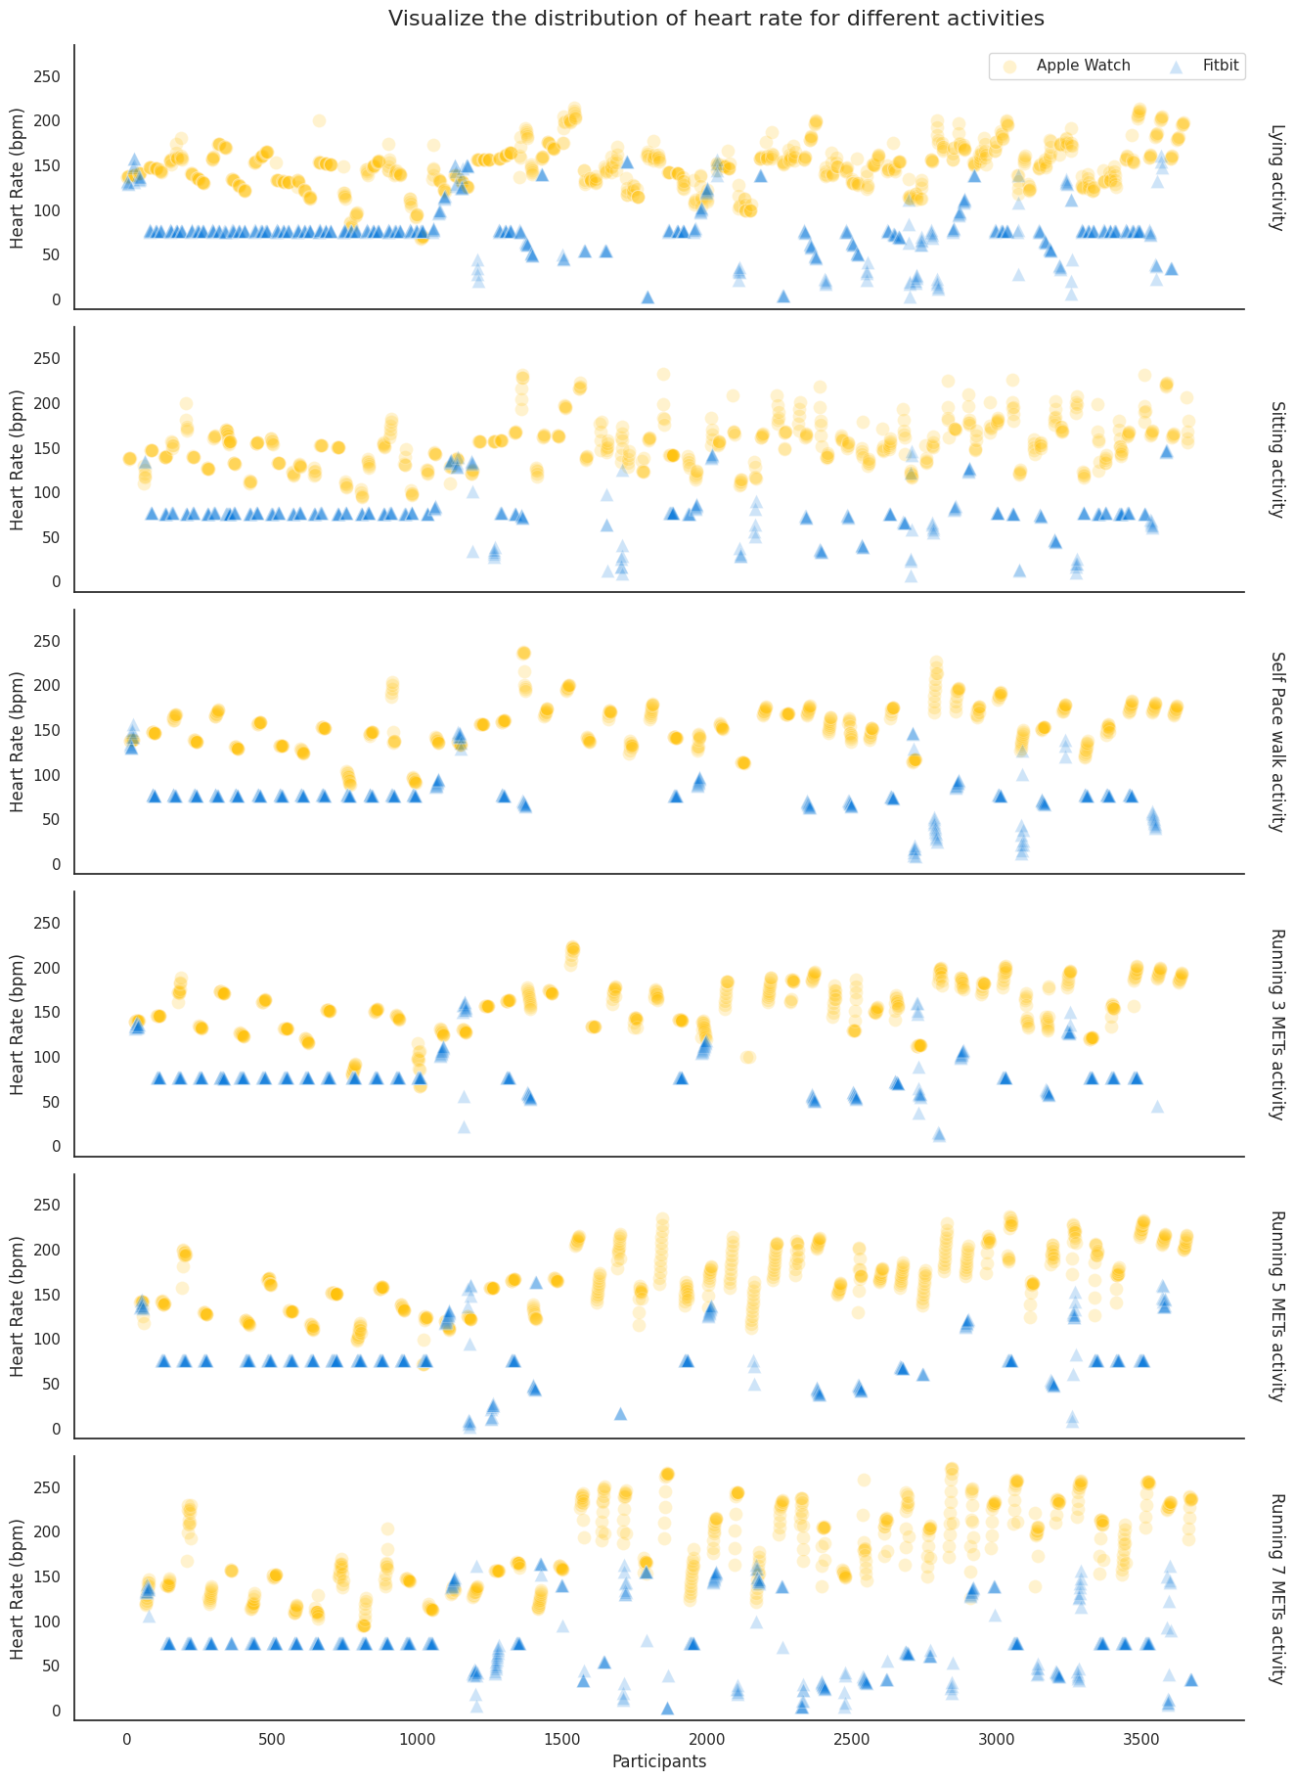
Visualizing the distribution of heart rate across different activities for apple watches and fitbits
We used a 1D scatter plot to see how the data is distributed for Apple and Fitbit watches for each activity
We notices that the heart rate recorded by the apple watches are always on the higher end when compared to the fitbit watches.
The fitbit watches failed to capture the variation in data as apple watches do.
To understand this better we performed a violin plot
Notes:
Apple watches heart rate are on the higher side. On the other side we could see that fitbit failed to capture the variation.

Slide 10
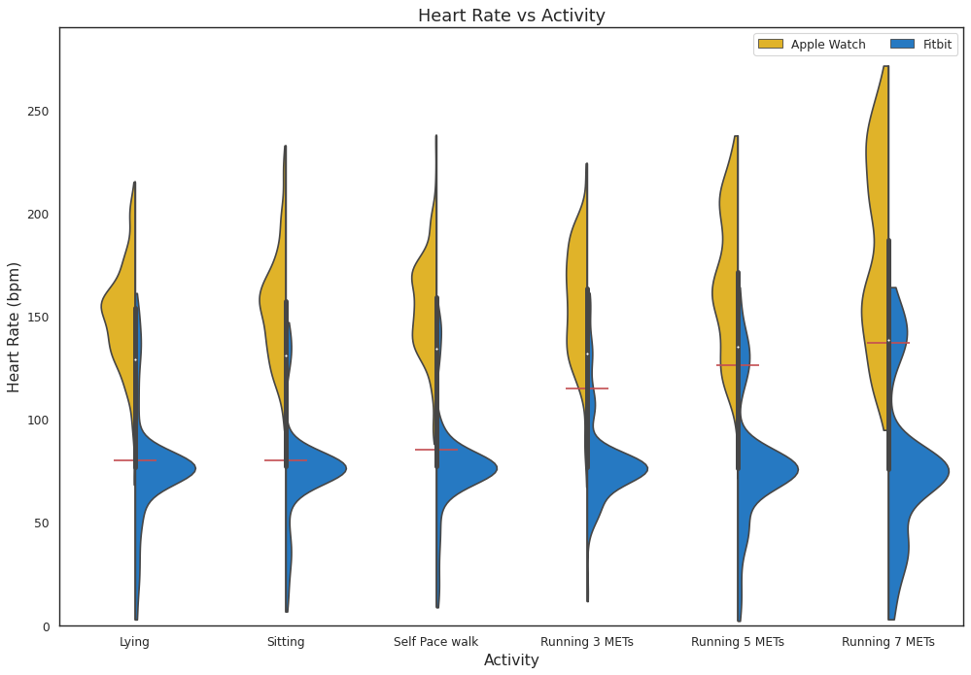
Violin plot to visualize the distribution of heart rate for apple and fitbit watches across each activity
Clutter-free visualization
For apple watch data, we see a same trend like the swarm plot.
For fitbits,
The lower range for the activities has a minute increases from lying to 3m run, but their median seems to remain the same.
For 5m and 7m running, our lower limits extends to 0 which seems off.
Notes:
Talk about median
LAST POINT - MAY BE SOME ISSUE WITH THE RECORDING OR MAYBE SOME PPL DINT WANT TO RUN :p

Slide 11
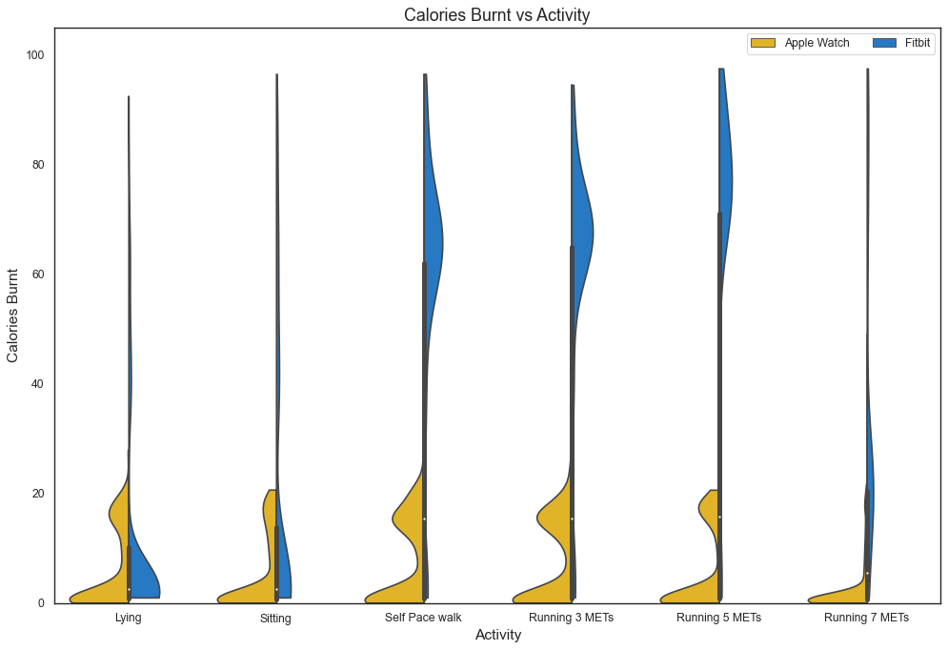
Violin plot to visualize the distribution of calories burnt for apple and fitbit watches across each activity
The apple watches’ distribution falls below 20 cals, whereas the fitbit’s calories lies in the higher ranges for Walking and Running.
Fitbit’s data for Lying and Sitting lies in the lower ranges below 20 cals.
Other than for 7m running, fitbit data seems to more accurately reflect our assumptions.
Notes:
Talk more about how 7 m has lower calorie burn than others.

Slide 12
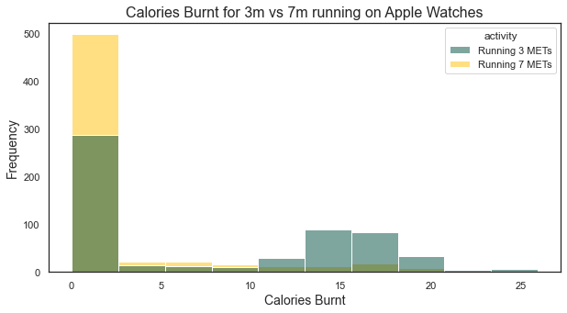
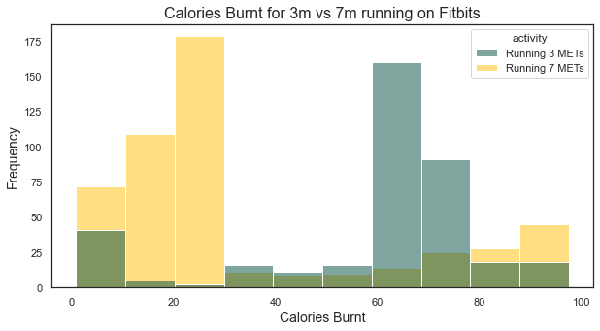
Is there a significant difference in the calories burnt when comparing 3-meter and 7-meter running
It seems that the calories burnt in the 3m run occupies a wider distribution
Whereas the 7m running has positive skew, having more observations in the 0 cal zone
Notes:
We also notice a lot of observations for 3m running range 15-20 cals and 40 - 70 cals for apple and fitbit respectively
Whereas, for the 7m running the values range lesser than 3m running. We have a lot of observations in the range 0-15 and 0-30 for apple and fitbit respectively

Slide 13
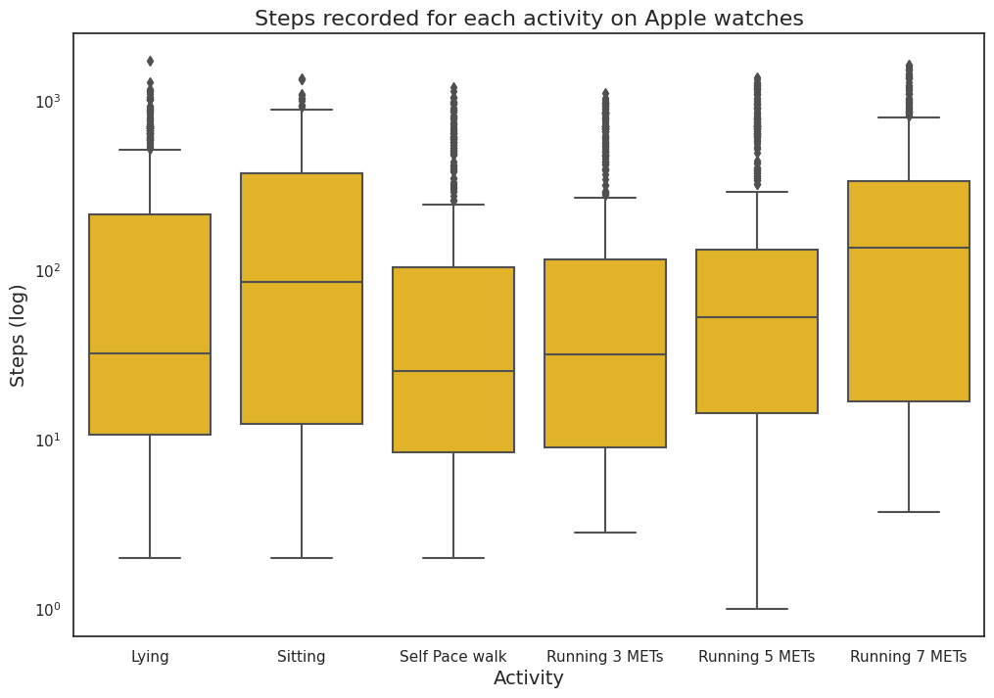
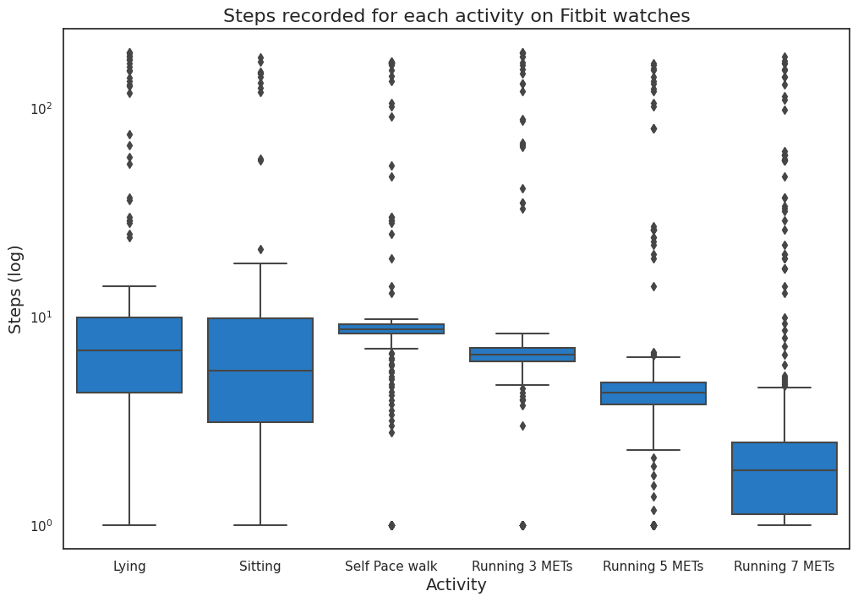
Visualizing the steps recorded for each activity
From the given box plots we can see that apple watches perform better in capturing the number of steps taken for 3m, 5m, and 7m running when compared to the fitbit data, as we see a trend of increasing step counts as the activity goes from 3m to 7m running.
Both the watches perform poorly by recording that there are steps taken during lying and sitting activity which is unlikely

Slide 14
Visually explore the difference among various categories such as Male vs Female, different Age Groups and different BMI classes.

Slide 15
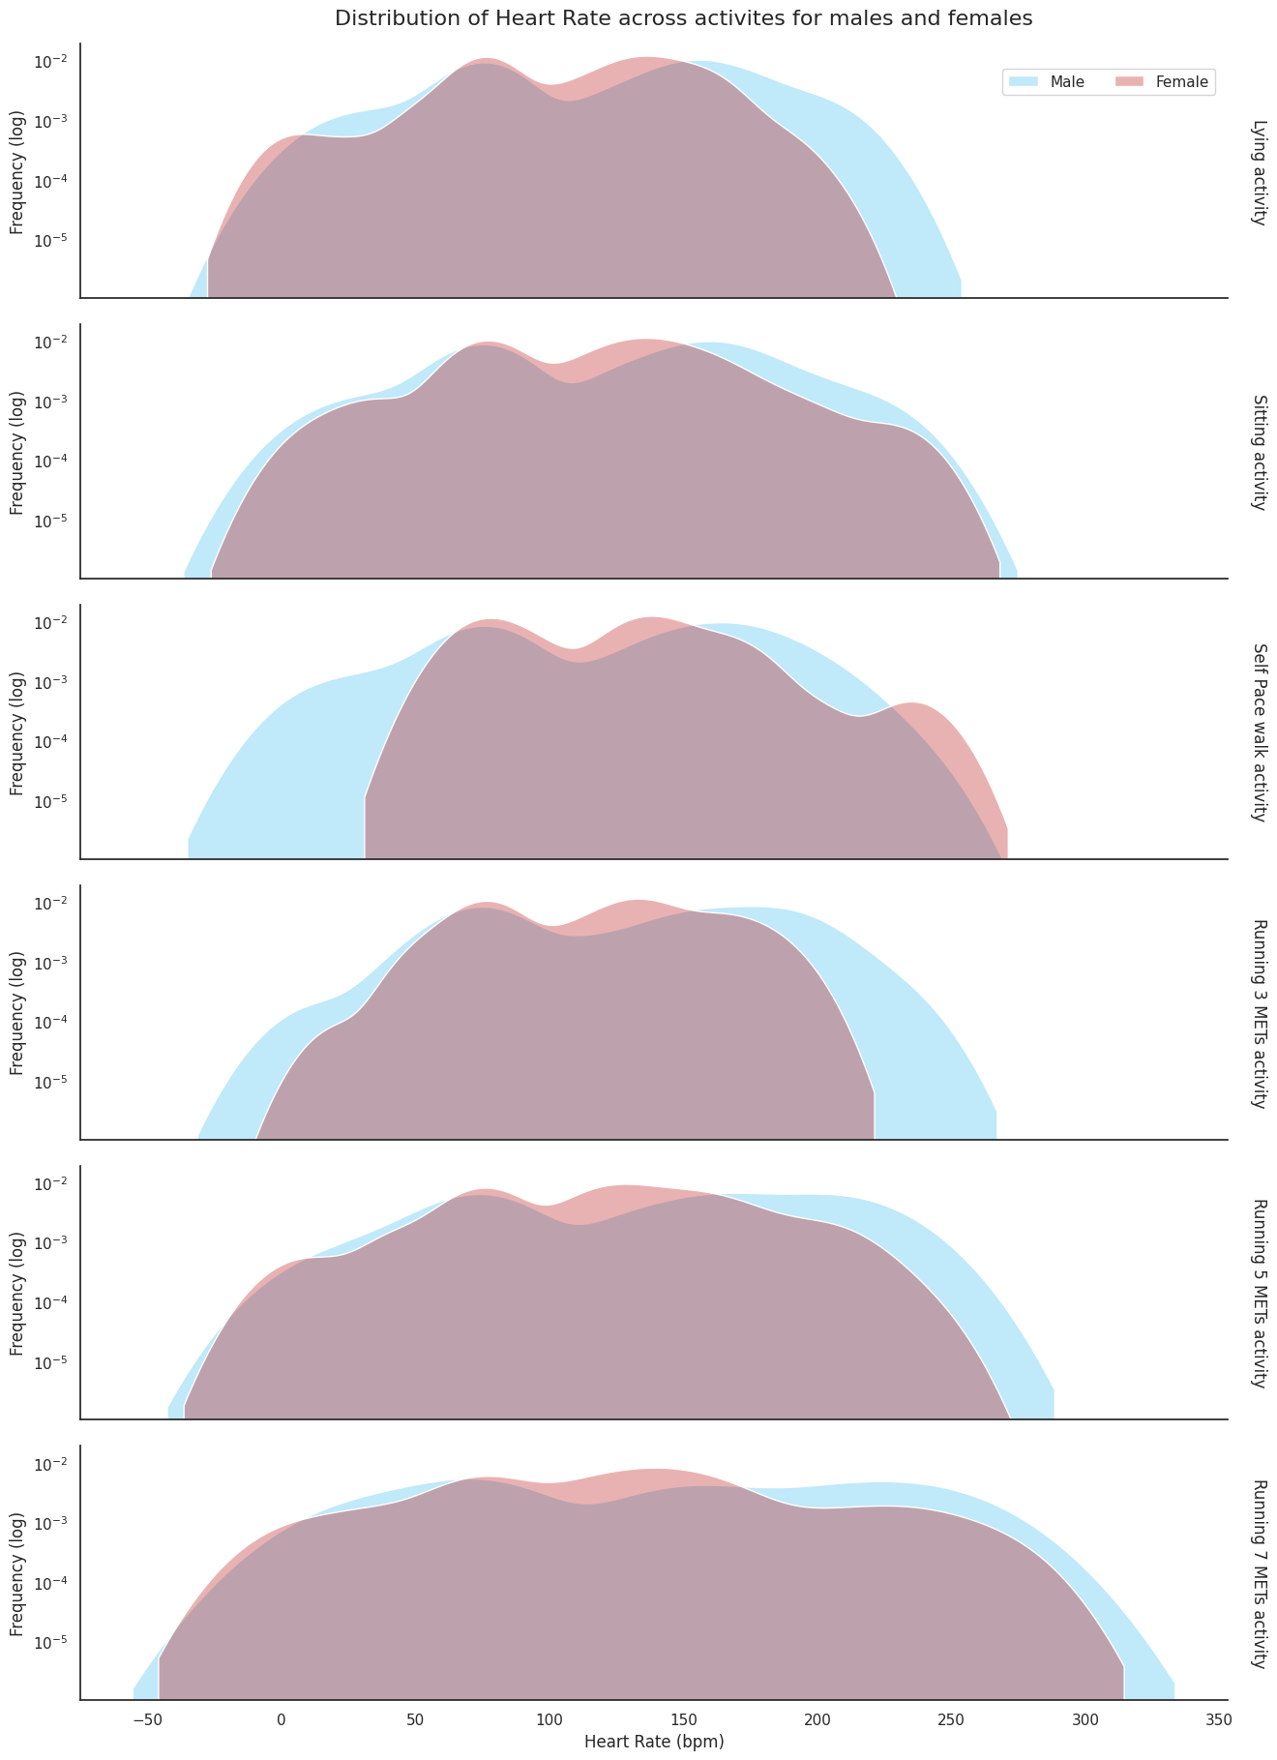
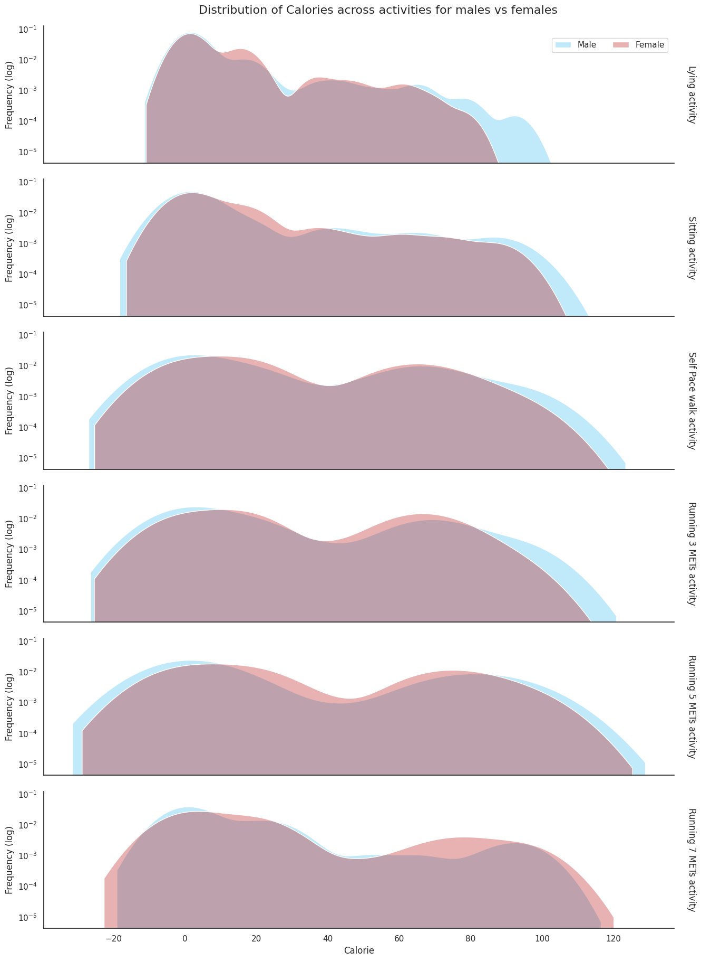
Visualize the similarity in heart rate and calories burnt for male and female across each activity
We have almost the same distribution of Calories burnt for Male and Female.
For Heart Rate, in self paced walk, the distribution for male, ranges lower than females.
For both self-paced walking and 3m running, the distribution of male is wider than that of female.

Slide 16
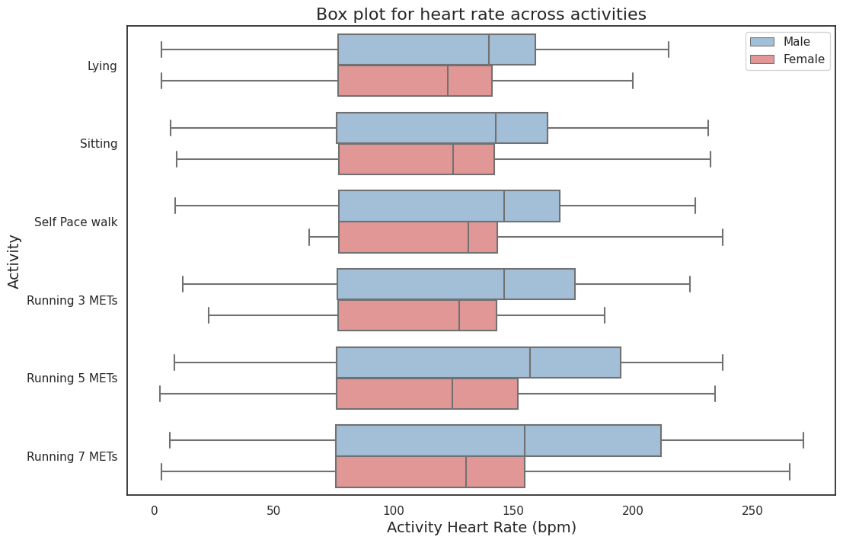
Box plot to visualize the Heart Rate for each activity for both male and female
To get a better look at the how heart rate varies for male and female, we used a box plot.
We can see that the median of males always fall higher than females.
And the quartile range is also wider than that of females.
Notes:
Tell lot of data so didnt overlay with swarm plot.

Slide 17
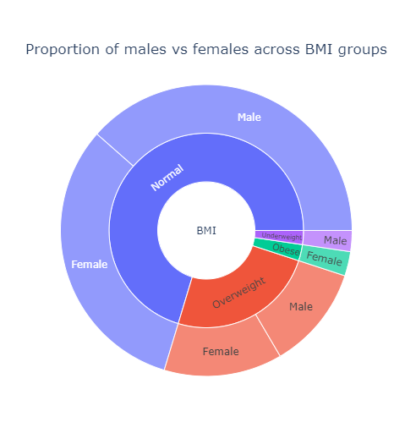
Analyze the proportion of male and female for each BMI category
We used a sunburst plot to visualize the proportion of male and female in each of the BMI group
Since using a donut chart are hard to interpret the exact values, we corrected our mistake by plotting a stacked bar plot.
Notes:
Normal -
Overweight -
Obse -
Underweight

Slide 18
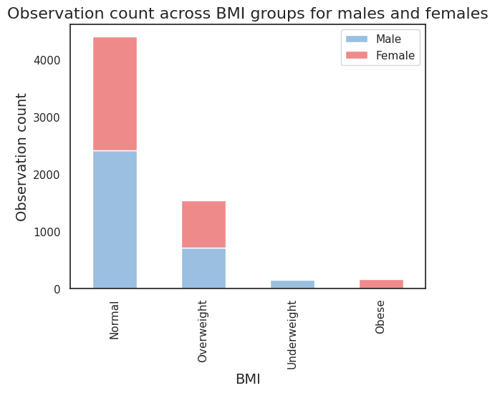
Stacked bar plot to analyze the proportion of male and female for each BMI category
We can better interpret this visualization.
There are almost equal number of participants who fall under the normal and overweight BMI category

Slide 19
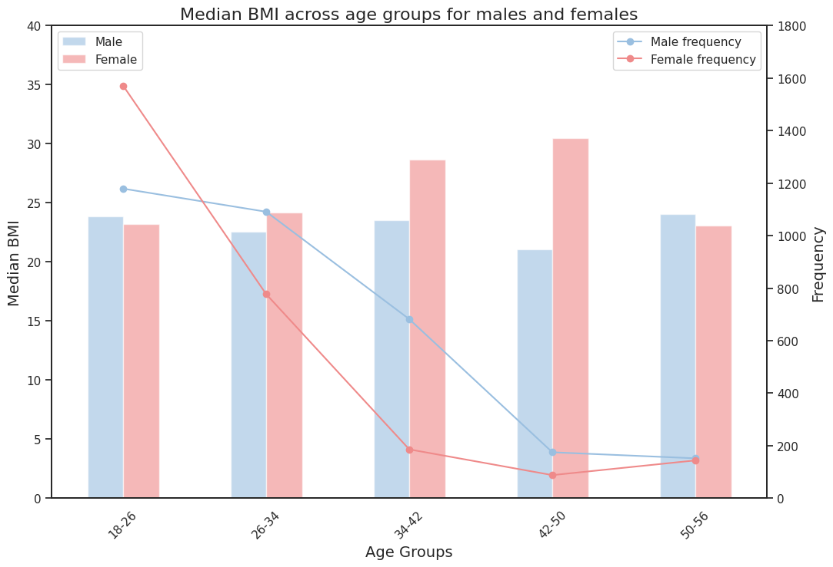
Visualizing how Median BMI varies across age groups for male and female
For higher age groups we have less and less records.
For female, the median BMI for 34-42 and 42-50 are higher than the rest.
Having a balanced data with an equal number of observation for each age group, could provide an unbiased analysis.

Slide 20
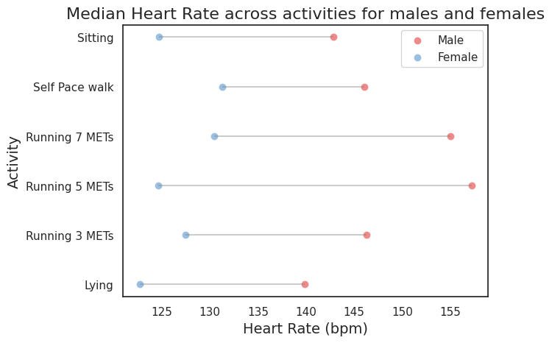
Lollipop visualization for median heart rate between male and female
This visualization, focuses on the difference in median heart rate between male and female across the activities.
We have see that the median heart rate of male is always higher than female.
Notes:
Dint start the scale from 0 because we just wanted to concentrate on the difference

Slide 21
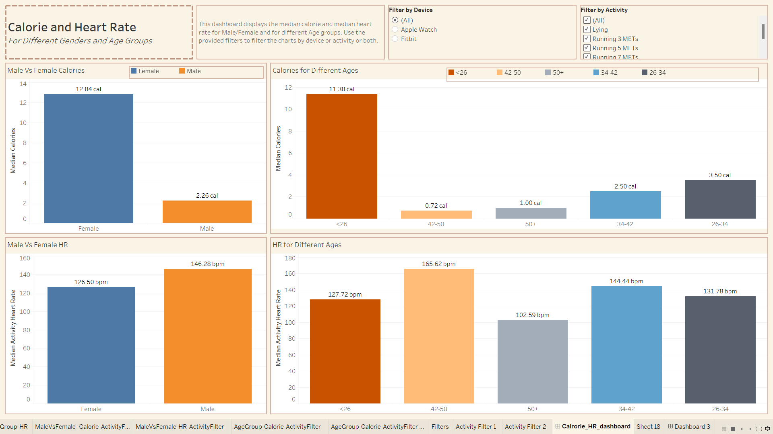
Interactive Dashboard using Tableau
You can view the median heart rate and calorie for different genders and age groups. You can interact with the visualization using the filters for devices and activities.
Link:https://public.tableau.com/views/DV_Project_16695919079250/Calrorie_HR_dashboard?:language=en-US&publish=yes&:display_count=n&:origin=viz_share_link

Slide 22
Results
From multiple color-blindness friendly visualizations, we were able to obtain some interesting insights.
Both Apple and Fitbit watches collect the data in a different way
Apple and fitbit watches perform poorly when it comes to capturing the steps during lying and sitting activity.
We can see that the Apple watches is able to capture the heart rate better when compared to the fitbit as the seen in the swarm plots.
Unlike our assumption, that 7m running burns more calories when compared to 3 m running, the visualization tells a different story.
Our visualization shows that the median heart rate for male is always higher than female irrespective of the activity which is a proven fact. [1]
We also suggest using a balanced dataset which has equal number of observations for each age groups in order to perform more accurate analysis.
Notes:
For calories, Apple Watch collects active calories, that do not include a constant to account for basal metabolic rate whereas fitbit does not capture a true 0 value for sitting and lying with will be the ideal case.
2.apple watch is better able to capture individual heart rate, where as for fitbit the hear rate falls within specified intervals

Slide 23
Thank You!

Slide 24
Reference
Saleem S, Hussain MM, Majeed SM, Khan MA. Gender differences of heart rate variability in healthy volunteers. J Pak Med Assoc. 2012 May;62(5):422-5. PMID: 22755301.
https://assets.researchsquare.com/files/rs-17022/v1/d5923374-d56c-4fe7-a036- 949ecf41917e.pdf?c=1631831698
https://dataverse.harvard.edu/file.xhtml?persistentId=doi:10.7910/DVN/ZS2Z2J/SEZCTK &version=1.0
https://towardsdatascience.com/data-analysis-of-your-applewatch-workouts672fe0366e7c
https://www.valuepenguin.com/fitness-tracker-smartwatch-health-survey#:~:text=The%20vast%20majority%20(92%25),achievements%20cited%20by%20smartwatch%20users.

