Slide 1
Bank Campaign Recommendation
System
Recommendation System
Batch details | DSE FEB 2021
Team members | Bhawyaraj Panicker Pauline Rathni Grace Rhea Prakash Syed Mohd Emad Imam
Domain of Project | Recommendation System
Proposed project title | Bank Campaign Recommendation System
Group Number | 5
Team Leader | Syed Mohd Emad Imam
Mentor Name | Mr. Animesh Tiwari

Slide 2
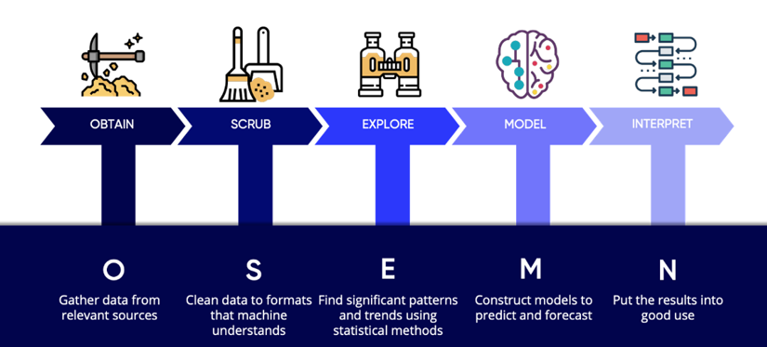
Agenda
01
Problem Definition
02
Exploratory data analysis
03
Feature Engineering and statistics
04
Model Building
05
Solution & Conclusion

Slide 3
Problem Definition
What Improves Marketing ?
How does recommendation system play a major role in improving the efficiency?
Targeted system : Bank campaigning recommendation system
Our primary goal : Understand, Analyse and Correlate various ML algorithms to direct those customers to appropriate campaigns
Who are likely to subscribe ?
‘Portuguese banking institution’ dataset
41188,21
Data Dictionary : 'age', 'job', 'marital', 'education', 'default', 'housing', 'loan', 'contact', 'month’, 'day_of_week', 'duration', 'campaign', 'pdays', 'previous', 'poutcome', 'emp.var.rate', 'cons.price.idx', 'cons.conf.idx', 'euribor3m', 'nr.employed', 'y'
The data is related with direct marketing campaigns of a Portuguese banking institution. The marketing campaigns were based on phone calls. Often, more than one contact to the same client was required, in order to access if the product (bank term deposit) would be ('yes') or not ('no') subscribed.

Slide 4
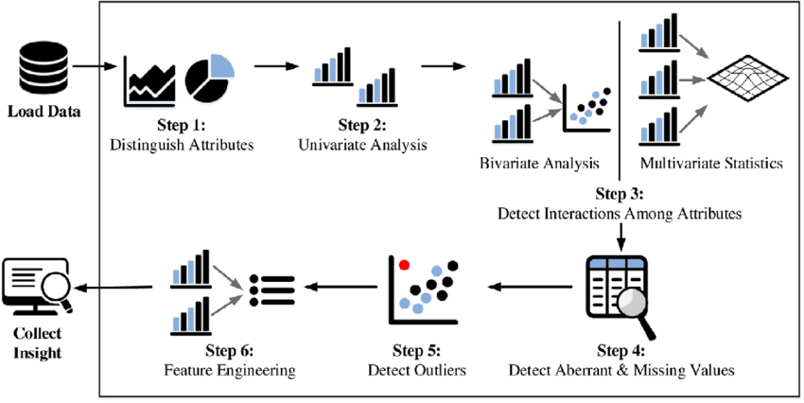
Exploratory Data Analysis
DATA ANALYSIS, CLEANING/ PREPROCESSING
Exploratory Data Analysis (EDA) is an approach to extract the information enfolded in the data and summarize the main characteristics of the data. It is considered to be a crucial step in any data science project
For Categorical data -> Replaced/Filled null values based on mode value.
For numerical data -> Based on skewness and symmetry , Filled values with mean/Median.

Slide 5
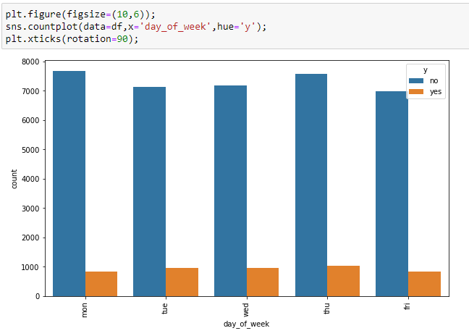
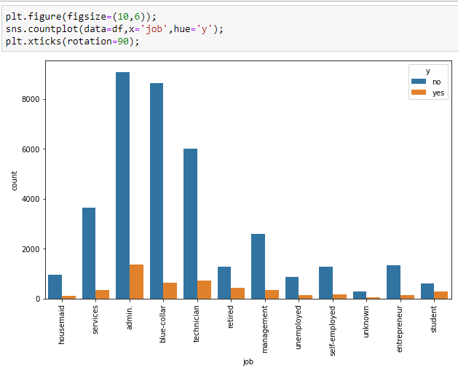
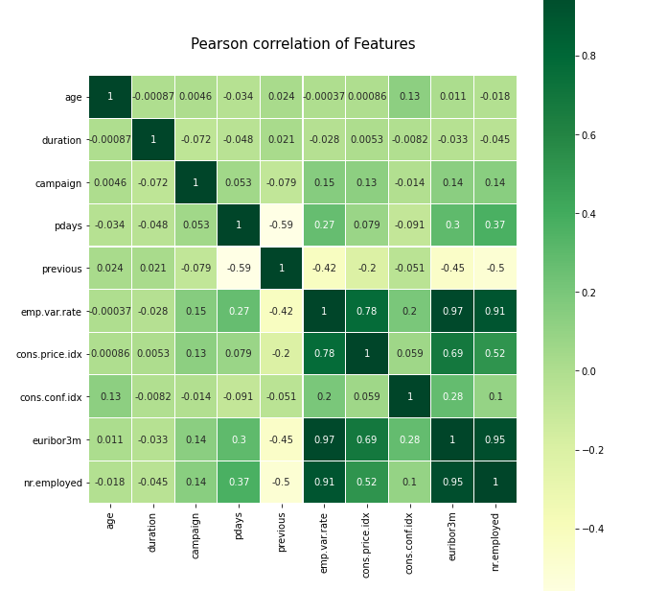
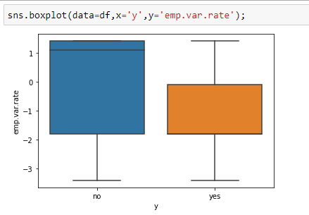
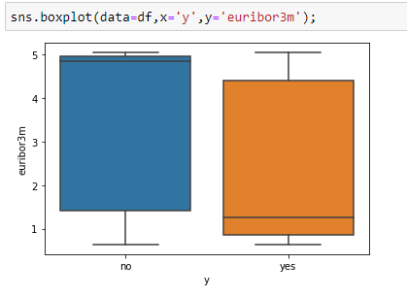
EDA of Categorical Features
EDA of Numerical Features
The emp.var.rate, cons.price.idx, euribor3m and nr.employed features have very high correlation. With euribor3m and nr.employed having the highest correlation of 0.95
Euribor3m: We can clearly see the difference in median for both the classes. This indicates that the feature can be very useful in predicting the term subscription.

Slide 6
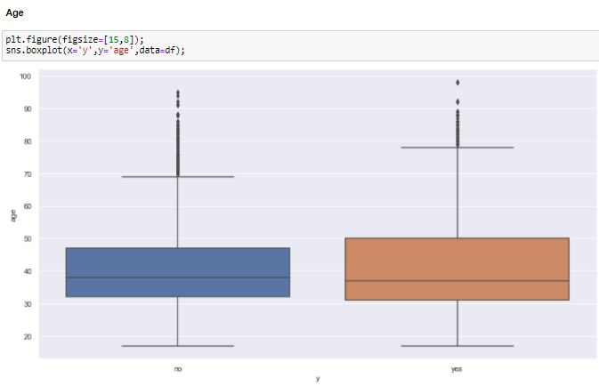
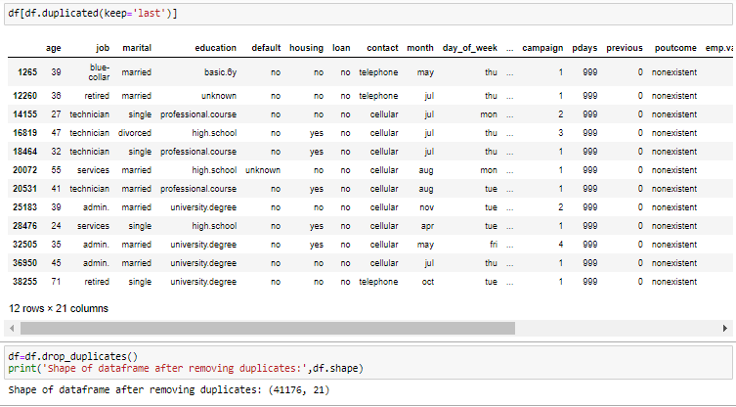
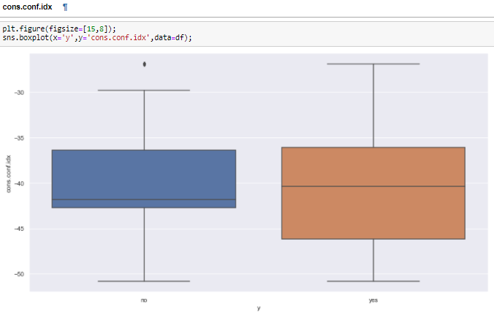
Boxplot and Z-score gives us the outliers present in the data.
Performed outliers treatments on 3 variables:
cons.price.idx(Boxplot, since Zscore gave same approx. number of outliers)
Previous(removed based on count, since the ouput was 50% for yes and 50% for no)
Outlier Treatment

Slide 7
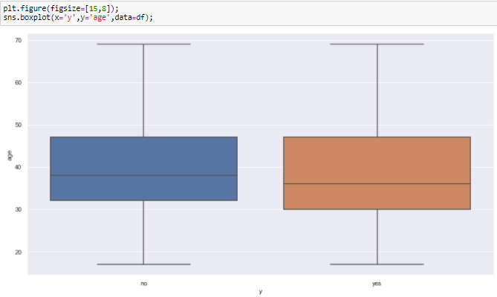
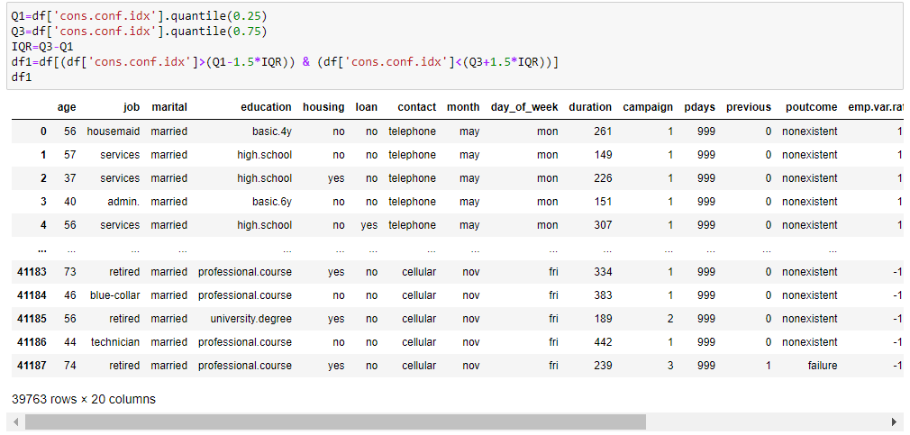
Outlier Treatment
Outlier removal :
Outlier removal using IQR :

Slide 8
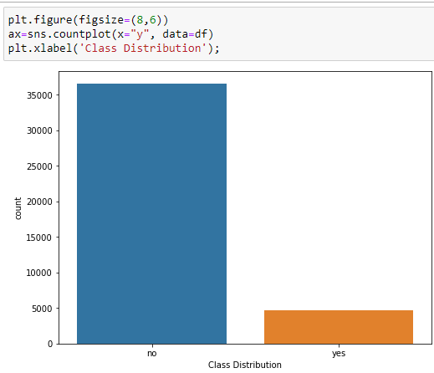
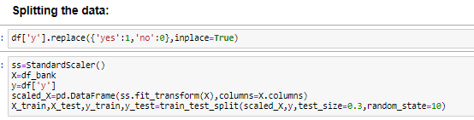
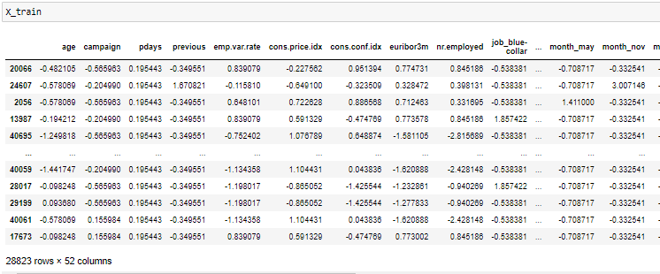
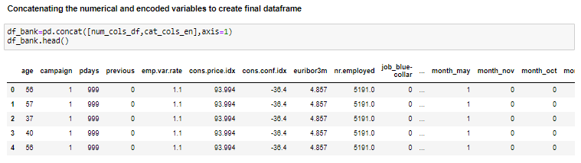
Imbalance in target variable :
Feature Engineering
Scaling and splitting of Features:
Creating final Dataframe with encoded variables:

Slide 9
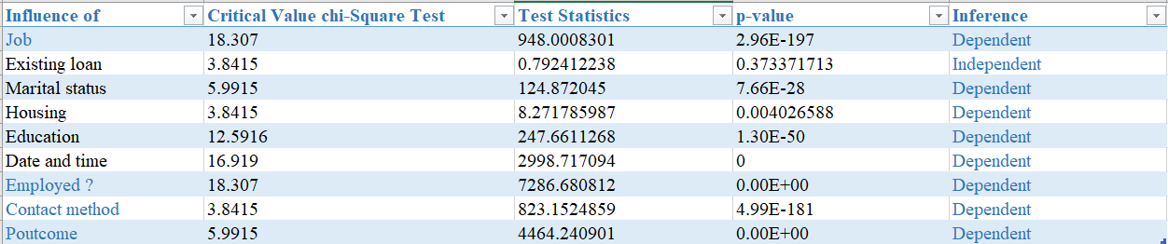
How the features are related to target variable ‘y’:
How does the age of customer affect subscription?
Does having a job influence the decision of subscribing to a bank term deposit ?
Does having an existing loan affect the decision of subscribing to a bank term deposit ?
Is marital status affecting the customer subscription ?
Are social and economic indicators relevant?
Are date and time conditions relevant to the subscription ?
is term deposit subscription dependent or independent on housing?
duration has any effect on term deposit?
pdays has any effect on term deposit?
nr.employed has any effect on term deposit?
contact method has any effect on term deposit?
previous has any effect on poutcome?
poutcome has effect on subscription
Statistics

Slide 10
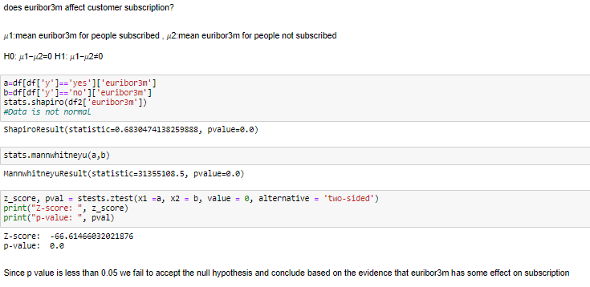
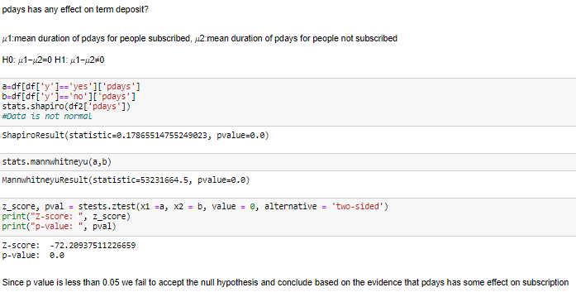

Slide 11
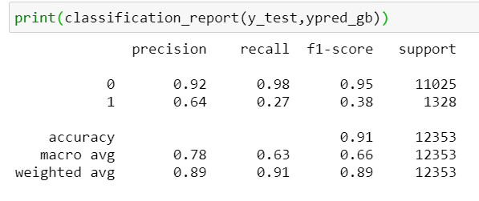
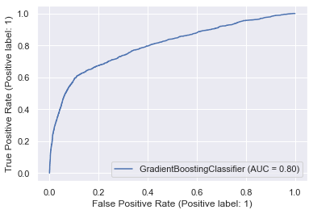
Model Building
Check for the assumptions to be satisfied for each of the models in
Regression – SLR, Multiple Linear Regression, Logistic Regression
Classification – Decision Tree, Random Forest, SVM, Bagged and boosted models
Clustering – PCA (multi-collinearity), K-Means (presence of outliers, scaling, conversion to numerical etc.)
Machine learning is the study of computer algorithms that improve automatically through experience and by the use of data.
BASE MODEL : For our classification problem , We have taken the Gradient Boosting model as our base model for this project.
The GB algorithm can compete with the most accurate models because it makes highly accurate predictions. Therefore, you can use the GB algorithm for applications that require high accuracy but that do not require a human-readable model.

Slide 12
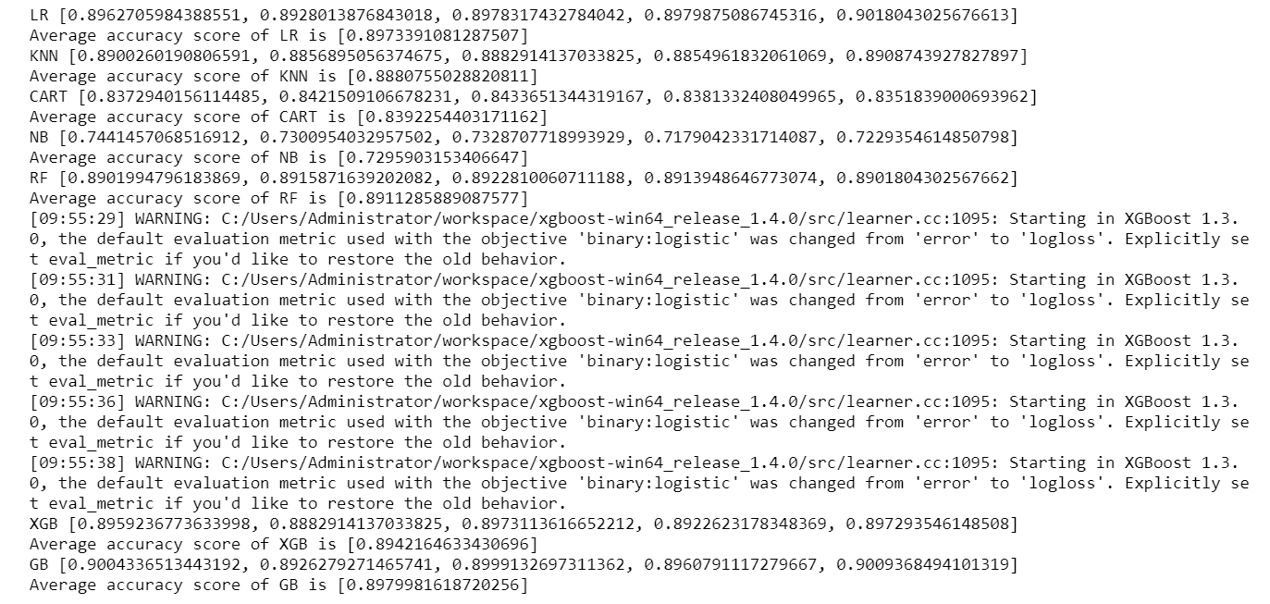
Model Building
Comparison to benchmark:
After performing a KFold Validation, we got an accuracy of 89.7% for Gradient Boosting classification ML algorithm.

Slide 13
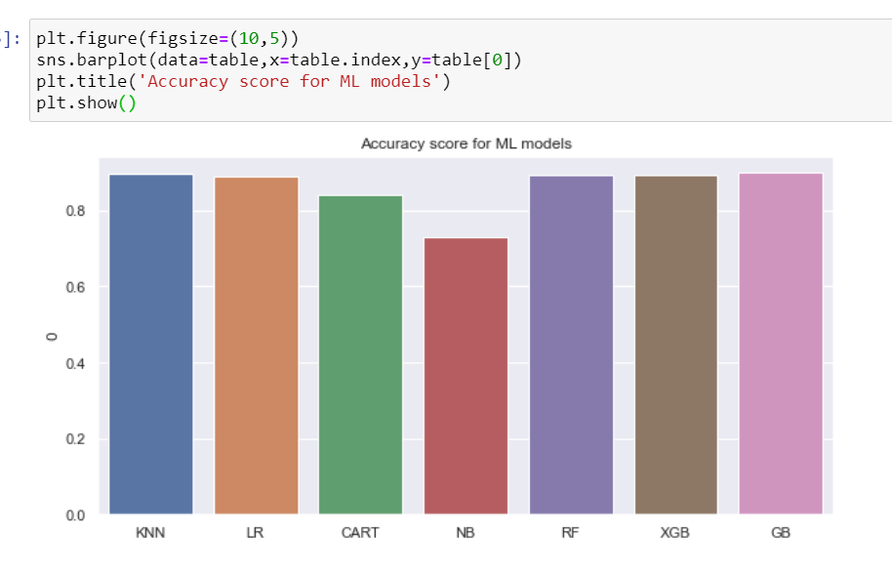
Model Building
The accuracy has improved a bit from the benchmark. The accuracy obtained from KNN was 88% and we got an accuracy of 89.7%

Slide 14
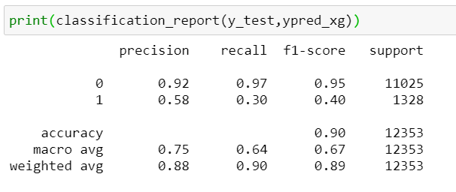
Model Building
Compare classification algorithms
Classification report shows the precision, recall, F1 and support scores for the LR classification model.
Precision of 0 (the client said no) represents that for all instances predicted as no subscription, the percentage of clients that actually said no is 88%.
Recall is the ability of a classifier to find all positive instances. Recall of 0 indicates that for all clients that actually said no, the model predicts 100% correctly that they would decline the offer

Slide 15
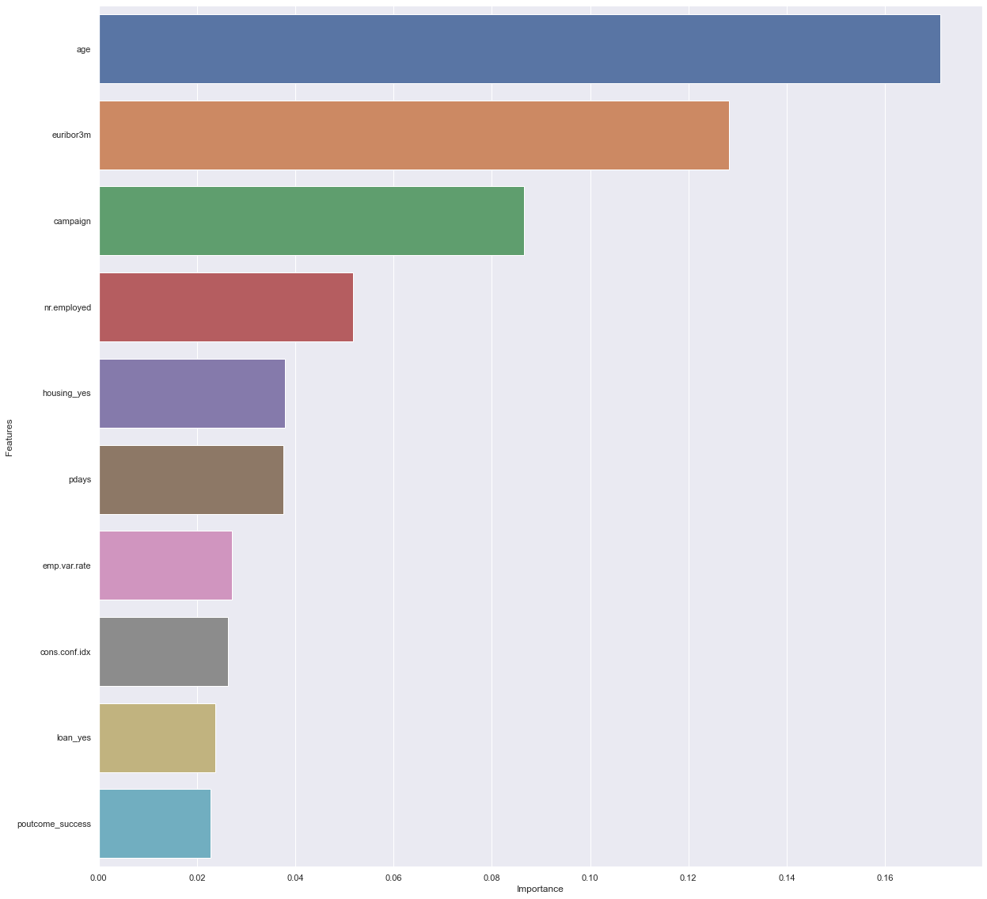
Solution
& Interpretation
Recommendations:

Slide 16
Thank You!

