Slide 1

A PRESENTATION
ABOUT MYSELF
Presented by: Tirth Rathod

Slide 2









I AM
I am an adaptive and calm individual with a friendly demeanor that makes me approachable to others. My disciplined nature ensures that I approach tasks with focus and determination, striving for excellence in everything I do.
I constantly seek new and innovative solutions to challenges. By understanding and being patient with people allows me to connect with people on a deeper level and foster positive relationships.

Slide 3






I LIKE
CHOCOLATE
GAMING
AUTOMOBILES
DRAWING
MOVIES
SLEEP

Slide 4

I HATE
LIES
EXPECTATIONS
PRESSURE
LABOUR
RAPID SITUATIONS
GETTING SICK

Slide 5

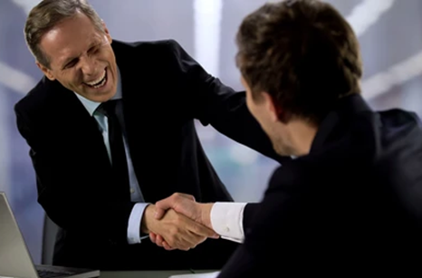


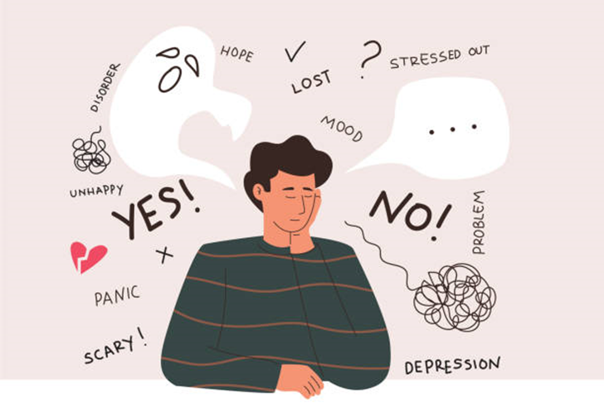
STRENGTH
Logical Thinker
Easy-Going
Quick-Learner
Patience
Lazy
Overthinker
WEAKNESS

Slide 6





OPPURTUNITY
Rise of AI
Freelancing
Industry Trends
Client Expectations
Rapid Technology changes
Competition
THREAT

Slide 7

January
I BELIEVE IN MYSELF

Slide 8

Thank You

