Slide 1
CSN-503 Advanced Computer Networks
Group Chat Application
Group - 10
17114004 Abhishek Rathod
17118007 Ajay Neeti Kannan
17114013 Anshuman Shakya
17114030 Suresh Babu Gangavarapu
17114008 Aman Jaiswal
17114009 Aman Verma

Slide 2
Problem Statement
To build a Group Chat Application using Socket Programming which can help students to communicate with each other. An authentication feature also needs to be implemented so that only the students of the hostel have the access.

Slide 3
Introduction
We implemented a desktop application for the Group Chat App using python programming language.
Technologies used in the application are :-
Python 3
Tkinter - The tkinter package is the standard Python interface to the Tk GUI toolkit.
SQLite3 - SQLite is a C library that provides a database and allows accessing the database using a nonstandard variant of the SQL.

Slide 4
Features Implemented
Admin can add and delete students in the database.
Students have to connect to the server as clients.
Students can login to the app using credentials given by the admin.
Students can change the initial password which was created by the admin.

Slide 5
Students can then chat with each other using the chat room.
The Admin Officials can post different hostel level notices for the students to view.
Students can then discuss their views with other students and the admin.
The students can also view other clients who are active on their screen.

Slide 6
Modules

Slide 7
Socket Programming - Python3
The Application is based on communication between server and clients using socket programming.
To meet our purpose of group chat, the connection of a client is set up with the server and then the server waits to receive messages from each client in different threads.
When a client sends a message to server, the server broadcasts the message to all the other clients.
In the client, threading is done for receiving messages from the server and for running the GUI.

Slide 8
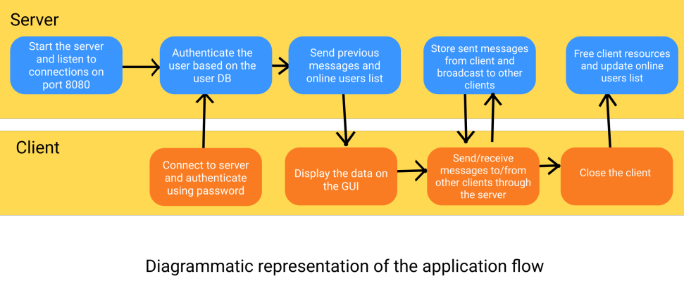

Slide 9
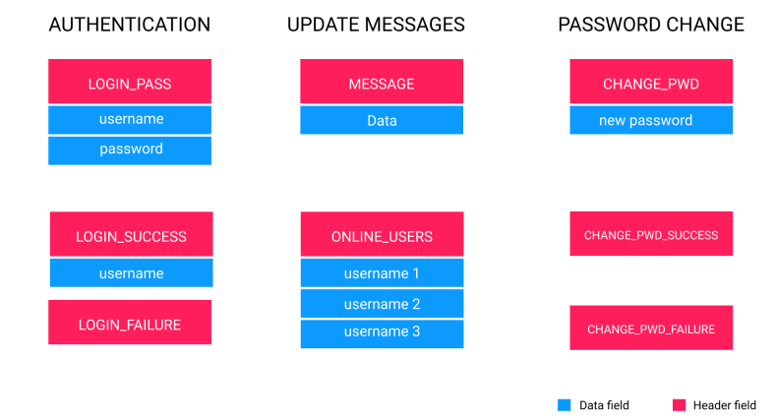
Types of Messages

Slide 10
2) Chat GUI - Tkinter
Tkinter is a framework that’s built into the Python standard library.
It’s cross-platform, so the same code works on Windows, macOS, and Linux.
The foundational element of a Tkinter GUI is the window. Windows are the containers in which all other GUI elements live.
The other GUI elements, such as text boxes, labels, and buttons, are known as widgets. Widgets are contained inside of windows.

Slide 11
Some widgets we used are:
Label - A widget used to display text on the screen.
Button - A button that can contain text and can perform an action when clicked.
Entry - A text entry widget that allows only a single line of text.
Text - A text entry widget that allows multiline text entry.
Frame - A rectangular region used to group related widgets or provide padding between widgets.

Slide 12
There are three main operations to perform with Text widgets:
Retrieve text with .get()
Delete text with .delete()
Insert text with .insert()
MessageBox Widget is used to display the message boxes in the application like error messages.

Slide 13
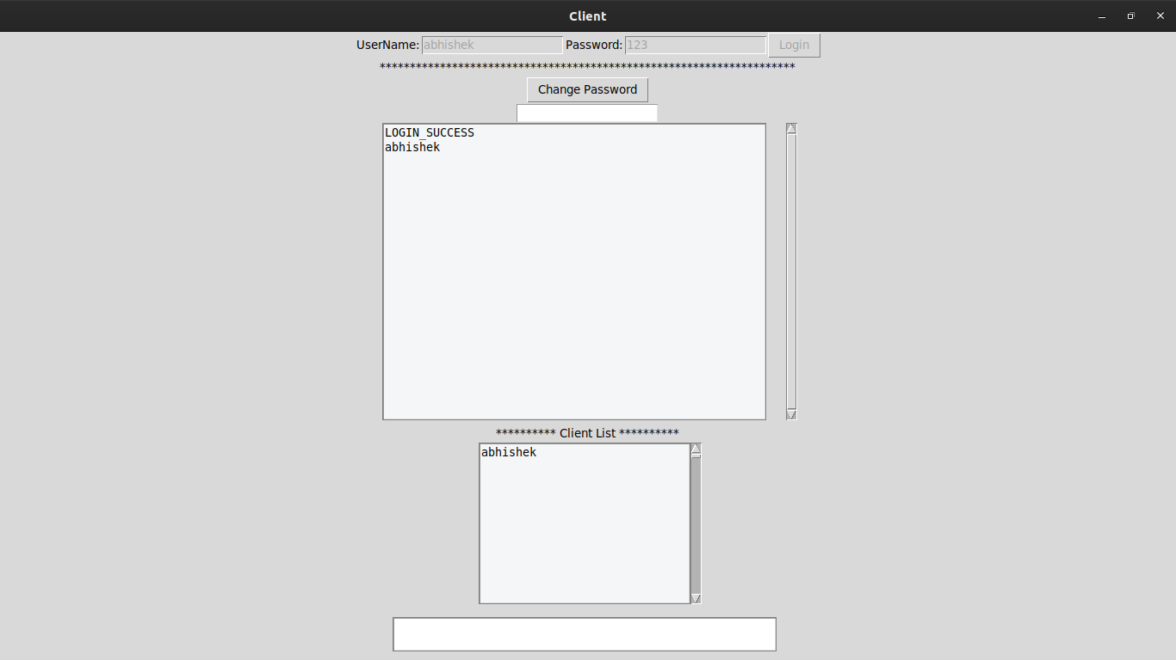

Slide 14
3) Database - SQLite3
SQLite is a C library that provides a lightweight disk-based database that doesn’t require a separate server process and allows accessing the database using a nonstandard variant of the SQL query language.
For this project the database required two tables:-
Users - to store different users and information. The stored information can be used to authenticate a user while login.
Messages - to store all the messages of group chat.

Slide 15
Database design is as follows :-
CREATE TABLE users (
pid INTEGER PRIMARY KEY NOT NULL,
Name TEXT NOT NULL,
enr_no INT,
password CHAR(50) NOT NULL,
Is_admin BIT
);
2) CREATE TABLE messages (
mid INTEGER PRIMARY KEY,
sender INT NOT NULL,
date DATETIME DEFAULT,
data CHAR(256),
FOREIGN KEY (sender) REFERENCES users(pid) ON
);

Slide 16
The admins who have access to the server, can use the terminal to register new students. This can be done by running the command
> python3 commands.py registerstudent
Users can be removed as well using the removestudent command
> python3 commands.py removestudent
Other command line functions for the admins include ability to get all the messages, get all the users, create new admins, etc.

Slide 17
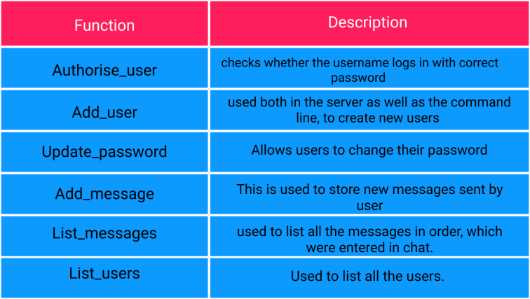
Functions implemented to interact with database

Slide 18
DEMO

Slide 19
Future Improvements
Adding a GUI interface for admin instead of command line instructions.
More features in chat interface like file and image upload.
Using Transport Layer Security for secure communication between server and client.

Slide 20
Thank You!

