Slide 1
Assignment-Discussion Vector Based WSD
Anand Kumar, 200050007
Chetan Rathod, 200050116
Rudra Pakhare, 200050121
27 November, 2022

Slide 2
Problem Statement: Part-1:Vector based extended Lesk
Given a sequence of words, produce the synset IDs of only NOUNS
Data SemCor
First Technique to be used: Extended Lesk
5-fold cross validation
See if the baselines are crossed (WFS, MFS)

Slide 3
First Baseline
Most Frequent Sense (MFS)
Precision - 0.6308
Recall - 0.7501
F1-score - 0.6607
Accuracy - 0.7501

Slide 4
Second Baseline
Wordnet First Sense (WFS)
Precision - 0.4872
Recall - 0.6980
F1-score - 0.5739
Accuracy - 0.6980

Slide 5
Performance report of Extended Lesk
Precision - 0.7567
Recall - 0.4922
F1-score - 0.5744
Accuracy - 0.4922

Slide 6
Part-2: Page Rank Based
Score all TagSet
Precision - 0.6915
Recall - 0.5717
F1-score - 0.6067
Accuracy - 0.5717

Slide 7
Part-2: Page Rank Based
Precision - 0.5837
Recall - 0.3186
F1-score - 0.3540
Accuracy - 0.3187

Slide 8
Confusion Cases (for EL)
ex1: There is a bank on the river bank.
for this sentence the sense for bank1 will be that of river bank, as their river word in the sentence which will cause more value for cosine similarity.
ex2: There is a finance bank on the river bank.
the finance word dominates and on both the bank word and predicts money bank as sense
ex3: Behind the money bank there is a big house.
No word more similar to the correct sense of behind in the context.
ex4: The watchman is wearing a watch.
sense for watch is incorrect, predicts observe sense. difference created due to watchman word
ex5: The watchman sees time in his watch.
even adding time word which is in definition do not change the sense.

Slide 9
Confusion Cases (for PR)
ex1: There is a bank on the river bank.
ex2: The watchman is wearing a watch.
ex3: Cricket is flying in the ground.
ex4: Behind the money bank there is a big house.
ex5: The watchman sees time in his watch.
ex6: He was right about turning right.

Slide 10
Interpretation of confusion (error analysis: EL)
Few of the reason for confusion are
There is no similar word in the sentence corresponding to the word whose sense is to be predicted.
for ex sense of behind in the ex5
There is word in sentence which is similar to some other sense of the word.
as example using of bank and river bank in the same sentence

Slide 11
Interpretation of confusion (error analysis: PR)
Similarity(weight) on a edge in our model is calculated using only cosine similarity of the vectors obtained for the senses from definition of the sense. Using hyponyms and hypernyms can lead to increase in accuracy.

Slide 12
Data Processing Info
Word Vectors and how you obtained them : word2vec was obtained by using GoogleNews-vectors-negative300 file loaded using gensim api.
ONLY word2vec: Sentence was obtained by using semcor.sents(). took addition of vectors of word present in the sentence and in the word to vector dataset.
Preprocessing on sentence: Removed stopwords and punctuations from the sentence also removed words which are not alphanumeric.
Removed word for which we have to predict sense for the sentence

Slide 13
Model Briefing of EL
Made vector ( context_vec ) for each sentence using word2vec
using wn.synset(word) got all possible senses for the word. For each sense got a vector. Created more vectors using definition sentence obtained from sense.hyponym() and sense.hypernym()
calculated cosine similarity between the vectors obtained senses and context
predicted sense which has highest value of cosine similarity with the context vector

Slide 14
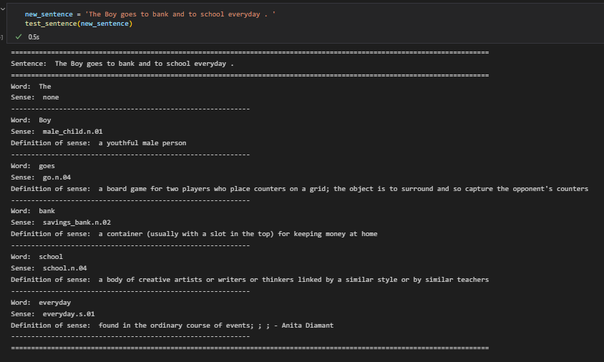
Extended Lesk

Slide 15
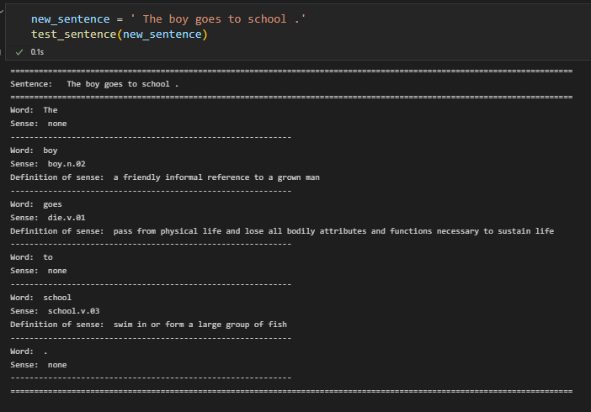
Page Rank

