Slide 1

Prof.V.B.Shah Institute of Management & R.V.Patel College of Commerce (Eng.Med.) & V.L.Shah College of Commerce (Guj.Med.) & Sutex Bank College of Computer Applications & Science, Amroli
(Accredited ‘B’ (CGPA 2.55) by NAAC Dec.-2009)
VEER NARMAD SOUTH GUJARAT UNIVERSITY, SURAT
Minor-PROJECT REPORT
FOR THE DEGREE OF
Bachelor of computer application
(B.C.A 6TH SEMESTER) YEAR: 2025-26
SUBMITTED BY :
440 Rathod Chirag Jivanbhai
419 Mandaviya Viral Bhupatbhai
478 Chauhan Hresh Mukeshbhai
GUIDED BY :
Mr. Ashish solankiamani.
METICS

Slide 2
METICS

Slide 3
Overview
Project Profile
Project Overview
Screen Shots
References

Slide 4
Project Profile
Cinex
Project title: | Metics
Frontend: | Angular, Html ,css ,Bootstrap5,Tailvind css
Backend: | Node.Js , Express.js
Database: | MongoDB
Browser and Emulator: | Chrome, crosoft Edge
Platform: | VS Code
Documentation tool: | Powerpoint
Internal guide: | Mr. ashish solanki

Slide 5
Project Overview
Metics is a Online Cloth Shopping E-Commerce website where you can Buy Clothes with Multiple Choices
Metics Provide a best, Tranding Fashions
The Metics consists of two panels:
User Panel
Admin Panel.

Slide 6
Project Features: User
Requires login with a user account.
User can browse Clothes.
User can buy their favorite clothes.
User can choose any payment option for order.

Slide 7
Project Features: Admin
The admin panel allows the website administrator or to manage and monitor the platform.
Admin can add Clothes, Manage orders and more .
Admin can view, edit, or remove products.
Admin can view order history and see how many orders are placed.
Admin can see the recent orders of their products.

Slide 8
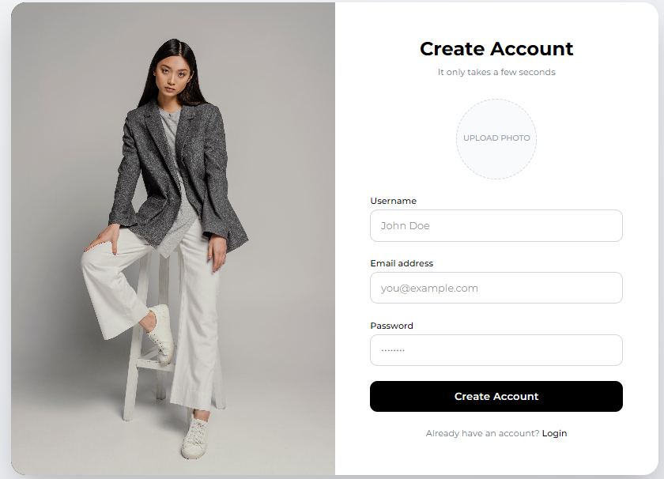
Signup page

Slide 9
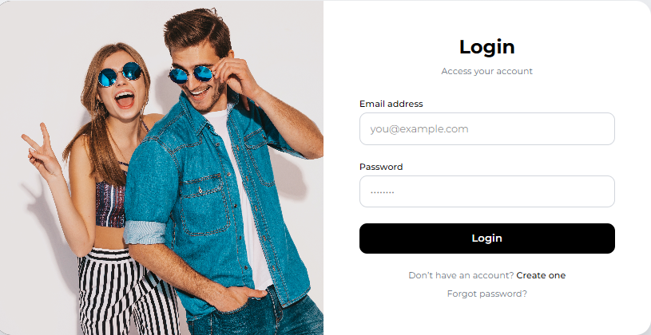
Login page

Slide 10
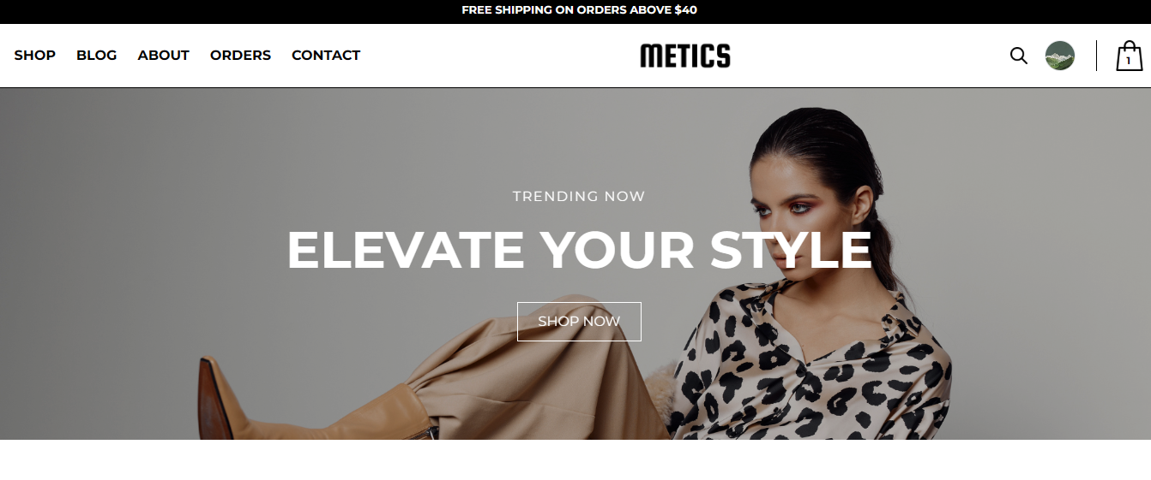
Home page

Slide 11
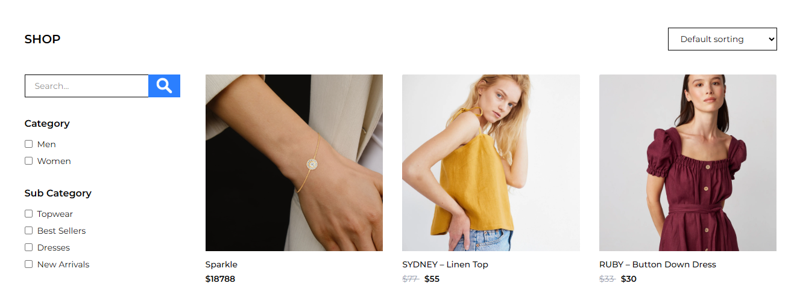
shop page

Slide 12
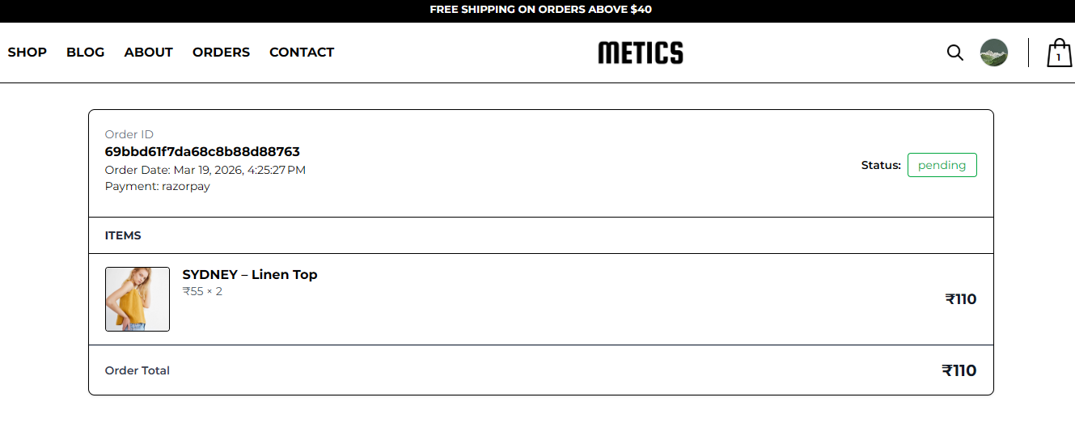
Order page

Slide 13
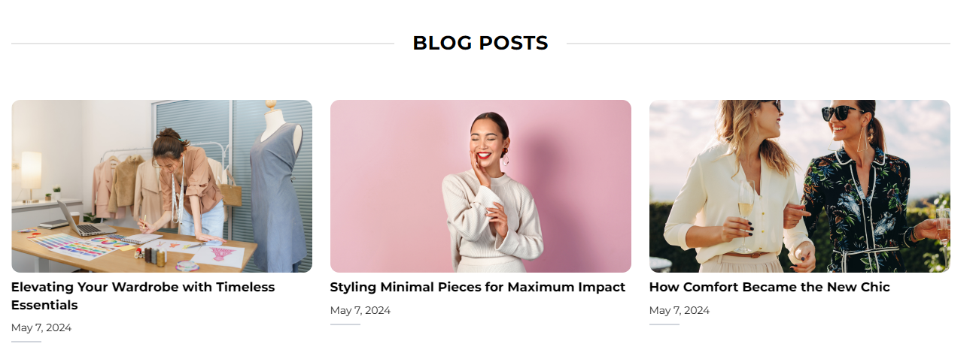
Blog page

Slide 14
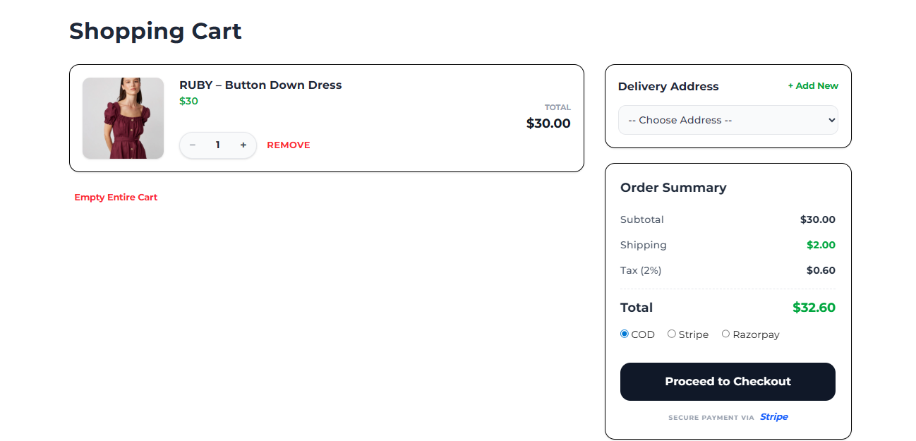
Payment page(Process to Checkout)

Slide 15
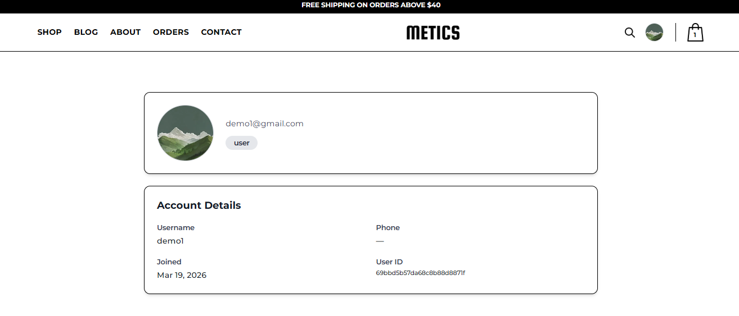
Profile page

Slide 16
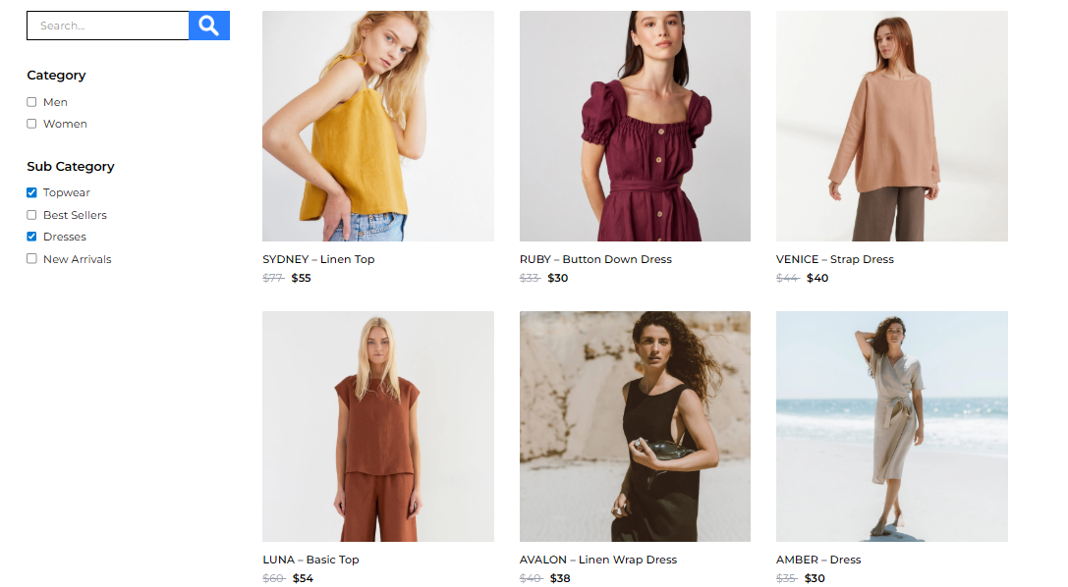
Category wise products

Slide 17
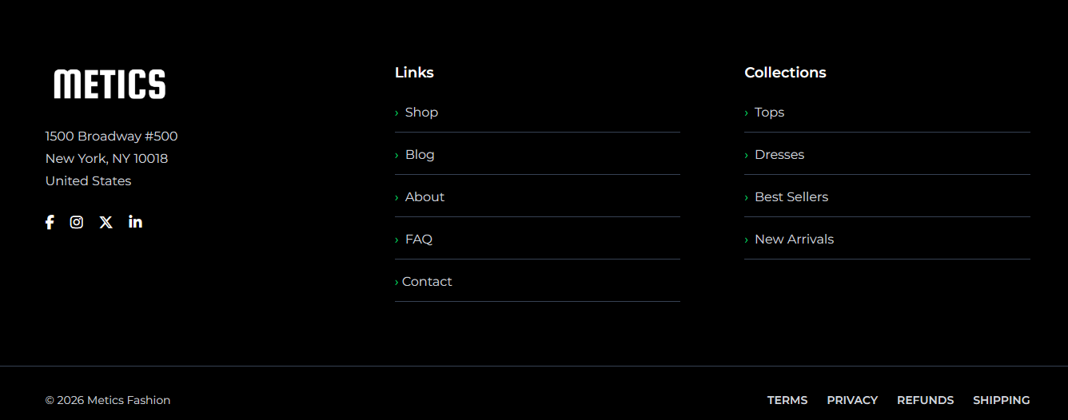
Footer

Slide 18
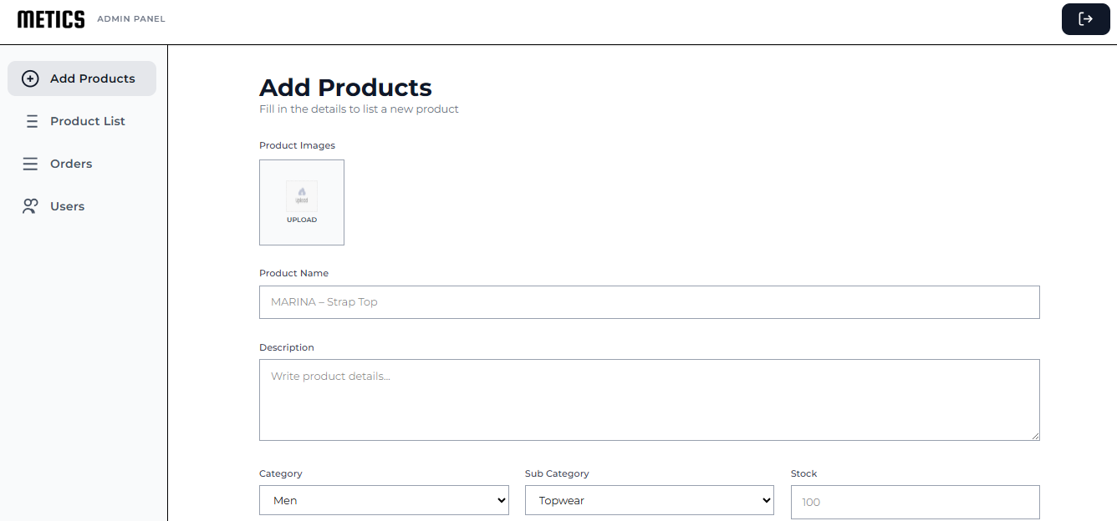
Admin panel: Home page

Slide 19
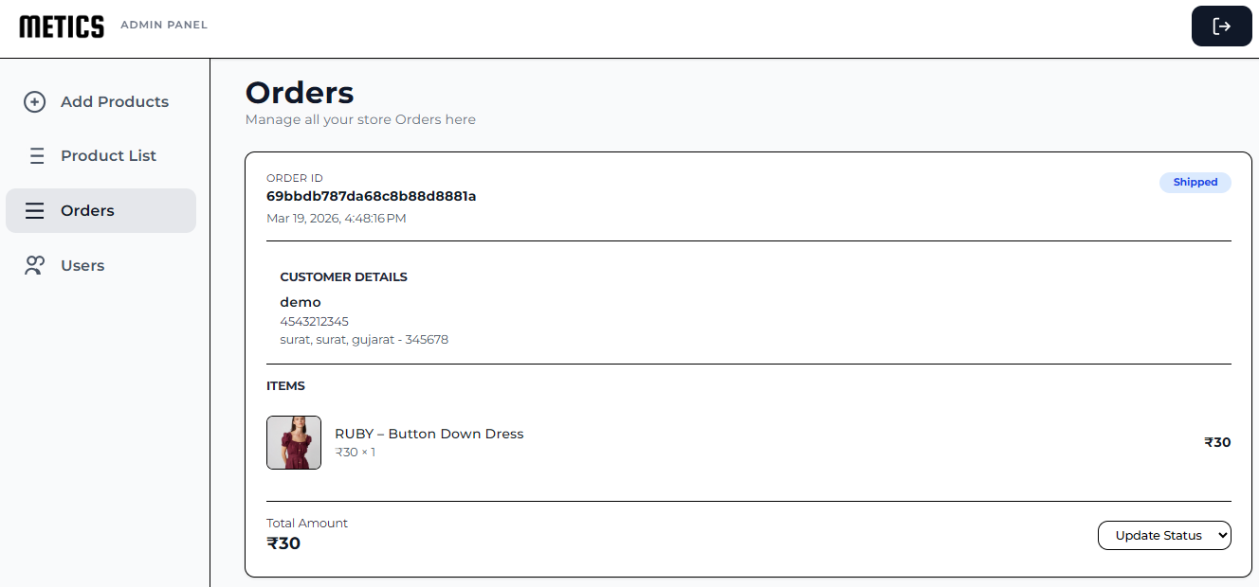
Manage orders page

Slide 20
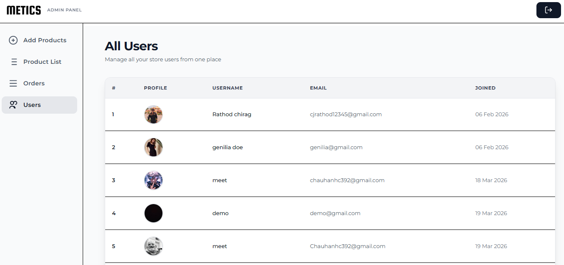
Users page

Slide 21
References
https://openai.com
https://youtube.com
https://angular.dev/learn
https://w3school/css
https://gemini.google.com

Slide 22
Thank You

