Slide 1
SMART INDIA HACKATHON 2026 — OFFICIAL IDEA SUBMISSION
PROBLEM STATEMENT DETAILS
Problem Statement ID:
26025
Problem Statement Title:
Development of an AI-enabled Low Cost Real Time Mine Subsidence Monitoring, Prediction and Early Warning System for Underground Coal Mines in India.
Theme / Sector:
Mining, Safety & Geotechnical Monitoring / Disaster Management
PS Category:
Software / IoT Hybrid Prototype
Team ID:
[Team ID Placeholder]
Team Name:
[Team Name Placeholder]
PROPOSED INNOVATION
MineGuard
AI-Enabled Low-Cost Real-Time Mine Subsidence Monitoring & Early Warning Prototype
A distributed SURFACE wireless sensor network prototype deployed above underground coal mine panels, utilizing ESP-NOW multi-hop telemetry, causal 16-feature extraction, and a baseline-calibrated Isolation Forest anomaly detection prototype for continuous strata safety monitoring.
● Surface Non-Invasive Deployment (Avoids Hazardous Underground IS/Flameproof Constraints)
● 3-Node ESP-NOW Multi-Hop Prototype Architecture
● 16 Causal Physics-Aware AI Features (Zero Future Data Leakage)
● Isolation Forest-Based Anomaly Detection Prototype
● Industrial SCADA-Style React Telemetry Dashboard

Slide 2
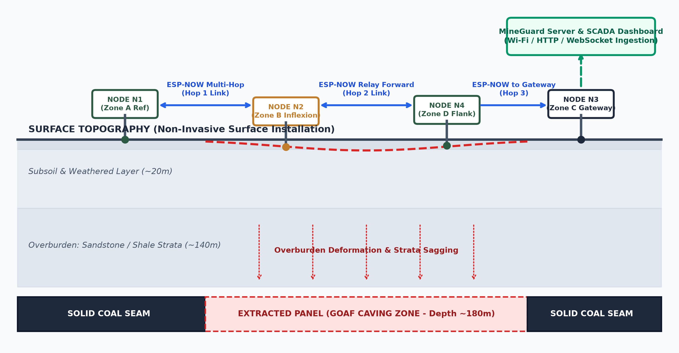
PROPOSED IDEA: SURFACE WIRELESS MESH SENSOR NETWORK
Continuous real-time surface deformation tracking above underground coal extraction panels
SIH 2026 | PS 26025
Slide 2 / 6
WHAT IS THE PROBLEM?
Underground coal extraction (longwall & depillaring) induces roof collapse into the caved goaf, causing progressive bending and shear strain through overlying rock strata. This leads to vertical surface subsidence troughs and ground fissuring, creating potential safety hazards for surface infrastructure, railway lines, pipelines, and local communities.
WHY IS IT CRITICAL & CURRENT MONITORING GAPS?
• Manual Levelling Surveys: Labor-intensive, periodic (weeks or months apart), and expose survey personnel to hazardous ground.
• Satellite InSAR: Susceptible to atmospheric noise/vegetation decorrelation and constrained by 12–24 day orbital revisit latency.
• Operational Gap: Lack of continuous, real-time telemetry to capture rapid dynamic acceleration or early shear inflexion.
WHAT ARE WE PROPOSING & WHAT IS NOVEL?
• Surface Monitoring Grid: Low-cost wireless sensor nodes (ESP32 + MPU6050) anchored across surface extraction panels.
• Peer-to-Peer Multi-Hop Relay: Relays sensor packets across surface nodes to a gateway without requiring cellular modules on every node.
• Surface Non-Invasive Advantage: Deployed entirely on the surface, bypassing strict underground flameproof/intrinsically safe equipment restrictions.
PROTOTYPE TOPOLOGY & DATA ROUTING CONCEPT
• Prototype Mesh: Node N1 (Zone A Reference) ──[Hop 1]──> Node N2 (Zone B Relay) ──[Hop 2]──> Node N3 (Gateway Bridge)
• Root Gateway converts ESP-NOW payloads into HTTP REST (/api/telemetry) & WebSocket streams to the MineGuard server.
• Designed to detect subtle inclination anomalies during early strata deformation prior to major surface settlement.

Slide 3
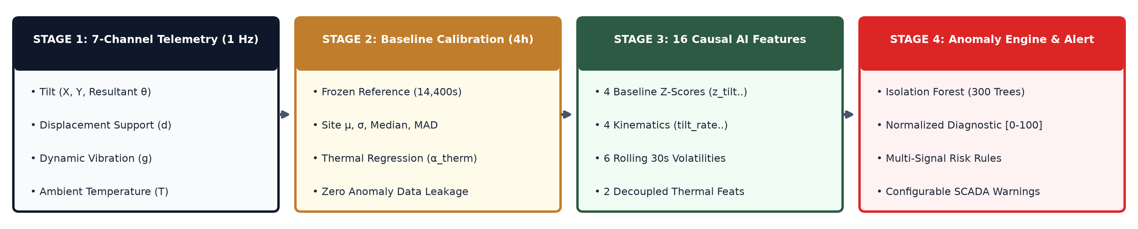
TECHNICAL APPROACH: END-TO-END SYSTEM & AI PIPELINE
Hardware sensing architecture, multi-hop mesh telemetry, 16 causal AI features, and anomaly detection prototype
SIH 2026 | PS 26025
Slide 3 / 6
AI ANOMALY DETECTION SUBSYSTEM & 16 CAUSAL FEATURES
• Baseline Calibration (First 4h / 14,400s): Fits site-specific μ, σ, median, MAD & thermal drift coefficient (α_thermal = +0.00366°/C). Frozen reference prevents anomaly leakage.
• 16 Causal Features (Strictly Past-Only / Zero Data Leakage):
- 4 Baseline Z-scores: z_tilt, z_displacement, z_vibration, z_temperature
- 4 Kinematic Derivatives (5s): tilt_rate, disp_rate, disp_accel, vib_rate
- 6 Rolling Volatility (30s): tilt_mean_30s, tilt_std_30s, vib_std_30s, volatility_ratio..
- 2 Decoupled Thermal: delta_temperature, detrended_tilt
• Isolation Forest-Based Anomaly Detection Prototype: 300 estimators; continuous anomaly score in [0, 100] via tanh mapping. Evaluated on synthetic strata simulation data (diagnostic aid, not certified failure prediction).
IMPLEMENTED SYSTEM ARCHITECTURE & TECH STACK
• Edge Hardware Architecture:
ESP32 Dual-Core SoC (240MHz) + MPU6050 6-DOF IMU (I2C interface). ESP-NOW 2.4 GHz low-overhead peer protocol with node ID, sequence, and hop-count headers.
• Backend & Middleware:
Node.js & Express.js REST API (/api/telemetry). Socket.IO real-time event dispatcher. In-memory per-node 120s causal ring buffers.
• AI & Anomaly Engine:
Python scikit-learn training pipeline; exported JSON tree models for sub-ms Node.js runtime inference with multi-signal transparent risk rules.
• SCADA Frontend Dashboard:
React + TailwindCSS + Recharts. Responsive industrial SCADA UI with SVG Mine Panel map, live tilt progression charts, and alert center.

Slide 4
FEASIBILITY, VIABILITY & ENGINEERING REALISM
Challenge-response engineering matrix, operational viability, and verified implementation status
SIH 2026 | PS 26025
Slide 4 / 6
ENGINEERING CHALLENGE & MITIGATION
▶ Sensor Noise & Thermal Drift:
Baseline calibration with empirical thermal regression (α = +0.00366°/C) to decouple diurnal day-night ambient expansion from genuine strata tilt.
▶ Surface Obstacles & Line-of-Sight:
Multi-hop relay topology enables flexible line-of-sight routing around surface terrain obstacles without cellular modules on every node.
▶ Real Mine Data Scarcity:
Physics-based strata caving simulation benchmark + external landslide proxy dataset audit (40.6k records) for empirical noise modeling.
▶ False Alarm Mitigation:
Multi-signal fusion combining physical angle thresholds, 5s rate-of-change, and Isolation Forest statistical anomaly score.
▶ Power Autonomy in Remote Mines:
Low-power ESP32 sleep modes (<20ms active TX) paired with compact solar-battery harvesting.
OPERATIONAL & ECONOMIC VIABILITY
✔ Low-Cost Commodity Hardware Design:
Utilizes off-the-shelf microcontrollers (ESP32) and MEMS IMUs (MPU6050), targeting a fraction of the cost of commercial robotic total stations or imported extensometers.
✔ Rapid Surface Deployment:
Installed on surface ground anchors in hours without specialized surveying crews or drilling expensive boreholes.
✔ Non-Disruptive Monitoring:
Surface installation allows continuous tracking without interrupting underground coal extraction, hauling, or ventilation.
✔ Regulatory Alignment:
Designed to support Directorate General of Mines Safety (DGMS) strata monitoring workflows and safety documentation.
✔ Modular Grid Scalability:
Panel grids expand by deploying additional relay nodes; gateway aggregates data across extensive longwall panels.
IMPLEMENTATION & ROADMAP HONESTY
CURRENTLY IMPLEMENTED PROTOTYPE:
• 3-node ESP-NOW multi-hop prototype architecture implemented; physical end-to-end hardware validation underway.
• Full REST telemetry ingestion API (/api/telemetry) & Socket.IO live stream.
• Causal 16-feature extraction pipeline & baseline calibrator.
• Isolation Forest anomaly detection prototype (sub-ms runtime).
• SCADA-style React dashboard with interactive mine panel map.
PLANNED FIELD ROADMAP (HONEST DISCLOSURE):
○ Sub-GHz LoRa / LoRaWAN transceivers for kilometer-range mesh scaling.
○ Active mine site pilot trials collocated with high-precision extensometers.
○ Field calibration of configurable prototype thresholds (e.g. 1.00° warning, 2.00° critical, pending DGMS site guidelines).
○ Edge TinyML deployment directly on ESP32 microcontroller.

Slide 5
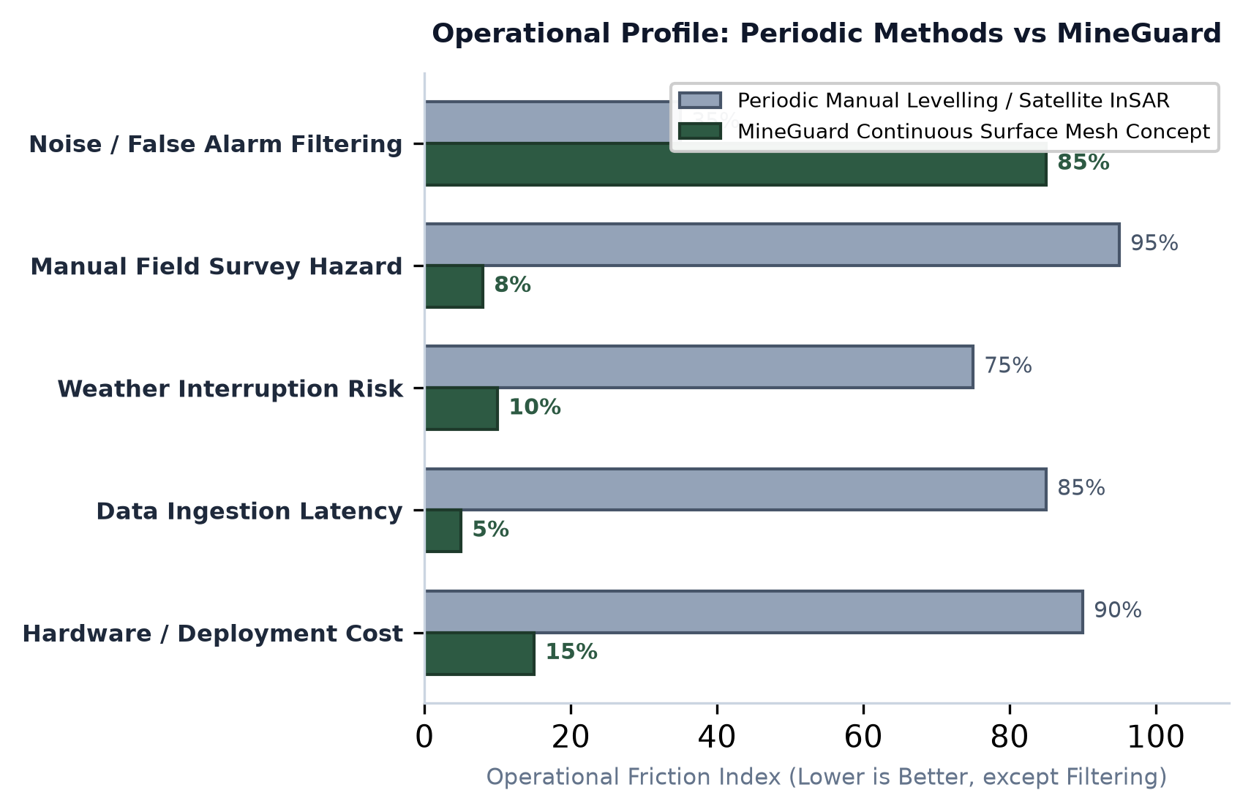
SYSTEM IMPACT, SAFETY & STRATEGIC VALUE
Transforming mine safety, surface asset protection, environmental integrity, and operational efficiency
SIH 2026 | PS 26025
Slide 5 / 6
1. MINE & COMMUNITY SAFETY
• 24/7 Autonomous Tracking: Reduces manual survey hazards by automating ground movement monitoring in active subsidence zones.
• Early Anomaly Warning: Designed to detect subtle tilt rate changes before macroscopic surface fractures occur.
• Life & Settlement Protection: Provides early decision support to assist timely evacuation of surface structures and mining colonies.
2. INFRASTRUCTURE & ECONOMIC VALUE
• Asset Protection: Aids early intervention for overland railway lines, highways, transmission towers, and water pipelines.
• Operational Continuity: Helps avoid emergency unplanned mine shutdowns through continuous surveillance.
• Scalable Cost Profile: Commodity hardware enables dense spatial grid coverage across multiple extraction blocks.
3. ENVIRONMENTAL & LAND PROTECTION
• Aquifer & Water Resource Protection: Early detection of ground fissuring enables timely surface sealing to mitigate groundwater drainage into the goaf.
• Spontaneous Combustion Mitigation: Timely crack sealing reduces atmospheric oxygen ingress into abandoned coal goaf areas.
• Targeted Land Reclamation: Informs post-mining land backfilling, grading, and ecological restoration.
4. OPERATIONAL MODERNIZATION
• SCADA Telemetry Dashboard: Gives shift-in-charge real-time visual situational awareness across all active monitoring zones.
• Automated Historical Logging: Maintains continuous time-series records to assist statutory DGMS compliance reporting.
• Multi-Signal Decision Support: Combines physical tilt measurements with AI anomaly diagnostics for transparent evaluation.
STRATEGIC PROFILE COMPARISON
• Monitoring Cadence: Periodic Surveys (Weeks/Months) ➔ Continuous Real-Time Telemetry (1 Hz Prototype)
• Hardware Approach: High-Cost Optical/Borehole Setups ➔ Low-Cost Distributed Wireless Mesh Grid
• Weather Resilience: Optical Line-of-Sight Limitations ➔ All-Weather Surface-Anchored Inclinometers

Slide 6
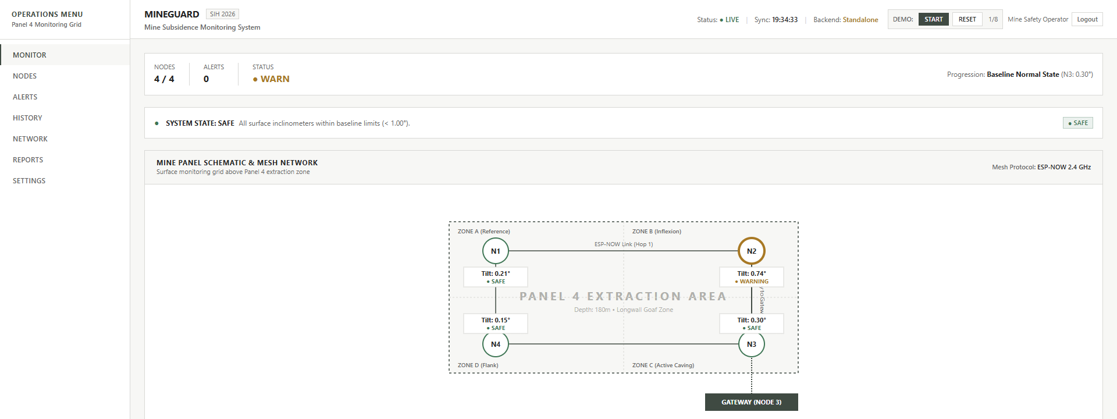
RESEARCH FOUNDATIONS, REFERENCES & WORKING SCADA UI
Academic grounding in strata mechanics, mesh networking, ML anomaly detection, and verified prototype UI
SIH 2026 | PS 26025
Slide 6 / 6
1. STRATA MECHANICS
• Peng, S.S. (1992). Surface Subsidence Engineering. Society for Mining, Metallurgy, and Exploration (SME), Littleton, CO.
• Foundational theory on subsidence troughs, inflection points, and tensile strain curves over extracted coal panels.
2. DGMS STATUTORY CONTEXT
• Directorate General of Mines Safety (DGMS), Govt. of India (2017).
• Coal Mines Regulations (CMR 2017), Reg. 123 & DGMS Technical Circulars on Strata Control and Monitoring Plans (SCAMP).
• Configurable prototype thresholds (1° warning, 2° critical) subject to site calibration.
3. WIRELESS SENSOR MESH
• Bandyopadhyay, L. K., Chaulya, S. K., & Mishra, P. K. (2010). Wireless Communication in Underground Mines: RFID-based Sensor Networking for Strata and Safety Monitoring. Springer.
• Validates multi-hop relaying principles for robust geotechnical telemetry.
4. AI NOVELTY & SEPARATION
• Liu, F. T., Ting, K. M., & Zhou, Z.-H. (2008). "Isolation Forest." IEEE International Conference on Data Mining (ICDM), pp. 413-422.
• MineGuard Novelty: Causal 16-feature kinematic extraction with baseline calibration decoupling thermal drift from strata deformation.
VERIFIED WORKING PROTOTYPE — INDUSTRIAL SCADA DASHBOARD & MESH TOPOLOGY

