Slide 1
EDA on Used Car sales
Saikrishna Rathod

Slide 2
Outlines
What is EDA
Given Problems statement
Pre and Post profiling
EDA
Insights
Conclusion

Slide 3
What is EDA
Exploratory Data analysis (EDA) is an approach for data scientist that employs variety of steps.
Intro/problem statement,Data,profiling,processing,eda and insights conclusion

Slide 4
Problem statement/Introduction
This dataset contains data for more than 9.5K cars sale. Most of them are used cars so it opens the possibility to analyze features related to car operation.
Prices of the cars
Need to focus on car price prediction
Car sales

Slide 5
Pre-profiling
Libraries
Shape of the given Data : 9576,10
Pre-profiling
Pandas profiling
Data Obseervation
Out of 10 columns, engV and drive had NaNs
837 null values
113 duplicated values
Data types

Slide 6
Pre-processing
Data pre-processing
Removed duplicate entries
Empty values replaces with NaN
NaNs with 0
Numerical data with Median – Price, Mileage,engV, year
Categorical data with Mode – Car, Model, engType
I felt there were no outliers

Slide 7
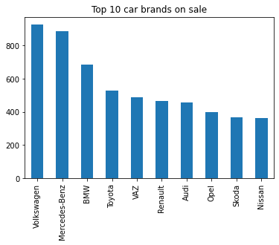
Exploratory Data Analysis
Data – post processing
Check if there are null,na and duplicated values etc
Data information and description
EDA: Analysis on data
Top Brands : Volkswagen and Merecedes-Beng

Slide 8
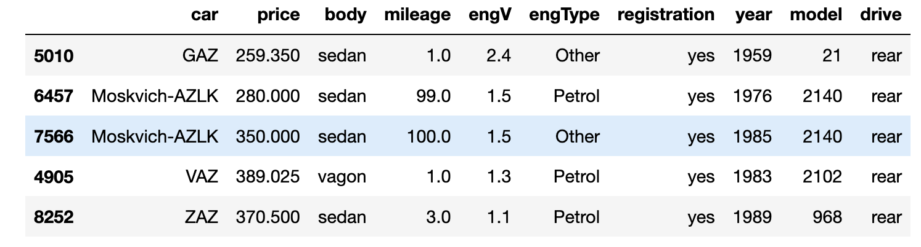
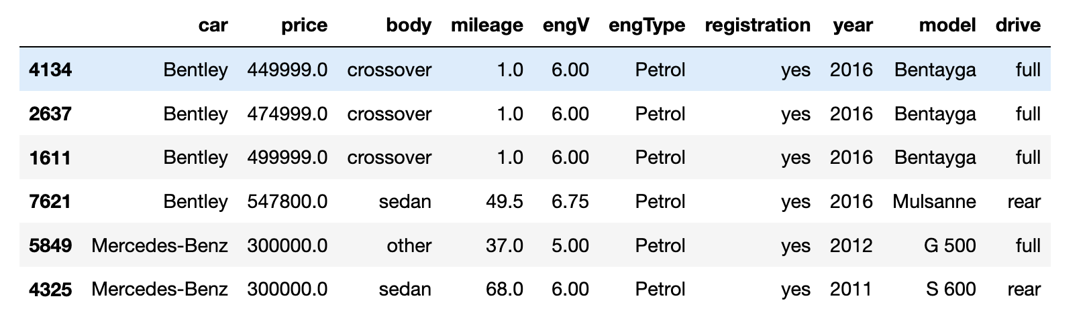
Exploratory Data Analysis
Top car brands with respect to price are Bentley, Mercedes-Benz
Brands with lowest price are GAZ,Moksvich-AZLK etc

Slide 9
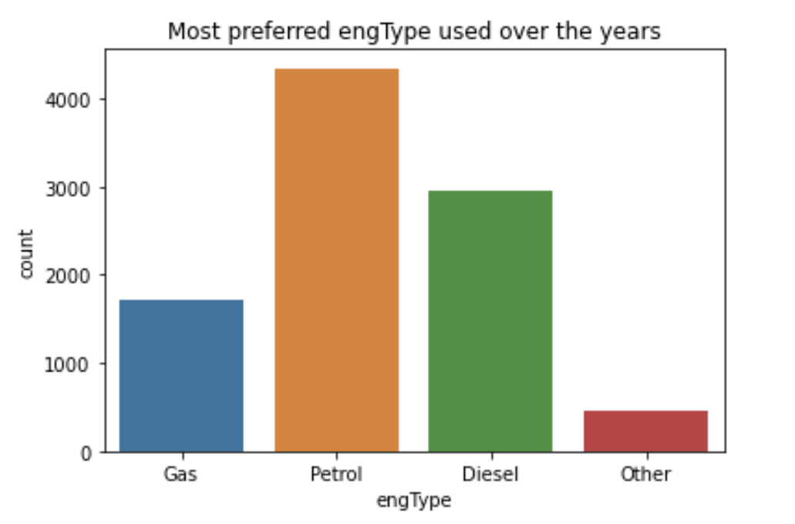
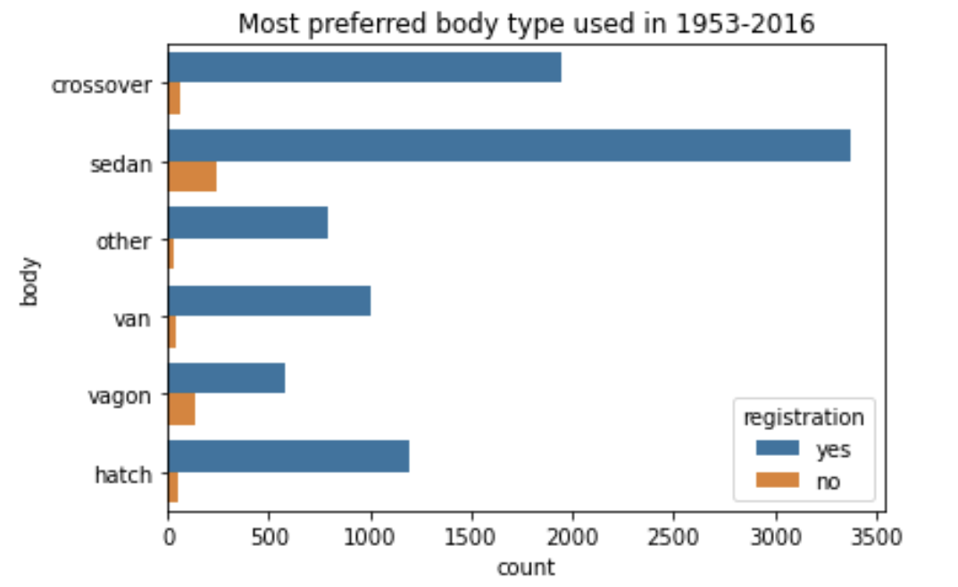
Most preferred body type of the
Most preferred engine Type

Slide 10
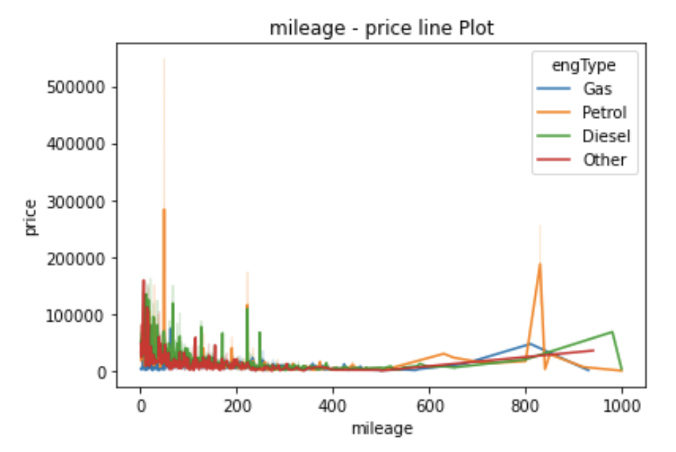
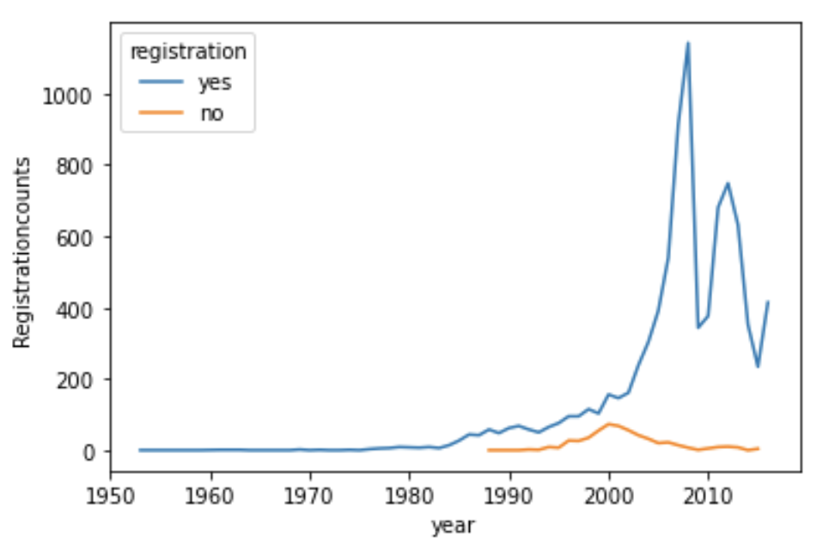
More registration years
Mileage Vs Price

Slide 11
Insights
More actions needed on the cars with low sales
Remodel the old cars like changing the driving models: rear
Sales for rear type of drive has low sales
Cars with low sales are age old cars - Hence re-design might increase the sales

Slide 12
Conclusion
These is impact of columns like mileage, year and engType on the Price increase/decrease rate.
The most important inference drawn from all this analysis is, we get to know what are the features on which price is highly positively and negatively correlated with.
Sales for rear type of drive has low sales
This analysis will help me to choose which machine learning model we can apply to predict price of test dataset in later terms and projects

