Slide 1

Chef
Raj
Day 1

Slide 2
Introduction
2008 – Ops code
Progress Chef
Configuration management
Chef
Ruby/Erlang
Client/Server model
Stand alone – Chef Solo
Server uses Elastic search to index attribtes- api client to query these information
Initial support Linux – later windows support added

Slide 3
Introduction
Created by Adam Jacob
2019 – becomes open source under Apache 2.0 license
2020 – Progress acquisition
Chef Automate – Single commercial product
Chef
InSpec
Habitat (Application automation)
Chef version
Basic (free, open source)
Hosted Chef ($72/node, minimum 20 node purchase)
Chef Automate ($137/node, annual subscription)

Slide 4
Chef – Interaction with learners
Repeatable
Scalability
40 to 50 hosts
25 to 30 regions
Terraform – provisioning
Other configuration – Oracle property tools.
Version controlling (IaC)
SaaS offering

Slide 5
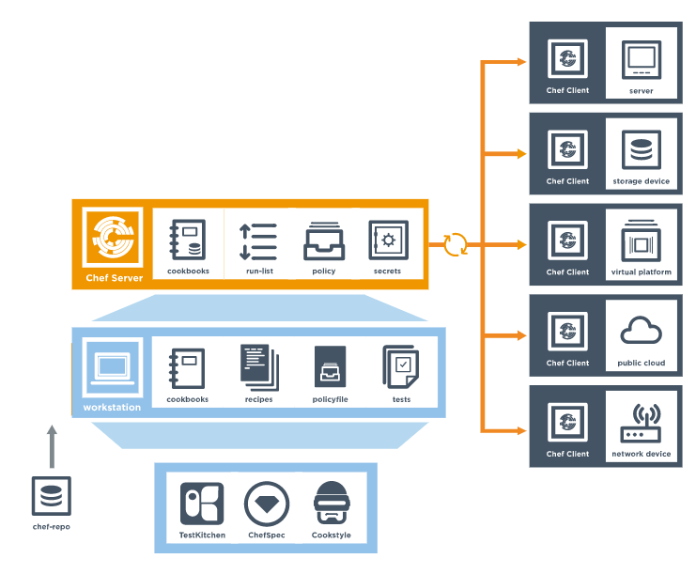
Chef architecture

Slide 6
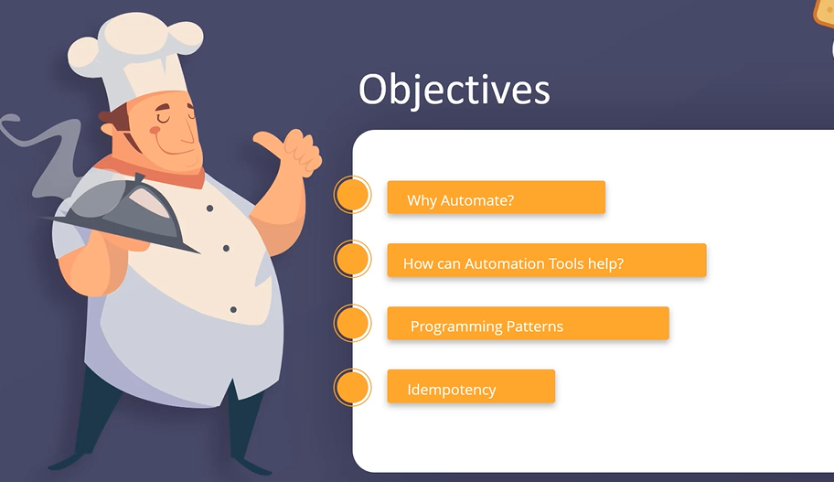
Chef Objective

Slide 7
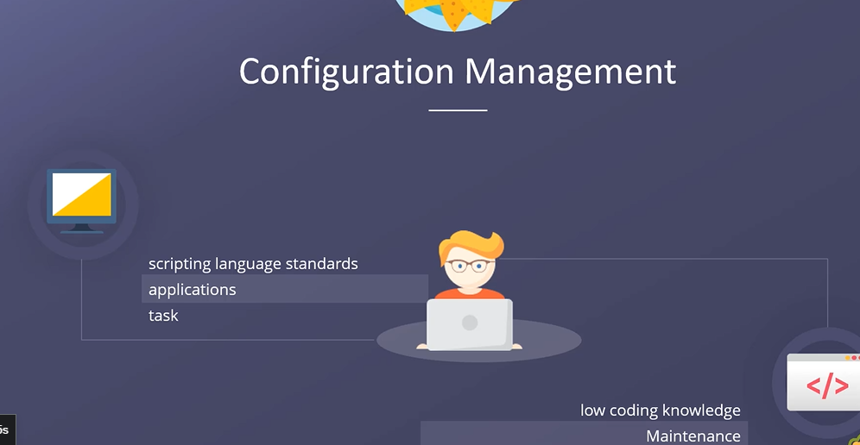
Configuration management

Slide 8
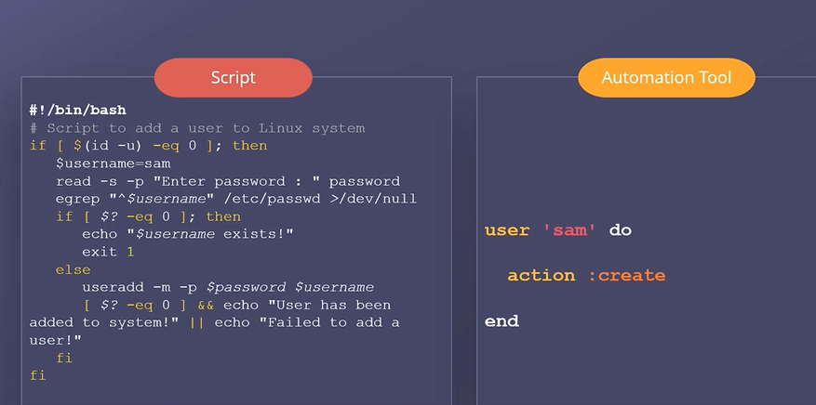
Imperative vs Declarative

Slide 9
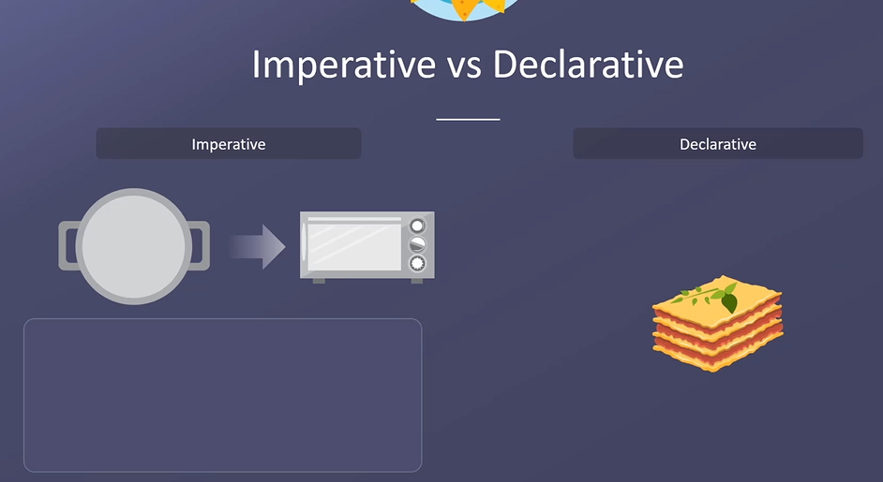

Slide 10
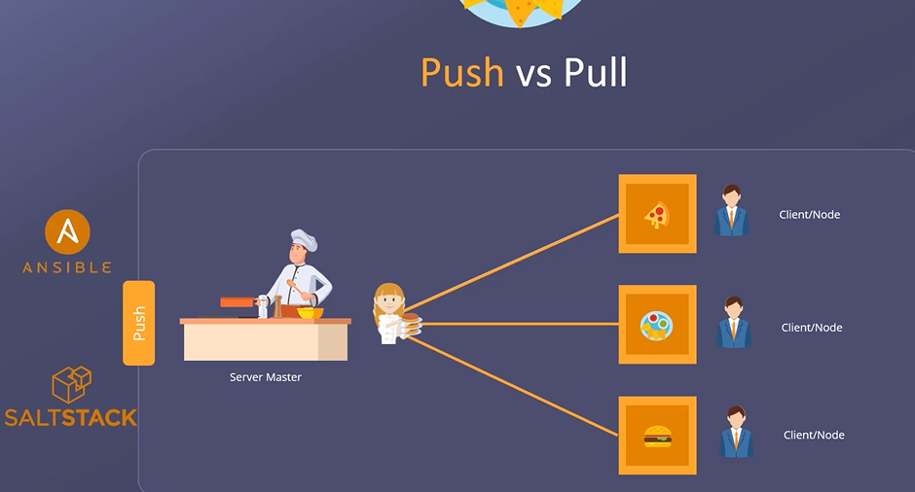
Push

Slide 11
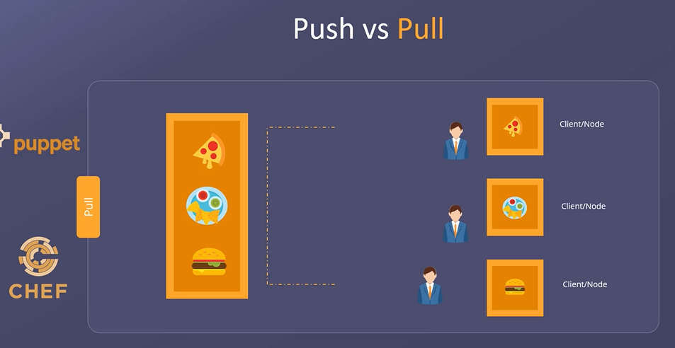
Pull

Slide 12
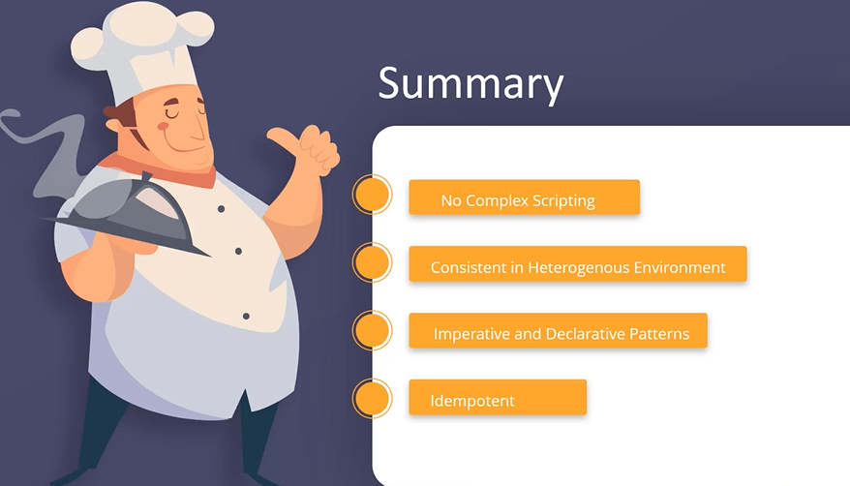

Slide 13
Chef
OpsCode – 2008
Declarative
Productivity
Consistent Delivery
Simplicity
Highly scalable

Slide 14
Chef components
Create
Test
Apply

Slide 15
Chef
Idempotent
Declarative/Imperative
Push/pull model

