Slide 1

Chef
Senthilraj
Day 3

Slide 2
Recap – Day 1
2008 – Ops code
Progress Chef
Configuration management
Chef
Ruby/Erlang
Client/Server model
Stand alone – Chef Solo
Server uses Elastic search to index attributes - Api client to query these information
Initial support Linux – later windows support added

Slide 3
Recap – Day 1
Created by Adam Jacob
2019 – becomes open source under Apache 2.0 license
2020 – Progress acquisition
Chef Automate – Single commercial product
Chef
InSpec
Habitat (Application automation)
Chef version
Basic (free, open source)
Hosted Chef ($72/node, minimum 20 node purchase)
Chef Automate ($137/node, annual subscription)

Slide 4
Recap – Day 1
Ruby
DSL
Recipe
Cook book
Ruby Recipe – syntax (.rv)
Cook book - syntax
Chef
Development cycle
Code creation
Create-Check-Test-Run
Client tools
Cookstyle recipe file ( Perform syntax check – native ruby utility – linting tool – better chef code)
Chef-client - perform the Smoke test – validate the expected result – (self container/server model)

Slide 5
Recap -1
Chef-client –why-run <RECIPE File> (Default mode – Contact server)
Chef-Client <RECIPE file)
Chef-client –local-mode –why-run <RECIPE File>
Chef-Client –local-mode <RECIPE file)
Chef Zero - easy to get start with – validate recipe, cookbook,run-list – before to server

Slide 6
Day 2
Azure PaaS
Setup Window 10 Lab machine
Setup Cent OS environment
Chef Server
Chef workstation
Chef client
Microsoft account – Hotmail, outlook account.. Create one..
https://www.microsoftazurepass.com/ - setup your Microsoft account to get azure subscription.
Azure portal login
Azure Market place – going to create 4 machine. 3 Linux and 1 windows 10 machine.
Windows 10 – our workstation
Setup – Chef Server – one of the Linux
Chef – workstation – other linux
Chef – Client – other linux machine.
Recipe with client tool.
Create an account with Chef – login with that account – we are going to register our workstation and client with SaaS based Chef.

Slide 7
Session 2
Chef SaaS – application download the zip folder
mkdir chef-repo
cd chef-repo
mkdir cookbooks
chef generate cookbook sample
chef-apply - Testing tool
sudo chef-apply -e "package 'httpd’”
Run list

Slide 8
Day 3
Node Object & Search
Roles
Environment
Setting up Chef environments
Assigning cookbooks based on environments
Chef Supermarket
Chef Community
Community Cookbooks
Supermarket cookbooks usage

Slide 9
Day 3
Data-bags
Creating User
Chef – RBAC
Template
Adding HTML Templates Dynamically with Chef
Adding HTML Template Dynamically with Chef

Slide 10
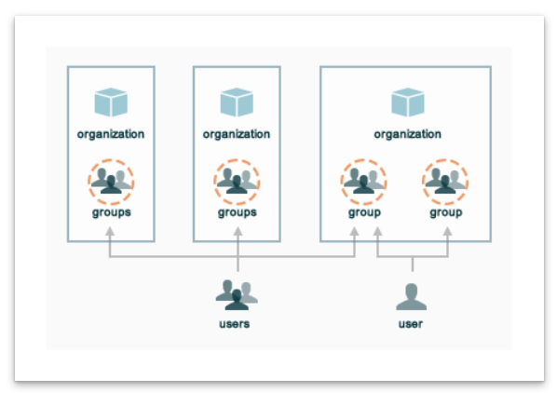
Chef RBAC - Organization

Slide 11
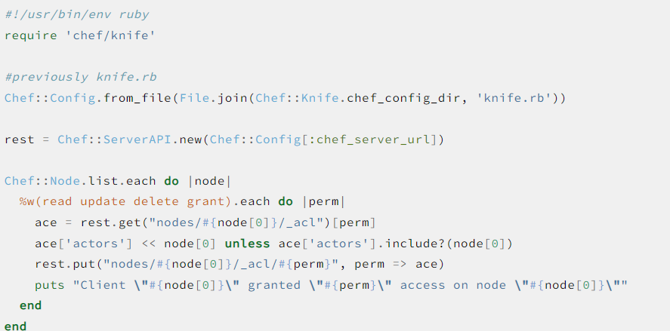
knife exec chef_server_permissions.rb

Slide 12
Chef RBAC
Chef Infra Server uses RBAC to restrict access to objects – nodes, environments, roles, databags , cookbooks
Fine grained, object type, object, group, user and organization
Object permission
Delete
Grant
Read
Update
Global permission
Create
List

Slide 13
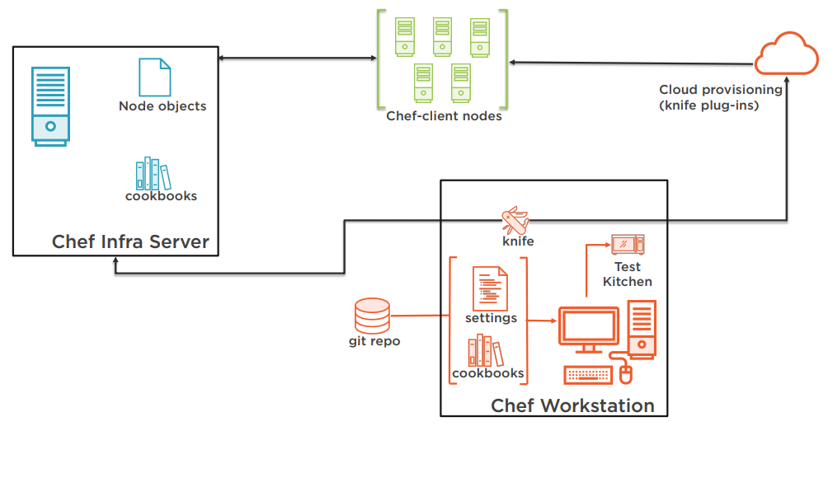
Chef – work flow

Slide 14
Data bags
Global variables as JSON data, indexed for searching loaded by cookbook or accessed during search
Can be created using knife or manually
Creation using knife
knife data bag create DATA_BAG_NAME (DATA_BAG_ITEM)
knife data bag from file BAG_NAME ITEM_NAME.json
Manually
Data_bags directory in chef repo
mkdir data_bags/admins
vi data_bags/admins/charlie.json
Create a Cookbook (to create user on nodes)
Storing data in Data Bags
Encrypting Data in Data bags
Encrypting Data with Chef Vault

Slide 15
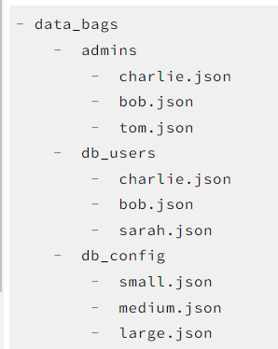
Data bags

Slide 16
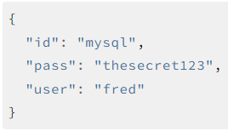
Data bags – encrypt and decrpt
Encrypting data bag item requires secret key
Create secret key
openssl rand -base64 512 | tr -d '\r\n' > encrypted_data_bag_secret
openssl rand -base64 512 | tr -d '\r\n' > my_secret_key
Using knife get encrypted
knife data bag create passwords mysql --secret-file /tmp/my_data_bag_key
Decrypt
knife data bag show --secret-file /tmp/my_data_bag_key passwords mysql

Slide 17
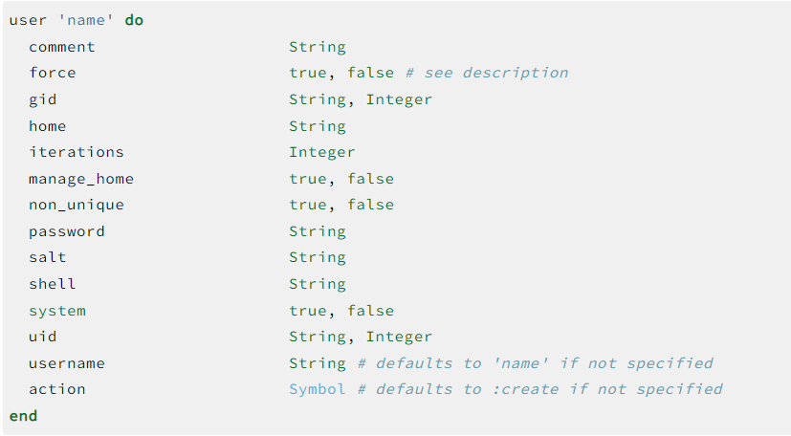
Creating User – Full syntax

Slide 18
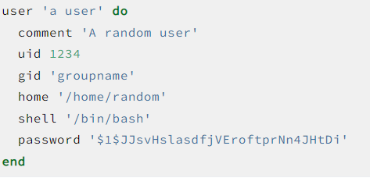
Creating User – Full syntax

Slide 19
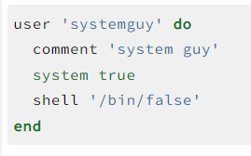
Create User

Slide 20
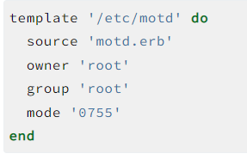
Chef Template
Text file with mix of static and dynamic components
Uses special characters to embed logical statement and expressions
Can do simple variable substitution and advanced logic inline
.erb extension
Requires a template file and a template resource
Embedded Ruby Template – dynamically generate static text files
Contains Ruby expression and statement
Use template resource to manage contents of a file using ERB template file in cookbook /template directory
Resource includes actions and properties from the file resource

Slide 21
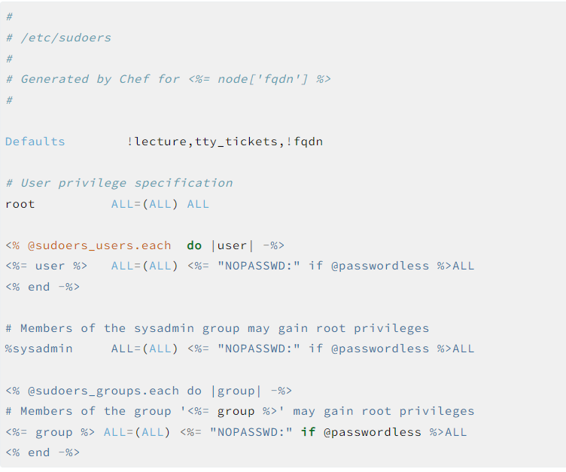
Template file ..user use case

Slide 22
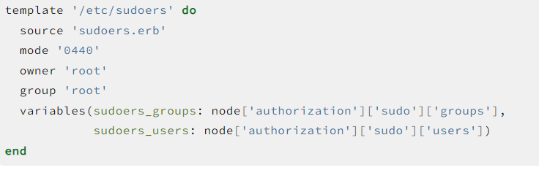
Template file – user use case

Slide 23
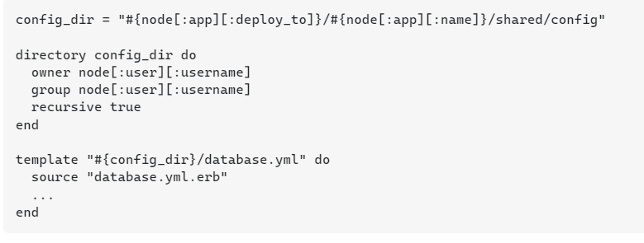
Applying dynamic template

Slide 24
Ohai
Tool to collect
System configuration data
Provided to chef client to use in cookbook
Chef client start of every runs Ohai to determine system state
Automatic attributes – Infra Client uses this to ensure the desired state
Ohai attribute collection includes
OS, network, memory, disk, cpu, kernel, host names, FQDN, virtualization, Cloud provider metadata
Plug in model
Write custom plugins to collect additional configuration information
Ohai directory

Slide 25
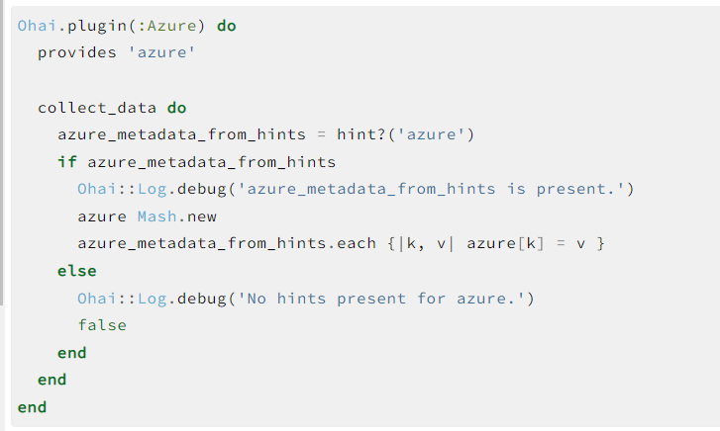
Ohai custom Plugin

Slide 26
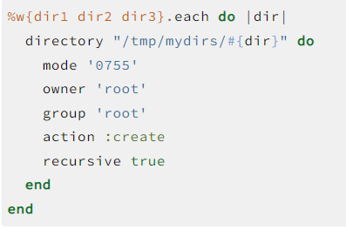
Create Directory Recursively

Slide 27
Node object & search
Group of attributes and run list
Attribute – Piece of the data about the node (file system)
Run-list – Ordered list of recipes and/or roles – run in exact order
Node object consists of run-list and node attributes – JSON file
Chef Infra Server -> Chef Infra client (Chef-Client)
Attribute
Specific details about the node – current state
State of previous run
State should be end of the current run
Cookbooks (attribute file and/or recipes)
Policy file
Infra client build node attribute with every Client run
Data about the node collected by Ohai
Attribute passed using JSON on the command line
Manage node using knife
Search
All the Attributed are indexed for search

Slide 28
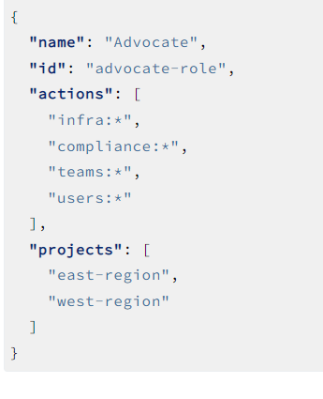
Roles
Identity and access management – named group of actions to define policies
Action describe what is allowed by user
Chef managed roles
Viewer, Editor, Owner, Project owner, Ingest
Custom roles – elevated user can define it based on the need
Can be created using roles API.

Slide 29
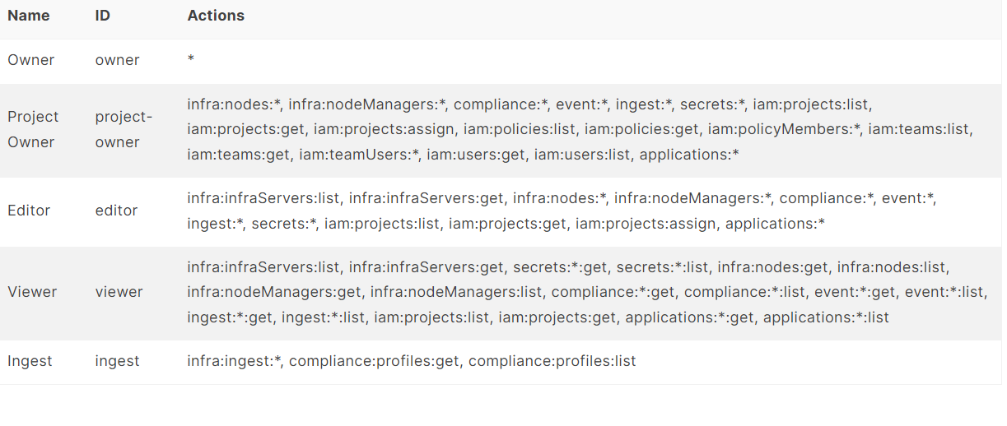
Managed Roles and their actions

Slide 30
Environment
Map organizations real-life workflow
Mapping using setting attributes and pinning cookbook at environment level
Can change cookbook configuration based on system designation (QA/Prod)
Help to set the mature release process
Chef Infra Organization
At least one environment
_default environment (can’t be changed)
Attributes can be defined in environment – used to override default attribute in the cookbook
When environment attribute take precedence over default attribute, it applies, during client runs
Environment can be set to default or override attribute level

Slide 31
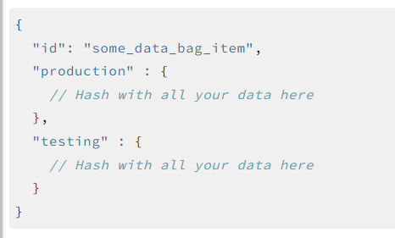
Environment specific databags

Slide 32
Cookbook versioning
Set of functionality based on version
Ensuring correct use of third party component
Updating a bug fix
Adding an improvement
Version form : x.y.z
X- major
Y- minor
Z- patch
Freeze version – to prevent update
knife cookbook upload redis –freeze
knife cookbook upload redis --force

Slide 33
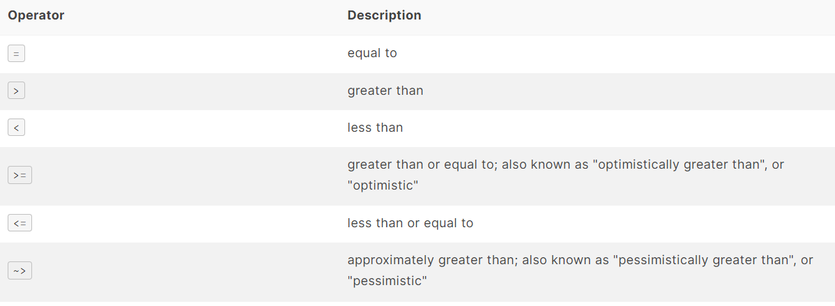
Cookbook version constraints

Slide 34
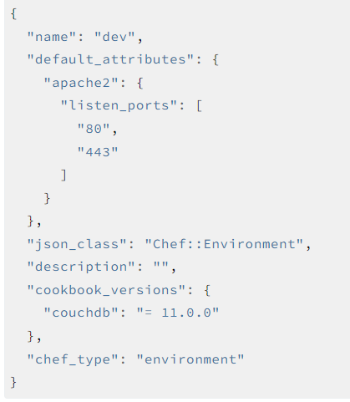
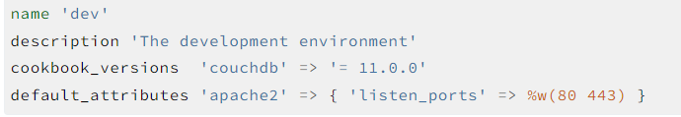
Cookbook example
Environment name : Dev
Cookbook name : couchdb
Cookbook version : 11.0.0 or higher
Listens Port : 80 and 443
Ruby and JSON format

Slide 35
Chef Supermarket
https://supermarket.chef.io/
https://supermarket.chef.io/cookbooks/recursivedir
Community cookbook
Searchable cookbook repository and a friendly web UI
Hosted by Chef Software
Option of Public or Private super market
To use Chef supermarket use knife supermarket command
knife supermarket download COOKBOOK_NAME [COOKBOOK_VERSION] (options)
knife supermarket install COOKBOOK_NAME [COOKBOOK_VERSION] (options)
Pristine copy with new branch created
Removed all existing version from the branch
Download in the format of tar.gz
Untarred and contents are committed in Git
Pristine copy branch is merged with master
Sudo yum install git

Slide 36
Chef Supermarket - commands
knife supermarket list
knife supermarket search mysql
knife supermarket share "my_apache2_cookbook" "Web Servers“
knife supermarket unshare "my_apache2_cookbook" "Web Servers"

Slide 37
Berksfile
Dependency manager for chef cookbook
Easily depend on community cookbooks, safely included in your workflow
Will download from source

Slide 38
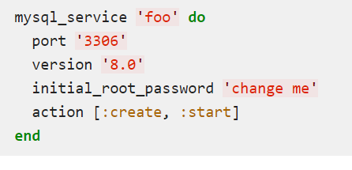
Supermarket Mysql usage
Depends mysql in metadata.rb
https://supermarket.chef.io/cookbooks/mysql

Slide 39
Chef community
https://docs.chef.io/community/
Active, caring, smart and fast growing group
Learn , follow and contribute to community
Meet
Chef events
Meetups
Learn
Chef training
Self guided learning
Interact
Twitter
Facebook
Linkedin
Mailing list
Github
Supermarket

Slide 40
SuperMarket Cookbook lab
Login on Super Market
Use the command to download the mysql cookbook
Install git
Initialize your chef repo with git.. It is looking one commit, you ensure that, if required add a file and do a commit.
You come across, dependency when you install mysql, understand, download and install the dependent super market cook book.
Review all the files..
Upload cook book.
Using run list .. Validate the cook book activity in the node…

Slide 41
Attribute
Default
Automatic
Normal
Force default
Override
Force override

Slide 42
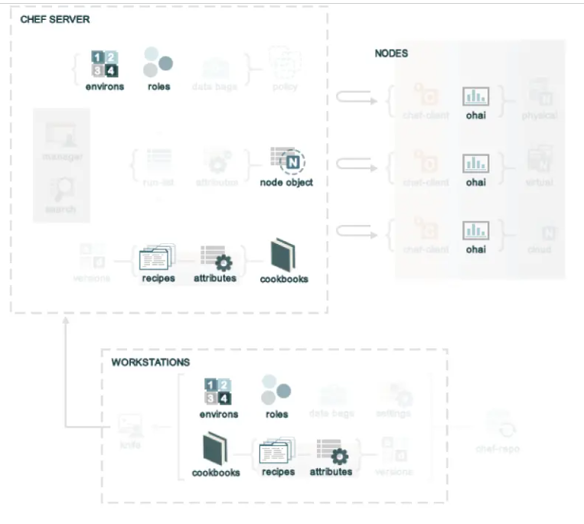
Source of Attributes

Slide 43
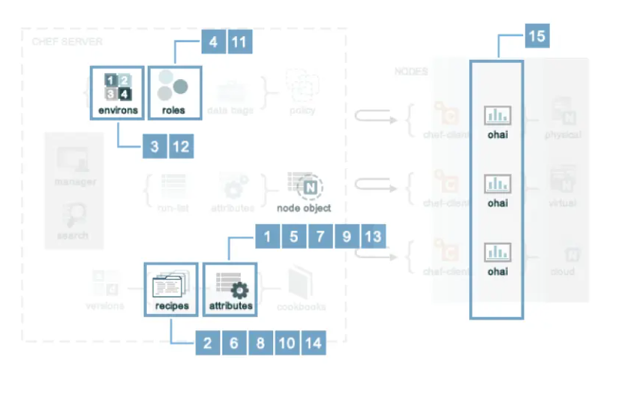
Attribute Precedence

Slide 44
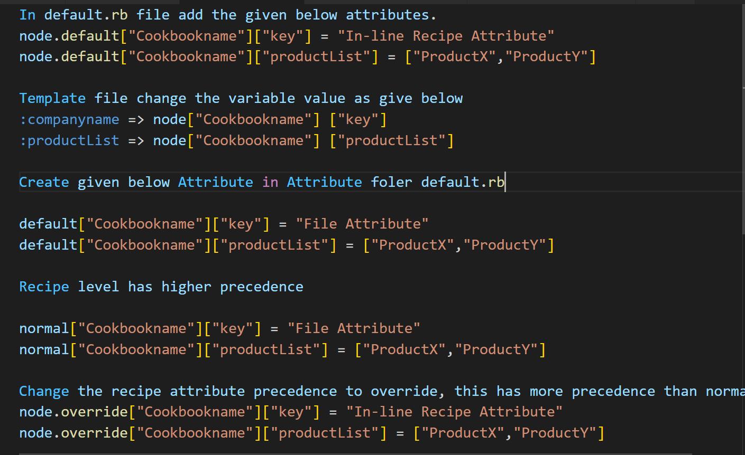
Attributes – Lab session

