Slide 1

Chef
Senthilraj
Day 4

Slide 2
Recap – Day 1
2008 – Ops code
Progress Chef
Configuration management
Chef
Ruby/Erlang
Server uses Elastic search to index attributes - Api client to query these information
Initial support Linux – later windows support added
2019 – becomes open source under Apache 2.0 license
2020 – Progress acquisition
Chef version
Basic (free, open source)
Hosted Chef ($72/node, minimum 20 node purchase)
Chef Automate ($137/node, annual subscription)

Slide 3
Recap – Day 1
Ruby
DSL
Recipe
Cook book
Ruby Recipe – syntax (.rv)
Cook book - syntax
Chef
Development cycle
Code creation
Create-Check-Test-Run
Client tools
Cookstyle recipe file ( Perform syntax check – native ruby utility – linting tool – better chef code)
Chef-client - perform the Smoke test – validate the expected result – (self container/server model)

Slide 4
Recap -1
Chef-client –why-run <RECIPE File> (Default mode – Contact server)
Chef-Client <RECIPE file)
Chef-client –local-mode –why-run <RECIPE File>
Chef-Client –local-mode <RECIPE file)
Chef Zero - easy to get start with – validate recipe, cookbook,run-list – before to server

Slide 5
Day 2
Azure PaaS
Setup Window 10 Lab machine
Setup Cent OS environment
Chef Server
Chef workstation
Chef client
Microsoft account – Hotmail, outlook account.. Create one..
https://www.microsoftazurepass.com/ - setup your Microsoft account to get azure subscription.
Azure portal login
Azure Market place – going to create 4 machine. 3 Linux and 1 windows 10 machine.
Windows 10 – our workstation
Setup – Chef Server – one of the Linux
Chef – workstation – other linux
Chef – Client – other linux machine.
Recipe with client tool.
Create an account with Chef – login with that account – we are going to register our workstation and client with SaaS based Chef.

Slide 6
Session 2
Chef SaaS – application download the zip folder
mkdir chef-repo
cd chef-repo
mkdir cookbooks
chef generate cookbook sample
chef-apply - Testing tool
sudo chef-apply -e "package 'httpd’”
Run list

Slide 7
Day 3
Node Object & Search
Roles
Environment
Setting up Chef environments
Assigning cookbooks based on environments
Chef Supermarket
Chef Community
Community Cookbooks
Supermarket cookbooks usage

Slide 8
Day 3
Data-bags
Creating User
Chef – RBAC
Template
Adding HTML Templates Dynamically with Chef
Chef super market – Lab session
Attributes – Lab session

Slide 9
Day 4
Chef attribute lab
Run-list – Lab session
Chef Pipeline
Azure DevOps
YAML pipeline – Pipeline as code
Classic pipeline
Marketplace chef task, install
Chef Supermarket lab – exercise - recursivedir
https://supermarket.chef.io/cookbooks/recursivedir
Review of the entire course
Thank you!

Slide 10
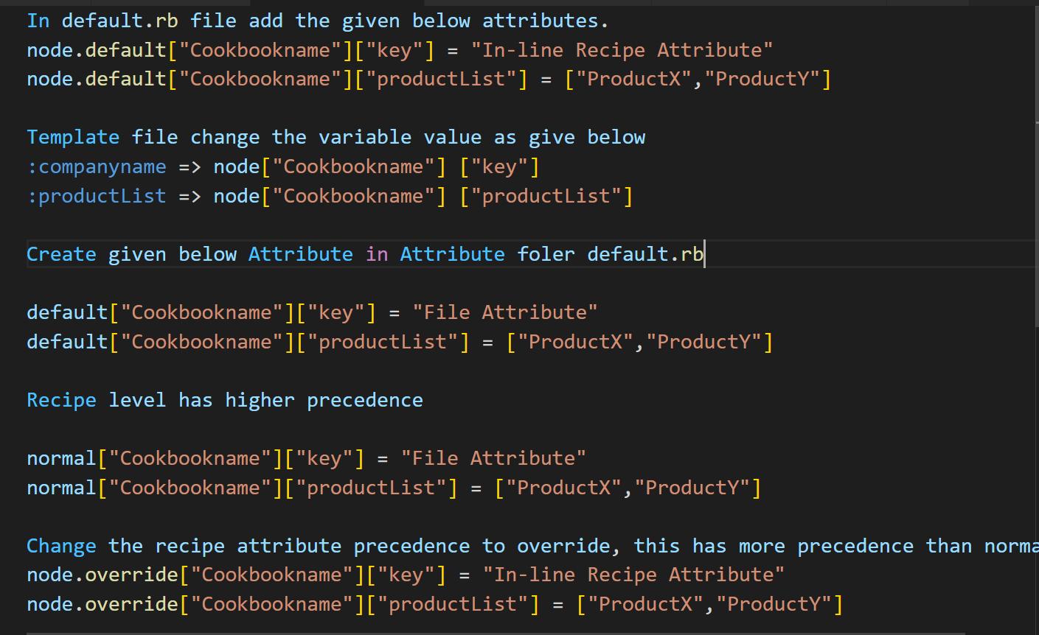
Attributes – Lab session

Slide 11
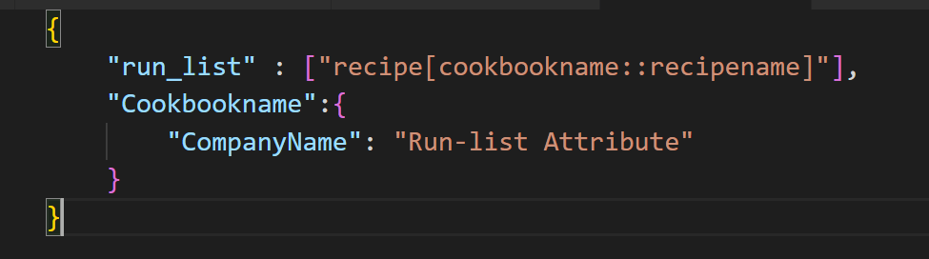
Run list with attribute
Lab session
Create a Jason file with cookbook attribute
Call chef client with switch to pass the attribute parameters
sudo chef-client -z -j runlist.json

Slide 12
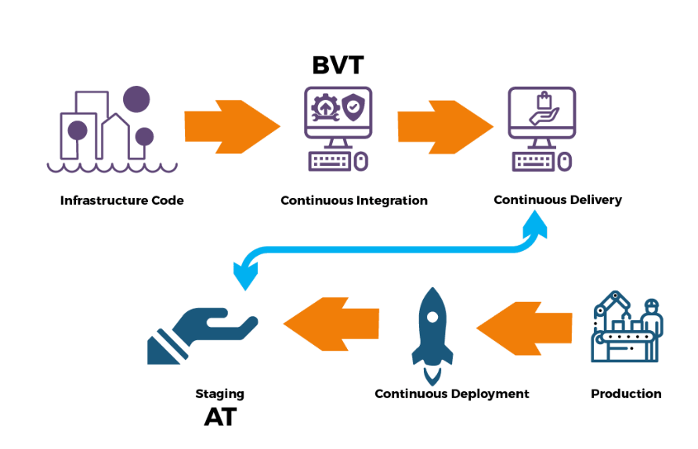
Chef pipeline

Slide 13
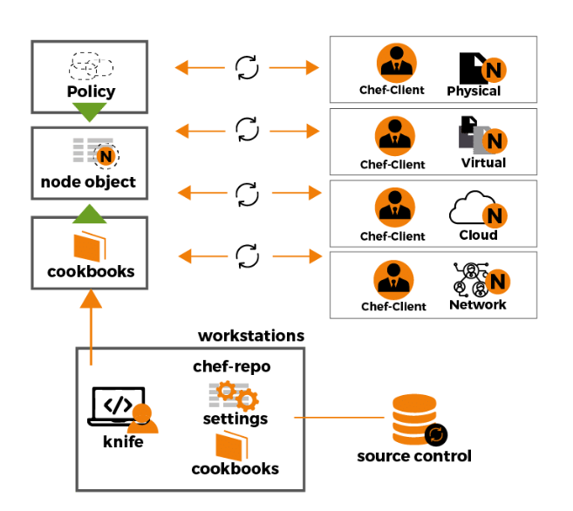
Chef pipeline

Slide 14
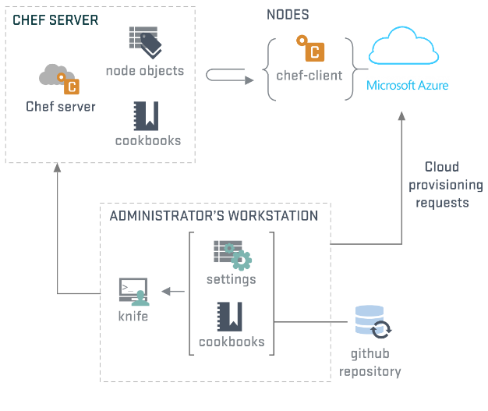
Chef pipeline

Slide 15
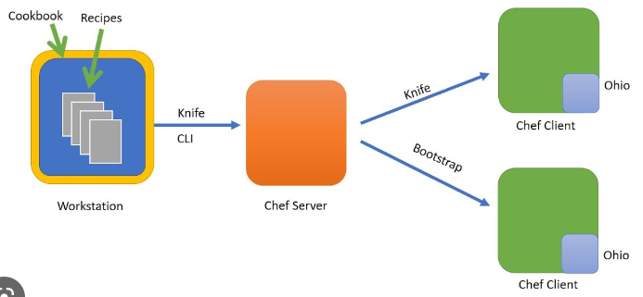
Chef pipeline

Slide 16
Test Kitchen
Kitchen.yaml
Drivers
Target the compute platform or type which will run the VM instance
Can target hypervisors and cloud platforms (e.g. Azure, AWS EC2)
Community drivers available to target Docker and Hashicorp Terraform
Provisioner
Responsible for configuring the VM instance deployed by the driver
Default provisioner include Chef Infra and Shell (i.e command line)
Default behaviour can be overridden to suit target system OS configuration
Verifiers
Responsible for checking the configuration applied by the provisioner
Verifier act as third party auditors, independent of provisioner
Verification tests are usually written in InSpec or ServerSpec

Slide 17
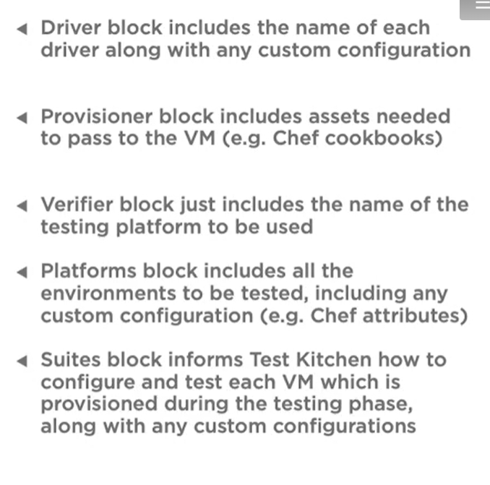
Test Kitchen
Yaml
Driver
Name: vagrant
Provisioner:
Name: chef_zero
Verifier:
Name: inspec
Platforms:
Name: windows-2019
Suites:
Name: default
Verifier:
Inspec_tests:
Test//integration/default

Slide 18
Test Kitchen commands
Kitchen list
Provides all the testing environment from yaml file and current status of instances
https://github.com/test-kitchen/kitchen-dokken
Kitchen list
Kitchen create
Kitchen converge
Kitchen verify
Kitchen destroy

Slide 19
Chef community
https://docs.chef.io/community/
Active, caring, smart and fast growing group
Learn , follow and contribute to community
Meet
Chef events
Meetups
Learn
Chef training
Self guided learning
Interact
Twitter
Facebook
Linkedin
Mailing list
Github
Supermarket

