Slide 1
Concurrency:
Multi-core Programming
& Data Processing
Lab 2
-- Explicit synchronization in Java --

Slide 2
ReentrantLock
java.util.concurrent.locks package
Primitives: lock() and unlock()
Attention exceptions! -- have to manually unlock() in a finally block
Reentrance property:
Can be called more than once by the thread holding the lock
Internal counter increment/decrement -- released when 0
ReentrantLock lock = new ReentrantLock()
lock.lock();
shareObject.someMethod();
lock.unlock();
Notes:
<number>

Slide 3
Semaphore
java.util.concurrent.Semaphore
Usage:
to send signals between threads
to guard a critical section
Internal counter limits the number of threads accessing a shared resource
initialized to any integer
operations: acquire (decrement) and release (increment)
if the result is negative, thread blocks until semaphore is incremented
current semaphore value cannot be read
Notes:
<number>

Slide 4
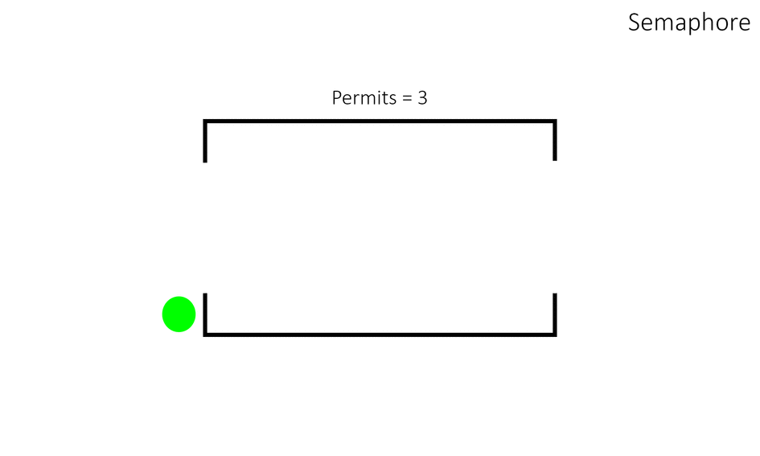

Slide 5
CountDownLatch
java.util.concurrent.CountDownLatch
Allows one thread to wait for one or more before it starts processing
number of threads specified at initialization
Operations:
await() -- called by the thread that waits for others (usually main thread), blocks until internal count is 0
countDown() -- called by the other threads to decrement count
Not reusable
Notes:
<number>

Slide 6
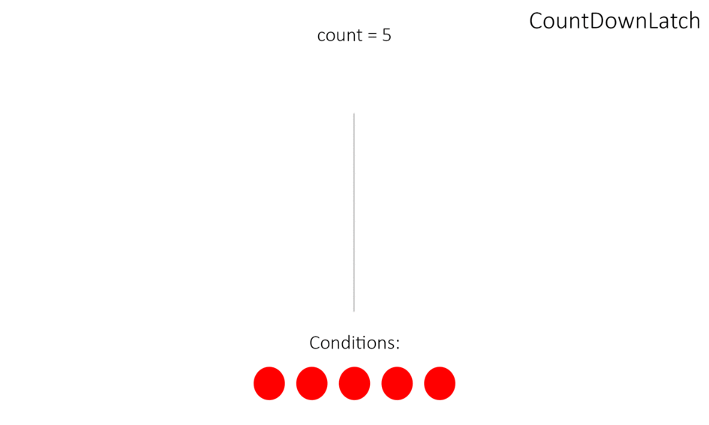

Slide 7
CyclicBarrier
java.util.concurrent.CyclicBarrier
All threads must reach the barrier before they are allowed to continue
number of threads specified at initialization
Operations:
await() -- called by the threads in order to wait at the barrier for the others
Supports a custom barrier action (Runnable), executed when last thread arrives at the barrier
Notes:
<number>

Slide 8
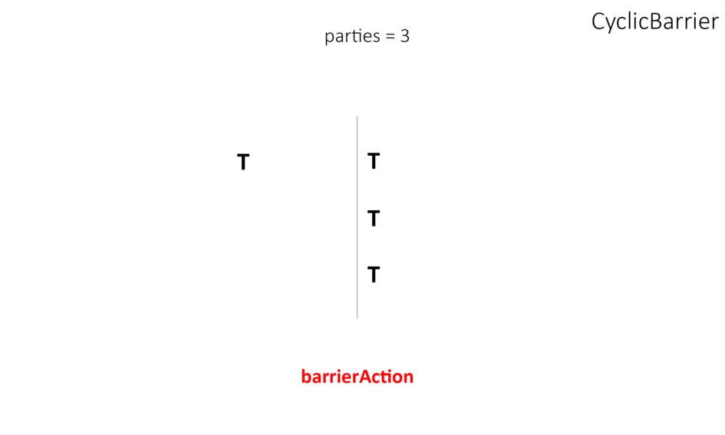

Slide 9
Exchanger
java.util.concurrent.Exchanger
Two-party barrier, where the parties exchange data at the barrier point
Similar to a rendezvous point where threads can safely exchange their objects
Operations:
exchange() -- receives the object as parameter
Task to be performed at the meeting point: Runnable
Notes:
<number>

Slide 10


Slide 11
Phaser
java.util.concurrent.Phaser
Combination of CyclicBarrier and CountDownLatch:
dynamic number of threads
reusable
advanceable
Operations:
register() -- called when a thread wants to be known by the Phaser
arrive() vs. arriveAndAwaitAdvance() -- when the thread arrives at the barrier (advanceable vs. not advanceable)
Notes:
<number>

Slide 12
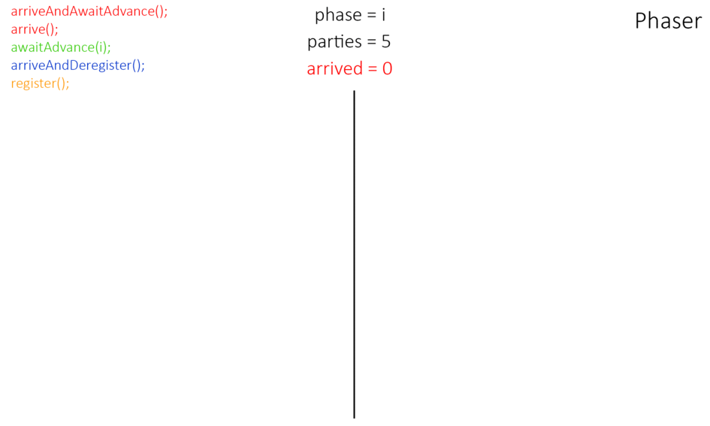

Slide 13
Exercise (CyclicBarrier)
Concurrent processing of an input image. The goal is to find out how many black pixels are in the input image. A master thread loads the image and waits for all other threads to start before splitting the image between them (first barrier point). Each thread counts the number of black pixels of its slice. All threads wait until everybody counted their pixels, save the value in a shared array and synchronize (second barrier point). Master thread computes the final value after synchronization.
Download code-skeleton and input file from ILIAS lab2/exercises
Complete parts indicated by comments in the source code
for i in `seq 1 50`; do java ImageAnalysis; done
Notes:
<number>

