Slide 1
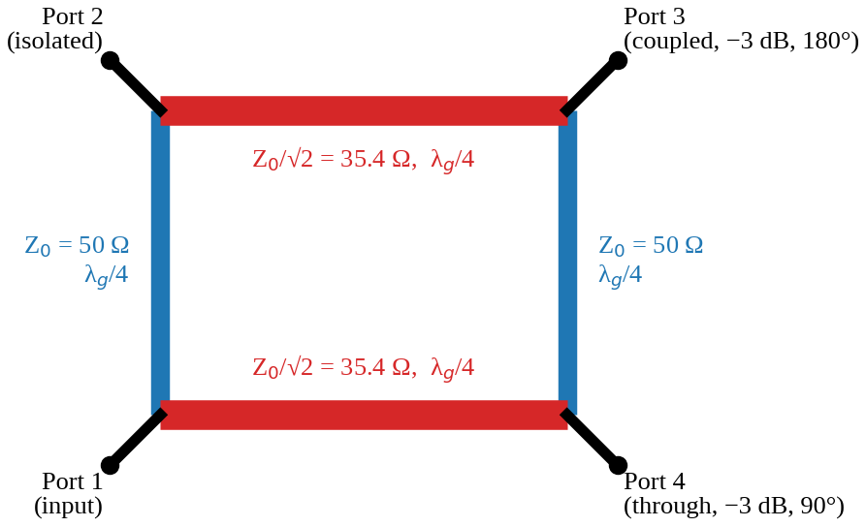
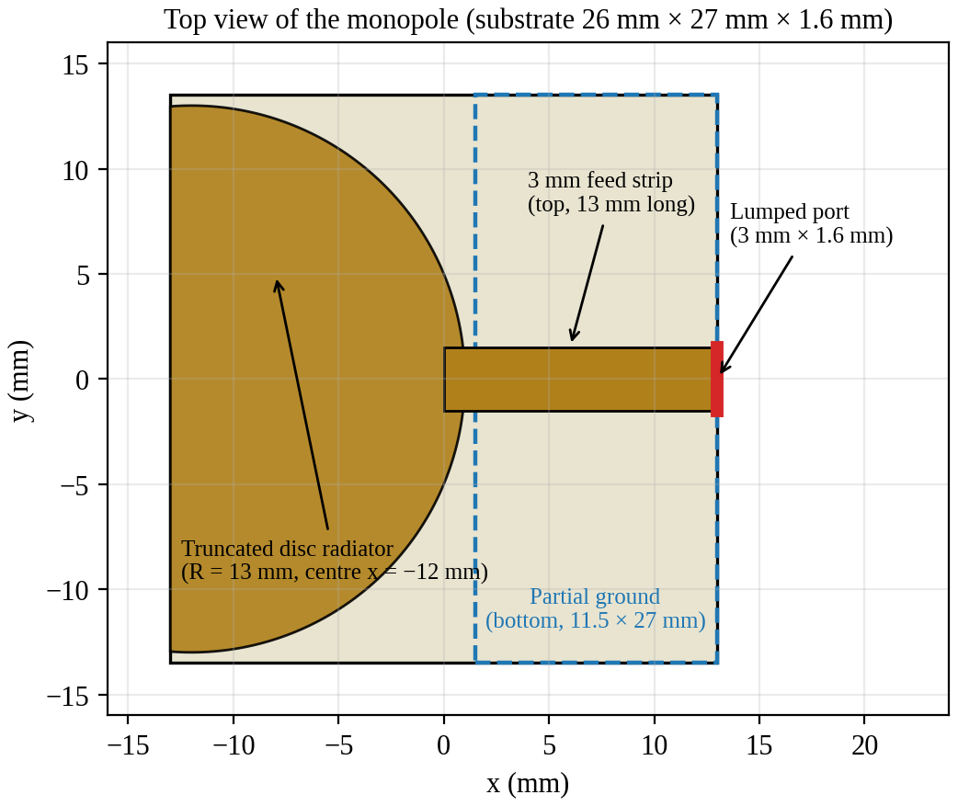
MICROWAVE THEORY AND ANTENNA (23EC5PCMTA)
Branch-Line Coupler and UWB Monopole Antenna
Design and characterization using Ansys HFSS on 1.6 mm FR4
Team 1: Nabi Abhishikth Zacharias (1BF24EC086) | Ratik Agrawal (1BF24EC118) | Rohit Nair (1BF24EC121) | Sawan Kumar (1BF24EC136)
Course Instructor: Dr. Shaila V. Hegde, Professor in ECE | B.M.S. College of Engineering | June 2026
Notes:
Opening. Two designs: a 2.4 GHz branch-line coupler (Part A) and a printed UWB monopole antenna (Part B), both on 1.6 mm FR4 and simulated in Ansys HFSS.

Slide 2




Introduction
PART A | COUPLER
A directional coupler divides the power entering one port between two output ports and keeps a fourth port isolated.
The branch-line coupler (90° hybrid) is the simplest planar version: four quarter-wave microstrip sections form a closed ring.
Equal split (-3 dB to each output), outputs 90° apart in phase.
Understand
Design
Model
Characterize
Operation and ideal S-parameters
50 Ω and 35.4 Ω quarter-wave arms on FR4
4-port HFSS model, 1.2 to 3.6 GHz sweep
Return loss, isolation, split, bandwidth
Notes:
Used in balanced amplifiers, mixers, phase shifters and antenna feed networks.

Slide 3


How the Coupler Works
PART A | COUPLER
Isolated port
The two paths differ by half a wavelength and cancel: nothing arrives.
Through port
Paths add: -3 dB, 90° phase shift.
Coupled port
Paths add: -3 dB, 180° (diagonal port).
Exact only at f₀: that is why the coupler is narrowband
Series arms 35.4 Ω (red), shunt arms 50 Ω (blue), each λ_{g}/4

Slide 4
Ideal Behaviour
PART A | COUPLER
Ideal S-parameters at f₀
Quantity | Ideal value
Input return loss | ∞ (S₁₁ = 0)
Isolation | ∞
Split to each output | -3.01 dB
Phase between outputs | 90°
Series / shunt arms | 35.4 Ω / 50 Ω, λ_{g}/4
S₁₁ = 0 (matched)
S₂₁ = -j/√2 (through)
S₃₁ = -1/√2 (coupled)
S₄₁ = 0 (isolated)
How the coupler is characterized
Return loss
Isolation
Coupling
VSWR
-20 log|S₁₁|
-20 log|S_{isolated}|
-20 log|S_{coupled}|
(1+|Γ|)/(1-|Γ|)
Notes:
Directivity = isolation minus coupling. Bandwidth is the range where RL and isolation stay above 10 dB or 20 dB and the split stays near -3 dB.

Slide 5
Design at 2.4 GHz on FR4
PART A | COUPLER
3.0 mm
5.3 mm
Quantity | 50 Ω arms | 35.4 Ω arms
Synthesis width | 3.06 mm | ≈ 5.3 mm
ε_{eff} | 3.32 | 3.49
Phase constant β | 91.7 rad/m | 93.9 rad/m
Width used in HFSS | 3.0 mm | 5.3 mm
50 Ω line width
35.4 Ω arm width
Z = 50.8 Ω
Z = 35.1 Ω
17.1 mm
16.7 mm
ε_{eff} = (ε_{r}+1)/2 + [(ε_{r}-1)/2](1 + 12h/w)^{-1/2}
λ_{g}/4, 50 Ω arm
λ_{g}/4, 35.4 Ω arm
λ_{g} = 68.6 mm
λ_{g} = 66.9 mm
Hammerstad equations on ε_{r} = 4.4, h = 1.6 mm. Both widths are within 2 % of target impedance. FR4 dielectric loss is about 0.83 Np/m (7.2 dB/m), roughly 0.5 dB per guided wavelength.
Notes:
Free-space wavelength at 2.4 GHz is 125 mm. The 3.0 mm line is 1.6 % above 50 ohm; the 5.3 mm line is 0.8 % below 35.4 ohm.

Slide 6
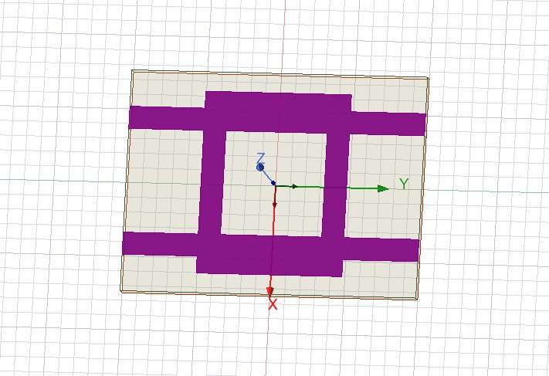
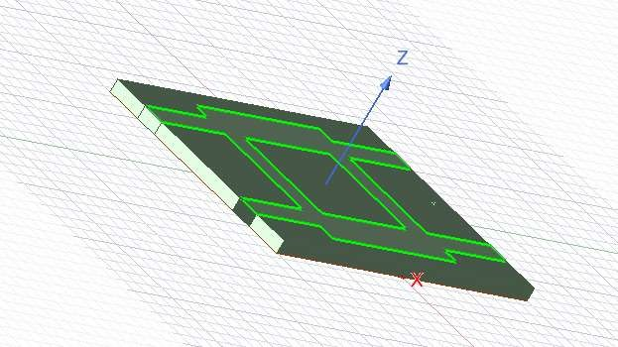
HFSS Model
PART A | COUPLER
Item | Setting
Substrate | FR4, 30 × 40 × 1.6 mm
Conductors | Perfect E: ground + top pattern
Ring | 24.7 × 19.7 mm outer, arms 5.3 / 3.0 mm
Feeds | 3.0 mm wide, to edges at y = ±20 mm
Ports | 4 lumped ports, 50 Ω
Air box | 50 mm cube, radiation boundary
Solution | Adaptive at 2.4 GHz, 6 passes, ΔS 0.02
Sweep | 1.2 to 3.6 GHz, 6 MHz step
Top view
3-D view
Solution type: HFSS Terminal Network (project Branch_line_coupler).
Zero-thickness Perfect E sheets for the ground plane and coupler pattern; lossy FR4 for the substrate.

Slide 7
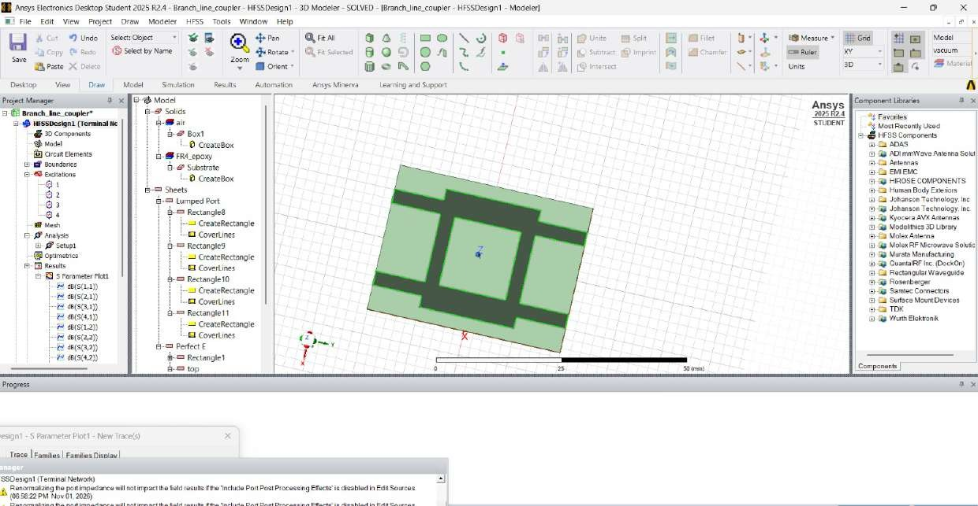
Ports and Arm Layout
PART A | COUPLER
50 Ω arms (3.0 mm)
join P1-P2 and P3-P4
35.4 Ω arms (5.3 mm)
join P1-P4 and P2-P3
With P1 as input
P4 = through, P3 = coupled, P2 = isolated
HFSS modeler: model tree with four lumped ports and the air box
Port positions (mm): P1 (-8.6, -20), P2 (-8.6, +20), P3 (+8.55, +20), P4 (+8.55, -20)

Slide 8
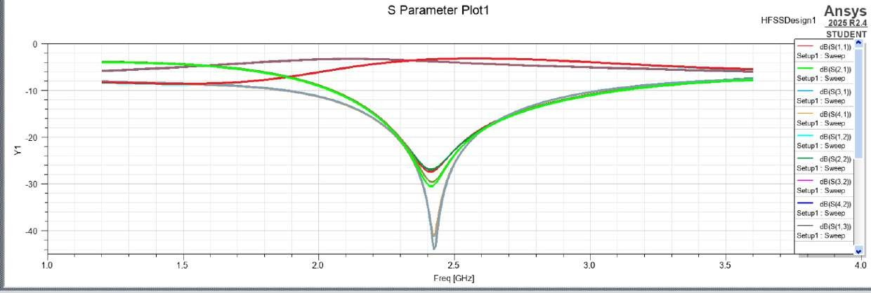
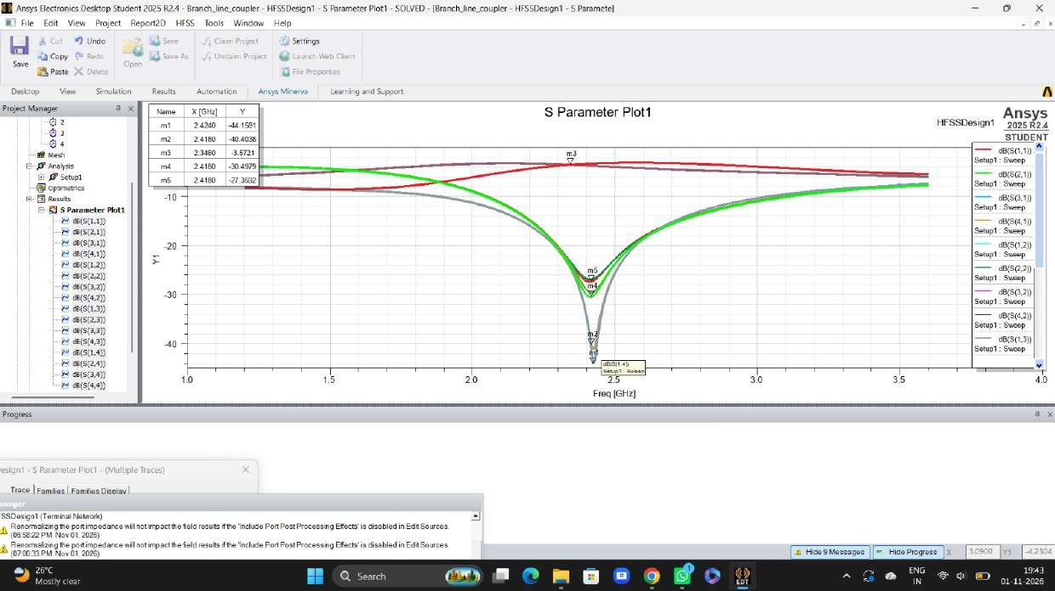
S-Parameters and Markers
PART A | COUPLER
Family 1: near -3 to -4 dB
Markers m1 to m5 near the centre frequency. m1, m2, m4, m5 lie on the dip curves; *m3 lies on a power-split curve.
Power-split paths (through and coupled), roughly equal across the middle of the band
Mark | GHz | dB | |S| | VSWR
m1 | 2.434 | -44.16 | 0.006 | 1.01
m2 | 2.418 | -40.49 | 0.010 | 1.02
m4 | 2.418 | -30.50 | 0.030 | 1.06
m5 | 2.418 | -27.36 | 0.043 | 1.09
m3* | 2.346 | -3.57 | 0.66 | -
Family 2: sharp dips near 2.42 GHz
Input reflection and isolation: both become small at the centre frequency, as theory predicts

Slide 9
Key Results
PART A | COUPLER
2.42 GHz
27-44 dB
Centre frequency
Return loss / isolation
+0.8 % from 2.4 GHz
VSWR ≤ 1.09
-3.57 dB
≈ 10 %
Power split (m3)
20 dB bandwidth
ideal -3.01 dB
2.3 to 2.55 GHz
Notes:
Every dip is deeper than the usual 20 dB goal. The worst case m5 gives |S| = 0.043, so the isolated port receives under 0.2 percent of the input power.

Slide 10
Discussion
PART A | COUPLER
Centre frequency
Power split
Bandwidth
Minima near 2.42 GHz, 0.8 % above target. Typical of corner (junction) discontinuities and fringing that quarter-wave equations ignore. Slightly longer arms would pull it to 2.4 GHz.
Marker m3 reads -3.57 dB, about 0.56 dB below the ideal -3.01 dB. Consistent with FR4 dielectric loss (about 0.5 dB per wavelength) plus some radiation. The two split curves are nearly, not perfectly, equal.
Better than 20 dB over about 2.3 to 2.55 GHz (about 10 %), better than 10 dB over about 2.0 to 3.0 GHz. At the sweep edges return loss falls to about 8 dB: the quarter-wave ring is narrowband.
Bandwidth values are read from the plot and are approximate.

Slide 11

Conclusion: Part A
PART A | COUPLER
What the simulation shows
Limitations
Centred at about 2.42 GHz, only 0.8 % above the design frequency
Legend truncated: curves identified by behaviour, marker-to-trace to be confirmed in Ansys
90° phase difference not shown in the plots, so not verified
Perfect-E sheets: only dielectric loss included
Simulation only, no fabrication
Return loss and isolation 27-44 dB (VSWR ≤ 1.09) at the centre
Roughly equal split, near -3.6 dB (FR4 loss)
Narrow band: about 10 % at 20 dB, as expected for a quarter-wave ring

Slide 12
Introduction
PART B | ANTENNA
3.1-10.6
≥ 20 %
> 3 : 1
GHz, FCC UWB band
fractional BW (or ≥ 500 MHz)
frequency span
A printed monopole is planar, cheap, easy to feed with a microstrip line and naturally wideband.
Estimate
Model
Characterize
Radiation
Choose substrate, radiator, f_{L}
HFSS, 50 Ω feed, 1 to 15 GHz
S₁₁, bandwidth, VSWR
Realized-gain patterns at 5 GHz

Slide 13

UWB Antenna Theory
PART B | ANTENNA
f_{c} = (f_{H} + f_{L})/2
FBW = (f_{H} - f_{L})/f_{c} × 100 %
BR = f_{H}/f_{L}
Tapered transition
A wide, curved disc acts like a taper from feed line to free space: several close modes merge into one broad band.
Partial ground
Ground under the feed line only keeps the radiator open to air and helps the match.
0.316
1.92
10 %
0.46 dB
|Γ| at -10 dB
VSWR
power reflected
mismatch loss
Monopole-like pattern
f_{L} ≈ c / (4 L √ε_{eff}), ε_{eff} ≈ (ε_{r}+1)/2
G_{realized} = (1 - |Γ|²) · G_{antenna}
Broad, nearly omnidirectional radiation.

Slide 14
Antenna Design on FR4
PART B | ANTENNA
Part | Dimension
Substrate | FR4, 26 × 27 × 1.6 mm
Radiator (top) | Disc R = 13 mm, centre x = -12 mm, cut at x = -13 mm
Feed line (top) | 3 mm wide (50 Ω), 13 mm long, x = 0 to 13 mm
Ground (bottom) | 11.5 × 27 mm, from x = 1.5 to 13 mm
Feed | Lumped port 3 × 1.6 mm, 50 Ω, at x = 13 mm
Air box | 40 mm cube, radiation boundary
Top view; dashed: partial ground on the bottom face

Slide 15
Design Check and Setup
PART B | ANTENNA
Quarter-wave estimate of the lower edge
HFSS settings
14.5 mm
3.15 GHz
3.52 GHz
One lumped port, 50 Ω
Perfect E conductors, radiation boundary
Adaptive at 5 GHz, 6 passes, ΔS 0.02
Sweep 1 to 15 GHz, 141 points
Outputs: S11 and realized gain at 5 GHz
→
Longest path L
Estimate f_{L}
Simulated edge
ground edge to far end
c / (4L√ε_{eff})
S₁₁ = -10 dB
The simulated edge is close to, and a little above, the estimate: a match better than -10 dB needs the radiator slightly longer than a quarter wavelength.
Lengthening the radiator lowers the edge.

Slide 16
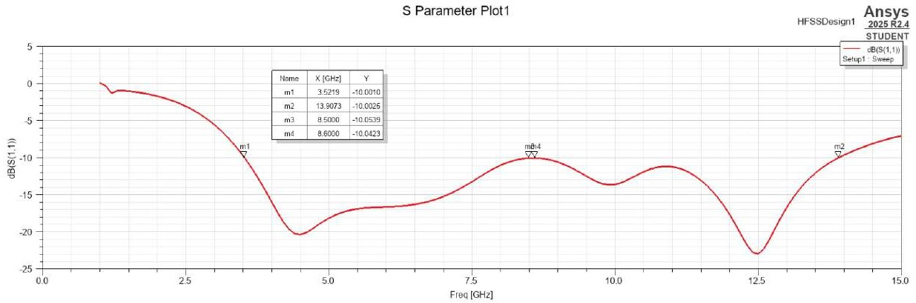
Reflection Coefficient
PART B | ANTENNA
m1
3.522 GHz
m3
8.500 GHz
m4
8.600 GHz
m2
13.907 GHz
-10.00 dB | lower edge
-10.05 dB | shallow hump
-10.04 dB | shallow hump
-10.00 dB | upper edge

Slide 17
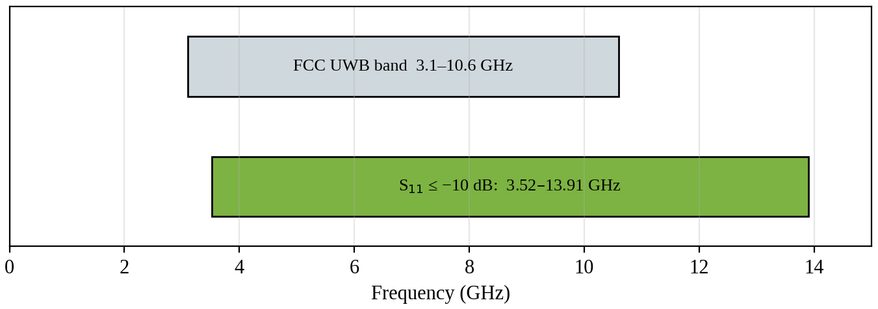
Bandwidth Characterization
PART B | ANTENNA
10.39 GHz
119 %
3.95 : 1
1.93
Bandwidth
Fractional BW
Bandwidth ratio
VSWR at edges
3.52 to 13.91 GHz
f_{c} = 8.71 GHz
f_{H} / f_{L}
|Γ| = 0.316
Covered: 3.52 to 10.6 GHz of the FCC band, and up to 13.9 GHz.
Not covered: 3.1 to 3.52 GHz.
Margin at 8.5 to 8.6 GHz is only about 0.05 dB.

Slide 18
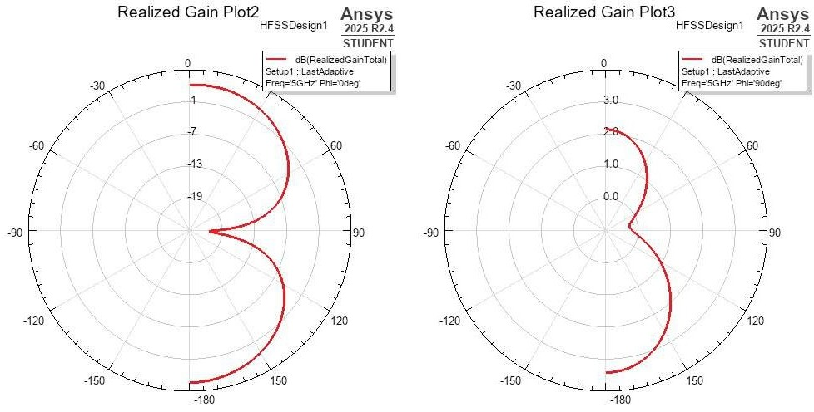
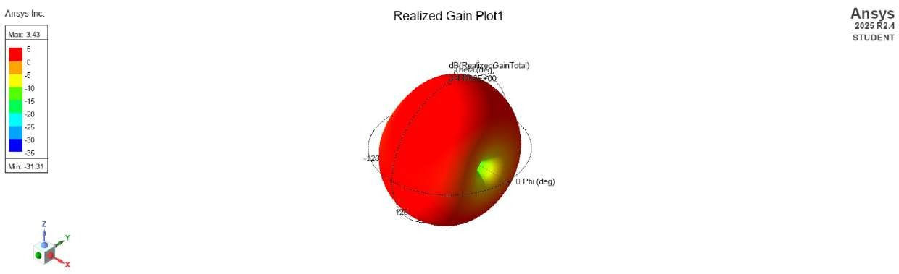
Radiation and Gain Cuts, 5 GHz
PART B | ANTENNA
Three-dimensional realized gain at 5 GHz
3.43 dB
-31.31 dB
≈ -18 dB
Peak realized gain
Deepest null
S₁₁ at 5 GHz
(a) φ = 0° cut (left), (b) φ = 90° cut (right), 5 GHz
1.6 % reflected
Almost uniformly red: gain stays within a few dB of its maximum over most of the sphere, with one narrow null. A broad, nearly omnidirectional monopole pattern.
φ = 0° cut
φ = 90° cut
About 0 dB near θ = 0° and 180°, deep null toward θ = ±90°.
About 2 dB at θ = 0°, about 3 dB at 180°, only a shallow dip near 90°.
Gain values are read from the polar plots and are approximate.

Slide 19
Conclusion: Part B
PART B | ANTENNA
What the simulation shows
Limitations
S₁₁ below -10 dB from 3.52 to 13.91 GHz: 119 % fractional bandwidth, VSWR below 1.93
Simulation only, not fabricated or measured
Patterns only at 5 GHz; efficiency and group delay not characterized
Air box about 7 mm from the board, closer than a quarter wavelength at low frequency
Perfect-E sheets: real FR4 loss will lower gain at high frequency
Covers the FCC UWB range from 3.52 to 10.6 GHz, not 3.1 to 3.52 GHz
At 5 GHz: broad, nearly omnidirectional pattern, peak realized gain 3.43 dB
Next step: a slightly longer radiator would extend the band toward 3.1 GHz, then fabricate and measure.

Slide 20
Summary
 | Part A: Coupler | Part B: UWB monopole
Function | Equal 3 dB split, 90° hybrid | Wideband radiator, 3.1-10.6 GHz target
Structure | Ring of four λ_{g}/4 arms (50 Ω / 35.4 Ω) | Disc radiator, 3 mm feed, partial ground
Key result | Centre 2.42 GHz, RL / isolation 27-44 dB | 3.52-13.91 GHz, 119 % FBW, 3.43 dB peak gain
Main limit | Narrowband (about 10 %), FR4 loss | Misses 3.1-3.52 GHz, tight margin near 8.5 GHz
Both designs on 1.6 mm FR4 meet their targets in simulation; next step: fabricate and measure.

Slide 21
References
1
D. M. Pozar, Microwave Engineering, 4th ed. Hoboken, NJ: Wiley, 2012.
2
E. Hammerstad and O. Jensen, "Accurate models for microstrip computer-aided design," IEEE MTT-S Int. Microwave Symp. Dig., 1980, pp. 407-409.
3
C. A. Balanis, Antenna Theory: Analysis and Design, 4th ed. Hoboken, NJ: Wiley, 2016.
4
Federal Communications Commission, "Revision of Part 15 ... Ultra-Wideband Transmission Systems," First Report and Order, ET Docket 98-153, FCC 02-48, Apr. 2002.
5
Ansys, Inc., Ansys HFSS / Electronics Desktop Student 2025 R2 documentation.

