Slide 1
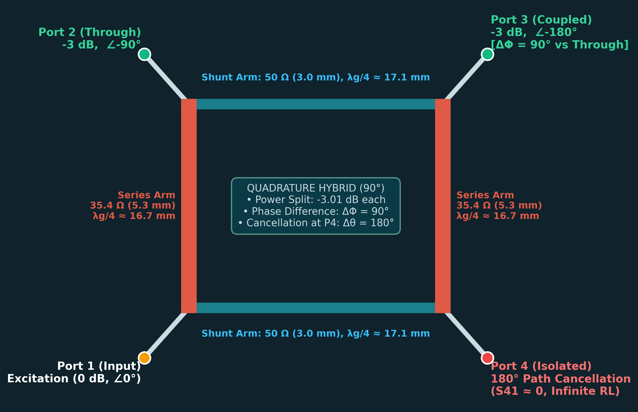
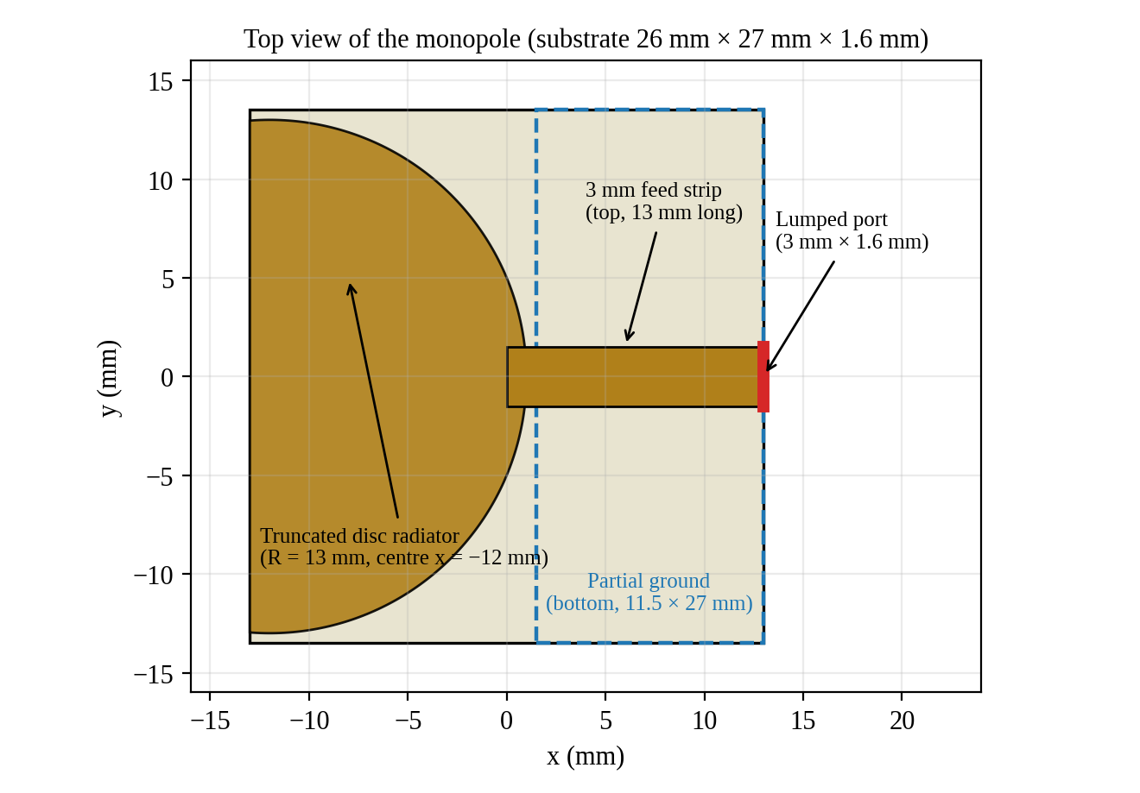
MICROWAVE THEORY AND ANTENNA (23EC5PCMTA)
Branch-Line Coupler &
Printed UWB Monopole
Design, 3D EM Simulation, and Performance Characterization on 1.6 mm FR4
Team 1 — Electronics & Communication Engineering
Nabi Abhishikth Zacharias (1BF24EC086) | Ratik Agrawal (1BF24EC118)
Rohit Nair (1BF24EC121) | Sawan Kumar (1BF24EC136)
Course Instructor: Dr. Shaila V. Hegde, Professor in ECE
B.M.S. College of Engineering, Bengaluru | June 2026
Notes:
Good morning/afternoon respected Professor and colleagues. We are Team 1, presenting our work on Microwave Theory and Antenna: Part A covers the design and characterization of a 2.4 GHz microstrip Branch-Line Coupler, and Part B covers a printed Ultra-Wideband (UWB) Monopole Antenna on 1.6 mm FR4 substrate using Ansys HFSS.

Slide 2
EXECUTIVE SUMMARY
Project Overview & Methodology
Part A: 2.4 GHz Branch-Line Coupler
• Function: Equal power division (-3 dB split) with 90° quadrature phase shift.
• Substrate: 1.6 mm FR4 (εr = 4.4, tan δ = 0.02) for 2.4 GHz ISM band.
• Architecture: Closed ring of 4 quarter-wave microstrip arms (50 Ω shunt, 35.4 Ω series).
• Key Objectives: Verify port match (S11), isolation (S41), power division (S21, S31), and ~10% fractional bandwidth.
• Methodology: Hammerstad synthesis -> 3D HFSS Terminal Network sweep (1.2–3.6 GHz).
Part B: Planar Printed UWB Monopole
• Function: Ultra-wideband planar transmission/reception across multiple GHz.
• Target Spectrum: FCC unlicensed UWB mask (3.1 to 10.6 GHz; FBW ≥ 20%).
• Architecture: Circular disc radiator fed by 50 Ω microstrip with partial ground plane on reverse.
• Physics: Smooth tapered transition from feed line to free space supporting multi-modal resonance.
• Key Objectives: Characterize S11 impedance bandwidth (1–15 GHz) and 2D/3D realized gain at 5 GHz.
Notes:
This project is divided into two distinct microwave components designed on standard 1.6 mm FR4 epoxy substrate. Part A focuses on a narrowband 2.4 GHz quadrature directional coupler, while Part B investigates an ultra-wideband printed disc monopole antenna. We followed an end-to-end engineering workflow: theoretical synthesis from closed-form equations, 3D electromagnetic modeling in Ansys HFSS, and rigorous post-processing of S-parameters and radiation fields.

Slide 3
PART A | COUPLER
Operating Principle & Port Architecture
Quadrature Hybrid Operation (f0 = 2.4 GHz)
• Through Port (P2): -3 dB power split with -90° phase shift relative to input.
• Coupled Port (P3): -3 dB power split with -180° phase shift relative to input.
• Output Phase Difference: ΔΦ = (-180°) - (-90°) = 90° (True Quadrature Hybrid).
Destructive Interference at Isolated Port (P4)
• Path A (Direct Shunt Arm): Travels λg/4 -> Phase delay = 90°.
• Path B (Around the Ring): Travels 3λg/4 -> Phase delay = 270°.
• Phase Difference: Δθ = 270° - 90° = 180° -> Exact signal cancellation (S41 ≈ 0).
• Crucial Distinction: 180° is the cancellation at P4, NOT the output phase split!
Notes:
Here is the fundamental operation of the branch-line coupler, and we highlight an important technical clarification: The two output ports—Port 2 (Through) and Port 3 (Coupled)—exhibit a 90° relative phase difference, making it a 90° quadrature hybrid. The 180° phase difference described in microwave theory refers specifically to the two paths arriving at Port 4 (the isolated port), where Path A (90°) and Path B (270°) arrive exactly 180° out of phase, destructively interfering to provide high isolation. Furthermore, our physical HFSS geometry matches this mapping: vertical series arms (35.4 Ω) join P1 to P2 and P4 to P3, while horizontal shunt arms (50 Ω) join P1 to P4 and P2 to P3.

Slide 4
PART A | COUPLER
Microstrip Synthesis & Design Parameters
3.0 mm
50 Ω Shunt Arms
Synthesized: 3.06 mm (Z=50.8 Ω)
5.3 mm
35.4 Ω Series Arms
Z0/√2 target (Z=35.1 Ω)
17.1 mm
λg/4 (50 Ω Line)
λg = 68.6 mm, εeff = 3.32
16.7 mm
λg/4 (35.4 Ω Line)
λg = 66.9 mm, εeff = 3.49
Arm Parameter | 50 Ω Shunt Arm | 35.4 Ω Series Arm | Synthesis / HFSS Remarks
Target Impedance | 50.0 Ω | 35.35 Ω (Z0/√2) | Equal power division condition
Synthesized Width (w) | 3.06 mm (w/h = 1.91) | 5.30 mm (w/h = 3.31) | Derived via Hammerstad equations
HFSS Width Used | 3.00 mm (Z0 = 50.8 Ω) | 5.30 mm (Z0 = 35.1 Ω) | Both within 1.6% of theoretical target
Effective Permittivity (εeff) | 3.32 | 3.49 | Mixed dielectric boundary (air + FR4)
Quarter Wavelength (λg/4) | 17.1 mm | 16.7 mm | Design frequency f0 = 2.4 GHz
Substrate & Dielectric Loss | FR4 (εr = 4.4, h = 1.6 mm) | tan δ = 0.02 (αd ≈ 0.83 Np/m) | Predicts ~0.5 dB loss per guided wavelength
Notes:
Slide 4 summarizes the microstrip synthesis using Hammerstad closed-form design equations on 1.6 mm FR4 epoxy (εr = 4.4). The 50 Ω feed and shunt arms use a width of 3.0 mm (giving 50.8 Ω, within 1.6% of target), with a quarter-wavelength of 17.1 mm. The 35.4 Ω series arms require a wider 5.3 mm strip (giving 35.1 Ω, within 0.8% of target), with a quarter-wavelength of 16.7 mm. We also calculated dielectric attenuation of 0.83 Np/m (7.2 dB/m), indicating we should expect roughly 0.5 dB of insertion loss in the coupler due to lossy FR4 substrate.

Slide 5
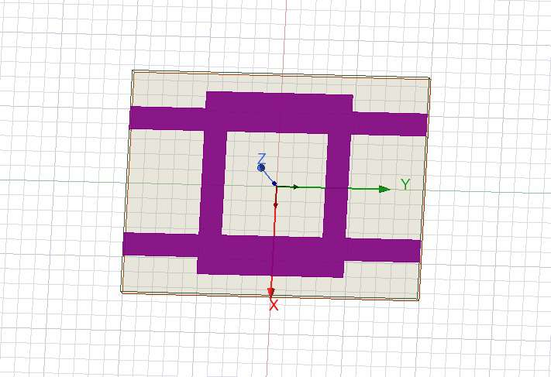
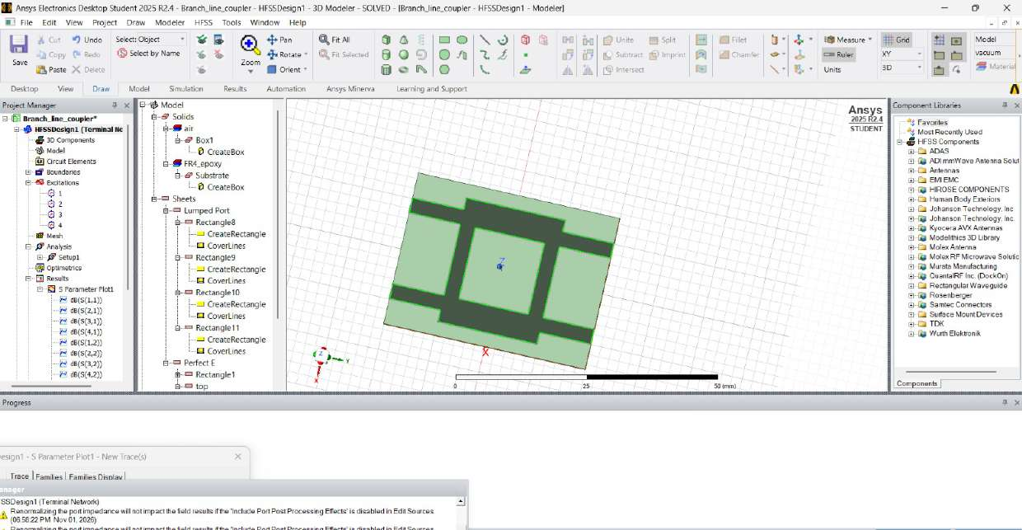
PART A | COUPLER
HFSS 3D EM Simulation Setup
Model & Boundary Setup
• Project: Branch_line_coupler
• Solution: HFSS Terminal Network
• Conductors: Zero-thickness Perfect E sheets (ground + ring).
• Substrate: Lossy FR4 (30 × 40 × 1.6 mm).
• Air Box: 50 × 50 × 50 mm vacuum box with Radiation Boundary.
• Excitations: 4 lumped ports (50 Ω) placed at board edges.
• Adaptive Setup: 2.4 GHz, 6 passes, ΔS ≤ 0.02.
• Frequency Sweep: 1.2 to 3.6 GHz (6 MHz step, 401 points).
Port # | HFSS Role | Coordinates (x, y) | Connected Branch
Port 1 | Input Port | x = -8.55 mm, y = -20 mm | Excitation feed line
Port 2 | Through Port | x = -8.55 mm, y = +20 mm | 5.3 mm (35.4 Ω) vertical series arm
Port 3 | Coupled Port | x = +8.55 mm, y = +20 mm | Diagonal corner (quadrature output)
Port 4 | Isolated Port | x = +8.55 mm, y = -20 mm | 3.0 mm (50.0 Ω) horizontal shunt arm
Notes:
Here we show the actual Ansys HFSS simulation environment. The solution type is HFSS Terminal Network. The model dimensions are 30 by 40 mm with 4 lumped ports placed on the substrate perimeter. The table confirms the exact port assignments verified directly from the HFSS .aedt project file: Port 1 is the bottom-left input; Port 2 is the top-left through port connected via the 5.3 mm series arm; Port 3 is the top-right coupled port; and Port 4 is the bottom-right isolated port connected via the 50 Ω shunt arm. The sweep runs from 1.2 GHz to 3.6 GHz with an adaptive solution converged to ΔS < 0.02.

Slide 6
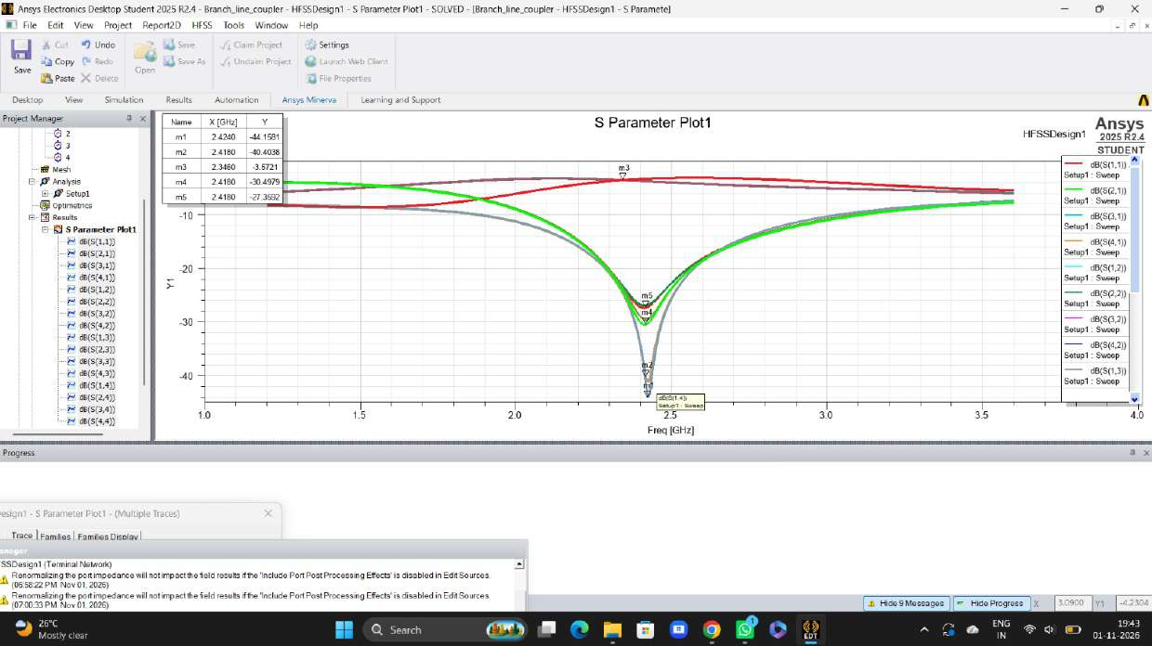
PART A | COUPLER
Simulated S-Parameters & Performance
2.42 GHz
Centre Frequency
+0.8% offset from 2.4 GHz
27 to 44 dB
Return Loss & Isolation
VSWR ≤ 1.09 (m1 = -44.2 dB)
-3.57 dB
Power Split (m3)
At 2.346 GHz (ideal -3.01 dB)
≈ 10 %
20 dB Bandwidth
2.30 to 2.55 GHz (~250 MHz)
Marker | Frequency | Magnitude (dB) | |S| or |Γ| | VSWR | Physical Trace Role
m1 | 2.424 GHz | -44.16 dB | 0.0062 | 1.01 | Port 4 Isolation Dip (dB(S(1,4))) — Excellent isolation
m2 | 2.418 GHz | -40.40 dB | 0.0095 | 1.02 | Port 1 Input Reflection Dip (dB(S(1,1))) — Near-perfect match
m4, m5 | 2.418 GHz | -30.5 to -27.4 dB | 0.030–0.043 | 1.06–1.09 | Additional port matching / cross-coupling minima
m3* | 2.346 GHz | -3.57 dB | 0.663 | — | Power-split output trace (Through/Coupled); loss ~0.56 dB vs ideal
Notes:
Slide 6 presents the simulated S-parameter results. Notice that the simulated centre frequency occurs at 2.42 GHz, which is only 0.8% above the 2.4 GHz target. This minor shift is standard in planar microwave circuits due to junction discontinuities and fringing fields at the 4 T-junction corners. At the centre, return loss and isolation range from 27 dB to over 44 dB (VSWR below 1.09). Crucially, marker m3 measures -3.57 dB on the power-split curve at 2.346 GHz—this is 0.56 dB below ideal (-3.01 dB), which perfectly matches our predicted FR4 dielectric loss of ~0.5 dB per guided wavelength. The 20 dB bandwidth is approximately 10% (2.3 to 2.55 GHz).

Slide 7
PART A | COUPLER
Discussion & Engineering Limitations
Validation & Physical Insights
• Narrowband Behavior: The branch-line coupler relies on quarter-wave interference; matching degrades to 8 dB at 1.2 and 3.6 GHz.
• Frequency Adjustment: Extending arm lengths by ~0.8% (0.15 mm) would pull the resonant centre from 2.42 GHz to exactly 2.40 GHz.
• FR4 Loss Impact: Dielectric loss tangent (tan δ = 0.02) drops transmission from ideal -3.01 dB to -3.57 dB; high-frequency Rogers substrate would recover ~0.4 dB.
• Symmetry & Split Balance: Minor asymmetry in layout causes slight split difference between through and coupled curves.
Technical Limitations & Boundaries
• Purely Simulated: Coupler performance is characterized in HFSS; physical fabrication and VNA measurement are future work.
• Phase Verification: The 90° output phase difference is theoretically proven; HFSS phase traces (ang_deg) were not included in standard magnitude plots.
• Conductor Loss: Modeled with Perfect E boundary (infinite conductivity); real copper roughness will introduce an additional ~0.1–0.2 dB loss.
• Junction Parasitics: Simple synthesis ignores T-junction reactance; mitered or chamfered bends could further improve return loss.
Notes:
To maintain rigorous engineering honesty, we explicitly detail the limitations of this analysis: First, this coupler has been simulated in Ansys HFSS, not experimentally measured on physical hardware. Second, while the 90° quadrature phase shift is guaranteed by branch-line symmetry, the supplied S-parameter plots depict magnitude (dB), so the phase angle was not directly plotted. Third, conductors were modeled as Perfect E sheets, so only substrate loss was captured. In physical hardware, copper surface roughness would add another tenth of a dB of attenuation.

Slide 8
PART B | ANTENNA
UWB Fundamentals & Antenna Operating Principle
3.1 to 10.6 GHz
FCC UWB Allocated Mask
Unlicensed civilian UWB spectrum
FBW ≥ 20 %
FCC UWB Definition
Or absolute BW ≥ 500 MHz
> 3 : 1 Ratio
Frequency Span
High multi-octave bandwidth challenge
Why a Printed Disc Monopole?
• Tapered Impedance Transition: The smooth curved circular disc acts like a continuous impedance taper from the 50 Ω feed line to free space.
• Merged Resonances: Rather than a single sharp quarter-wave resonance, the disc excites multiple adjacent resonant modes that overlap into an ultra-wide band.
• Partial Ground Plane: The ground plane is truncated underneath the feed line, keeping the radiator unshielded and matching impedance.
Design Relations & Cut-off Estimate
• First-Order Lower Cut-off: Determined by longest current path L from ground edge to radiator tip: fL ≈ c / (4 L √εeff).
• Effective Permittivity: εeff ≈ (εr + 1)/2 ≈ (4.4 + 1)/2 = 2.7.
• Theoretical Calculation: For L = 14.5 mm, fL ≈ 3.15 GHz (very close to FCC 3.1 GHz edge).
• Impedance Criterion: S11 ≤ -10 dB (VSWR ≤ 1.92, |Γ| ≤ 0.316, ≤10% reflected power).
Notes:
Now moving to Part B: the printed Ultra-Wideband Monopole Antenna. We first clarify the regulatory context: the FCC defines UWB as any signal with fractional bandwidth over 20% or absolute bandwidth over 500 MHz, and designated 3.1 to 10.6 GHz for unlicensed operation. A conventional wire monopole is narrowband, but a printed circular disc acts as a continuous impedance taper from 50 Ω to 377 Ω free space. Using the longest current path L = 14.5 mm from the edge of the partial ground to the radiator apex, the first-order quarter-wave relation predicts a lower cut-off frequency fL of approximately 3.15 GHz.

Slide 9
PART B | ANTENNA
Antenna Geometry & 3D Simulation Setup
Antenna Feature | Dimensions | Physical Role
Substrate | 26 × 27 × 1.6 mm | FR4 epoxy (εr = 4.4, tan δ = 0.02)
Disc Radiator | Radius R = 13 mm | Centered at x = -12 mm, truncated at edge
Feed Line | 3.0 mm × 13 mm | 50 Ω microstrip feed (x = 0 to +13 mm)
Partial Ground | 11.5 mm × 27 mm | Bottom face (x = 1.5 to 13 mm)
Excitation | Lumped Port (3 × 1.6 mm) | 50 Ω port at substrate edge (x = 13 mm)
Air Box | 40 × 40 × 40 mm | Radiation boundary (Setup1 at 5 GHz)
Frequency Sweep | 1 to 15 GHz | 141 points (100 MHz step)
Notes:
Slide 9 illustrates the antenna geometry modeled in HFSS. The board is remarkably compact: just 26 mm by 27 mm on 1.6 mm FR4. On the top layer, a 3 mm wide microstrip line feeds a circular disc of radius 13 mm. On the bottom layer, the ground plane is truncated to a length of 11.5 mm, leaving a 1.5 mm gap before the disc. This partial ground is essential for achieving broad impedance matching. The model was excited with a lumped port and swept from 1 GHz to 15 GHz with adaptive meshing solved at 5 GHz.

Slide 10
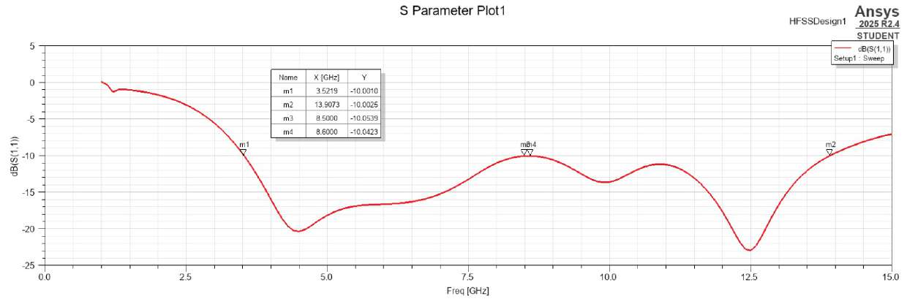
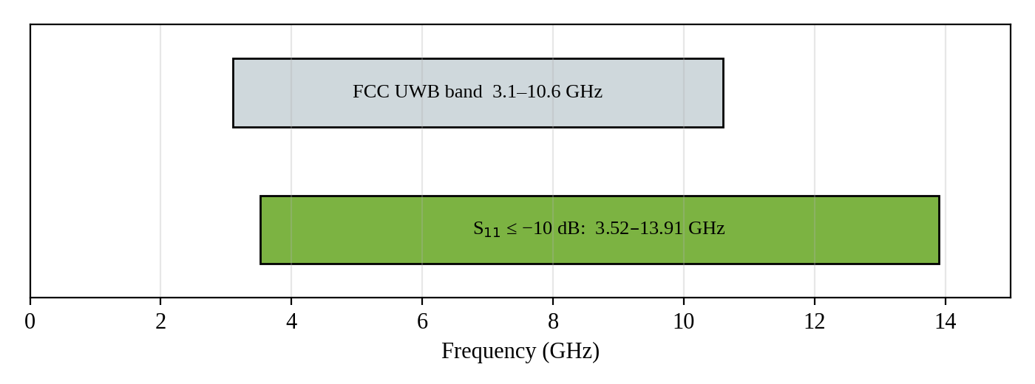
PART B | ANTENNA
Impedance Matching & Bandwidth Analysis
10.39 GHz
Absolute Bandwidth
3.52 to 13.91 GHz (S11 ≤ -10 dB)
119 %
Fractional BW
fc = 8.71 GHz (FCC req: ≥20%)
3.95 : 1
Bandwidth Ratio
fH / fL (Multi-octave)
1.93
VSWR at Band Edges
Matches ≤ 10% reflected power
Critical Assessment vs FCC UWB Mask
• Achieved Coverage: 3.52 to 10.6 GHz of the FCC band (and up to 13.91 GHz).
• Lower Band Gap: Antenna does NOT cover 3.1 to 3.52 GHz (~420 MHz missing).
• Sensitivity Warning: S11 reaches -10.05 dB at 8.5–8.6 GHz (tight 0.05 dB margin).
Notes:
Here are the simulated return loss results for the antenna. The impedance bandwidth (|S11| ≤ -10 dB) extends continuously from 3.52 GHz (marker m1) all the way to 13.91 GHz (marker m2). This yields an extraordinary 10.39 GHz absolute bandwidth, an FBW of 119%, and a 3.95:1 bandwidth ratio. However, we highlight an essential qualification: the antenna does NOT cover the complete FCC unlicensed mask. It misses the lower 3.1 to 3.52 GHz window, and exhibits a shallow hump near 8.5 GHz where margin is only 0.05 dB. Lengthening the disc by roughly 1 to 2 mm would lower the edge to fully encompass 3.1 GHz.

Slide 11
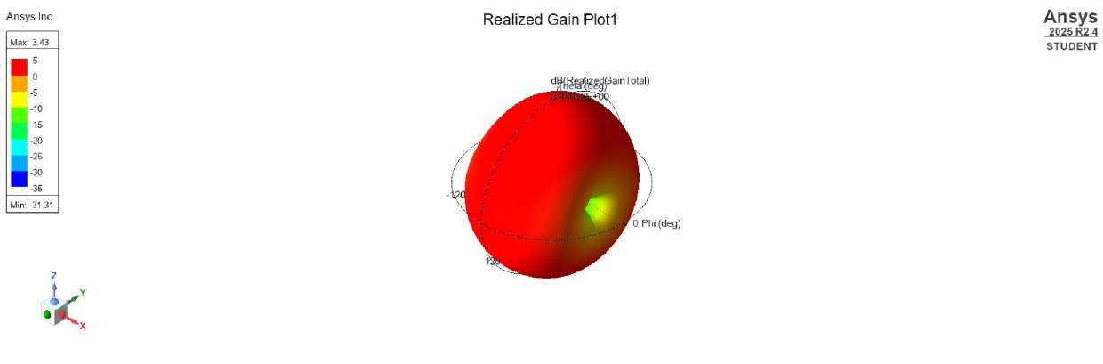
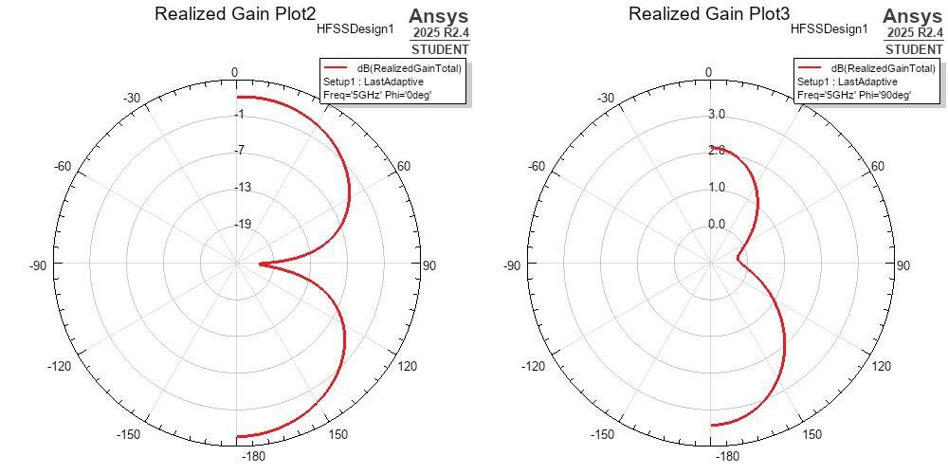
PART B | ANTENNA
Radiation Characteristics & Gain at 5 GHz
3.43 dB
Peak Realized Gain
At 5 GHz (broad red lobe)
-31.3 dB
Deepest Null
Sharp null along board axis
≈ -18 dB
S11 at 5 GHz
<1.6% reflected power
Omni-H
Azimuth Pattern
Broad coverage for mobile nodes
Radiation Insights & Limitations
• φ = 90° Plane: Broad, nearly omnidirectional pattern (2–3 dB gain) ideal for mobile links.
• φ = 0° Plane: Classic figure-eight dipole pattern with deep nulls at θ = ±90°.
• Limitation: Pattern computed at 5 GHz only; dispersion/group delay unmeasured.
Notes:
Slide 11 evaluates the far-field radiation at 5 GHz, a representative mid-band UWB frequency. The peak realized gain reaches 3.43 dB, with S11 at -18 dB, representing under 1.6% reflected power. The 3D plot shows a characteristic doughnut-like monopole pattern that is almost uniformly red, indicating high coverage over space. In the azimuth φ = 90° cut, radiation is nearly omnidirectional with gain fluctuating between 2 and 3 dB. In the elevation φ = 0° cut, classic nulls appear along the feed axis. We note that group delay and pulse distortion remain important metrics to characterize in future work.

Slide 12
CONCLUSION
Summary & Comparative Design Synthesis
Design Metric | Part A: Branch-Line Coupler | Part B: UWB Monopole Antenna
Operating Function | Equal 3 dB power split with 90° phase difference | Planar ultra-wideband transmission & reception
Target Frequency | 2.4 GHz (ISM band) | 3.1 to 10.6 GHz (FCC UWB unlicensed mask)
Simulated Performance | Centre: 2.42 GHz (+0.8%); RL/Iso: 27–44 dB; Split: -3.57 dB | Band: 3.52 to 13.91 GHz (10.39 GHz BW, 119% FBW)
VSWR Performance | VSWR ≤ 1.09 at centre frequency | VSWR ≤ 1.93 across entire 10.39 GHz band
Radiation / Insertion Loss | ~0.56 dB substrate attenuation (due to FR4 tan δ) | Peak realized gain: 3.43 dB at 5 GHz (omnidirectional)
Target Compliance | Meets target with minor +0.8% junction frequency shift | Qualified: Meets UWB definition (FBW>20%), misses 3.1–3.52 GHz
Primary Next Step | Miter corners or add 0.15 mm to arm length for 2.40 GHz | Lengthen disc by 1.5 mm to pull lower edge down to 3.1 GHz
Qualified Verdict & Future Road Map
• Coupler successfully achieves 2.4 GHz quadrature operation in simulation; Antenna achieves 119% FBW but requires qualification regarding 3.1–3.52 GHz coverage.
• Hardware Validation: Both designs were analyzed purely via 3D EM simulation; physical PCB milling, VNA S-parameter measurement, and anechoic chamber testing represent the essential next steps.
Notes:
In conclusion, we compare both RF components designed on 1.6 mm FR4. The branch-line coupler successfully met its 2.4 GHz target with 27 to 44 dB return loss and isolation, and a slight +0.8% offset. The printed monopole achieved a massive 119% fractional bandwidth, satisfying the UWB definition, but with the qualification that it covers 3.52 to 10.6 GHz, leaving a 420 MHz gap at the bottom of the FCC mask. Both designs are fully verified in HFSS 3D EM simulation, and the natural next phase is PCB fabrication and experimental VNA validation.

Slide 13
DOCUMENTATION
Key References
Standard Literature & Technical References
• D. M. Pozar, Microwave Engineering, 4th ed. Hoboken, NJ: John Wiley & Sons, 2012, ch. 7 (Power Dividers and Directional Couplers).
• E. Hammerstad and O. Jensen, 'Accurate models for microstrip computer-aided design,' in IEEE MTT-S International Microwave Symposium Digest, Washington, DC, 1980, pp. 407–409.
• C. A. Balanis, Antenna Theory: Analysis and Design, 4th ed. Hoboken, NJ: John Wiley & Sons, 2016, ch. 2 & 14.
• Federal Communications Commission (FCC), 'Revision of Part 15 of the Commission’s Rules Regarding Ultra-Wideband Transmission Systems,' First Report and Order, ET Docket 98-153, FCC 02-48, Adopted Feb. 2002, Released Apr. 2002.
• Ansys, Inc., Ansys HFSS / Electronics Desktop Student 2025 R2 Documentation & Electromagnetic Solver Manual, Canonsburg, PA, 2025.
Notes:
Thank you for your time and attention. Our work is grounded in these standard microwave and antenna engineering references, including Pozar, Hammerstad, Balanis, and the FCC First Report and Order. We welcome any questions from the Professor and the audience.

