Slide 1
Messaging Concept
Ratikanta Panda
Senior Consultants (Technical Architect)

Slide 2
Messaging
Communication- Exchange of messages between software components.
Tightly coupled communication -TCP network sockets, CORBA or RMI
Loosely coupled distributed communication – Messaging (Message Oriented Technology)
Message Oriented Technology allows software components to communicate 'indirectly' with each other.
Note:- A messaging system is loosely coupled. This is the most important feature of a messaging system. An application or program, called a sender or publisher, sends a message to a destination, not directly to another client. Another application or program, called a receiver or subscriber, receives the message from a destination. Senders and receivers do not have to be aware of each other.

Slide 3
Message Oriented Technology
Benefits of Messaging System or Services
Distributed application to be loosely coupled, reliable, and asynchronous(decoupled).
A messaging system isolates clients from each other.
Neither sender nor receiver needs to know about each other. They only need to know the message format and destination.
Portability-Ability to integrate heterogeneous platforms.
Reduce system bottlenecks.
Increase scalability.
Additional features like Persistence Messaging, Guaranteed Delivery and Securities.
Note:- Asynchronous messaging - A sender and receiver use the system at different times. They do not have to be up and running at the same time. A sender sends the message to a destination, and the receiver takes the messages whenever it is ready. A sender does not need to wait for a response
Reliable-which means that Messaging System ensures that a message is delivered once and only once

Slide 4
Popular Message Exchange Patterns
Message exchange pattern (MEP) describes the pattern of messages required by a communications protocol to establish or use a communication channel.
Request/Reply - HTTP
One Way – UDP
Point-to-Point(P2P) -JMS
Publish/Subscribe(Pub/Sub) -JMS
Push/Poll
Note- By default, TCP endpoints use the request-response exchange pattern, but they can be explicitly configured as one-way.

Slide 5
TCP Endpoints
TCP Endpoints = Host Name + Port
Inbound Endpoint- Messages will be received on inbound endpoints.
Outbound Endpoint- Messages will be sent to outbound endpoints.

Slide 6
Message Brokers
Solace Appliance
IBM MQ
TIBCO EMS
Rabbit MQ
JMS
JNDI
AMQP
ESB
EMS
EIS(Enterprise Information System)
EI(Enterprise Integration)
EAI(Enterprise Application Iintegration)

Slide 7
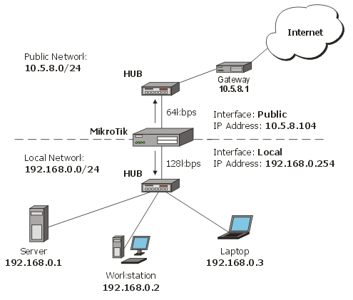

Slide 8
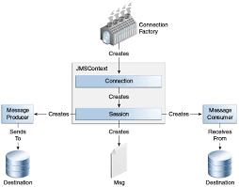

Slide 9
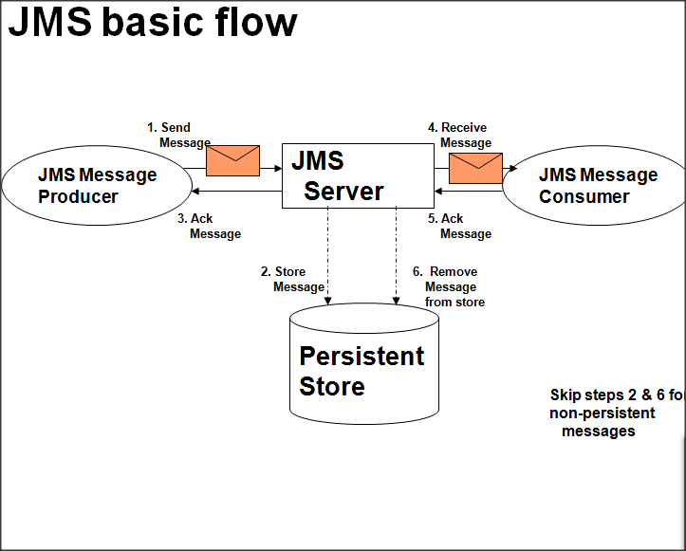

Slide 10
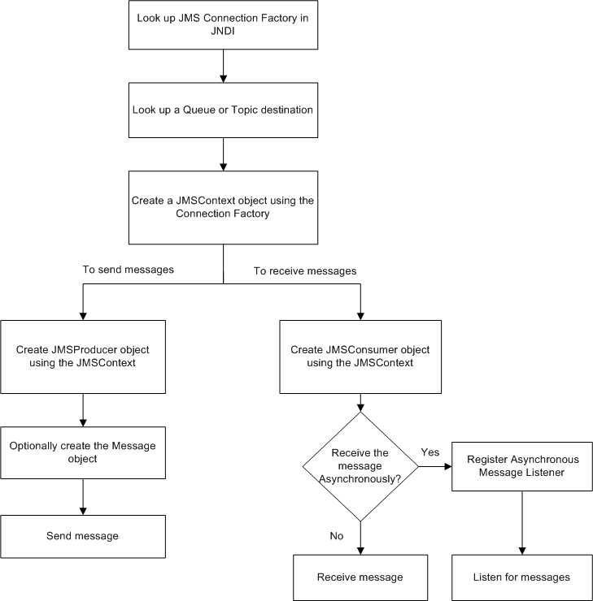

Slide 11
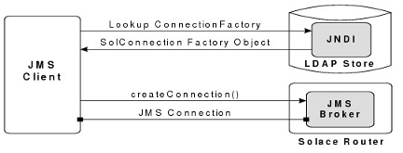

Slide 12
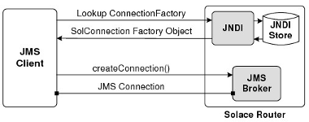

Slide 13
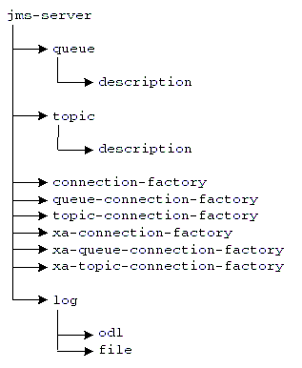

Slide 14
JMS
Java Message service API

Slide 15
Message Exchange
Asynchronous communication is the exchange of messages, such as among the hosts on a network or devices in a computer, by reading and responding as schedules permit rather than according to some clock that is synchronized for both the sender and receiver or in real time. It is usually used to describe communications in which data can be transmitted intermittently rather than in a steady stream.
Real time refers to sensing and responding to external events nearly simultaneously with their occurrence. Although real time operations are typically thought of as being fast, this does not necessarily have to be the case: slow systems can allow slow real time operations, and fast operations are not necessarily real time.
Most communications between devices within computers (e.g., between the CPU and disk drives) and between computers and external devices (e.g., modems and printers) are asynchronous. Asynchronous communications also include computer-based exchanges of messages for which the participants need not be available or online at the same time, but, rather, read and respond as their schedules (and desires) permit. Examples include e-mail, discussion boards and text messaging over cell phones.
Direct communication, where all parties involved in the communication are present at the same time is a form of synchronous communication or real time communication. Examples include telephone conversations and instant messaging.
In asynchronous communications it is necessary for the receiver to be able to distinguish between valid data and noise (i.e., random signals). In computer communications, this is usually accomplished through the use of special bits at the beginning and end of each message.

Slide 16
Data transmission over Network
There are three types of Ethernet addresses:
Unicast addresses – represent a single LAN interface. A unicast frame will be sent to a specific device, not to a group of devices on the LAN.
Multicast addresses – represent a group of devices in a LAN. A frame sent to a multicast address will be forwarded to a group of devices on the LAN.
Broadcast addresses – represent all device on the LAN. Frames sent to a broadcast address will be delivered to all devices on the LAN.

Slide 17
Asynchronous Messaging
A messaging system allows decoupling. A sender and receiver use the system at different times. They do not have to be up and running at the same time. A sender sends the message to a destination, and the receiver takes the messages whenever it is ready. A sender does not need to wait for a response. It can process another task without being blocked. I refer to this feature as asynchronous messaging in the remainder of the book, which generally means that clients are able to use the system at different times, and they do not have to know whether other clients in the system are up and running.

