Slide 1
What is Network?
A computer network can be described as a system of interconnected devices that can communicate using some common standard (called protocol). These devices communicate to exchange resources (e.g. files and printers) and services.
http://study-ccna.com/encapsulation/

Slide 2

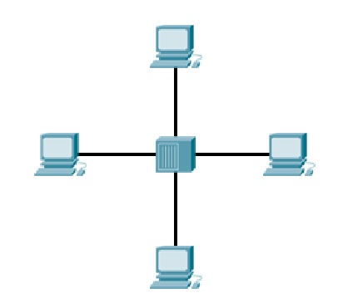
Network topology
Small network- two computers are directly connected using a cable.
What if we want to expand our network? Then we can use a network device, either a switch or a hub, to connect more than two computers together:

Slide 3
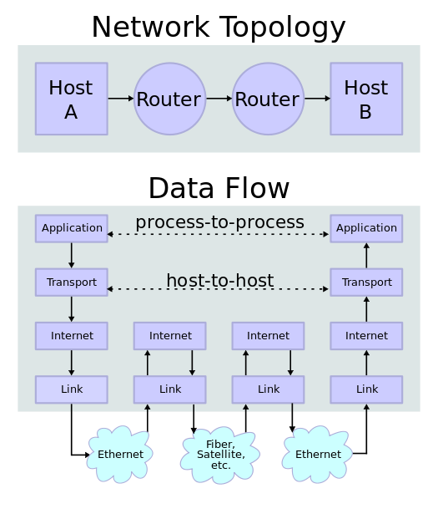
Data flow

Slide 4
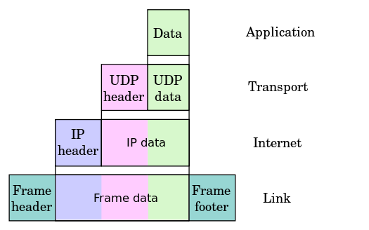
Ensapsulation

