Slide 1
Notes:
1
Many of these charts have animation and speaker notes.
Version 1.0

Slide 2
Introduction to Embedded Systems
Version 2.0

Slide 3
Date
Version
Description
Modified By
Reviewed & Approved by
17-Nov-09
1.0
Initial Version
3
Notes:
3
Version 1.0

Slide 4
What is Embedded System?
What is a Real Time System?
Entities in an Embedded System
Entities in a CPU
Timers
Interrupts
Memory
Cache.
MMU
RTOS
Boot-Loader
Kernel
User-space
Kernel-space
Process/Threads
Synchronization Mechanisms IPC
Interrupts
Debugging
4
Notes:
4
Version 1.0

Slide 5
What is Embedded System?
Designed to perform one or few dedicated functions.
Consists of CPU, Memory, I/O and External devices, which are needed to accomplish the dedicated functions.
Designed to reduce the size and cost of the product and increase the reliability and performance
Designed based on General / Real-Time OS or even without OS (Microcontrollers)
Examples:
MP3 Player, Digicam

Slide 6
What are Real-time Systems ?
Execute within time constraints
Deadline must be met
Time and Memory
Examples:
ABS in automobiles
Aircraft Control Systems
Pacemakers
6

Slide 7
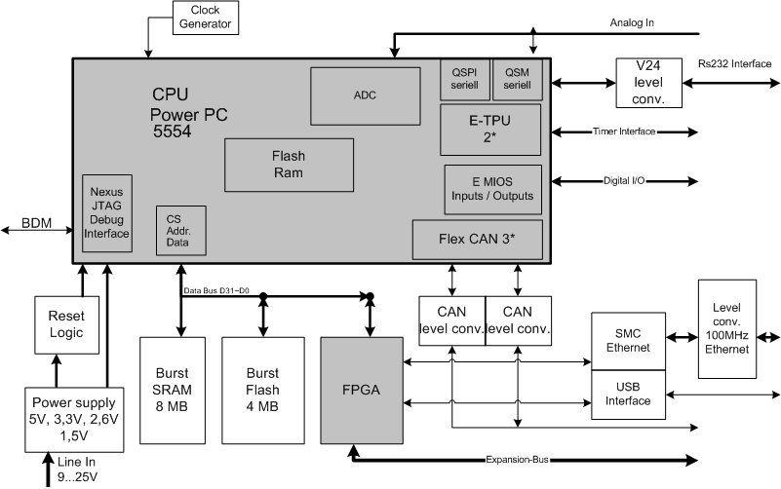
Entities in an Embedded System (CPU and Peripherals)
[ Scope:- Mention what are the main entities in a typical embedded system. Below is an example. ]

Slide 8
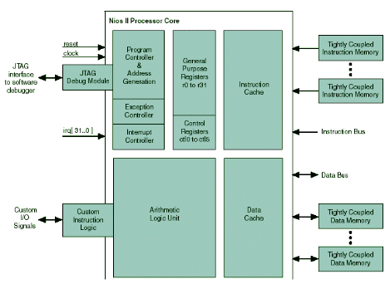
CPU Entities
To the trainer:Mention what are the main entities in a typical CPU.

Slide 9
CPU Entities (Cont.)
Arithmetic logic unit (ALU) is a digital circuit that performs arithmetic and logical operations.
Most ALU use two’s compliment number system.
Common operations:
Integer arithmetic operations(Addition & Subtraction).
Bitwise logical operations (AND, OR,NOT,XOR).
Bit shifting Operations (multiplications by 2 and divisions by 2)
Address bus (that may be 8, 16 or 32 bits wide) carries address for accessing memory location

Slide 10
CPU Entities (Cont.)
Data bus (that may be 8, 16 or 32 bits wide) carries data to memory or receive data from memory.
RD (Read) and WR (Write) line to tell the memory whether it wants to set or get the addressed location.
Clock line that lets a clock pulse sequence the processor.
Reset line that resets the program counter to zero (or whatever) and restarts execution.
Registers A, B and C are simply latches made out of flip-flops.
Program counter is a latch with the extra ability to increment by 1 when told to do so, and also to reset to zero.

Slide 11
Real Time Clock (RTC)
A RTC is a computer clock that keeps track of the current time.
RTCs often have an alternate source of power
Low power consumption (important when running from alternate power).
Frees the main system for time-critical tasks.

Slide 12
TIMERS
[ Scope:- Explain hw and sw timers ]
A timer is a specialized type of clock. A timer can be used to control the sequence of an event or process.
Computer systems usually have at least one timer. These are typically digital counters that either increment or decrement at a fixed frequency, which is often configurable, and that interrupt the processor when reaching zero.
As the number of hardware timers in a computer system or processor is finite and limited, operating systems and embedded systems often use a single hardware timer to implement an extensible set of software timers.

Slide 13

Watchdog Timer (WDT)
A watchdog timer (WDT) is a device that resets the processor after a certain period of time, if something goes wrong and the system does not recover on its own.

Slide 14
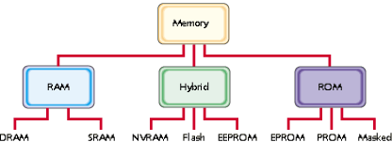
Memory Types
Volatile
SW re-writable
SW non-re-writable
Non-Volatile

Slide 15
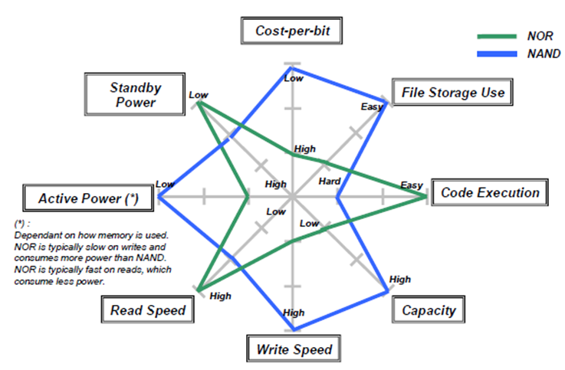
FLASH - NOR and NAND
NAND is generally used for large memory requirement and low cost.
NOR is used in systems which need fast access. NOR chips are costlier than NAND
Comparison of NOR vs NAND

Slide 16
RAM (SRAM, DRAM)
DRAM
Cheaper
Slower
Needs continuous clock triggers to refresh charge in the capacitors
SRAM:
Costlier
Faster
Needs no continuous clock triggers (uses flip-flops)

Slide 17
MMU - Address space
Logical Vs Physical Address space
Logical address – generated by the CPU; also referred to as virtual address.
Physical address – address seen by the memory unit.
Usually, Memory Management Unit (MMU) is a hardware device that maps virtual to physical address.
In MMU scheme, the value in the relocation register is added to every address generated by a user process at the time it is sent to memory.

Slide 18
MMU - Address binding
Address binding of instructions and data to memory addresses can happen at three different stages.
Compile time: If memory location known a priori, absolute code can be generated; must recompile code if starting location changes.
Load time: Must generate relocatable code if memory location is not known at compile time.
Execution time: Binding delayed until run time if the process can be moved during its execution from one memory segment to another. Need hardware support for address maps (e.g., base and limit registers).

Slide 19

Swapping, Paging, Segmentation
Program must be brought into memory and placed within a process for it to be run.
Swapping of programs to maximize memory utilization
Unavailability of contiguous memory while swapping in a program due to memory fragmentation
Paging - Divide physical memory into fixed-sized blocks called frames and logical memory into blocks of same size called pages.
To run a program of size n pages, need to find n free frames and load program.
Set up a page table to translate logical to physical addresses.
Segmentation - Memory-management scheme that supports user view of memory. Examples include CS, DS, SS, ES, etc.

Slide 20
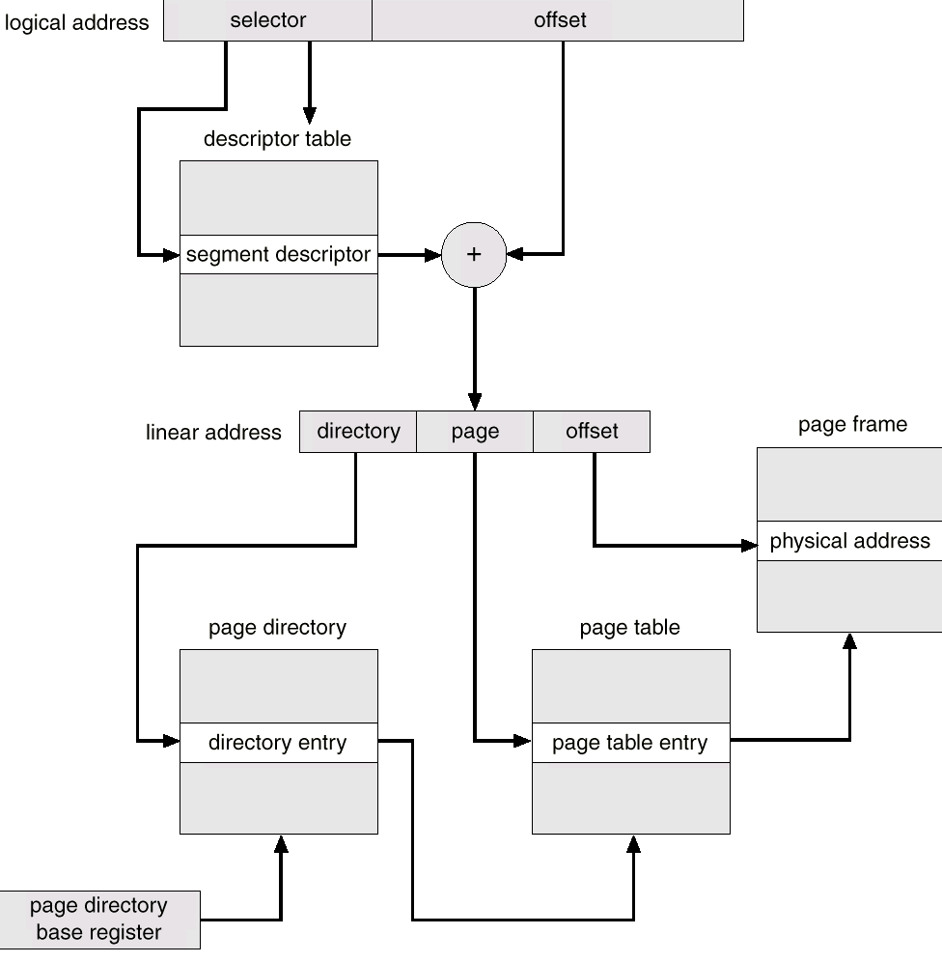
80386 Segmentation + Paging Unit

Slide 21
Cache
Cache is a short-term storage and it can speed up the operations by temporarily placing data where it can be accessed more rapidly than normal.
iCache – Instruction Cache
dCache – Data Cache

Slide 22
Cache (Cont.)

Slide 23
Cache (Cont.)
Cache Hit:
Finding and retrieving an instruction or item of data in a cache.
Cache Miss:
A failure to find the required instruction or data in the cache.
Hit rate or Hit ratio of the cache:
The percentage of access that result in cache hit is known as hit rate or hit ratio of the cache.

Slide 24
Cache (Cont.) – Write policies
Write-back cache:
Data normally written into the cache first.
During the idle machine cycles, the data are written from the cache into memory or onto disk.
Improves the performance, because a write to the high-speed cache is faster than to normal RAM or disk.
With this performance improvement comes a slight risk that data may be lost if the system crashes.
Write-through cache:
Data written by the CPU to memory or to disk is also written into the cache.
Write performance is not improved but subsequent read operation will be improved, because the data are already in the high-speed cache.

Slide 25
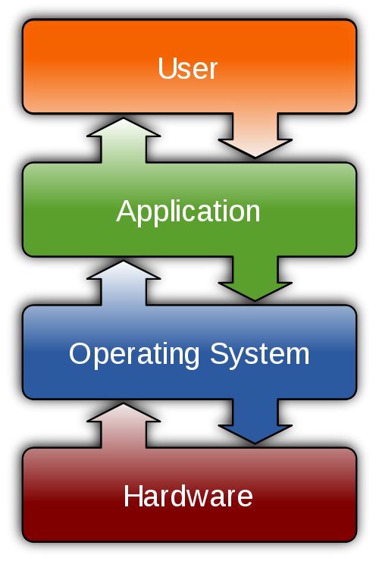
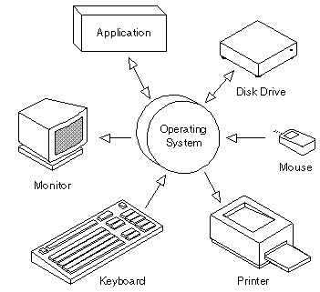
What is an Operating System?
It is a software, consisting of programs and data, that runs on computers and
manages computer hardware resources.
Types of OS:
General Purpose OS
Real-Time OS

Slide 26
What is a Real Time Operating System?
A real-time operating system (RTOS) is an operating system (OS) intended to serve real-time application needs.
Real-time operating systems have " deterministic " timing behavior.
A real-time OS has an advanced algorithm for scheduling.
Real-time OS have minimal interrupt latency and minimal thread switching latency

Slide 27
RTOS - Scheduling
Scheduling refers to the way processes are assigned to run on the available CPUs, since there are typically many more processes running than there are available CPUs. This assignment is carried out by software known as a scheduler and dispatcher.
Some scheduling algorithms include,
Cooperative scheduling
Preemptive scheduling
Rate-monotonic scheduling
Round-robin scheduling
Earliest Deadline First approach

Slide 28
RTOS - Types
Hard real-time or immediate real-time system:
Missing deadline may cause a critical failure of the system (Pacemaker – creating pulses within hard time limit)
Soft real-time system:
Tolerates lateness beyond deadline and may respond with decreased service quality (e.g., omitting frames while displaying a video).

Slide 29
What is Boot-loader?
Software that initializes the minimal required peripherals during boot.
Example: Clocks, CPU control registers, Memory
Load and kick start the OS.
OS requires some registers to be loaded with values such as entry points etc.
Responsible for initializing other peripherals like Ethernet, USB, SD-Card.

Slide 30
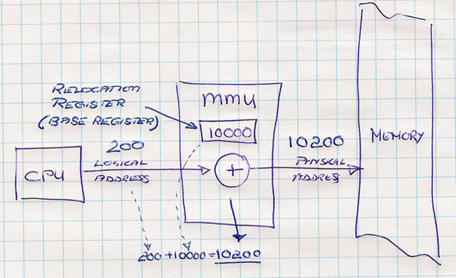
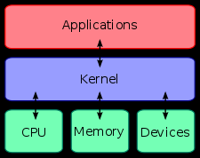
What is a Kernel?
[ Scope:- Introduce the Kernel and user space. Also talk about protected mode ]
Kernel can be thought of as the program which controls all other programs on the computer. Its responsibilities include managing the system's resources such as hardware and memory.
Virtual memory allows multiple programs to load in memory at the same time. Each application addresses memory starting at zero, but virtual memory takes control of the memory addressing and lets each application function as if it had unlimited memory.

Slide 31
Kernel Space
Kernel space is a privileged area; the user has access to it only through the system call interface
Kernel process can modify the memory map, an operation frequently required to perform process scheduling
A user process runs in kernel context when it executes a system call and executes kernel code

Slide 32
User Space
User space is the area in memory where user processes are run
A process executing in user space is said to be operating in user mode

Slide 33
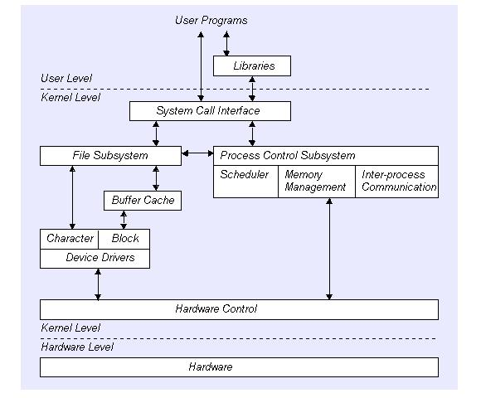
User & Kernel Space Layout

Slide 34
Process and Thread – A comparison
Process
Thread
A process is an executing instance of an application
Processes have their own address space
Threads can directly communicate with other threads of its process
Heavy context switching
A thread is a path of execution within a process
Threads within the same process share the same address space
Processes must use IPC to communicate with sibling processes
Light weight context switching

Slide 35
Types of Process
Parent Process
Process 1 is parent of all the process, Any process if creates a new process than it becomes a parent process to the newly created process
Child Process
All the process except Process 0 are child processes.
Orphan process
When Parent dies before child exits
Child process is adopted by init , i.e. its parent becomes init i.e. process id 1
Init does a wait on the orphaned child process , handles cleanup from process table on exit
Defunct or zombie process
child process exits, but still has an entry in the process table
parent is notified with a SIGCHLD
The child is in “defunct or zombie” state till the parent does a “wait” and reads the exit status of the child
Child process does not consume CPU resources, only sits in the Process table

Slide 36
Process memory structure
Process Memory
Each Process has its own
Program Counter
Stack
Stack Pointer
Address Space
Process May Share
Data
Code
High Address
stack
Process Control Block
sp (Stack Pointer)
pc (Program Counter)
fd table
heap
fd0
uninitialized Data
fd1
fd2
initialized Data
fd3
text
Low Address

Slide 37
Some Process Control functions
Below listed are few important functions for process
Create process
fork()
Vfork()
Exec ()
Exit process
exit()
return()
abort()
Wait for child status
wait()
waitpid()
Dynamic Priority changing
nice()
getpriority()
setpriority()
renice()
Note: To know more details please refer manual page in Linux with command man <function name>

Slide 38
Example of a Process
#include <stdio.h>
int main( ) {
int pid, status;
pid = fork();
if( pid == 0 ) {
printf(“inside child\n”); /* Here we can run different functions,
sleep(2);
exit(0); /* exiting from child*/
} else {
printf(“Inside parent\n”);
if( wait( &status ) == pid )
printf( “Child exited\n” );
}
exit(0); /* Exiting from parent */
}

Slide 39
Thread Memory Structure
Process Memory
High Address
Each thread has its own
Program Counter
Stack
Stack Pointer
Threads May Share
Address space
Code
Open files
stack1
Process Control Block
sp1 (Stack Pointer)
stack2
pc1 (Program Counter)
stack3
sp2 (Stack Pointer)
pc2 (Program Counter)
sp3 (Stack Pointer)
pc3 (Program Counter)
fd table
heap
fd0
Uninitialized data
fd1
fd2
Initialized data
fd3
text
Lower Address

Slide 40
Thread usage Example
#include <stdio.h>
#include <stdlib.h>
#include <pthread.h>
#define FAILURE -1
#define SUCCESS 0
void* DisplayMessage(void* msg) {
int status = 0;
printf("I am in the thread.. %s\n", (char*)msg);
pthread_exit(&status);
}
int main() {
char* msg1 = "Thread1";
char* msg2 = "Thread2";
pthread_t thread1, thread2;
int ret = 0;
ret = pthread_create(&thread1, NULL, DisplayMessage, (void*) msg1);
if (ret != 0) {
fprintf(stderr,"Error occured while creating thread1..\n");
exit(FAILURE);
}
ret = pthread_create(&thread2, NULL, DisplayMessage, (void*) msg2);
if (ret != 0) {
fprintf(stderr,"Error occured while creating thread2..\n");
exit(FAILURE);
}
printf("I am in main thread...\n");
exit(SUCCESS);
}

Slide 41
Task synchronization
Task synchronization can be achieved by using below two ways,
Semaphore
Mutex

Slide 42
Semaphore (1)
A semaphore is a protected variable or abstract data type that provides a simple but useful abstraction for controlling access by multiple processes to a common resource in a parallel programming environment.
Synchronize multiple tasks for a critical resource access
Two variants
Counting semaphore
Binary semaphore.
A semaphore is created with initial_count, which is the number of allowed holders of the semaphore lock. (initial_count=1: binary sem)
A task can get the semaphore when the count > 0; otherwise, block on it.

Slide 43
Semaphore (2)
Two operations:
P(S): get or wait for semaphore
V(S): release semaphore
Disadvantages (problems) with semaphores
Deadlocks
Loss of mutual exclusion
Blocking tasks with higher priorities (e.g. FIFO)
Priority inversion

Slide 44
Priority Inversion (1)
Priority inversion problem
Assume 3 tasks: A, B, C with priorities Ap<Bp<Cp
Assume semaphore: S shared by A and C
The following may happen:
A gets S by P(S)
C wants S by P(S) and blocked
B is released and preempts A
Now B can run for a long long period .....
A is blocked by B, and C is blocked by A
So C is blocked by B
It can be much worse if there are more tasks with priorities in between Bp and Cp, that may block C as B does.

Slide 45
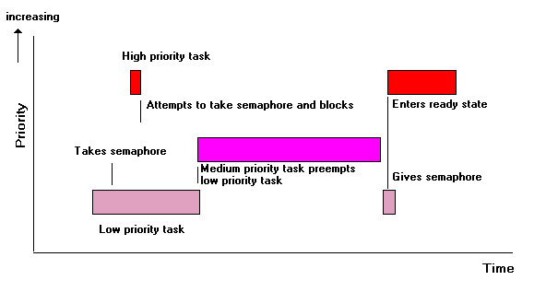
Priority Inversion - Demo

Slide 46
Priority Inversion (2)
Solution?
Task A with low priority holds S that task C with highest priority is waiting.
Task A can not be forced to give up S, but A can be
preempted by B because B has higher priority and can run without S.
So the problem is that ’A can be preempted by B’
High A’s priority when it gets a semaphore shared with a task with higher priority! So that A can run until it release S and then gets back its own priority

Slide 47
MUTual EXclusion
[ To be done: Simplify ]
Special kind of semaphore for providing mutual exclusion.
Provides ‘Lock’ and ‘Unlock’ services.
Task which locks a Mutex becomes its owner.
Other tasks trying to lock will be blocked.
Only the owner can unlock a Mutex.
If another task is blocked waiting for this Mutex, Its becomes its owner.
Mutex don’t have a count.
Mutex can solve Unbounded priority inversion.

Slide 48
Inter-Process Communication
Exchange of data between two or more, separate independent processes/threads.
Operating systems provide facilities/resources for inter-process communications (IPC), such as,
FIFO,
Message queues,
Shared memory,
Signals

Slide 49
Message Queue API & Description
What is Message Queue?
A message queue provides a buffered communication method for tasks.
Message queues also provide a way to communicate without copying data, which can save time.
Logically two queues are maintained in the message queue:
One for message buffers which are currently not being used (known as the “free” queue).
The other holds messages which have been sent but not yet received (known as the “send” queue). (Add Diagram)

Slide 50
Shared memory
Shared memory provides an efficient way of sharing data between multiple processes. It allows two unrelated processes to access the same logical memory.
Shared memory is a special range of addresses that is created by IPC for one process and appears in the address space of that process. Other processes can then 'attach' the same shared memory segment into their own address space.
Programmer has to take care of synchronized access.

Slide 51
Signals
A signal is an event generated by the system in response to some condition, upon receipt of which a process may in turn take some action.
They are generated by the shell and terminal handlers to cause interrupts. They can also be explicitly sent from one process to another as a way of passing information or modifying behavior.
Example
If typing the interrupt character (often Ctrl−C) at the keyboard will result in the SIGINT signal being sent to the foreground process, i.e. the program currently running. This will cause the program to terminate unless it has arranged to catch the signal.

Slide 52
Interrupts
Interrupt is an asynchronous signal indicating the need for processor attention.
Example: Keyboard generates an interrupt to read key pressed.
Types of Interrupts.
– Reset (Highest Priority)
– Software Interrupts and Exceptions
– Non-Maskable Interrupts (NMI): From External Hardware
– Maskable Interrupts (Lowest Priority)
Interrupt latency is the time between the generation of an interrupt by a device and the servicing of the device which generated the interrupt.
52

Slide 53
Interrupt service routine (ISR)
ISR is a callback subroutine which is executed by the reception of an interrupt.
Save IRQ (Interrupt Request) value and the registers to the kernel mode stack.
Send ack to the CPU/Programmable Interrupt Controller (PIC) thus allowing it to issue next interrupt.
Execute ISRs associated with all the devices that share same IRQ.
Execute active softirqs.
Terminate by jumping.

Slide 54
Hardware & Software Interrupts
Hardware Interrupts are generated from an external device, connected to processor through interrupt controller.
Maskable interrupt may be ignored by setting a bit in an interrupt mask register(IMR) bit-mask. Ex: Keyboard, Mouse
Non-maskable interrupt (NMI) lacks an associated bit-mask, so that it can never be ignored. Ex: Watch dog Timers,
Software interrupt is an interrupt generated within a processor by executing an instruction.
Ex: Signals like sig_term sent to terminate a process.
Exceptions, which are used to report grave runtime errors. Interrupts such as the int 0x80 instruction used to implement system calls on the x86 architecture
54

Slide 55
Do’s & Don'ts in ISR
Interrupt handlers should not relinquish the processor by calling sleepy functions.
Mutexes should not be used for protecting critical sections inside interrupt handlers instead use spinlock.
Interrupt handlers cannot directly exchange data with user space (Discussed later)
Design interrupt handlers to be reentrant.

Slide 56
Common Debugging Techniques
Debugging is tightly coupled to the system development environment.
OS provides certain utilities for debugging.
Writing code to support debugging
Using Asserts
Magic debug values
Debugging by Printing/software tracing/log file

Slide 57
Common Debugging Techniques (Cont.)
Debugging by Querying
By querying the process. eg: using proc file system on linux
Debugging by Watching
Sometimes minor problems can be tracked down by watching the behavior of an application in user space eg: strace on Unix platforms
Debuggers
Eg GDB, trace32, GreenHills probe

Slide 58
Debuggers-Advantages
Advantages:
Source level debugging
Step and trace
Change program execution state.
Conditional breakpoints
Watches
Call stack

Slide 59
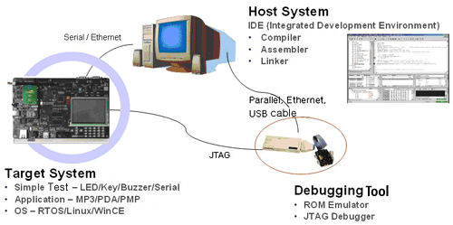
ICE (In circuit emulator)
An in-circuit emulator (ICE) is a hardware device used to debug the software of an embedded system.
The programmer uses the emulator to load programs into the embedded system, run them, step through them slowly, and view and change data used by the system's software.
An "emulator" gets its name because it emulates (imitates) the central processing unit of the embedded system's computer. Traditionally it had a plug that inserts into the socket where the CPU chip would normally be placed. Most modern systems use the target system's CPU directly, with special JTAG-based debug access.

Slide 60
ICE - JTAG
JTAG or Joint Test Action Group is a method of accessing memory and CPU resources without having an application running on the target.
BDM or background debugging mode also achieves this objective.
JTAG is standardized as IEEE 1149.1 Standard Test Access Port and Boundary-Scan Architecture.
JTAG aware hardware devices can be debugged using JTAG supported debuggers. Eg: Lauterbach Trace32 ICD and green hills (super probe) and Time machine suite

Slide 61
ICE - Notes
Recent ICEs enable a programmer to access the on-chip debug circuit that is integrated into the CPU via JTAG or BDM (Background Debug Mode) in order to debug the software of an embedded system. These systems often use a standard version of the CPU chip, and can simply attach to a debug port on a production system.
They are sometimes called in-circuit debuggers or ICDs, to distinguish the fact that they do not replicate the functionality of the CPU, but instead control an already existing, standard CPU.
OS aware debuggers may be needed to help in debugging systems with Virtual memory

Slide 62
Kernel Debugger
A kernel debugger is a debugger present in some kernels to ease debugging and kernel development by the kernel developers.
A kernel debugger might be a stub implementing low-level operations, with a full-blown debugger such as gdb, running on another machine, sending commands to the stub over a serial line or a network connection, or it might provide a command line that can be used directly on the machine being debugged.
Examples:
Windows : KD, rasta ring 0, softice
Linux : KDB

Slide 63
Memory debugger
Memory corruptions give rise to strange, bizarre and program crash.
To ease debugging of memory, memory debuggers are used.
Memory debuggers work by monitoring memory access, allocations, and de-allocation of memory.
Example:
Linux: Valgrind, Electric fence
Others: rational purify
DTV: memcheck, mudflap, leaktracer.

Slide 64

Thank you
www.hcltech.com
64
Notes:
64
Version 1.0

