Slide 1
Using SQLite with Java
Installing
1)Download a SQLite-JDBC driver for SQLite as a jar archive file
2) Add the jar archive to the java class path (build path in Eclipse)

Slide 2
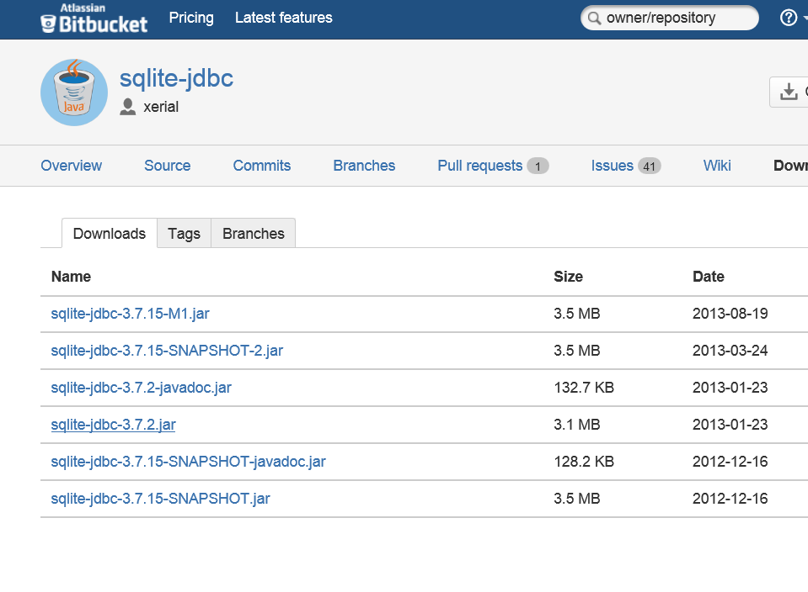
Step 1) Download sqlite-jdbc driver (.jar archive)
https://bitbucket.org/xerial/sqlite-jdbc/downloads

Slide 3
Step 2) Download sqlite-jdbc driver to class path.
See the following tutorial on how to add a .jar file to your eclipse project’s build path:
http://m.wikihow.com/Add-JARs-to-Project-Build-Paths-in-Eclipse-%28Java%29
2.1) Create a folder called “lib” in your project
2.2) Copy your sqlite-jdbc-3.7.2.jar to the lib folder and right click on project and choose “refresh”. The jar file should now be visible in the lib folder you created
2.3) Expand lib folder and right click on sqlite-jdbc-3.7.2.jar, select “build path” then “add to build path”
2.4) A Referenced Libraries item will be created and the sqlite-jdbc-3.7.2.jar should appear in it as a referenced library. (It is now on your project’s build path.)

