Slide 1
Yelp Restaurant Reviews & the Weather
April Chung, Kendra Gedney, Yipin Lu, Ratnadeep Mitra
M.S. in Analytics Program

Slide 2


Introduction
Data Science Questions:
Does the weather affect people’s moods so much that they will rate restaurants lower or higher?
Do people write more positive, five-star reviews on nice days because they are in a better mood?
Does good weather lead to people have better experiences at restaurants, and lead to positive reviews?
Data Source:
Restaurant Details and Reviews from Yelp
Daily weather data from NOAA

Slide 3
The Data
Cleaning:
checked for outliers, missing values and duplicates
Merging:
Used geopy package to calculate the distances between restaurants and stations in a range of +/- 1 latitude and longitude (~69 miles)
Selected the closest station’s data that have observed values on the same day as each review
Binning
US Regions
Final dataset:
14,788 reviews from 5,263 restaurants with weather measurements

Slide 4
ANALYSIS
PART 1 – Sentiment Analysis

Slide 5
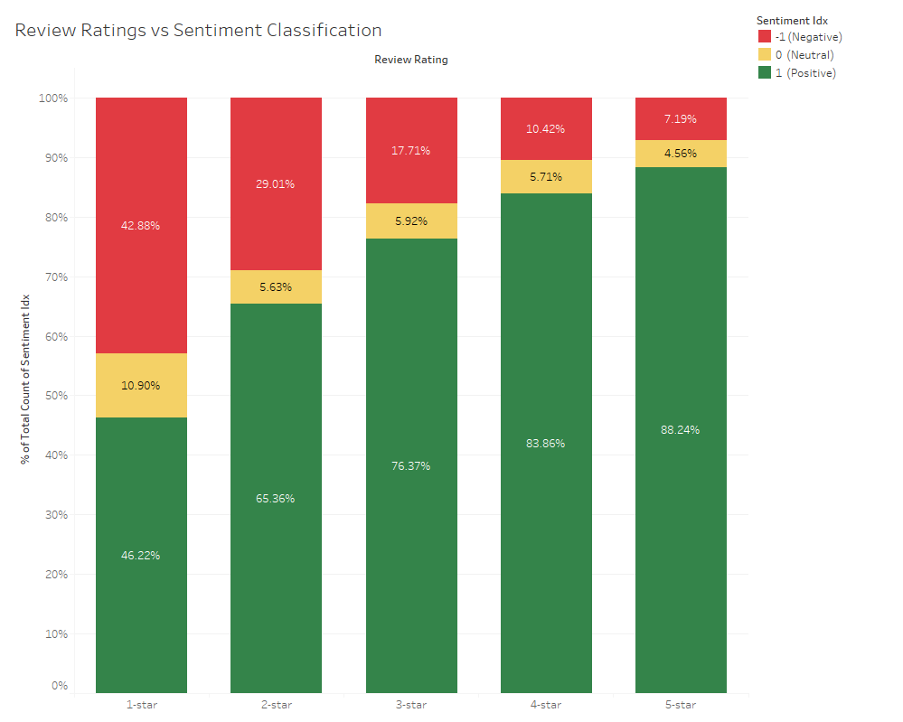
Sentiment Analysis
Used NLTK and Textblob
No strong correlation (0.32) between the computed sentiment and the given star rating
Limitations –
Sarcasm
Metaphor
Following 1-star reviews were classified as positive –
“Sitting here, I am absolutely astounded that previous reviews are, mostly, so overwhelmingly positive.”
“The one and only good thing about this place is they have a decent rose.”

Slide 6
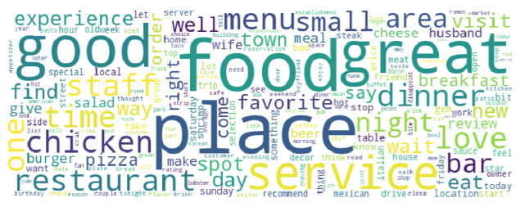
Sentiment Analysis - Word Cloud
Generated a word cloud based on the frequency of words in all the reviews
The largest words (and thus most common) tend to be positive, for example, “good”, “great”, and “love”
This is expected as the majority of reviews in our dataset were classified as positive (83%), and given 5-star reviews (55%)

Slide 7
ANALYSIS
PART 2 – Principal Analysis

Slide 8
Text Mining and Correlation Exploration
Correlation Coefficients
Region | TAVG & review_rating | TAVG & sentiment_polarity
Mountain | 0.06 | -0.06
SouthCentral | 0.04 | -0.01
MidAtlantic | 0.03 | 0.02
Southeast | 0.02 | 0.02
NorthCentral | 0.01 | 0.02
Midwest | 0.00 | 0.03
NewEngland | 0.00 | -0.03
Pacific | 0.00 | -0.01
Northwest | -0.06 | 0.06
All Regions | 0.02 | 0.01
Mined the reviews for weather-related terms. Only 0.7% of reviews include weather-related terms.
“What an afternoon of perfection. Great location, great food and awesome weather! I know the Back Porch isn't responsible for the cool breeze, but the ample..”
We do not find strong correlations between temperature and the review ratings or the sentiment. Both correlation coefficients are near zero.

Slide 9
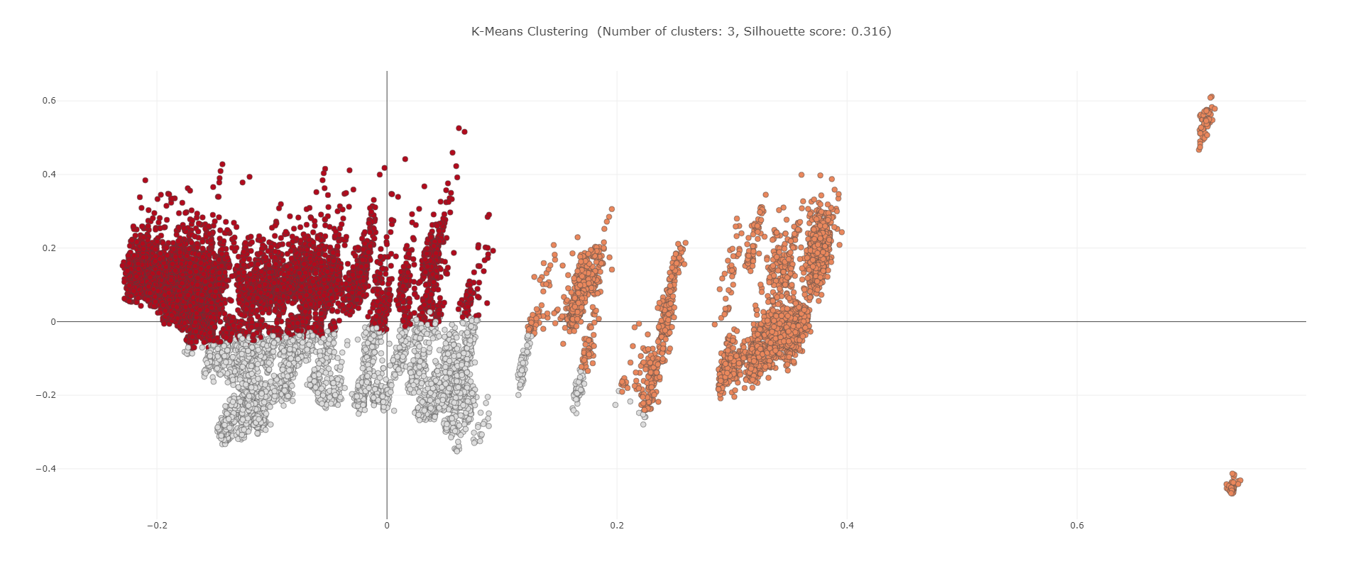
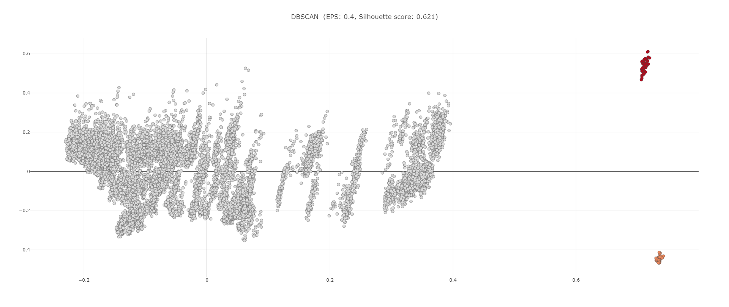
Clustering Analysis
Used both k-means (with k=3) and DBScan (with eps=0.4) clustering analysis to explore the relationship among temperature, sentiment and the location of the restaurant
Used PCA to visualize results. Although DBScan better identified the outliers, no clear clusters formed. This suggests that there is no strong relationship among temperature and Yelp reviews.
K-means Clustering
DBScan Clustering

Slide 10
Multivariate Linear Regression
Conducted multivariate linear regression analysis to explore whether rainy climate or level of temperature would influence customer’s sentiment.
The random points in the space and the low R² score (-0.0012) showed there is no relationship between X (weather attributes) and Y (sentiment_polarity)
Multivariate Linear Regression

Slide 11
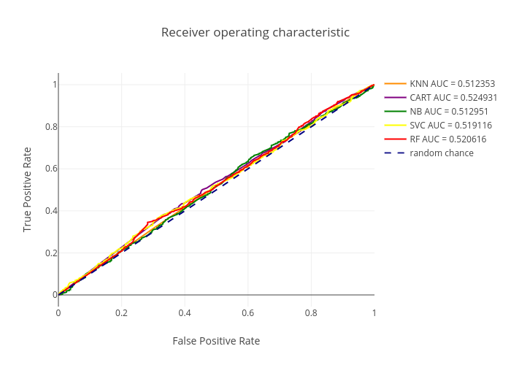
Classifying Reviews based on Weather and Location
Used five machine learning algorithms to test whether we could predict the rating based on location and weather alone:
Grouped the rating into two classes: High (4-5 stars) and Low (0-3 stars)
Applied each machine learning algorithm
Naïve Bayes and SVM performed the best in cross-validation, with ~80% accuracy
Cross-Validation Results
Method | mean | std
NB: | 0.80 | -0.01
SVC: | 0.80 | -0.01
KNN: | 0.77 | -0.01
RF: | 0.76 | -0.01
CART: | 0.75 | -0.01
The machine learning algorithms just barely outperforms the dotted line. This indicates that we cannot predict the rating by weather and location alone better than random chance

Slide 12
ANALYSIS
PART 3 – Regional Analysis

Slide 13
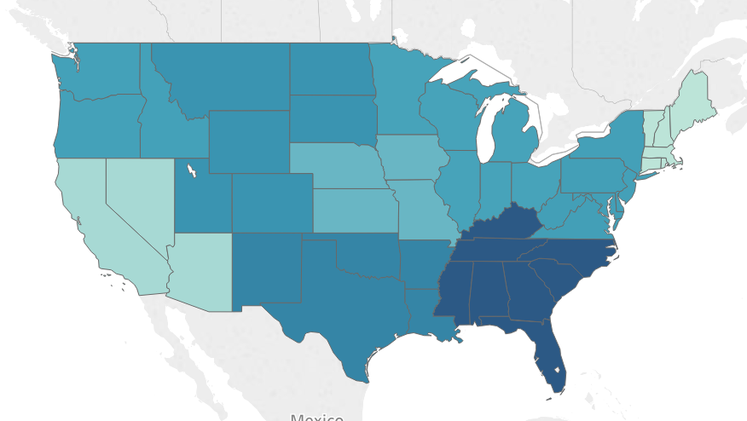
Regional Differences
Significant difference in ratings (p-value: 0.0003)
Slightly significant difference in sentiment (p-value: 0.055)
Average Rating by Region
Region | Mean review_rating
Southeast | 4.27
SouthCentral | 4.22
Mountain | 4.20
MidAtlantic | 4.19
Northwest | 4.19
NorthCentral | 4.19
Midwest | 4.16
Pacific | 4.12
NewEngland | 4.10

Slide 14
ANALYSIS
PART 4 – Text Analysis

Slide 15
Network Analysis
Truncated View of Associations on High Rating Reviews |  |  |  | Truncated View of Associations on Low Rating Reviews
Food 1 | Food 2 | Co-occurrence Count |  | Food 1 | Food 2 | Co-occurrence Count
chicken | steak | 26 |  | chicken | fries | 11
chicken | pork | 22 |  | chicken | cheese | 7
pork | brisket | 16 |  | fries | fish | 6
chicken | cheese | 16 |  | chicken | plate | 5
cheese | fries | 15 |  | meat | plate | 5
cheese | steak | 15 |  | cheese | meat | 5
fish | seafood | 15 |  | chicken | pork | 5
chicken | fries | 11 |  | chicken | side | 5
chicken | beef | 10 |  | chicken | shrimp | 5
shrimp | crab | 10 |  | chicken | fish | 4
chicken | shrimp | 10 |  | cheese | fries | 4
 |  |  |  | cheese | bread | 4
 |  |  |  | pork | plate | 4
Looking into our review data, we wanted to see if there were other attributes such as food items that affect ratings.
Top popular food items overall were shared across the nation with “chicken”, “cheese”, and “fries”

Slide 16
Topic Modeling
Used Latent Dirichlet Allocation (LDA) to create top 10 topics from Yelp reviews
Topic 5 is mostly composed of specific food items: chicken, cheese, salad, burger
Topic 7 has many atmosphere-related words without any food words: atmosphere, cute, seating, inside, bar
Topic 8 has the most service-related words: service, friendly, staff, attentive

Slide 17
Limitations
Well-known challenges faced by sentiment analysis
Sarcasm
Metaphor
Restrictions of the Yelp API
Only 3 reviews per restaurants
Returns only excerpts of reviews

Slide 18
Thank you!
Questions?

