Slide 1

Automata & Compiler Design
UNIT-I

Slide 2
Unit-I Syllabus
String
Alphabet
Language
Operations
Finite Automaton model
Acceptance of Strings & Languages
Deterministic finite automaton
Non deterministic finite automaton
Equivalence between NFA to DFA conversion

Slide 3
String:
A string over an alphabet ∑ is a Finite sequence of symbols of ∑.
Example: Let ∑ = {a,b} be an alphabet; then aa; ab; bba; baaba…………….
are some examples of strings over ∑.

Slide 4
Alphabet:
We formally define an alphabet as a non-empty finite set. We normally use the symbols letters/digits/any special symbols.
Example:
Letters: a, b, c……
Digits : 0,1
Special Symbols: +,-,(,),*,…..

Slide 5
Language
Given an alphabet I, a language L is a set of strings, that is a
subset of the universal language I.
Example:
The set of strings over 0’s and 1’s with equal number of
each:{ɛ,01,10,0011,0101,1001,….}
The set of binary numbers whose value is a prime:{10,11,101,1011,………}

Slide 6
Operations
On languages we can define the usual set operations that are.
union
intersection
Complement
Let L1 = {10} and L2 = {011, 11}.
Union: L1 𝖴 L2 = {10, 011, 11}
Concatenation: L1 L2 = {10011, 1011}
Kleene Star: L1 * = {e, 10, 1010, 101010, … }

Slide 7
Regular Language & Regular Expression & Regular Grammar
A language is regular if it can be expressed in terms of regular expression.
Regular Expressions are used to denote regular languages. An expression
is regular if:
ɸ is a regular expression for regular language ɸ.
ɛ is a regular expression for regular language {ɛ}.
If a ∈ Σ (Σ represents the input alphabet), a is regular expression with
language {a}.
If a and b are regular expression, a + b is also a regular expression with language {a,b}.
If a and b are regular expression, ab (concatenation of a and b) is also
regular.
If a is regular expression, a* (0 or more times a) is also regular.
A grammar is regular if it has rules of form A -> a or A -> aB or A -> ɛ where ɛ is a special symbol called NULL.

Slide 8
Closure Properties of Regular Languages
Union : If L1 and If L2 are two regular languages, their union L1 𝖴 L2 will also be regular.
For example, L1 = {a^{n} | n ≥ 0} and L2 = {b^{n} | n ≥ 0}
L3 = L1 𝖴 L2 = {a^{n} 𝖴 b^{n} | n ≥ 0} is also regular
Intersection : If L1 and If L2 are two regular languages, their intersection L1 ∩ L2 will also be regular.
For example,
L1= {a^{m} b^{n} | n ≥ 0 and m ≥ 0} and L2= {a^{m} b^{n} 𝖴 b^{n} a^{m} | n ≥ 0 and m
≥ 0}
L3 = L1 ∩ L2 = {a^{m} b^{n} | n ≥ 0 and m ≥ 0} is also regular.
Concatenation : If L1 and If L2 are two regular languages, their concatenation L1.L2 will also be regular.
For example,
L1 = {a^{n} | n ≥ 0} and L2 = {b^{n} | n ≥ 0}
L3 = L1.L2 = {a^{m} . b^{n} | m ≥ 0 and n ≥ 0} is also regular.

Slide 9
Closure Properties of Regular Languages
Kleene Closure : If L1 is a regular language, its Kleene closure L1* will also be regular.
For example, L1 = (a 𝖴 b) L1* = (a 𝖴 b)*
Complement : If L(G) is regular language, its complement L’(G) will also be regular. Complement of a language can be found by subtracting strings which are in L(G) from all possible strings.
For example,
L(G) = {a^{n} | n > 3}
L’(G) = {a^{n} | n <= 3}
Note : Two regular expressions are equivalent if languages generated by them are same. For example, (a+b*)* and (a+b)* generate same language. Every string which is generated by (a+b*)* is also generated by (a+b)* and vice versa.

Slide 10
Regular Expressions Examples
The set of all strings containing the substring 00 over ∑={0,1}
(0/1)* 00 (0/1)*
The set of all strings containing at most two 0’s over ∑={0,1}
(0/1)*0(0/1)*0(0/1)*
The set of all strings that begin and end with 1 over ∑={0,1}
1(0/1)*1
The set of all strings that ends with aa over ∑={a,b}
(a/b)*aa
The set of all strings that has at most 2a’s over ∑={a,b}
(b)*+(b)*a(b)* + (b)*a(b)* a(a)*
The set of all strings that has exactly 2a’s over ∑={a,b}
(b)*a(b)* a(b)*

Slide 11
Regular sets & Properties of Regular sets
Any set that represents the value of the Regular Expression is called a Regular Set.
Properties of Regular Sets:
Property 1. The union of two regular set is regular.
Proof −
Let us take two regular expressions RE₁ = a(aa)* and RE₂ = (aa)*
So, L₁ = {a, aaa, aaaaa,.....} (Strings of odd length excluding Null) and L₂ ={ ε, aa, aaaa, aaaaaa,.......} (Strings of even length including
Null)
L₁ 𝖴 L₂ = { ε, a, aa, aaa, aaaa, aaaaa, aaaaaa,.......}
(Strings of all possible lengths including Null)
RE (L₁ 𝖴 L₂) = a* (which is a regular expression itself) Hence, proved.

Slide 12
Property 2. The intersection of two regular set is regular.
Proof −
Let us take two regular expressions RE₁ = a(a*) and RE₂ = (aa)*
So, L₁ = { a,aa, aaa, aaaa, ....} (Strings of all possible lengths
excluding Null)
L₂ = { ε, aa, aaaa, aaaaaa,.......} (Strings of even length including Null) L₁ ∩ L₂ = { aa, aaaa, aaaaaa,.......} (Strings of even length excluding Null)
RE (L₁ ∩ L₂) = aa(aa)* which is a regular expression itself.
Hence, proved.

Slide 13
Property 3. The complement of a regular set is regular.
Proof −
Let us take a regular expression −
RE = (aa)*
So, L = {ε, aa, aaaa, aaaaaa, .......} (Strings of even length including
Null)
Complement of L is all the strings that is not in L.
So, L’ = {a, aaa, aaaaa, .....} (Strings of odd length excluding Null) RE (L’) = a(aa)* which is a regular expression itself.
Hence, proved.

Slide 14
Property 4. The difference of two regular set is regular.
Proof −
Let us take two regular expressions − RE₁ = a (a*) and RE₂ = (aa)*
So, L₁ = {a, aa, aaa, aaaa, ....} (Strings of all possible lengths excluding
Null)
L₂ = { ε, aa, aaaa, aaaaaa,.......} (Strings of even length including Null) L₁ – L₂ = {a, aaa, aaaaa, aaaaaaa, ....}
(Strings of all odd lengths excluding Null)
RE (L₁ – L₂) = a (aa)* which is a regular expression.
Hence, proved.

Slide 15
Property 5. The reversal of a regular set is regular.
Proof −
We have to prove L^{R} is also regular if L is a regular set. Let, L = {01, 10, 11, 10}
RE (L) = 01 + 10 + 11 + 10
L^{R} = {10, 01, 11, 01}
RE (L^{R}) = 01 + 10 + 11 + 10 which is regular
Hence, proved.
Property 6. The closure of a regular set is regular.
Proof −
If L = {a, aaa, aaaaa, .......} (Strings of odd length excluding Null) i.e., RE (L) = a (aa)*
L* = {a, aa, aaa, aaaa , aaaaa,……………} (Strings of all lengths
excluding Null)
RE (L*) = a (a)* Hence, proved.

Slide 16
Property 7. The concatenation of two regular sets is regular.
Proof −
Let RE₁ = (0+1)*0 and RE₂ = 01(0+1)*
Here, L₁ = {0, 00, 10, 000, 010, ......} (Set of strings ending in 0) and L₂ = {01, 010,011,.....} (Set of strings beginning with 01) Then, L₁ L₂ =
{001,0010,0011,0001,00010,00011,1001,10010,.............}
Set of strings containing 001 as a substring which can be represented by an RE − (0 + 1)*001(0 + 1)*
Hence, proved.

Slide 17
Identities Related to Regular Expressions
Given R, P, L, Q as regular expressions, the following identities hold −
∅* = ε
ε* = ε
RR* = R*R
R*R* = R*
(R*)* = R*
RR* = R*R
(PQ)*P =P(QP)*
(a+b)* = (a*b*)* = (a*+b*)* = (a+b*)* = a*(ba*)*
R + ∅ = ∅ + R = R (The identity for union)
R ε = ε R = R (The identity for concatenation)
∅ L = L ∅ = ∅ (The annihilator for concatenation)
R + R = R (Idempotent law)
L (M + N) = LM + LN (Left distributive law)
(M + N) L = LM + LN (Right distributive law)
ε + RR* = ε + R*R = R*

Slide 18
Finite State Machine
The finite automata is a mathematical model of a system with discrete
inputs and outputs.
The model consists of several states and transitions
At any time the state of the system summarizes the info concerning past inputs that is needed to determine the behavior of the system on subsequence inputs.
The control mechanism of an elevator is a good example of FSM. This mechanism doesn’t remember all previous requests for service but only the current flow the direction of motion (up or down) and the collection of not yet satisfied requests for service.
Lexical Analyzer scans the symbols of a computer program to locate the string of characters corresponding to identifiers, constants and reserved words.

Slide 19
Finite Automaton
Consists of a finite set of States and a set of transitions from a state to state that occur on input symbols chosen from an alphabet ∑.
A finite automaton is composed of five components:
1. Q: A finite set of states.
2. : A finite set of symbols, called the alphabet.
3. Q x ∑ --> Q is the transition function.
4. q0 in Q is the start state.
5. F is a set of final states (or accept states). F is a subset of Q.

Slide 20
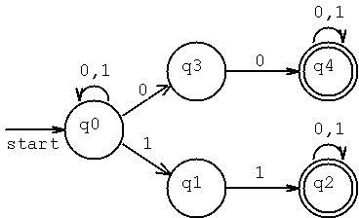
Transition diagram
A Directed Graph called a transition diagram is associated with a FA the vertices of the graph corresponds to the states of FA arcs labeled from one state to other state is called transition.

Slide 21
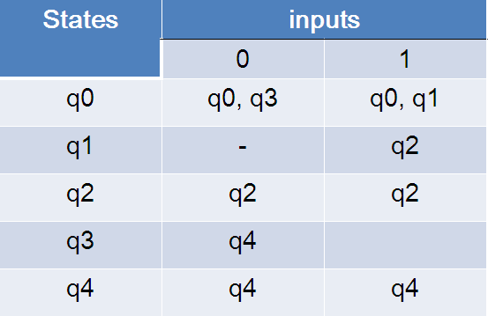
Transition table
Transition table represents the transitions.

Slide 22
String Acceptance:
A String is said to be accepted by a FA M=(Q,∑,δ,q0,F) if δ(q0,x)=p for some p in F.
A language is accepted if all the strings generated from the language is accepted.
A language is said to be regular if it is the set accepted by a FA M.
Ex: δ(q0,111)= δ(δ(δ(q0,1),11)
= δ(δ(q0,1),1)
= δ(q1,1)
= q2 ϵ F String is accepted

Slide 23
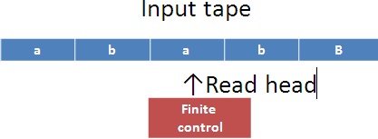
Finite Automaton Model
The finite automaton model can be represented as

Slide 24
Finite Automaton Model
Input tape: It is a linear tape having some cells which can hold an input
symbol from ∑.
Finite control: It indicates the current state and decided the next state on receiving a particular input from the input tape.
Tape reader reads the cells one by one from left to right and at any instance only one input symbol is read.
The read head examines the symbol and head moves to the right side with or without changing the state .when the entire string is read and if finite control is in final state then the string is accepted otherwise rejected.

Slide 25
Finite Automata
There are two types of finite automata
Deterministic Finite Automata
Non Deterministic Finite Automata

Slide 26
Deterministic Finite Automata
In DFA, for each input symbol, one can determine the state to which the machine will move. Hence, it is called Deterministic Automaton. As it has a finite number of states, the machine is called Deterministic Finite Machine or Deterministic Finite Automaton.
Formal Definition of a DFA :
A DFA can be represented by a 5-tuple (Q, ∑, δ, q₀, F) where −
Q is a finite set of states.
∑ is a finite set of symbols called the alphabet.
δ is the transition function where δ: Q × ∑ → Q
q₀ is the initial state from where any input is processed (q₀ ∈ Q).
F is a set of final state/states of Q (F ⊆ Q).

Slide 27
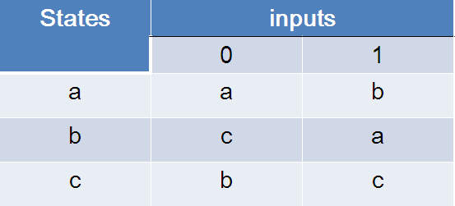
Deterministic Finite Automata
Example
Let a deterministic finite automaton be →
Q = {a, b, c},
∑ = {0, 1},
q₀ = {a},
F = {c}, and
Transition function δ as shown by the following table −

Slide 28
Non Deterministic Finite Automata
In NDFA, for a particular input symbol, the machine can move to any combination of the states in the machine. In other words, the exact state to which the machine moves cannot be determined. Hence, it is called Non-deterministic Automaton. As it has finite number of states, the machine is called Non-deterministic Finite Machine or Non-deterministic Finite Automaton.
Formal Definition of an NDFA:
An NDFA can be represented by a 5-tuple (Q, ∑, δ, q₀, F) where −
Q is a finite set of states.
∑ is a finite set of symbols called the alphabets.
δ is the transition function where δ: Q × ∑ → 2^{Q}
(Here the power set of Q (2^{Q}) has been taken because in case of NDFA, from a state, transition can occur to any combination of Q states)
q₀ is the initial state from where any input is processed (q₀ ∈ Q).
F is a set of final state/states of Q (F ⊆ Q).

Slide 29
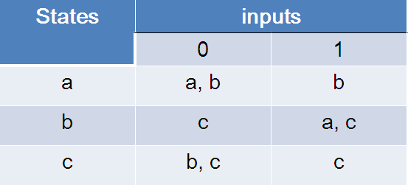
Non Deterministic Finite Automata
Example
Let a non-deterministic finite automaton be →
Q = {a, b, c}
∑ = {0, 1}
q₀ = {a}
F = {c}
The transition function δ as shown below −

Slide 30
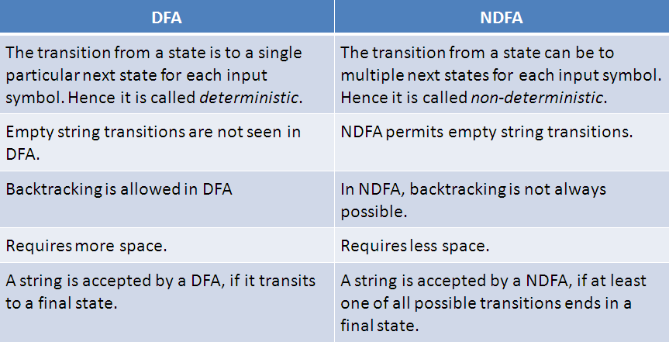
DFA vs. NDFA

Slide 31

Examples of FA
Example 1:
Design a FA with ∑ = {0, 1} accepts those string which starts with 1 and ends with 0.
Solution:
The FA will have a start state q0 from which only the edge with input 1 will go to the next state.
In state q1, if we read 1, we will be in state q1, but if we read 0 at state q1, we will reach to state q2 which is the final state. In state q2, if we read either 0 or 1, we will go to q2 state or q1 state respectively. Note that if the input ends with 0, it will be in the final state

Slide 32

Example 2:
Design a FA with ∑ = {0, 1} accepts the only input 101.
Solution:
In the given solution, we can see that only input 101 will be accepted. Hence, for input 101, there is no other path shown for other input

Slide 33
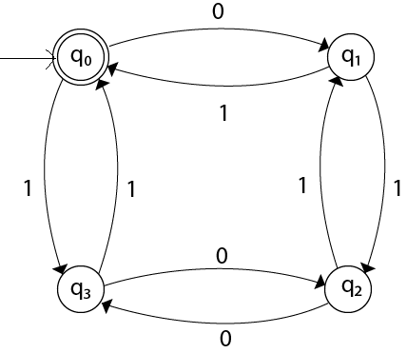
Example 3:
Design FA with ∑ = {0, 1} accepts even number of 0's and even number of 1's.
Solution:
This FA will consider four different stages for input 0 and input 1. The stages could be:

Slide 34
DFA- Practice Problems
Design a FA that accepts set of strings such that every string ends in 00,over alphabet ∑={0,1}.
Construct a FA that accept set of strings where the number of 0’s in every
string is multiple of three over alphabet ∑={0,1}.
Design a FA which accepts set of strings containing exactly four 1’s in every string over alphabet ∑={0,1}.
Design a FA that accept strings containing exactly one 1 over alphabet
∑={0,1}.
Design a FA which accept the language
L={ω ϵ (0,1)*/second symbol of ω is ‘0’ and fourth input is 1}.
Give a DFA for Σ = {0, 1} and strings that have an odd number of 1’s and any number of 0’s.
Give a DFA for Σ = {a, b, c} that accepts any string with aab as a substring.
Give a DFA for Σ = {a, b} that accepts any string with aababb as a substring.

Slide 35
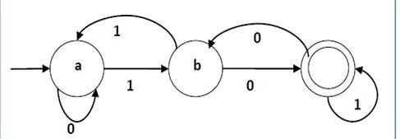
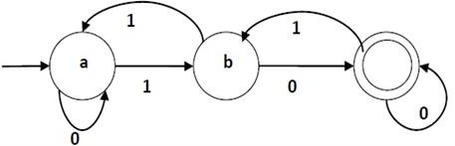
DFA- Practice Problems
9. For the given FA write the language and also give the transition table.
10. For the given FA write the language and also give the transition table.

Slide 36
DFA- Practice Problems
Design FA for the language L={(01)^{i} (1)^{2j} / i>=1,j>=1}.
Design a FA over alphabet ∑={0,1},which accept the set of strings either start with 01 or end with 01.
Give the DFA accepting the set of strings over alphabet ∑={0,1},such that in each string number of 0’s is divisible by five and number of 1’s is divisible by 3.
Design a FA which accept the language L={ω /ω has both an even number of 0’s and an even number of 1’s over alphabet ∑={0,1}.

Slide 37
NFA-Practice Problems
Design a NFA for the language L=all string over {0,1} that have at least two consecutive 0’s or 1’s.
2. Draw the state diagram for NFA accepting language L=(ab)*(ba)* U aa*.
Draw the state diagram for NFA accepting language L=(aba)*
U aa*.
Draw the state diagram for NFA accepting language L={(a^{n}:n>=0) U (b^{n}a:n>=1)}.
5. Draw the state diagram for NFA accepting language L=
={(a^{n}:n>=0) U (b^{n}:n>=0)}.

Slide 38
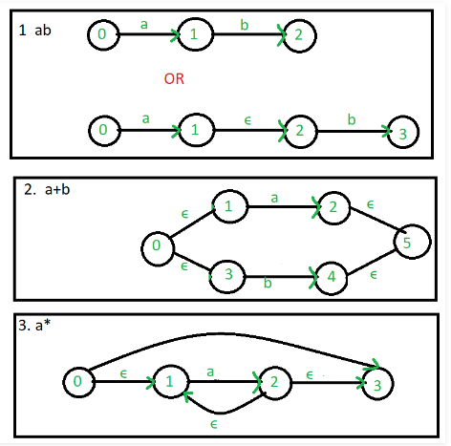
Regular expression to ∈-NFA

Slide 39
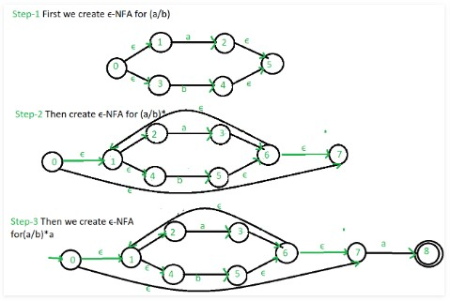
Regular expression to ∈-NFA for (a/b)*a

Slide 40
Conversion Of E-NFA To NFA
The Process Of Conversion Of ε-NFA To NFA Is Called As Thomson Construction. Note:-
No Change In Initial State
No Change In The Total No. Of States
May Be Change In Final States
Algorithm
Let M=(Q,Σ,δ,q₀,F) – ε-NFA
M¹= (Q¹,Σ,δ¹,q₀¹,F¹) – NFA
Initial State
q₀¹=q₀
Construction Of δ¹
_{δ}1
(q,x)=ε-Closure(δ(ε-Closure(q),x)
Final State
Every State Who’s ε-Closure Contain Final State Of ε-NFA Is Final State In NFA

Slide 41
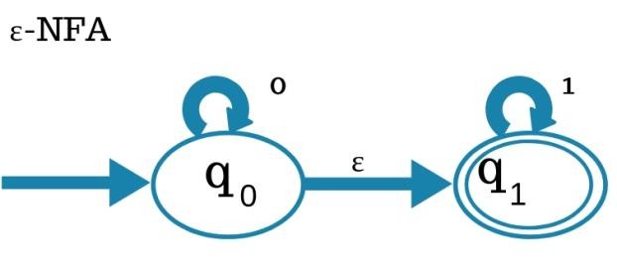
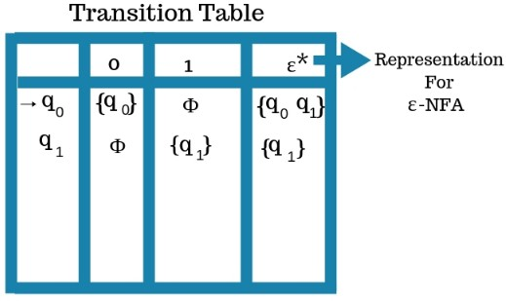
Conversion Of E-NFA To NFA -example
ε-Closure(q₀)-{q₀,q₁}
ε-Closure(q₁)-{q₁}
Initial State : q0
Construction Of δ¹
δ¹=(q₀,0)=ε-Closure(δ(ε-Closure(q₀,0)
=ε-Closure(δ({q₀,q₁},0))
=ε-Closure(q₀)
={q₀,q₁}

Slide 42
Conversion Of E-NFA To NFA -example
δ¹=(q₀,1)=ε-Closure(δ(ε-Closure(q₀,1)
=ε-Closure(δ({q₀,q₁},1))
=ε-Closure(q₁)
={q₁}
δ¹=(q₁,0)=ε-Closure(δ(ε-Closure(q₁,0)
=ε-Closure(δ({q₁},0))
=ε-Closure(Φ)
=Φ
δ¹=(q₁,1)=ε-Closure(δ(ε-Closure(q₁,1)
=ε-Closure(δ({q₁},1))
=ε-Closure(q₁)
={q₁}

Slide 43
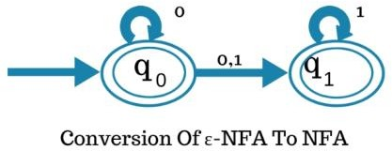
Conversion Of E-NFA To NFA -example
3. Final State?
q₀ & q₁ Both Are Final States Because ε-Closure(q₀)={q₀,q₁}
ε-Closure(q₁)={q₁}

Slide 44
Conversion from NFA to DFA
Let, M = (Q, ∑, δ, q0, F) is an NFA which accepts the language L(M). There should be equivalent DFA denoted by M' = (Q', ∑', q0', δ', F') such that L(M) = L(M').
Steps for converting NFA to DFA:
Step 1: Initially Q' = ϕ
Step 2: Add q0 of NFA to Q'. Then find the transitions from this start state.
Step 3: In Q', find the possible set of states for each input symbol. If this set of states is not in Q', then add it to Q'.
Step 4: In DFA, the final state will be all the states which contain F(final states of NFA)

Slide 45
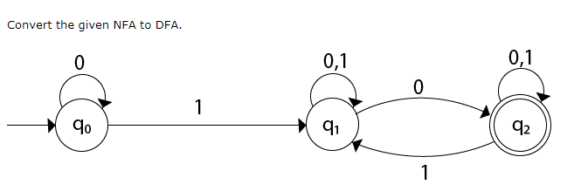
Conversion from NFA to DFA-Example
State | 0 | 1
→q0 | q0 | q1
q1 | {q1, q2} | q1
*q2 | q2 | {q1, q2}

Slide 46
Conversion from NFA to DFA-Example
δ'([q0], 0) = [q0]
δ'([q0], 1) = [q1]
The δ' transition for state q1 is obtained as:
δ'([q1], 0) = [q1, q2] (new state generated)
δ'([q1], 1) = [q1]
The δ' transition for state q2 is obtained as: δ'([q2], 0) = [q2]
δ'([q2], 1) = [q1, q2]
Now we will obtain δ' transition on [q1, q2].
δ'([q1, q2], 0) = δ(q1, 0) 𝖴 δ(q2, 0)
= {q1, q2} 𝖴 {q2}
= [q1, q2]
δ'([q1, q2], 1) = δ(q1, 1) 𝖴 δ(q2, 1)
= {q1} 𝖴 {q1, q2}
= {q1, q2}
= [q1, q2]

Slide 47
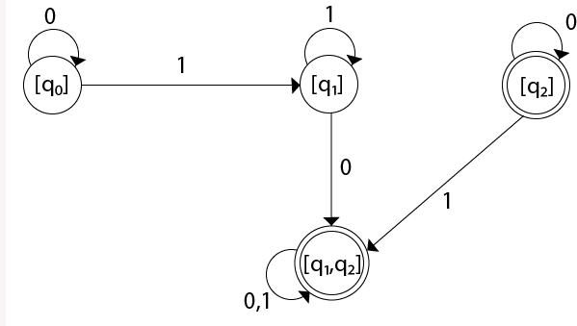
Conversion from NFA to DFA-Example
The state [q1, q2] is the final state as well because it contains a final state q2.
The transition table for the constructed DFA will be:
State | 0 | 1
→[q0] | [q0] | [q1]
[q1] | [q1, q2] | [q1]
*[q2] | [q2] | [q1, q2]
*[q1, q2] | [q1, q2] | [q1, q2]
Note: The state q2 can be eliminated because q2 is an unreachable state

Slide 48
Minimization of FSM:
Suppose there is a DFA ,D < Q, ∑, q0, δ, F > which recognizes a language
L. Then the minimized DFA D < Q’, ∑, q0, δ’, F’ > can be constructed for language L as:
Step 1: We will divide Q (set of states) into two sets. One set will contain all final states and other set will contain non-final states. This partition is called P0.
Step 2: Initialize k = 1
Step 3: Find P_{k} by partitioning the different sets of P_{k-1}. In each set of P_{k-1}, we will take all possible pair of states. If two states of a set are distinguishable, we will split the sets into different sets in P_{k}.
Step 4: Stop when P_{k} = P_{k-1} (No change in partition)
Step 5: All states of one set are merged into one. No. of states in minimized DFA will be equal to no. of sets in P_{k}.

Slide 49
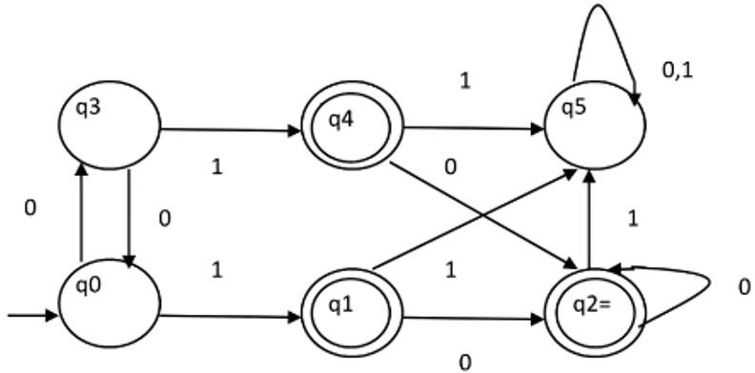
Minimization of FSM:
Example
Consider the following DFA shown in figure.

Slide 50
Minimization of FSM:
Step 1. P0 will have two sets of states. One set will contain q1, q2, q4 which are final states of DFA and another set will contain remaining states. So P0 = {
{ q1, q2, q4 }, { q0, q3, q5 } }.
Step 2. To calculate P1, we will check whether sets of partition P0 can be partitioned or not:
For set { q1, q2, q4 } :
δ ( q1, 0 ) = δ ( q2, 0 ) = q2 and δ ( q1, 1 ) = δ ( q2, 1 ) = q5, So q1 and q2 are
not distinguishable.
Similarly, δ ( q1, 0 ) = δ ( q4, 0 ) = q2 and δ ( q1, 1 ) = δ ( q4, 1 ) = q5, So q1 and q4 are not distinguishable.
Since, q1 and q2 are not distinguishable and q1 and q4 are also not distinguishable, So q2 and q4 are not distinguishable. So,
{ q1, q2, q4 } set will not be partitioned in P1.

Slide 51
Minimization of FSM:
For set { q0, q3, q5 } :
δ ( q0, 0 ) = q3 and δ ( q3, 0 ) = q0 δ ( q0, 1) = q1 and δ ( q3, 1 ) = q4
Moves of q0 and q3 on input symbol 0 are q3 and q0 respectively which are in same set in partition P0. Similarly, Moves of q0 and q3 on input symbol 1 are q3 and q0 which are in same set in partition P0. So, q0 and q3 are not distinguishable.
δ ( q0, 0 ) = q3 and δ ( q5, 0 ) = q5 and δ ( q0, 1 ) = q1 and δ ( q5, 1 ) = q5 Moves of q0 and q5 on input symbol 0 are q3 and q5 respectively which are in different set in partition P0. So, q0 and q5 are distinguishable. So, set { q0, q3, q5 } will be partitioned into { q0, q3 } and { q5 }. So,
P1 = { { q1, q2, q4 }, { q0, q3}, { q5 } }

Slide 52
Minimization of FSM:
To calculate P2, we will check whether sets of partition P1 can be partitioned or not:
⚫
For set { q1, q2, q4 } :
δ ( q1, 0 ) = δ ( q2, 0 ) = q2 and δ ( q1, 1 ) = δ ( q2, 1 ) = q5, So q1 and q2 are not distinguishable.
Similarly, δ ( q1, 0 ) = δ ( q4, 0 ) = q2 and δ ( q1, 1 ) = δ ( q4, 1 ) = q5, So q1 and q4 are not distinguishable.
Since, q1 and q2 are not distinguishable and q1 and q4 are also not
distinguishable, So q2 and q4 are not distinguishable. So,
{ q1, q2, q4 } set will not be partitioned in P2.

Slide 53
Minimization of FSM:
For set { q0, q3 } :
δ ( q0, 0 ) = q3 and δ ( q3, 0 ) = q0 δ ( q0, 1 ) = q1 and δ ( q3, 1 ) = q4
Moves of q0 and q3 on input symbol 0 are q3 and q0 respectively which are in same set in partition P1. Similarly, Moves of q0 and q3 on input symbol 1 are q3 and q0 which are in same set in partition P1. So, q0 and q3 are not distinguishable.
For set { q5 }:
Since we have only one state in this set, it can’t be further partitioned. So,
P2 = { { q1, q2, q4 }, { q0, q3 }, { q5 } }
Since, P1=P2. So, this is the final partition. Partition P2 means that q1, q2 and q4 states are merged into one. Similarly, q0 and q3 are merged into one.
Minimized DFA corresponding to DFA of Figure 1 is shown in Figure 2 as:

Slide 54
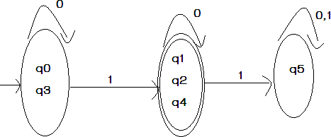
Minimization of FSM:

Slide 55
Equivalence between two FSM’s:
Definition : (equivalence of finite state machines): Two finite state machines M1 and M2 are equivalent (M1≡M2) if they have the same input and output alphabets and if, starting from their respective initial states, they produce the same output for any input string.

Slide 56
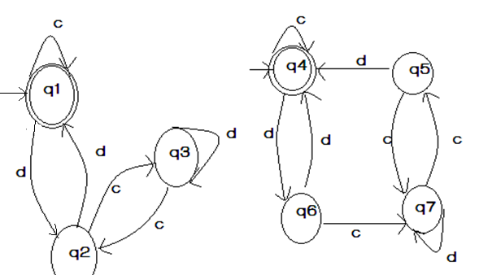
Equivalence between two FSM’s:

Slide 57
Equivalence between two FSM’s:
Solution: The initial states in M1 and M2 are q1 and q4. |Let us see that combined transition of M1 and M2 on inputs c and d as follows:
States/Inputs | c | d
(q1,q4) | (q1,q4) | (q2,q6)
(q2,q6) | (q3,q7) | (q1,q4)
(q3,q7) | (q2,q5) | (q3,q7)
(q2,q5) | (q3,q7) | (q1,q4)

Slide 58
Equivalence between two FSM’s:
(q1,q4) is new state
(q2,q6) is new state
(q3,q7) is new state
(q2,q5) is new state
Let us analyze the above transition table carefully, then we find that, the behavior of M1 and M2 is similar.
We do not get a pair (q , q’) where q is a final state ,and q’ is a non final state (or vice versa) at every row. Therefore M and M’ are equivalent.

