Slide 1
Healthcare Appointment Booking
Group 14 | NUID
Aman Malawade | 002762202
Santosha Nagaratnakar Chakkapalli | 002798165
Shreya Bage | 002837742
Yu Du | 002290656
Kartik Shanbhag | 002273864

Slide 2
OBJECTIVE
Healthcare Appointment Booking project is designed to make scheduling doctor appointments smoother and more efficient.
Right now, the healthcare industry often struggles with managing appointments, doctor availability, and keeping electronic health records organized.
This project aims to fix problems like double bookings or cancellations and improve the overall experience for both doctors and patients.
The idea is to build a sophisticated yet easy-to-use database system that handles all aspects related to medical appointments.
This includes keeping track of patient information, doctors’ schedules, health records, and billing details.

Slide 3
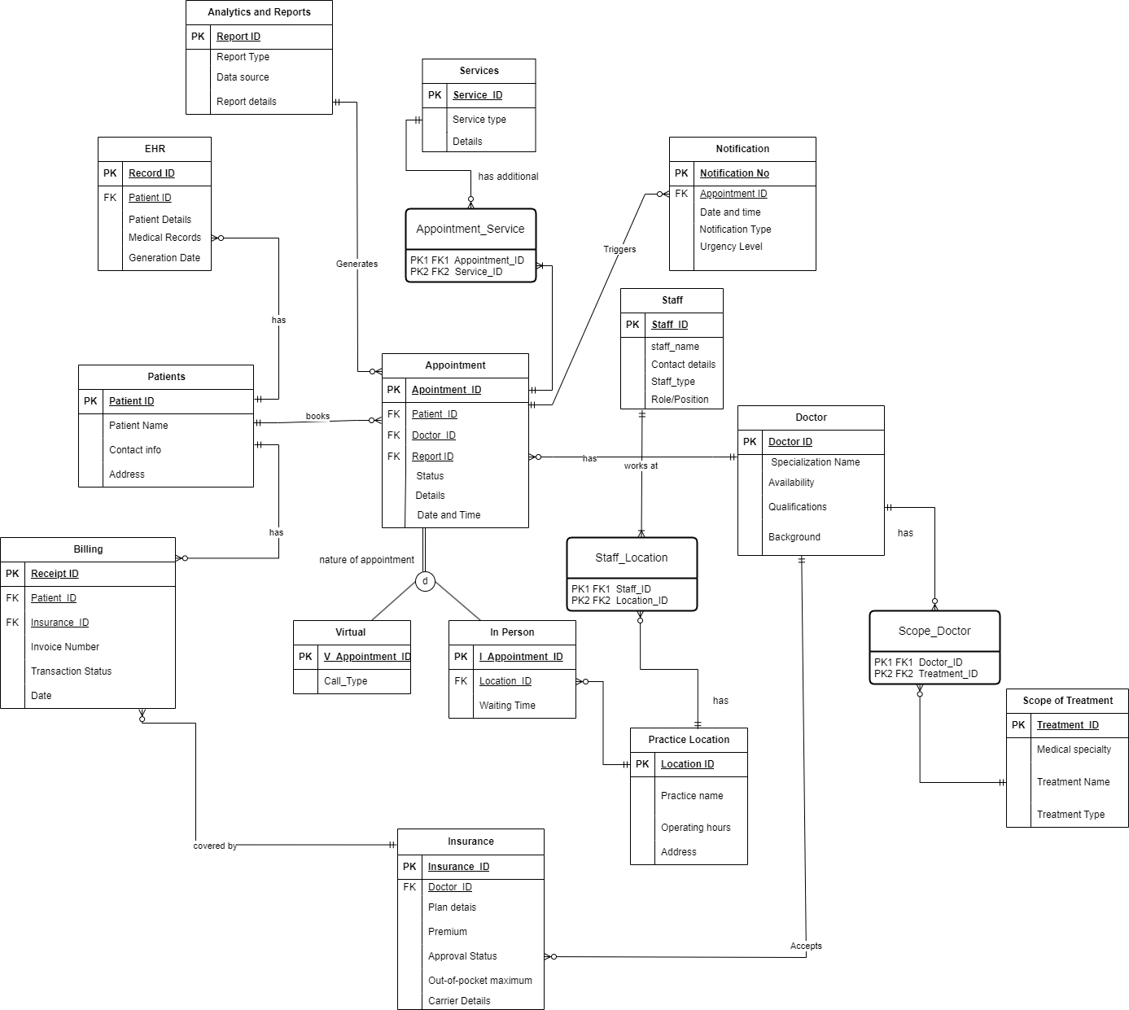
ENTITY RELATIONSHIP DIAGRAM

Slide 4
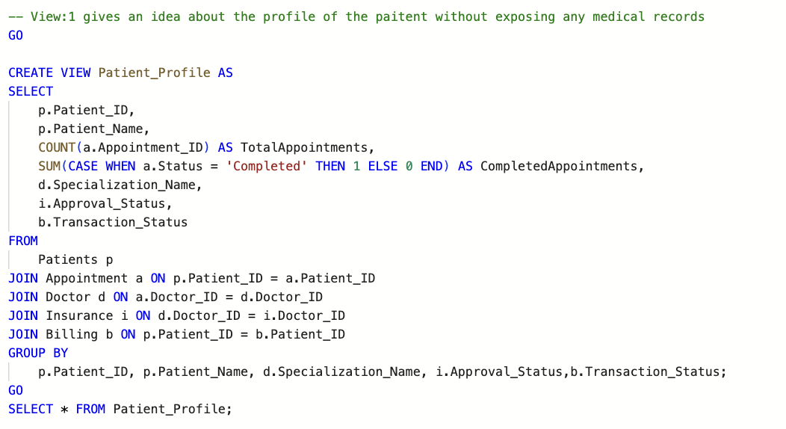
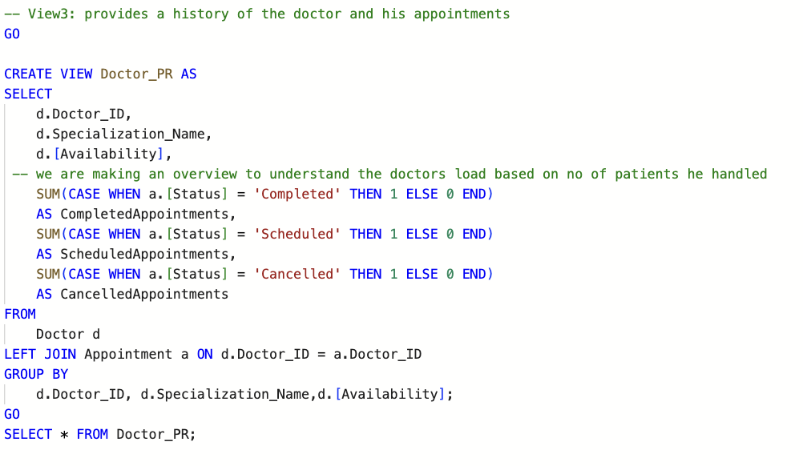
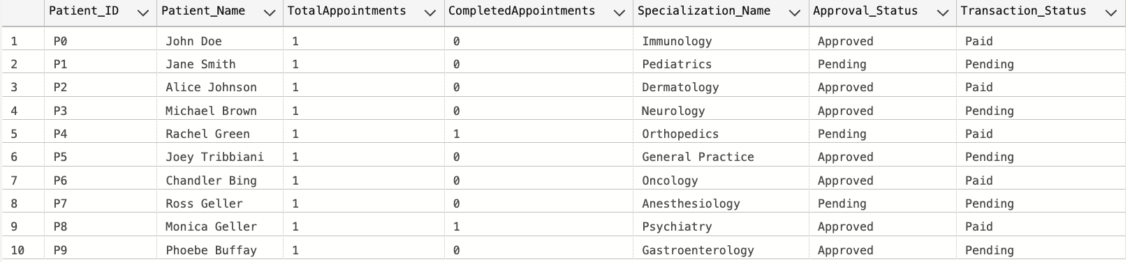
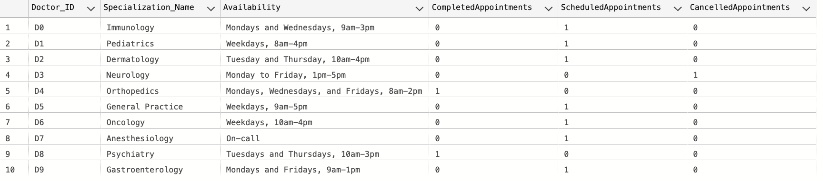
VIEWS
View that gives an idea about the Patient’s Profile
View that provides the history of Doctor’s appointments

Slide 5
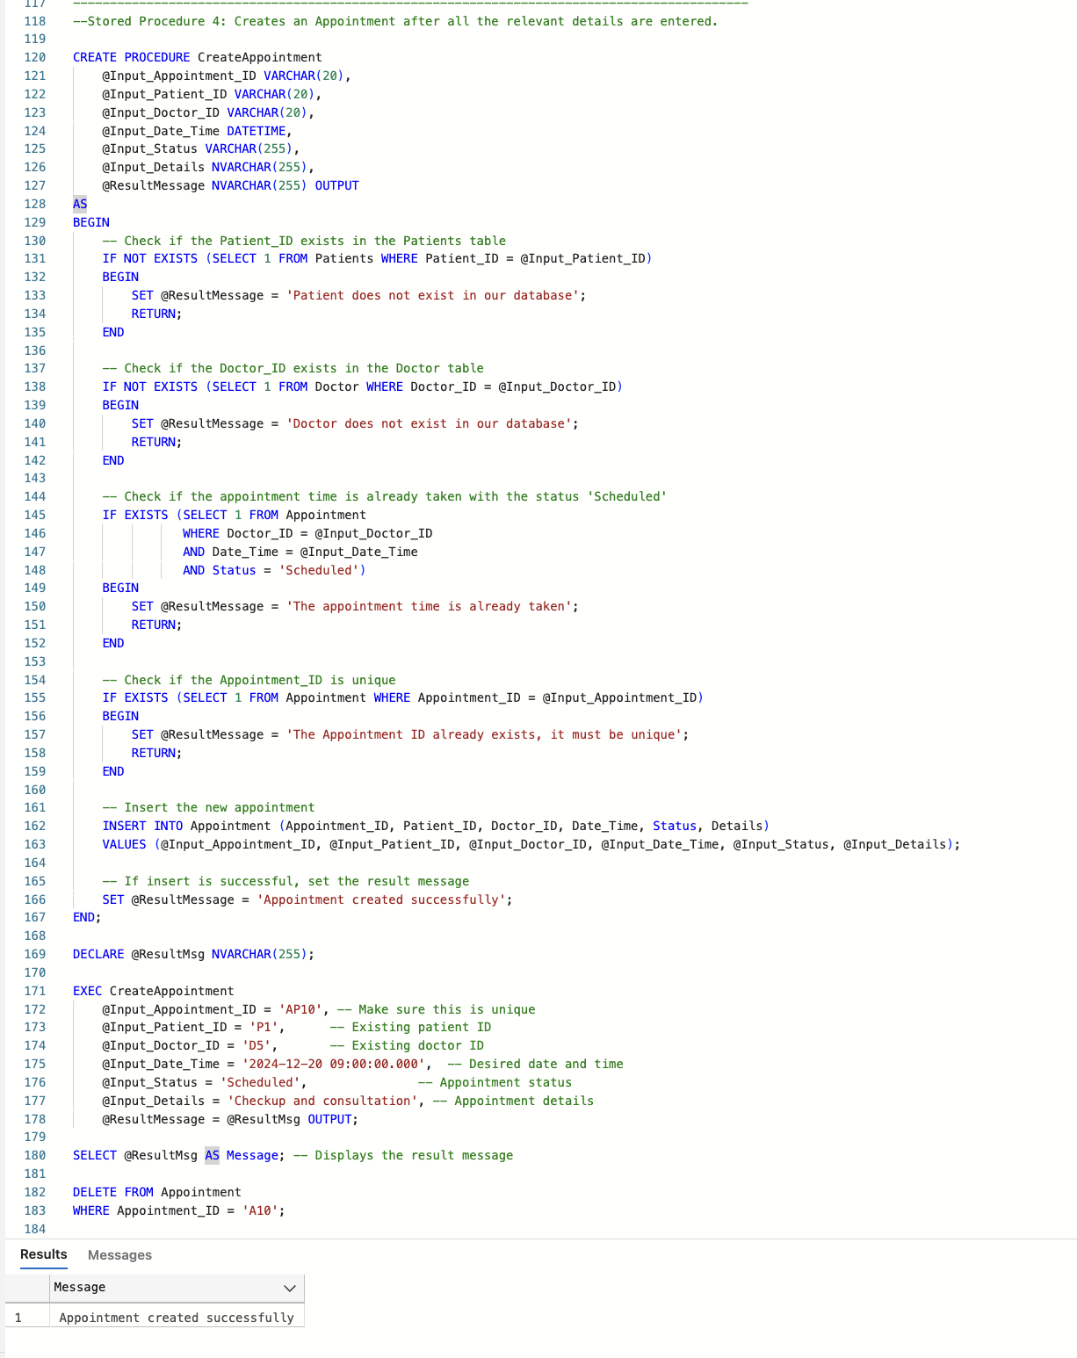
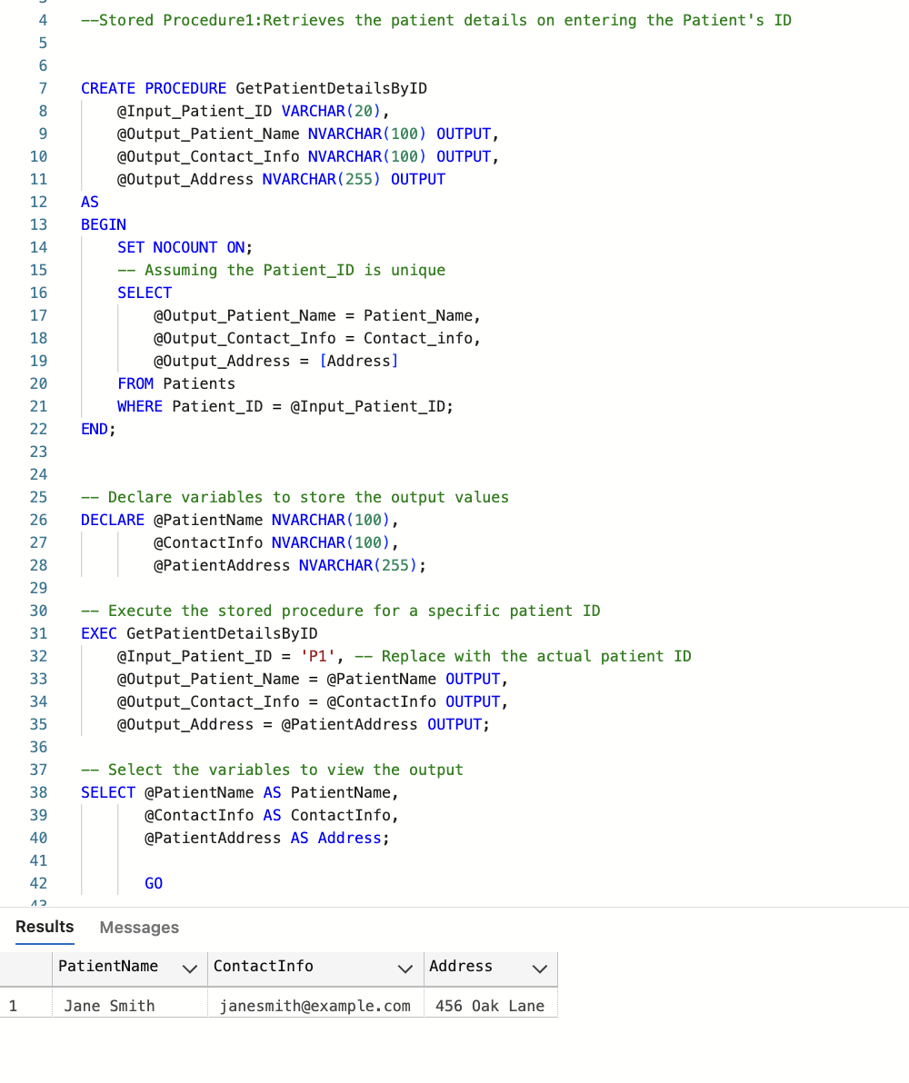
STORED PROCEDURES
Procedure to create an Appointment
Procedure to retrieve the patient details

Slide 6
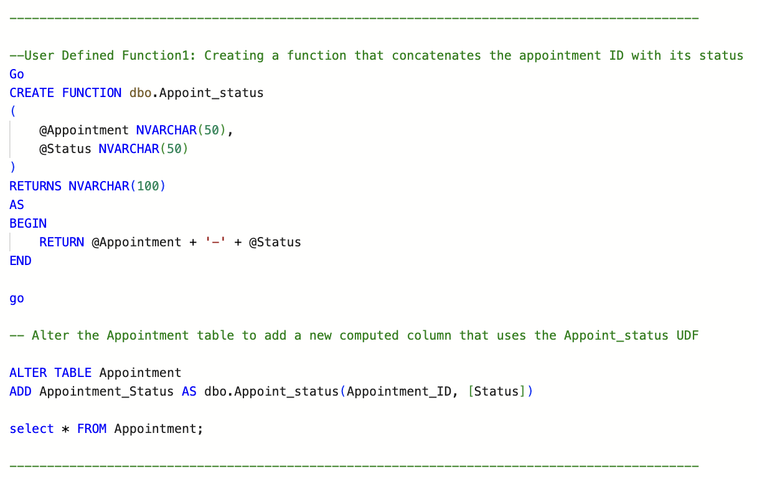
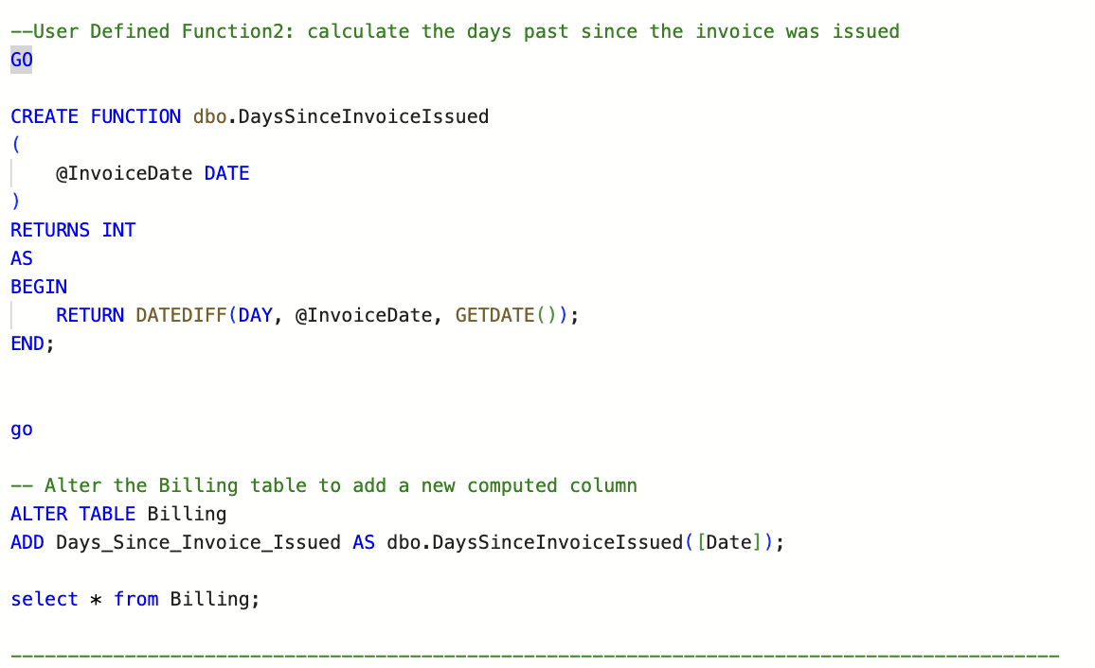
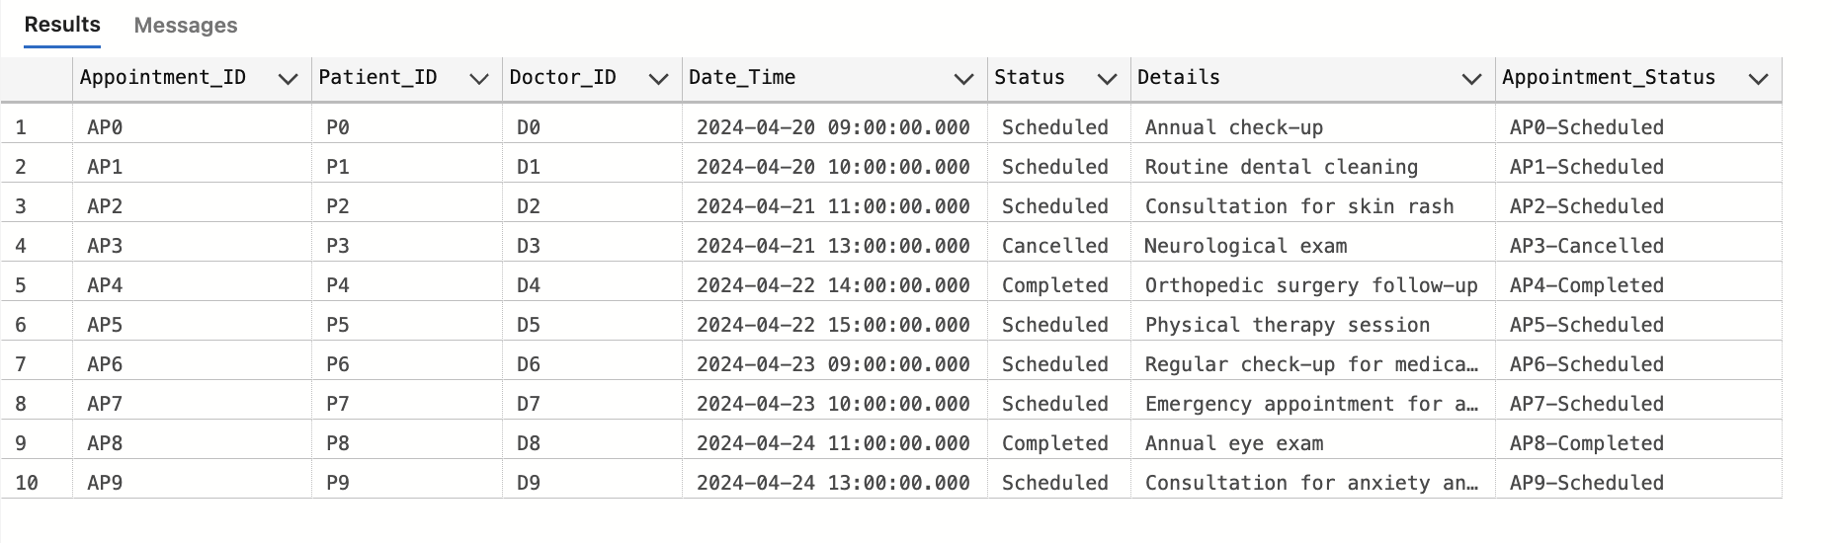
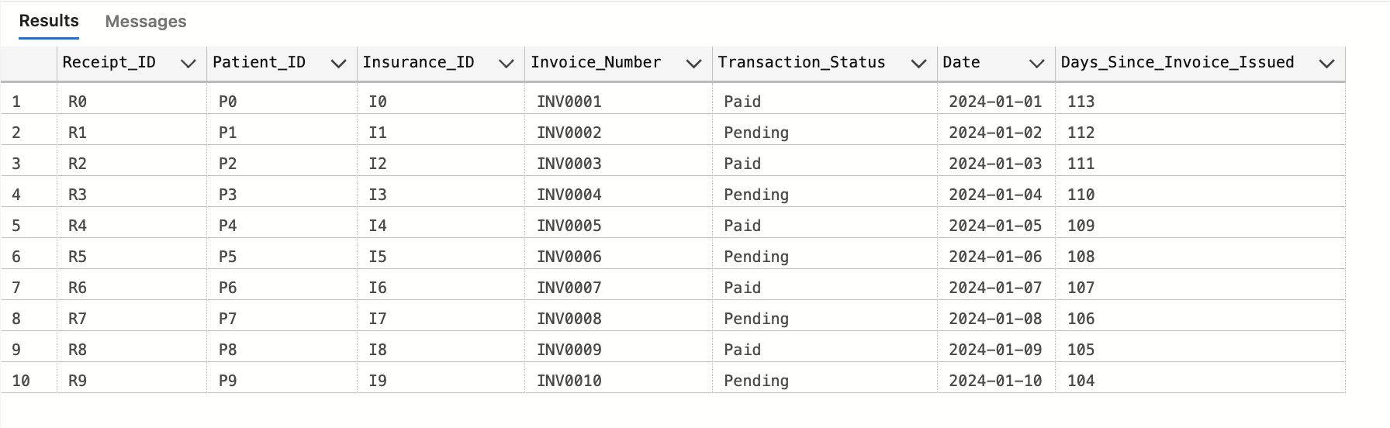
USER DEFINED FUNCTIONS
Function that concatenates Appointment ID with it’s Status
Function that calculates the days since the invoice was issued

Slide 7
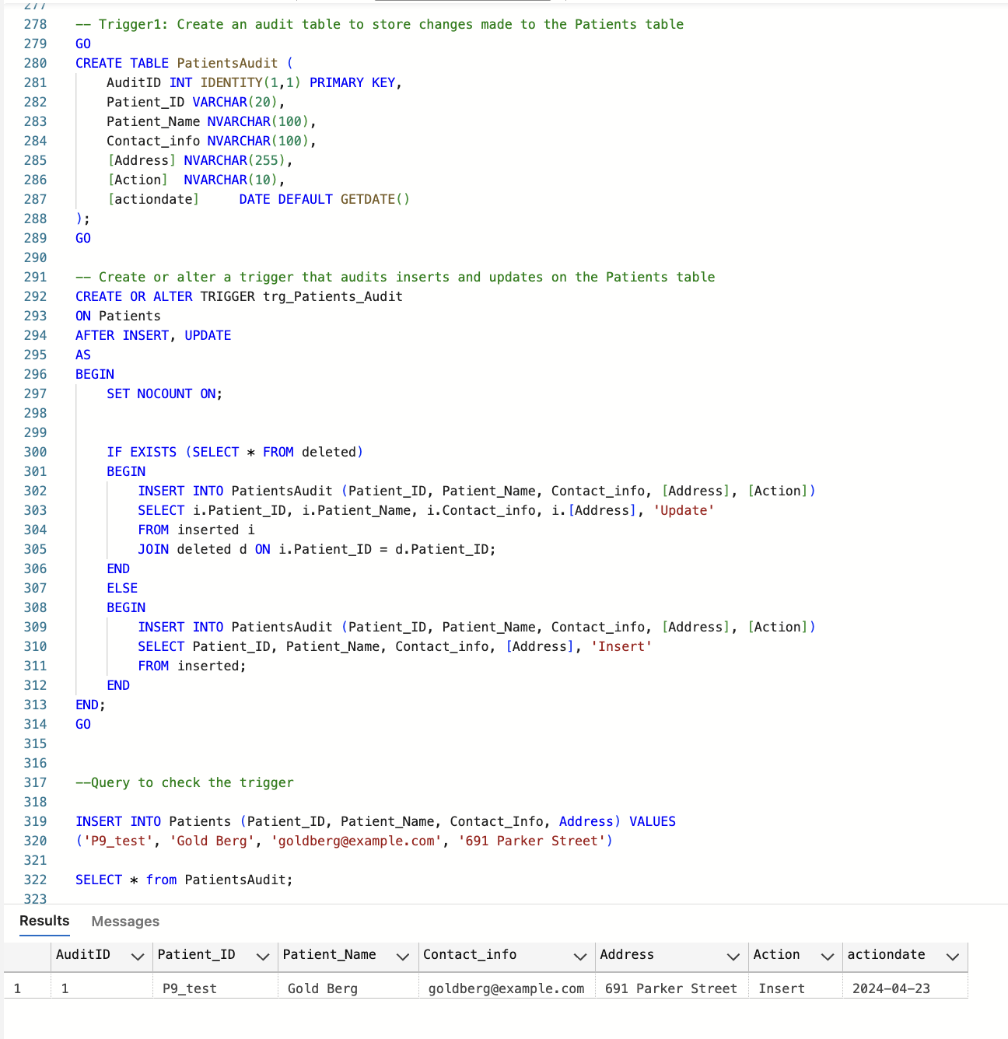
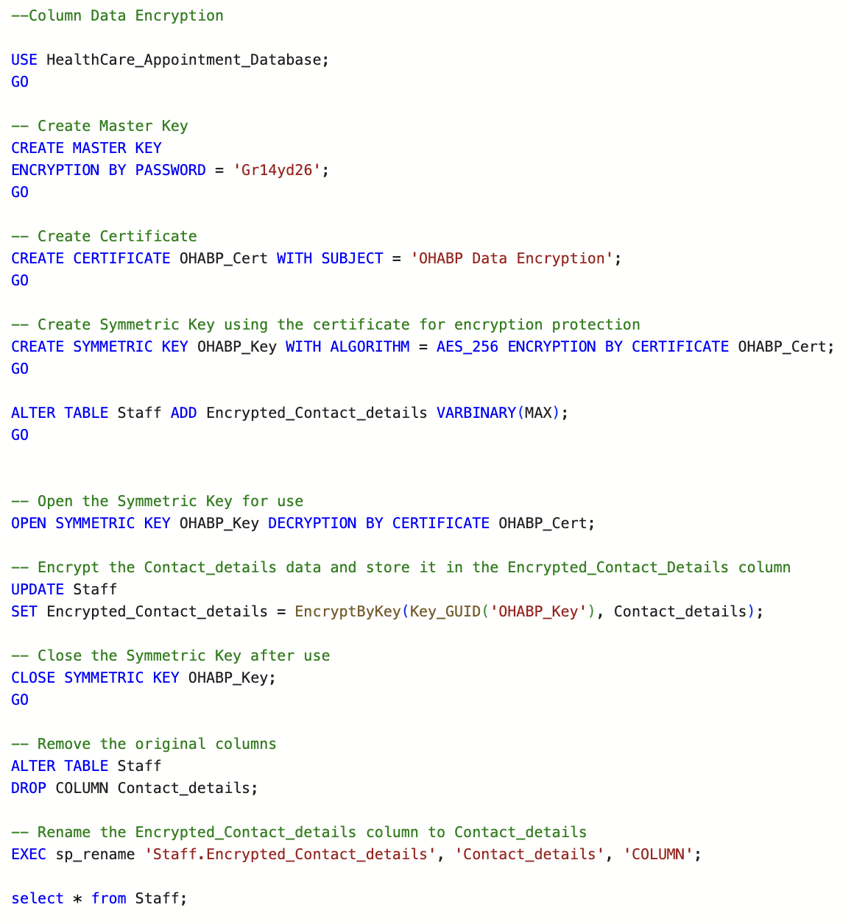
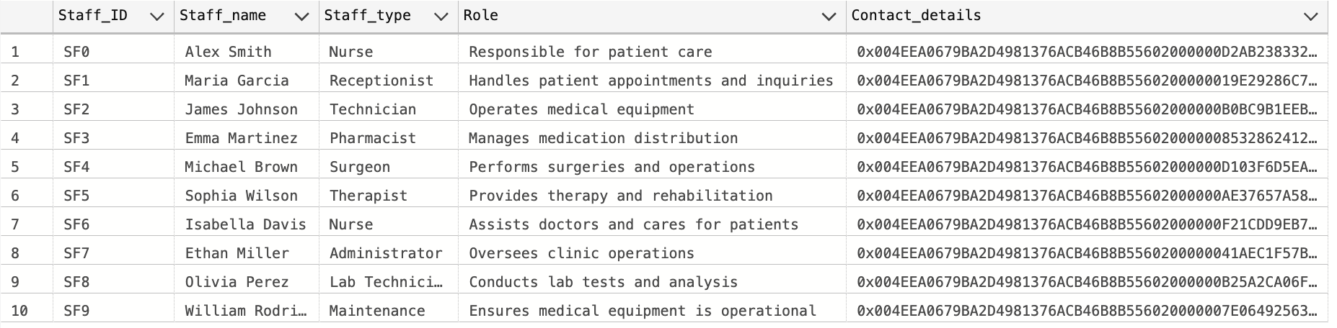
ENCRPTION
TRIGGER
Trigger that stores the changes made in the Patient’s table
Encrypting the contact details of Staff

Slide 8
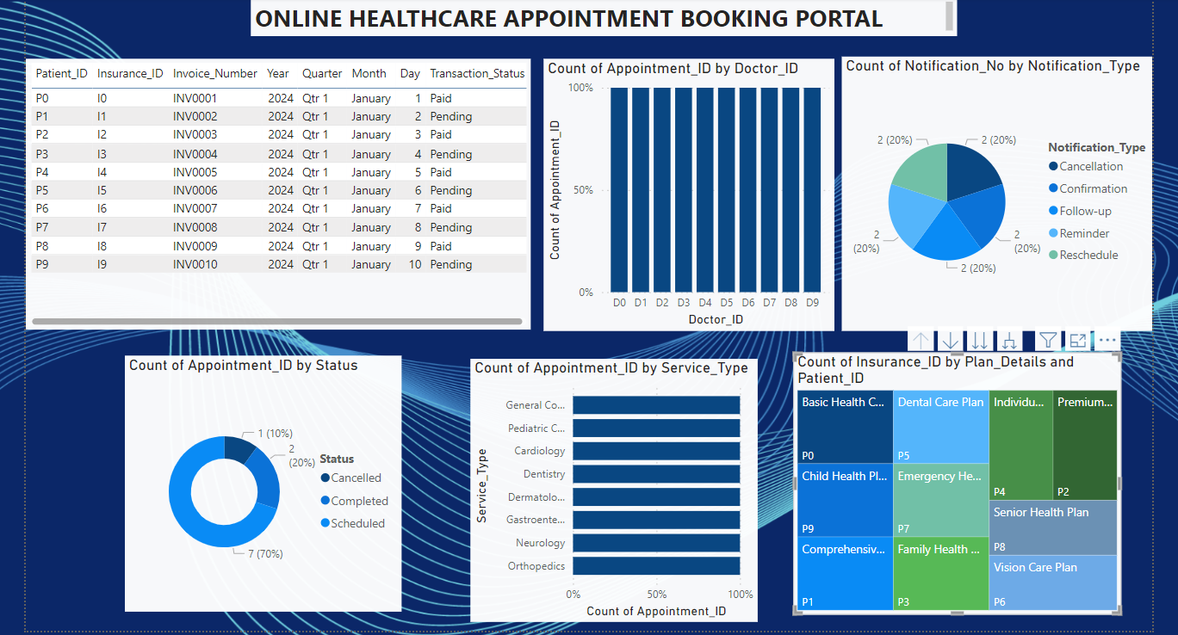
Visualization

Slide 9
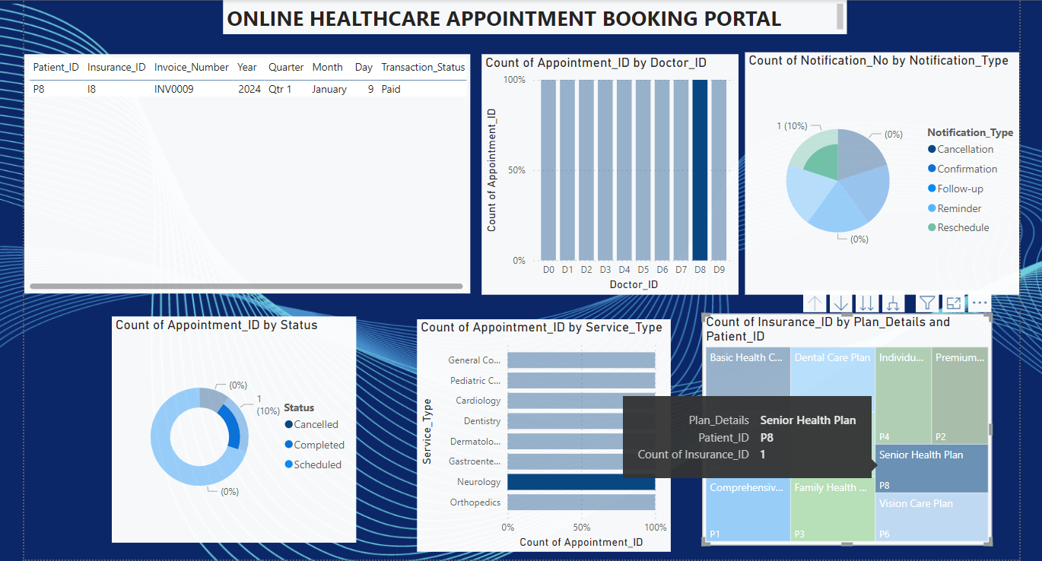
THANK YOU

