Slide 1
WeCare Fund Management Suite
Group members:
Santosha Nagaratnakar – 002798165
Deepak Kumar – 002631397
Sathwik Reddy Chelemela - 002873268

Slide 2
Introduction
This Java Swing application is designed for the WeCare Fund Management Suite, focusing on fund management.
EcoSystem: The central system class connecting various networks.
Network: Represents different geographical or operational networks.
Enterprise: Includes various enterprises like Donation, Funds, Kit Supply, and Donor Enterprises.
Organization: Different types of organizations within each enterprise.
Roles: Defines the responsibilities and capabilities of different users in the system.

Slide 3
Technologies Used
Java
Swing Framework
jBcrypt
JavaMail API
Git
GitHub
JFreeChart
Dbo4o

Slide 4
General Features
User Accounts: Each user type (Admin, Donor, Manager) has an individual account.
Dashboard: Users have access to a dashboard for a quick summary of activities and statuses.
Authentication: The system includes register, login, and logout functionalities.
Email Confirmation: Users receive email confirmations during registration and account creation.
Input Validation: Real-time validation status is provided in input fields.

Slide 5
Enterprise Structure
Donation Enterprise
Funds Enterprise
Kit Supply Enterprise
Donor Enterprise

Slide 6
Organizations
Disaster Relief Organization
Education Donation Organization
Funds Organization
Individual Donor Organization
Disaster Relief Kit Supply Organization
Education Kit Supply Organization

Slide 7
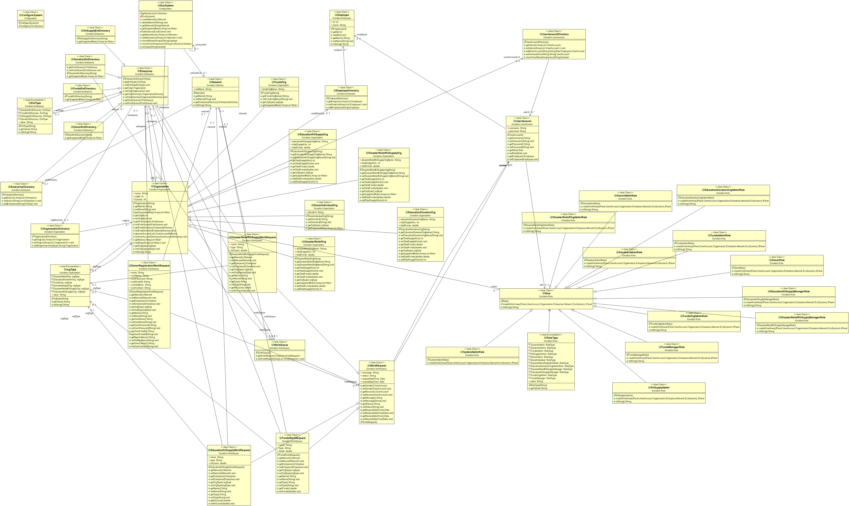
Class Diagram

Slide 8
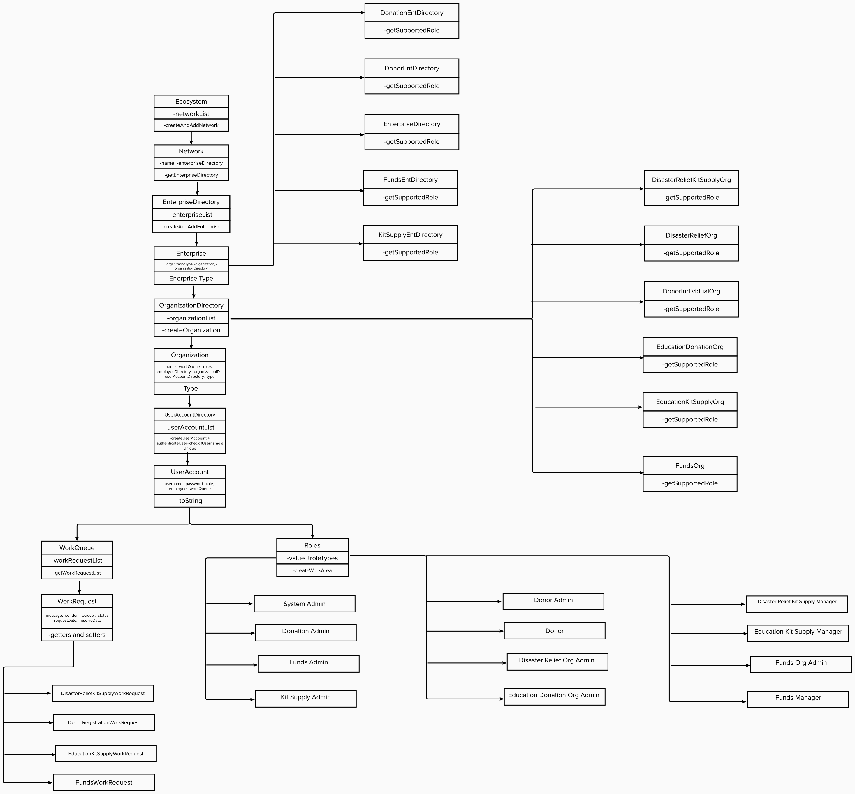
Object model

Slide 9
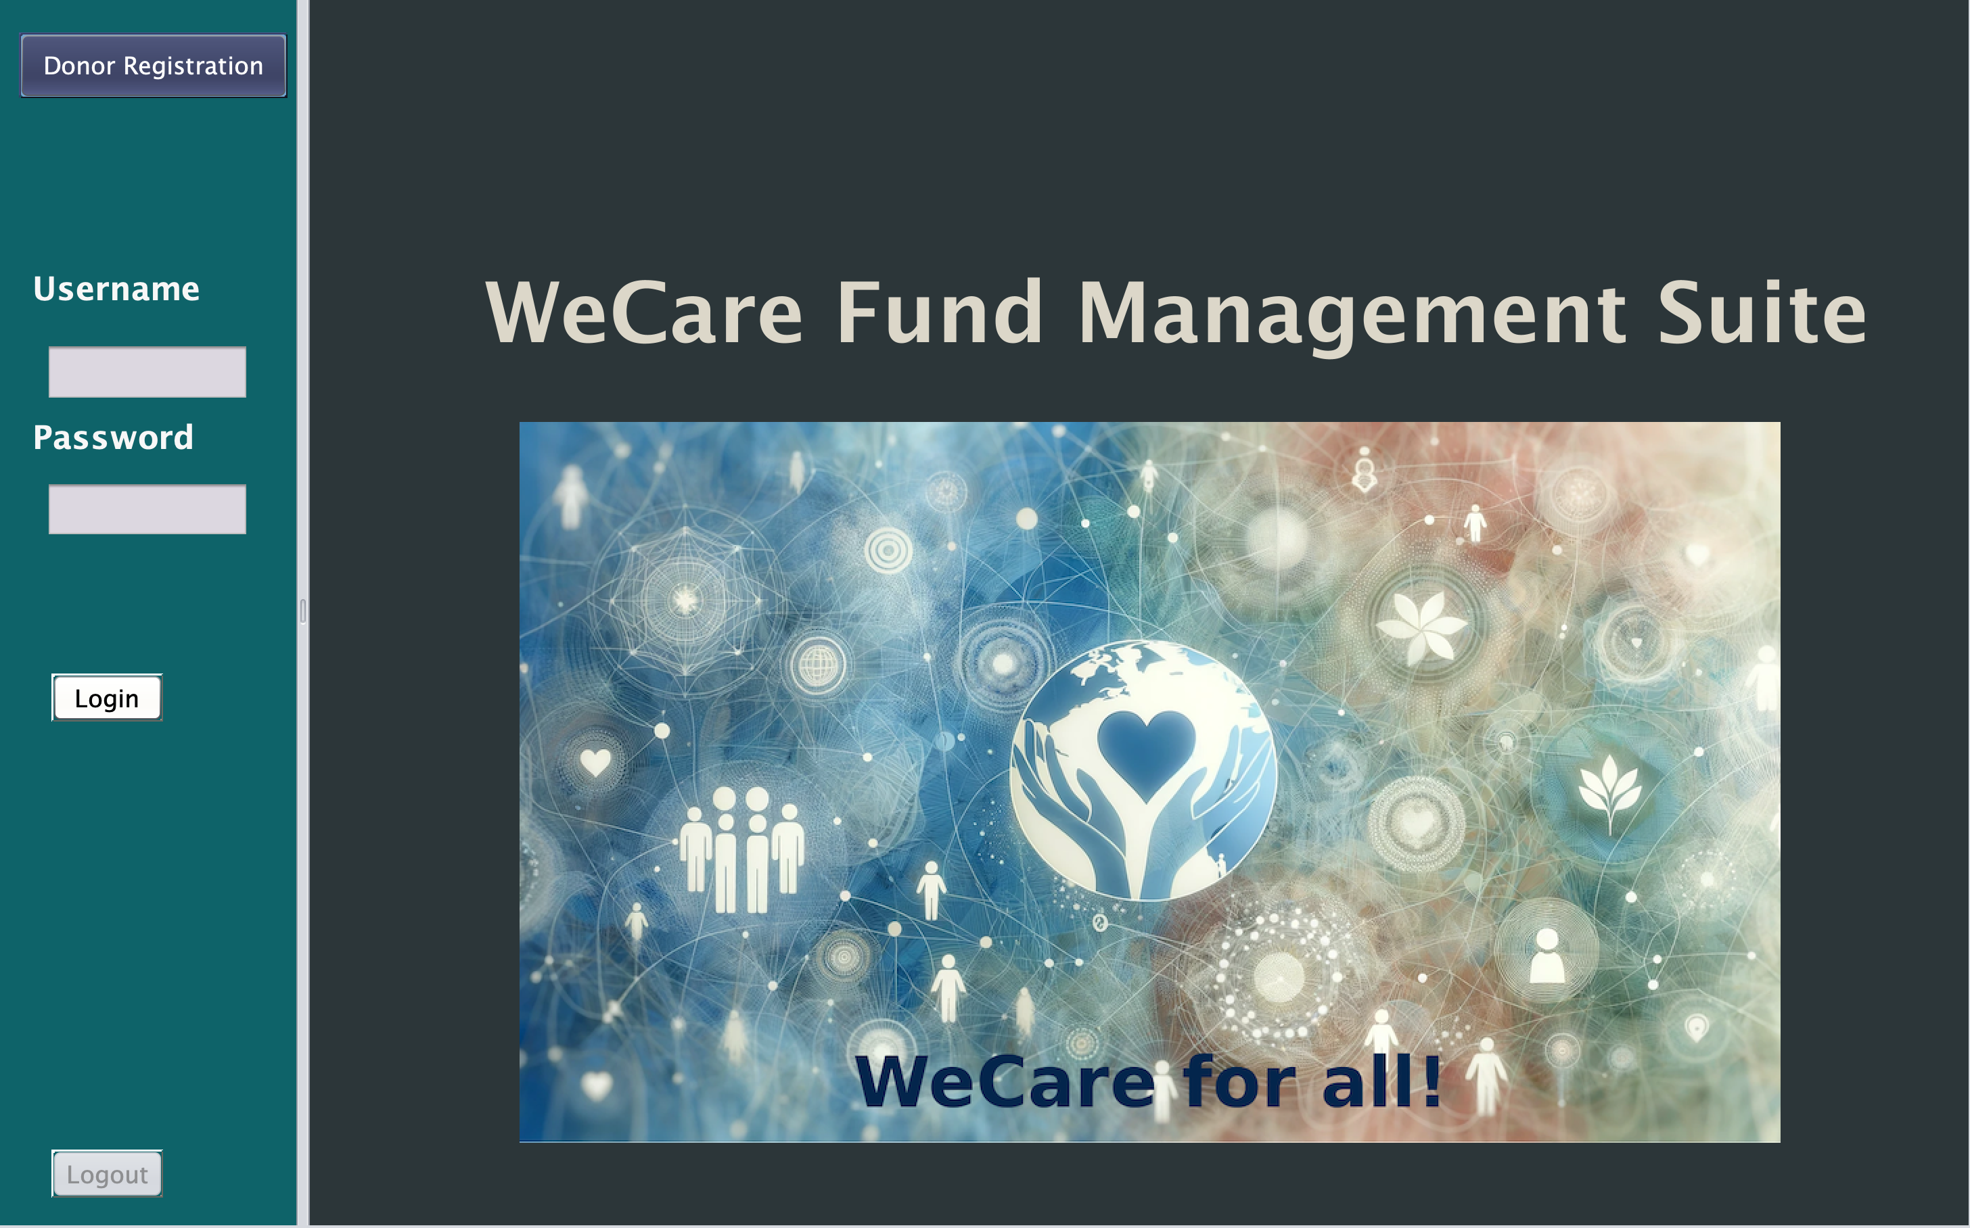
Home Page

Slide 10
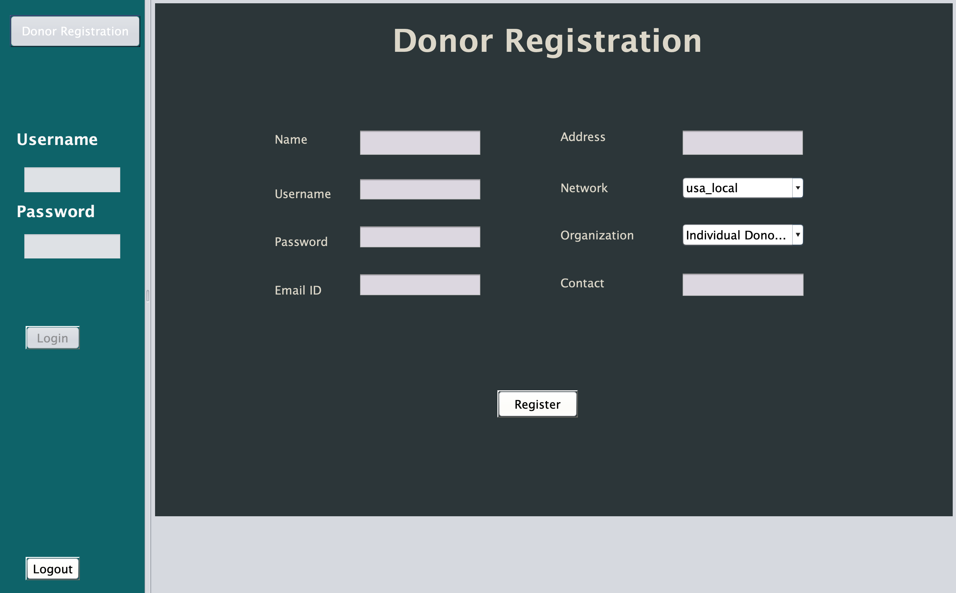
Donor Registration

Slide 11
References
https://www.jfree.org/jcommon/
https://www.youtube.com/watch?v=UI6lqHOVHic
https://www.youtube.com/watch?v=aBONSQ44cnk
https://dzone.com/refcardz/getting-started-db4o 5.
https://www.jfree.org/jfreechart/
https://www.youtube.com/watch?v=pCK6prSq8aw

Slide 12
Thank You

