Slide 1
REAL TIME ATTENDANCE MONITORING SYSTEM

Slide 2
Table of contents
ABSTRACT
ARCHICTECTURE
MODULES USED
OUTPUT

Slide 3
ABSTRACT
This project is based on real time attendance using image processing technique. The objective of our project is to provide real time attendance of students in the class to the faculties. For this we make use of Image Processing using python as a platform.
The camera will capture image of its nearby surrounding and detect the facial part of that image and send this image information to the processing systems. Now as per the algorithm which we are using, will compare the input image with the given data base (set of student images in class ) and search for a matching image. If there is a positive match, then the student’s attendance is stored to a database.

Slide 4
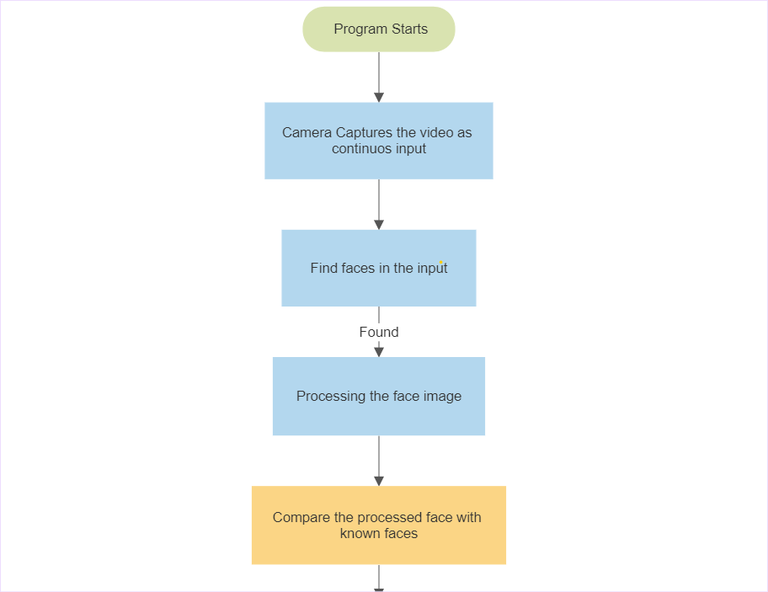
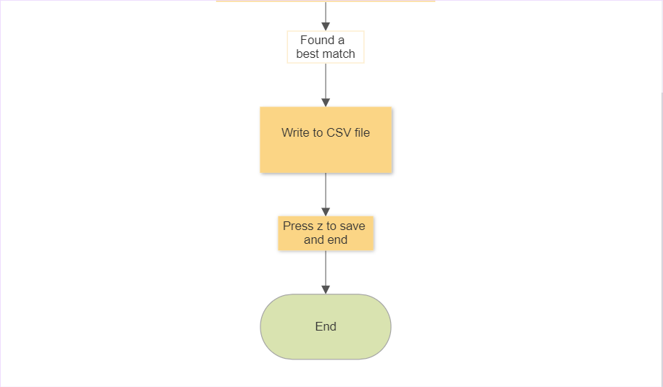
ARCHITECTURE

Slide 5

MODULES USED
CV2
Face Recognition
NumPy
A
Video Capture
Application
2
Load_image_file
Face_encodings
Face_locations
Compare_faces
Face_distance
3
Argmin

Slide 6
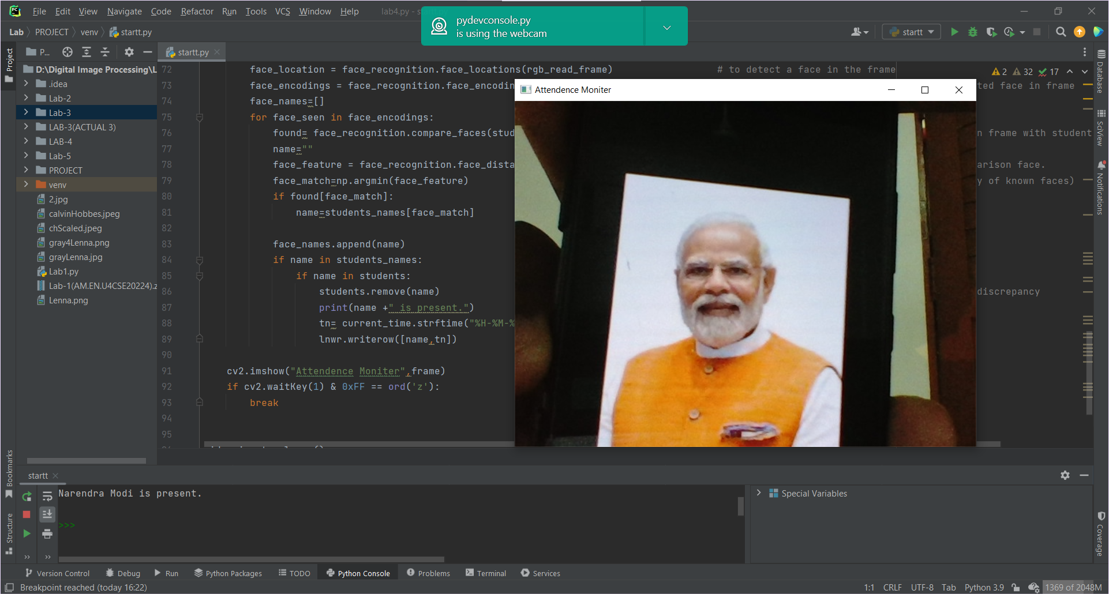
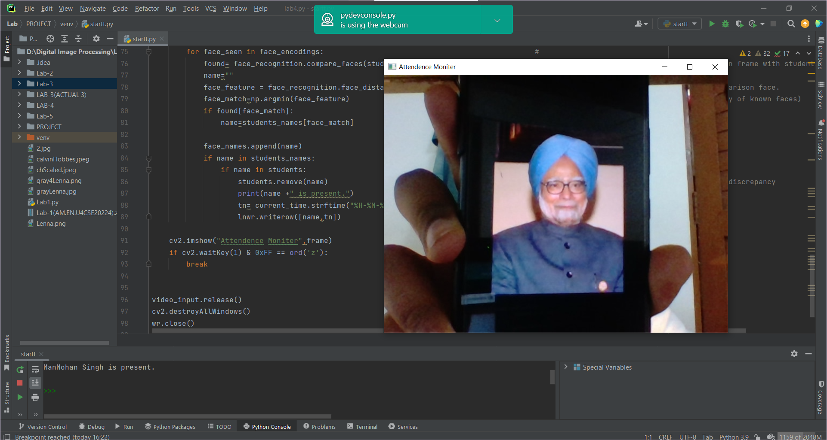
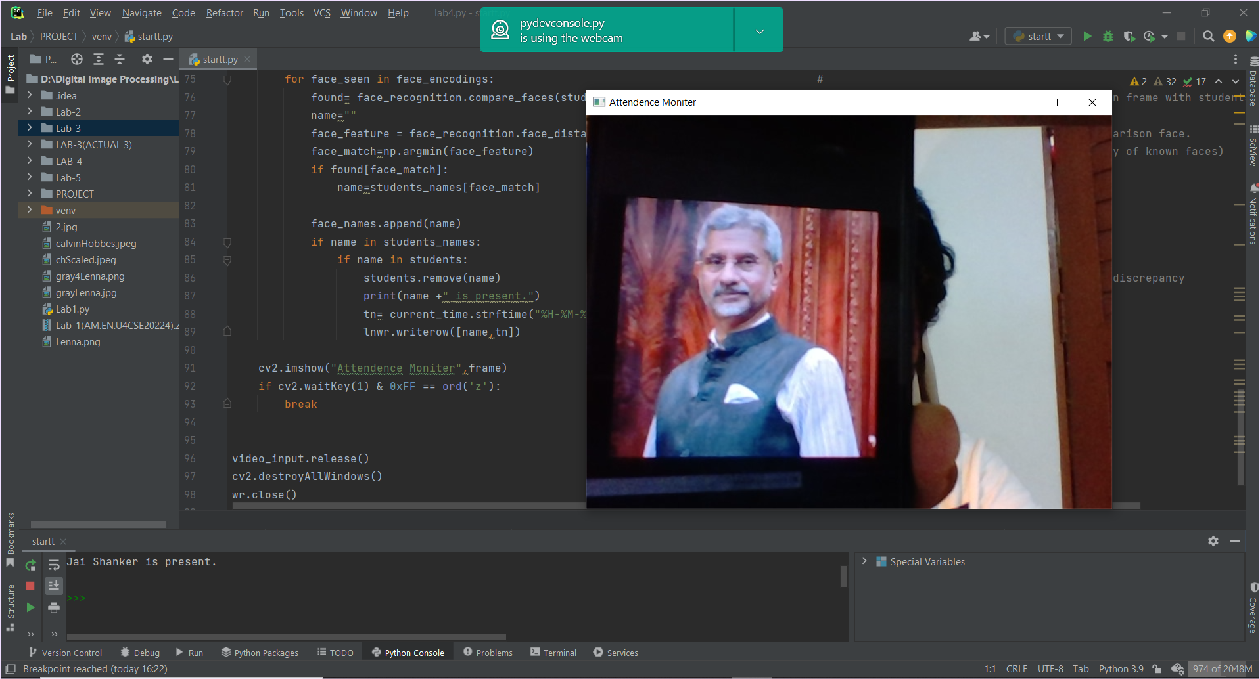
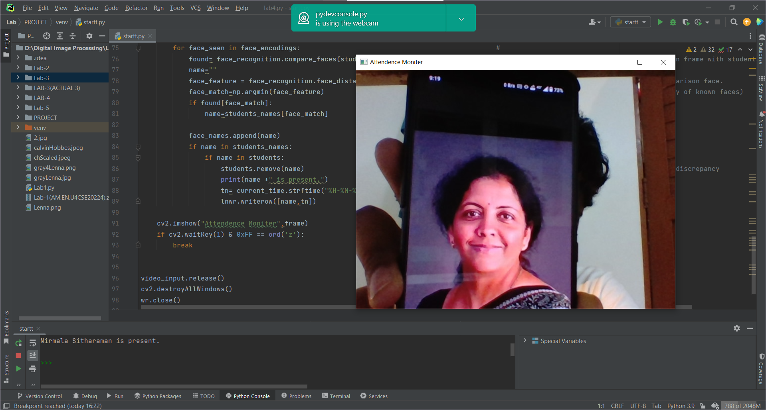
OUTPUT:

Slide 7
OUR TEAM:
PRAVEEN .G
RATNALA SASHANK
VISHAL REDDY
AM.EN.U4CSE20224
AM.EN.U4CSE2060
AM.EN.U4CSE20248

Slide 8
THANK YOU!

