Slide 1
Movie Recommendation System
Ratnam Srivastava (rs6436)

Slide 2
Flow
Project Introduction
Domain Introduction
Dataset
Recommendation Methodology
Results
Suggestions
Summary
References

Slide 3
Project Introduction
This Project is a step-by-step procedure to build a movie recommender using collaborative filtering with Spark's Alternating Least Squares implementation. It is organised in two parts. The first one is about getting and parsing movies and ratings data into Spark RDDs. The second is about building and using the recommender and persisting it for later use in our on-line recommender system.

Slide 4
Domain Introduction
A Recommender System is a subclass of information filtering system that seeks to predict the "rating" or "preference" a user would give to an item. They are primarily used in commercial applications.
Recommender systems are utilized in a variety of areas, and are most commonly recognized as playlist generators for video and music services like Netflix, YouTube and Spotify, product recommenders for services such as Amazon, or content recommenders for social media platforms such as Facebook and Twitter. These systems can operate using a single input, like music, or multiple inputs within and across platforms like news, books, and search queries. There are also popular recommender systems for specific topics like restaurants, research articles, financial services,and life insurance, etc.

Slide 5
Part 1: Building Recommender
Step 1: Getting and processing the data
Step 2: Loading and parsing datasets
Step 3: Collaborative Filtering
Step 4: Selecting ALS parameters using the small dataset
Step 5: Using the complete dataset to build the final model
Step 6: Making recommendations

Slide 6
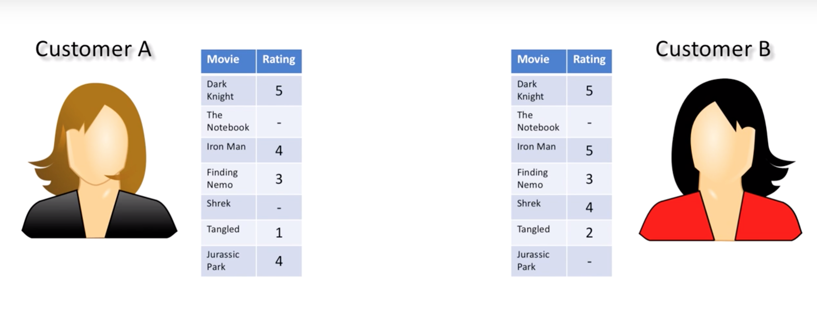
Collaborative Filtering

Slide 7
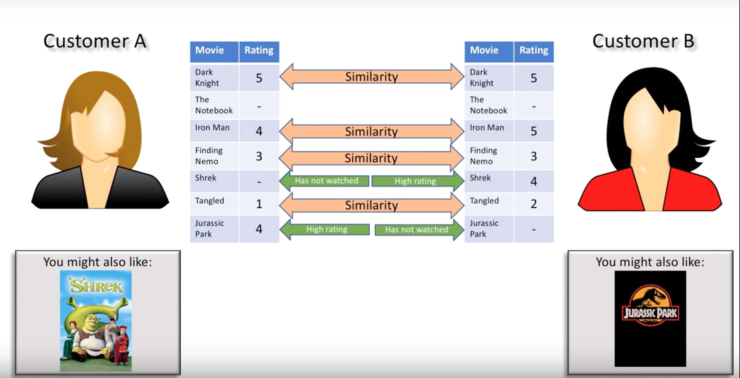

Slide 8
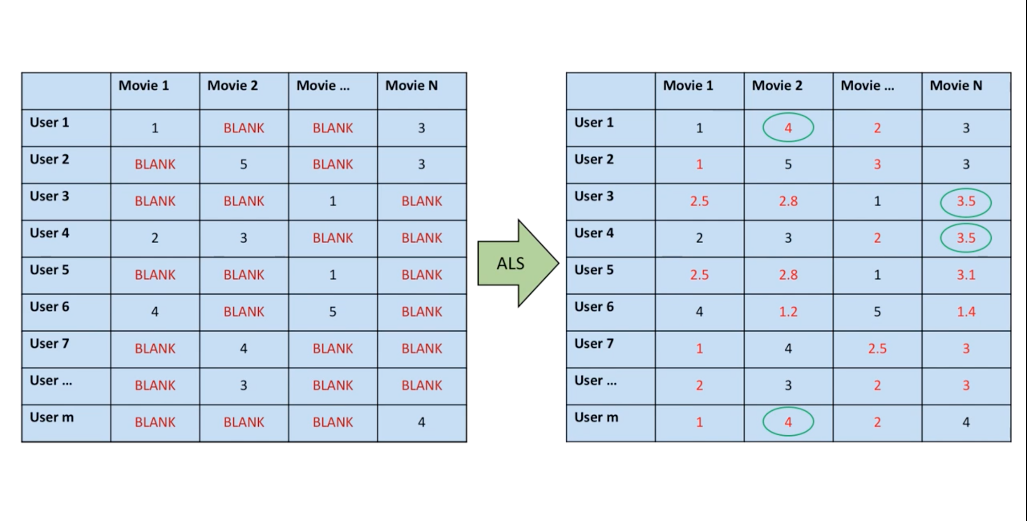

Slide 9
Dataset
We have used the MovieLens dataset for this Project. GroupLens Research has collected and made available rating data sets from the MovieLens web site (http://movielens.org). The data sets were collected over various periods of time, depending on the size of the set.
Small Dataset: Approx. 100,000 ratings and 2,488 tag applications applied to 8,570 movies by 706 users
Large Dataset: Approx. 27,000,000 ratings and 1,100,000 tag applications applied to 58,000 movies by 280,000 users.

Slide 10
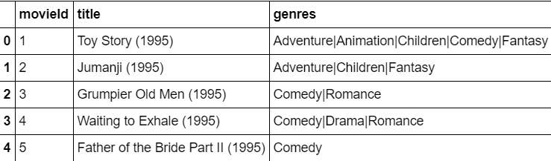
Overview

Slide 11
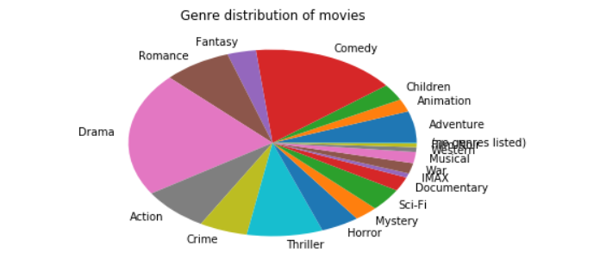
Genre distribution of Movies

Slide 12
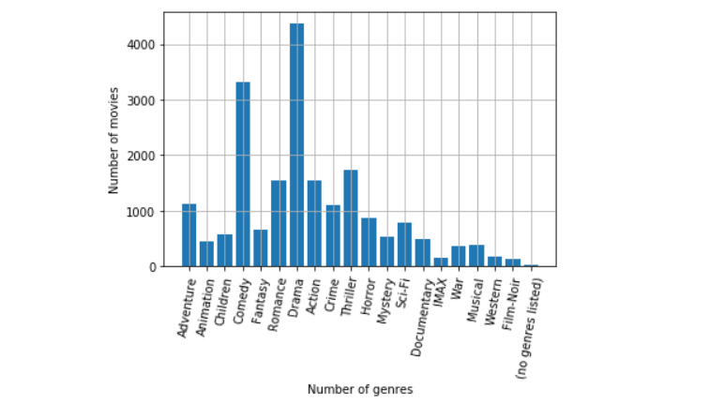
Number of Movies per Genre

Slide 13
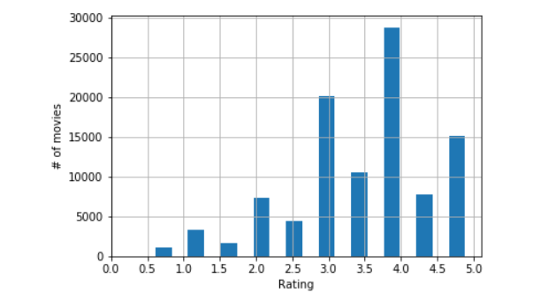
Ratings Distribution

Slide 14
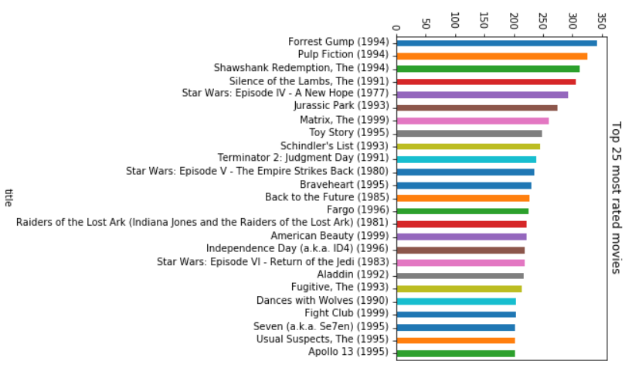
Top 25 Most Rated Movies

Slide 15
Recommendation Methodology
Step 1: Adding new user ratings
Step 2: Getting top recommendations
Step 3: Getting individual ratings
Step 4: Model Evaluation
Notes:
The major problem we are having that we need to train our model every time a new single user comes in which leads to increase in training time and scalability issue. To make this problem into less expensive operation we decided to train our model every time we train such that we can use this model whenever we need to add more users to our dataset.. So,to give recommendation for new user we first make resilient distributed dataset of a new user and then we use this rdd and combine it with our dataset.After that we basically used our previously trained model to train on our recently combined dataset.
After that we can give recommendation by taking out the movies which new user have all rated.

Slide 16
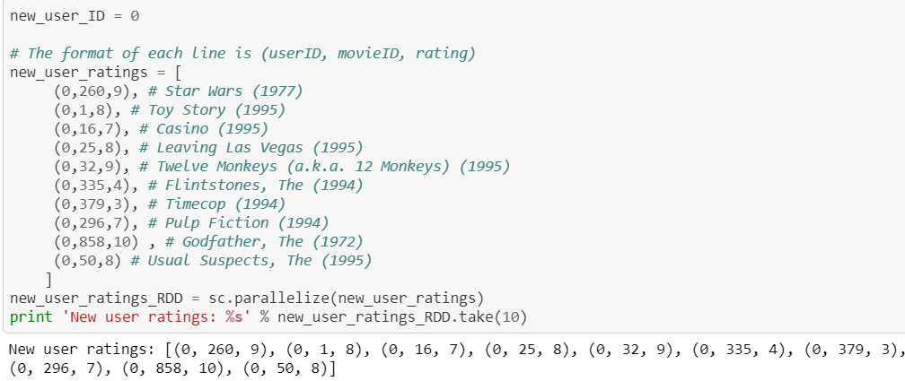
Results
Adding new user ratings:

Slide 17
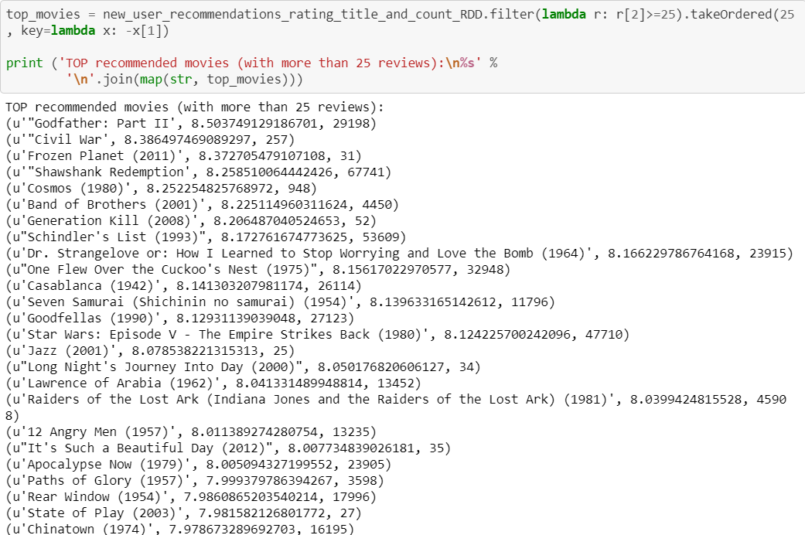
Getting top recommendations:
Notes:
We can then give the top 25 recommendation to the new user on the basis of the number of reviews.or we can show the best movie by showing the first recommendation as an output.

Slide 18
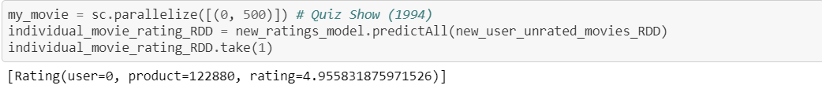
Getting individual ratings:
Notes:
Here we are showing the best movie for the new or upcoming user.

Slide 19
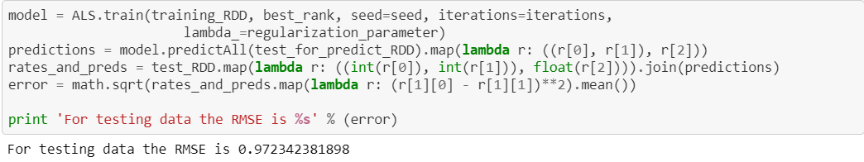
Model Evaluation
Notes:
So, as you see our model was able to give Rmse of 0.97 on test data..

Slide 20
Suggestions
We have not used the genre and timestamp fields in order to simplify the transformations. Incorporating them does not represent any problem. A good use could be filtering recommendations by any of them (e.g. recommendations by genre, or recent recommendations) like we have done with the minimum number of ratings.
We could also try to develop hybrid methods that try to combine the advantages of both content based methods and collaborative filtering into one recommendation system.
Notes:
Their are lot of ways to improve the performance of our model:
1:We can add more features like filtering by genre, actor or length of the movie which will help to give much better recommendation then this model.
2: We could also try to develop hybrid model that will combine collaborative filtering and content based filtering into one model which will help to give bettr recommendation to the new or upcoming user,
Now next slides will taken on by friend my ratnam

Slide 21
Summary
Typically, research on Recommendation Systems is concerned about finding the most accurate recommendation algorithms. However, there are a number of factors that are also important, like:
Diversity, Recommender persistence, Privacy, User demographics, Serendipity, Trust.
Notes:
Diversity – Users tend to be more satisfied with recommendations when there is a higher intra-list diversity, e.g. items from different artists.^{[67]}
Recommender persistence – In some situations, it is more effective to re-show recommendations,^{[68]} or let users re-rate items,^{[69]} than showing new items. There are several reasons for this. Users may ignore items when they are shown for the first time, for instance, because they had no time to inspect the recommendations carefully.
Privacy – Recommender systems usually have to deal with privacy concerns^{[70]} because users have to reveal sensitive information. Building user profiles using collaborative filtering can be problematic from a privacy point of view. Many European countries have a strong culture of data privacy, and every attempt to introduce any level of user profiling can result in a negative customer response. Much research has been conducted on ongoing privacy issues in this space. The Netflix Prize is particularly notable for the detailed personal information released in its dataset. Ramakrishnan et al. have conducted an extensive overview of the trade-offs between personalization and privacy and found that the combination of weak ties (an unexpected connection that provides serendipitous recommendations) and other data sources can be used to uncover identities of users in an anonymized dataset.^{[71]}
User demographics – Beel et al. found that user demographics may influence how satisfied users are with recommendations.^{[72]} In their paper they show that elderly users tend to be more interested in recommendations than younger users.
Robustness – When users can participate in the recommender system, the issue of fraud must be addressed.^{[73]}
Serendipity – Serendipity is a measure of "how surprising the recommendations are".^{[74]} For instance, a recommender system that recommends milk to a customer in a grocery store might be perfectly accurate, but it is not a good recommendation because it is an obvious item for the customer to buy.
Trust – A recommender system is of little value for a user if the user does not trust the system.^{[75]} Trust can be built by a recommender system by explaining how it generates recommendations, and why it recommends an item.

Slide 22
References
This Project contains a variety of content; some developed by Jose A. Dianes, and some from third-parties. The third-party content is distributed under the license provided by those parties.
https://github.com/jadianes
https://en.wikipedia.org/wiki/Recommender_system
https://grouplens.org/datasets/movielens/

