Slide 1
Image Preprocessing
Ratnesh Kumar Maurya
19BCE1208

Slide 2
Introduction
Pre-processing stage here is the process of locating and enhancement covid region of the x-ray image, where the processing stage includes the shape boundary representation and segmentation algorithms based feature vectors extraction and morphometric measurement.

Slide 3
2 Proposed System
a. Pre-processing stage include image acquisition, region localization (RL) and region localization enhancement.
b. Shape boundary representation and segmentation stage; include active shape model (ASM) segmentation based on shape boundary representation anatomical points .
c. Feature extraction stage; include feature extraction based shape feature vector and morphometric measurement-invariant features for indexing.

Slide 4
Pre-processingstage
To eliminate superfluous machine around the region of of interest (ROI) was extracted text for training and test.
The ROI on the chest X-ray images was defined by an area covering mainly the lung region.
ROI is important in Deep learning based model.

Slide 5
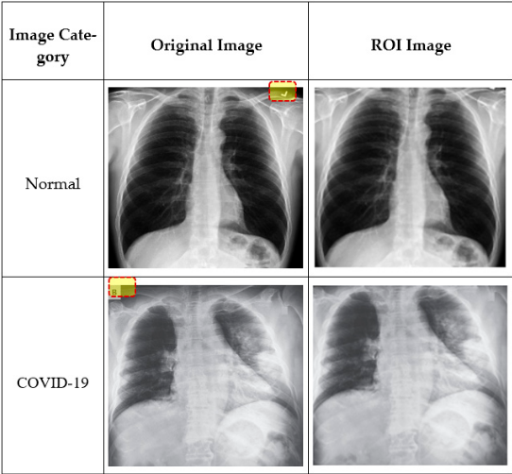
Pre-processing stage

Slide 6
Inpainting algorithm
import numpy as np
import pandas as pd
import cv2 as cv
from google.colab.patches import cv2_imshow
from skimage import io
from PIL import Image
import matplotlib.pylab as plt
img = cv.imread('/content/drive/MyDrive/imagePro_photos/download (4).jpeg')
mask = cv.imread("/content/drive/MyDrive/imagePro_photos/download (2).jpeg",0)
dst = cv.inpaint(img,mask,3,cv.INPAINT_TELEA)
cv2_imshow(dst)

Slide 7
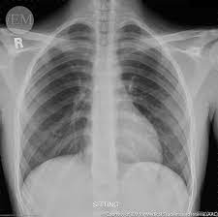
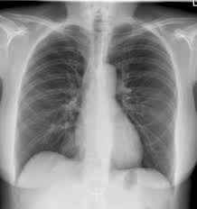
ROI
Original Prepossed

Slide 8
Enhancement approach
Changes in lighting conditions produces dramatically decrease of recognition performance, if an image is low contrast and dark, we wish to improve its contrast and brightness.
The widespread histogram equalization cannot correctly improve all parts of the image. When the original image is irregularly illuminated, some details on resulting image will remain too bright or too dark.
Typically, digitized x-ray images are corrupted by additive noise and de-noising can improve the visibility of some structures in medical x-ray images, thus improving the performance of computer assisted segmentation algorithms
Higher de-noising performance is important in obtaining images with high visual quality for that reason different enhancement techniques was implemented

Slide 9
Histogram equalization
Histogram equalization (HE) can be applied to aid in the viewing of chest, and it’s an excellent contrast enhancement method for medical image and other initially no visual images. In medical imaging its automatic operation and effective presentation of all contrast available in the image data make it a competitor of the standard contrast enhancement methods.

Slide 10
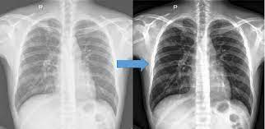

Slide 11
contrast enhancement
The idea is to enhance contrast locally analyzing local grey differences taking into account mean grey level. First we apply local adaptive contrast enhancement. Parameters are set to amplify local features and diminish mean brightness in order to obtain more contrast resulting image. After that we apply histogram equalization.
Identifying the correct preprocessing and augmentation steps most useful for increasing model performance requires a firm understanding of the problem, data collected, and production environment.

Slide 12
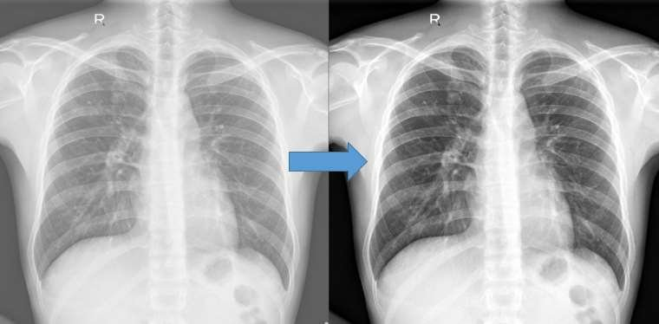

Slide 13
Resize
Changing the size of an image

Slide 14
Orientation
When an image is captured, it contains metadata that tells our machines the orientation by which to display that input image relative to how it is stored on disk.

