Slide 1


Slide 2

If something is not clear, ask!!
There is nothing like a stupid question. Its just that I have made the mistake before and hence I know how to avoid it.
Practice makes perfect!
Don’t wait for a opportunity to practice what you learnt, create the opportunity.
The last time someone taught you something was in the tenth grade. After that you have been learning.
Trainings are ONLY EYE OPENERS. They are not spoon feeding sessions.

Slide 3

To familiarize ones self with Java Language concepts
To gain knowledge about how Java can be used.
www.v2solutions.com

Slide 4
Sample Approaches of doing one program in multiple ways
Java Loaders
Static & Dynamic Loading
Static initializer
Object Characterstics
www.v2solutions.com

Slide 5
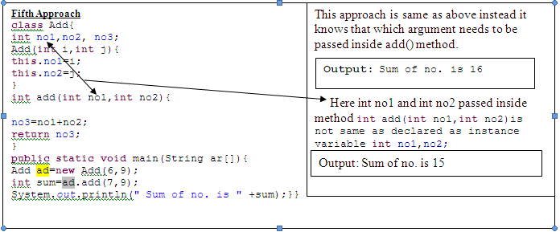
www.v2solutions.com

Slide 6
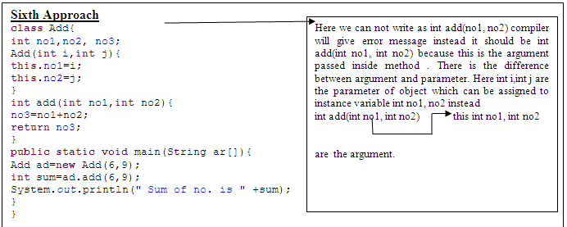
www.v2solutions.com

Slide 7
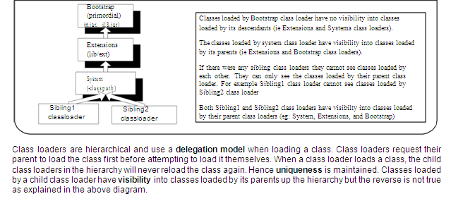
www.v2solutions.com

Slide 8
Classes are statucally loaded with Java’s “new” operator
class MyClass {
public static void main(String args[]) { Car c = new Car(); }
}
Dynamic loading is a technique for programmatically invoking the functions of a class loader at run time. Let us look at how to load classes dynamically.
Class.forName (String className); //static method which returns a Class
The above static method returns the class object associated with the class
String myClassName = "au.com.Jeep" ;
Class vehicleClass = Class.forName(myClassName) ;
myJeep = (Jeep) vehicleClass.newInstance();
myJeep.setFuelCapacity(50);
www.v2solutions.com

Slide 9
Public class StaticInitilaizer { public static final int A = 5; public static final int B;
//Static initializer block, which is executed only once when the class is loaded.
static { if(A == 5)
B = 10; else
B = 5;
}
public StaticInitilaizer(){} // constructor is called only after static initializer block}
The following code gives an Output of A=5, B=10.
public class Test {
System.out.println("A =" + StaticInitilaizer.A + ", B =" + StaticInitilaizer.B);
www.v2solutions.com

Slide 10
Encapsulation
Inheritance
Abstraction
Polymorphism
www.v2solutions.com

Slide 11
Inhertitance
is the inclusion of behaviour (i.e. methods) and state (i.e. variables) of a base class in a derived class so that they are accessible in that derived class
is uni-directional
In Java, you can only inherit from one superclas
Inheritance is two types
    Implementation Inheritance
    Interface Inheritance
www.v2solutions.com

Slide 12
Implementation Inhertitance
Implementation inheritance promotes reusability but improper use of class inheritance can cause programming nightmares by breaking encapsulation and making future changes a problem
make sure that the subclasses depend only on the behaviour of the superclass, not on the actual implementation
Interface Inhertitance
This is also known as subtyping
Interfaces provide a mechanism for specifying a relationship between otherwise unrelated classes
Interface inheritance promotes the design concept of program to interfaces not to implementations
This is more flexible than implementation inheritance because it won’t lock you into specific implementations which make subclasses difficult to maintain
www.v2solutions.com

Slide 13
Prefer interface inheritance to implementation inheritance because it promotes the design concept of coding to an interface and reduces coupling
Interface inheritance can achieve code reuse with the help of object composition
inheritance should be only used when subclass ‘is a’ superclass
If there is no ‘is a’ relationship and all you want is polymorphism then use interface inheritance with composition, which gives you code reuse
www.v2solutions.com

Slide 14
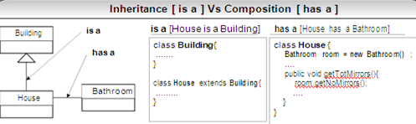
www.v2solutions.com

Slide 15
Implementation Inhertitance Java Code
Let’s assume that savings account and term deposit
account have a similar behaviour in terms of depositing
and withdrawing money, so we will get the super class to
implement this behaviour and get the subclasses to reuse
this behaviour. But saving account and term deposit
account have specific behaviour in calculating the interest.
public abstract class Account {
www.v2solutions.com

Slide 16
Implementation Inhertitance Java Code
public abstract class Account { public void deposit(double amount) { //deposit logic } public void withdraw(double amount) { //withdraw logic } public abstract double calculateInterest(double amount); } public class SavingsAccount extends Account { public double calculateInterest(double amount) { //calculate interest for SavingsAccount } } | public class TermDepositAccount extends Account { public double calculateInterest(double amount) { //calculate interest for TermDeposit } } The calling code can be defined as follows for illustration purpose only: public class Test { public static void main(String[] args) { Account acc1 = new SavingsAccount(); acc1.deposit(5.0); acc1.withdraw(2.0); Account acc2 = new TermDepositAccount(); acc2.deposit(10.0); acc2.withdraw(3.0); acc1.calculateInterest(500.00); acc2.calculateInterest(500.00); } }
www.v2solutions.com

Slide 17
Interface Inhertitance Java Code
Let’s look at an interface inheritance code sample, which makes
use of composition for reusability. In the following example the
methods deposit(…) and withdraw(…) share the same piece of code
in AccountHelper class. The method calculateInterest(…) has its
specific implementation in its own class.
www.v2solutions.com

Slide 18
Interface Inhertitance Java Code
public interface Account { public abstract void deposit(double amount); public abstract void withdraw(double amount); public abstract int getAccountType(); } public interface SavingsAccount extends Account{ public abstract double calculateInterest(double amount); } public interface TermDepositAccount extends Account{ public abstract double calculateInterest(double amount); } The classes SavingsAccountImpl,should implement the methods declared in its interfaces. The class AccountHelper implements the methods deposit(…) and withdraw(…) public class SavingsAccountImpl implements SavingsAccount{ private int accountType = 1; //helper class which promotes code reuse through composition AccountHelper helper = new AccountHelper(); public void deposit(double amount) { helper.deposit(amount, getAccountType()); } public void withdraw(double amount) { } helper.withdraw(amount, getAccountType()); public double calculateInterest(double amount) { } //calculate interest for SavingsAccount public int getAccountType(){ return accountType; }} | public class TermDepositAccountImpl implements TermDepositAccount { private int accountType = 2; //helper class which promotes code reuse through composition AccountHelper helper = new AccountHelper(); public void deposit(double amount) { } helper.deposit(amount, getAccountType()); public void withdraw(double amount) { } helper.withdraw(amount, getAccountType()); public double calculateInterest(double amount) { } //calculate interest for TermDeposit public int getAccountType() { } return accountType; } The calling code can be defined as follows for illustration purpose only: public class Test { public static void main(String[] args) { Account acc1 = new SavingsAccountImpl(); acc1.deposit(5.0); Account acc2 = new TermDepositAccountImpl(); acc2.deposit(10.0); if (acc1.getAccountType() == 1) { ((SavingsAccount) acc1).calculateInterest(500.00); } if (acc2.getAccountType() == 2) { ((TermDepositAccount) acc2).calculateInterest(500.00); } } }
www.v2solutions.com

Slide 19
means the ability of a single variable of a given type to be used to reference objects of different types
The benefit of polymorphism is that it is very easy to add new classes of derived objects without breaking the calling code
When you send a message to an object even though you don’t know what specific type it is, and the right thing happens, that’s called polymorphism.
The process used by object-oriented programming languages to implement polymorphism is called dynamic binding. Let us look at some sample code to demonstrate polymorphism
www.v2solutions.com

Slide 20
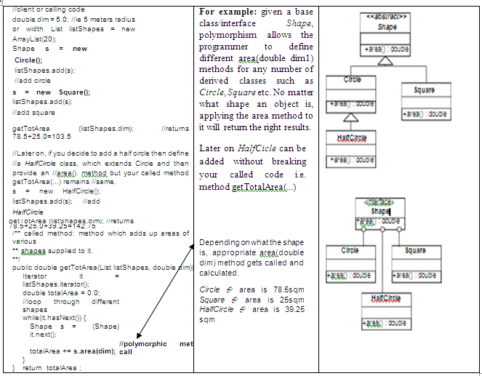
www.v2solutions.com

Slide 21
refers to keeping all the related members (variables and methods) together in an object. Specifying members as private can hide the variables and methods.
Being able to encapsulate members of a class is important for security and integrity. We can protect variables from unacceptable values.
www.v2solutions.com

Slide 22
how encapsulation can be used to protect the MyMarks object from having negative values. Any modification to member variable “vmarks” can only be carried out through the setter method setMarks(int mark). This prevents the object “MyMarks” from having any negative values by throwing an exception.
Class MyMarks
{ private int
vmarks = 0; private String name;
public void setMarks(int mark)
throws MarkException {
if(mark > 0) this.vmarks = mark;
else {
throw new MarkException
("No negative Values");
}}
public int getMarks(){ return vmarks;
}
//getters and setters for attribute name goes here.
}
www.v2solutions.com

Slide 23

Please feel free to send your suggestion / feedback

